Slide 1
A Fedora 3 to 4 Migration Case Study for UNSW Australia Library
UNSW Library
Arif Shaon, Harry Sidhunata
Fedora 4 Training Workshop, eResearch Australasia 2015, Brisbane

Slide 2
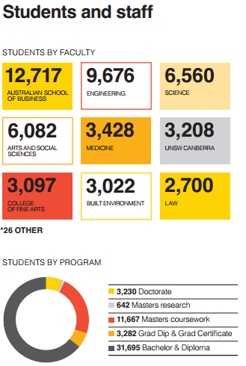
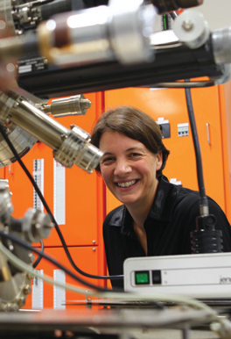
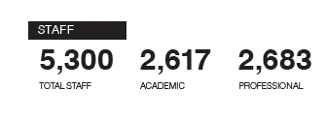
UNSW Australia
The University of New South Wales at a Glance:
https://www.unsw.edu.au/sites/default/files/documents/UNSW4009_Miniguide_2012_AW2_V2.pdf

Slide 3
UNSW Library Repository Service
UNSW Library has an increasingly important role in the management and curation of UNSW research materials
Library Repository Service (LRS) supports this by providing Web-based repositories to UNSW academic community
Research Centre
School
Deposit/Edit Web-forms
Faculty
Primo
Deposit/Edit Web-forms
Primo
Deposit/Edit Web-forms
Primo
Fedora
Fedora
Fedora

Slide 4
Outline
Fedora 3 repositories at UNSW Library
UNSW Library Fedora 3-to-4 migration pilot
UNSW Library use cases and Fedora 4 data models
Lesson learned
Future plans

Slide 5
Fedora 3 repositories at UNSW Library
UNSWorks – the online institutional repository for PhD and Masters by research thesis material
  13000+ records
  stores and disseminates digital preservation information
  Integrated with UNSW Research Output System (Symplectic Elements)
ResData – research data management planning and publishing service
  integrated with UNSW Long-term Research Data Store (LTRDS) service and other enterprise systems

Slide 6
Fedora 3 repositories at UNSW Library
Faculty-based repository services
  based on a standard, extensible framework
  customised to support specific requirements of individual disciplines
  enables discovery, accessibility and citation of resource
  Example: Faculty of Arts and Social Science repository

Slide 7
UNSW Library Fedora 3-to-4 Migration Pilot
Goal:
  formulate a strategy for upgrading the Library’s existing Fedora 3-based repositories
Criteria:
  compatibility with existing institutional data models
  interoperability with related repository applications and workflows
Use Cases/Test beds: ResData and UNSWorks
Timeline: Jan-May 2015

Slide 8
Migration Process
Use cases
  Defined migration use cases based on ResData and UNSworks
Fedora 4 test repository
  Deployed a test Fedora 4 instance
Fedora 4 features evaluation
  REST APIs, versioning of records, integration with external triple stores
  Comparison with Fedora 3 functions

Slide 9
Migration Process
Fedora 4 data model design
  Analysed default Fedora 4 data model and PCDM
  Mapped Fedora 3 object and datastream properties to Fedora 4
Fedora 4 plug-ins evaluation
  OAI-PMH module
  Audit service
Implementation strategy formulation
  Formulated a strategy for implementing the Fedora 4 REST API based on Fedora 4 data model design and the result of evaluation of Fedora 4 features

Slide 10
Use Case 1: UNSWorks System Architecture

Slide 11
Use Case 1: UNSWorks Fedora Object Model - Datastreams
Thesis file (PDF, DOC)
Thesis file (PDF, DOC)
RELS-EXT (Handle)
RELS-INT (Resource type, Preservation software)
Metadata (MODS – XML)
Supporting docs/Rights/licence (TXT, DOC)
Preservation Metadata (PREMIS – RDF)
Preservation Metadata (PREMIS – RDF)
Preservation Metadata (PREMIS - RDF)
EVENTS (PREMIS – RDF)

Slide 12
Use Case 2: ResData System Architecture
UNSW HR Database
MySQL 5.5
Fedora 3.7.1
Deposit/Edit
Harvesting Service (JOAI)
UNSW IT LTRDS
Storage Provisioning Service

Slide 13
Use Case 2: ResData Fedora Object Model - Datastreams
Dataset (RDF)
RDMP (RDF)
RELS-INT (DOI, Handle, versioning)
RELS-EXT (Resource type)
RELS-EXT (Resource type, storage info)
1
1
*
*
Activity/project (RDF)
Person (RDF)
RELS-INT (DOI, Handle, versioning)
RELS-EXT (DOI, Resource type)
RELS-INT (DOI, Handle, versioning)
RELS-EXT (Resource type)

Slide 14
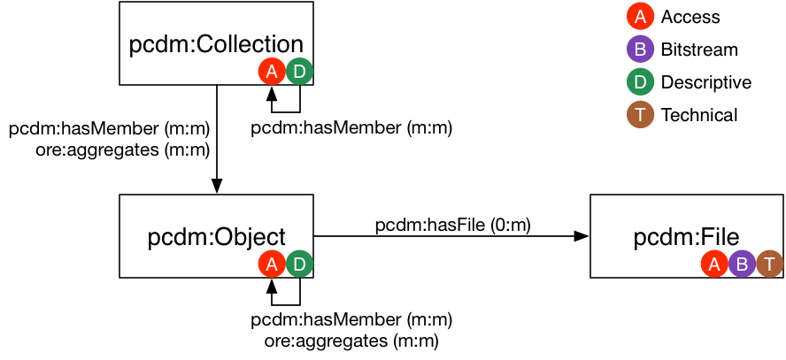
Fedora 4 Data Model – PCDM adaption
Source: https://github.com/duraspace/pcdm/wiki

Slide 15
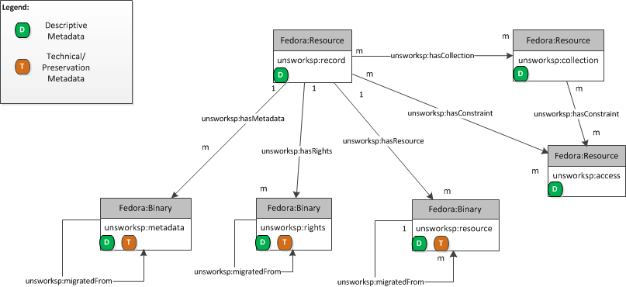
Fedora 4 Data Model for UNSWorks

Slide 16
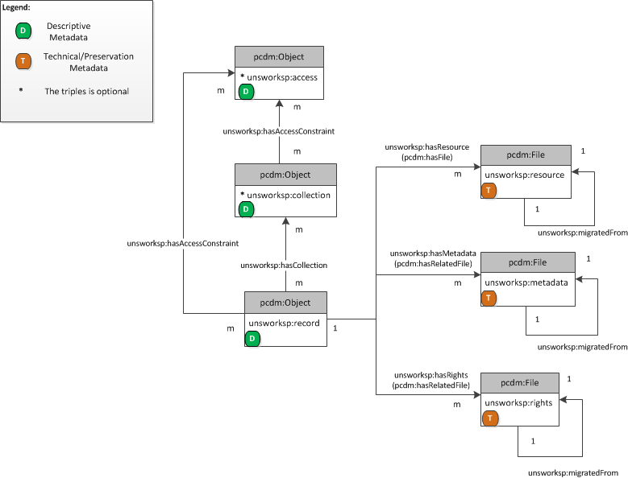
Fedora 4 Data Model for UNSWorks

Slide 17
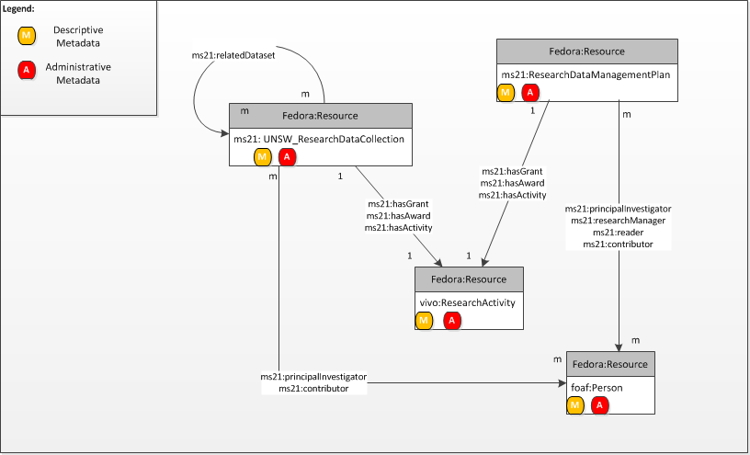
Fedora 4 Data Model for ResData

Slide 18
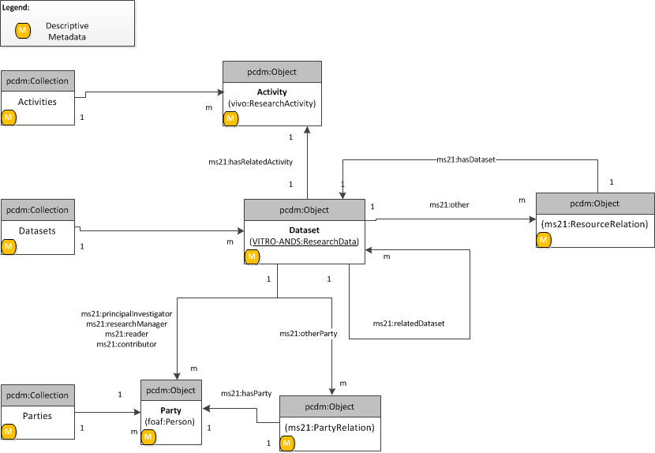
Fedora 4 Data Model for ResData

Slide 19
Fedora 4 Data Model Design – key considerations
Adaptation of PCDM
  PCDM hierarchical model is similar to the UNSWorks model
  Additional granularity needed to
    record preservation and migration events
    manage access-related information at both object and collection levels
    ensure interoperability with ResData that does not conform to a hierarchical organisation.

Slide 20
Fedora 4 Data Model Design – key considerations
Identifiers and URL structures
  Built-in Pairtree algorithm for generating unique identifiers and to limit number of children under a single resource
  Legacy Fedora 3 PIDs as “data properties” of migrated resource
  Cool URIs with embedded semantic information
  Example: /rest/[container name]/[container Pairtree id]/[resource id]

Slide 21
Fedora 4 Data Model Design – key considerations
Audit history and versioning
  Legacy Fedora 3 FOXML will be stored as a binary resource in Fedora 4
  Fedora 4 Audit Service to be used to record post-migration audit information
  Legacy creation dates for Fedora 3 objects cannot be migrated - custom properties to be used
  Legacy Fedora 3 PIDs as “data properties” of migrated resource
  Fedora 4 versioning to be used to record Fedora 3 versions

Slide 22
Fedora 3-to-4 Migration – Implementation Strategy
Fedora 4 to be used as “headless” repository instances
Fedora 4 REST API to be used by custom UIs and clients to manage CRUD of digital objects
Fedora 4 integrated with external triplestore to enable access control via custom UIs and clients
Update/re-factor existing Java-based Fedora 3 clients to support Fedora 4

Slide 23
Lessons learned
Review of the existing institutional information models has identified a need for
  better standardisation of existing RDF ontologies
  migration of existing XML schemas to RDF ontologies to ensure more efficient interoperability between repositories

Slide 24
Future plans
Investigation into access control-related ontologies, such as WebACL to enable standard-based access control of Fedora 4 objects
Evaluate existing Open Source tools for Fedora 3-to-4 migrations
Enhance/standardise UNSW ontologies according to the Fedora 4 model developed
Continue to be a platinum member of Fedora community

Slide 25
Useful links
Upgration Pilot – UNSW - https://wiki.duraspace.org/display/FF/Upgration+Pilot+-+UNSW
UNSWorks - http://www.unsworks.unsw.edu.au/primo_library/libweb/action/search.do?vid=UNSWORKS&reset_config=true
ResData - https://resdata.unsw.edu.au/pages/authenticate.faces

