Slide 1
Publishing Library Authoritative Information as Linked-Data
Daniel Okouya – Linked-Data Engineer at Stanford DLSS

Slide 2
The Problem
Publishing our records as a connected graph of linked-data where our authoritative information constitute the glue that tie the Graph together.
  => The Authoritative data which are unique in the graph and serve the purpose of unambiguously inter-connect and dive into the data of the graph (i.e. Records) must also be published as Linked-data.
  Question: How do we represent and publish our authoritative information ?

Slide 3
Back ground: W3c standard for Publishing Linked-data
Everything we want to talk about is a Resource
Resource are identified by URIs
2 type of Resources:
  Information Resource
    Anything that contains information that can be transmitted electronically i.e. web document like html Pages, PDF, emails, eBooks, …
  Non Information Resource
    Things in the world that can’t be transmitted electronically e.g. RWO as people, cars or Abstract things like Mathematics, or Imaginary things like a Unicorn, …

Slide 4
Back ground: W3c standard for Publishing Linked-data
What the Linked-data 3wc publishing standards specifies is:
  how to obtain the data about a resource of both types upon querying it’s URIs i.e. how the description of the resource can be obtain.
  https://www.w3.org/TR/cooluris/
  https://www.w3.org/TR/swbp-vocab-pub/
  https://www.w3.org/TR/ld-bp/

Slide 5
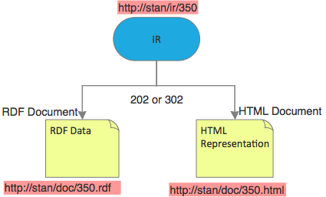
Linked-data Publishing: Information Resources
How to obtain an information resource description (RDF) or any other representation (HTML) of it trough content Negotiation
Content negotiation is basically deciding what representation of the resource do you need ? can be performed directly (202) or with a slight indirection (302)

Slide 6
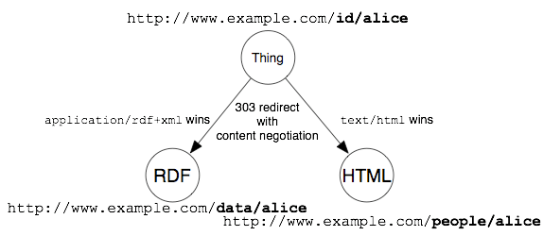
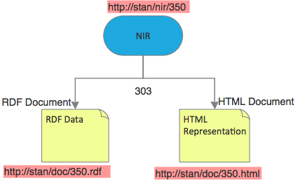
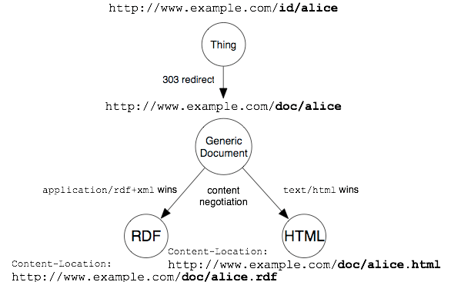
Linked-data Publishing: Non-Information Resources
How to obtain a non-information resource description (RDF) or any other representation of it (HTML) trough 303 redirect and content negotiation
303 indirection is what says that the resource is a non-information recourse

Slide 7
Linked-Data Publishing: Summary
Resource comes with description and the Linked-data w3c standards says how to get them.

Slide 8
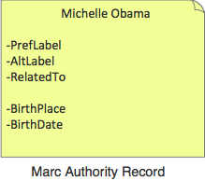
What are Authoritative Information
Authority record about:
  Abstract things
  Real World Objects
  Imaginary things
  ….

Slide 9
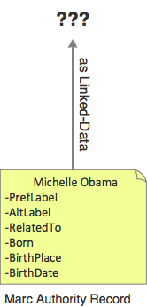
Question

Slide 10
Current Proposal
M0delization Suggested:
  Abstract and model the “authority record” and provide a distinguished URI for an associated RWO whenever what that Authority is about is something that physically exist in the world.
Problems:
    Leads to 2 possible Interpretation which are both Problematic
    Has a fundamental Design Flaw: why only RWO vs Authority, why not Abstract Thing Vs Authority or Imaginary Thing vs Authority, Subject Vs Authority

Slide 11
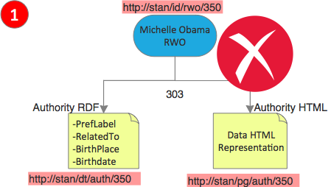
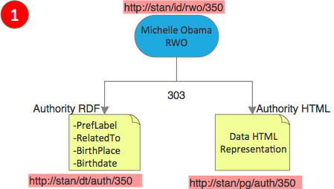
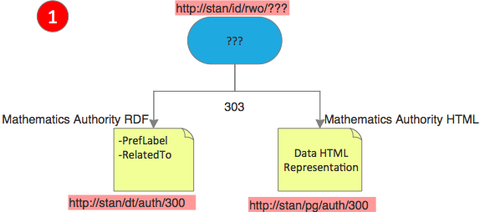
Interpretation 1: the RWO is the Resource and the Authority is the Description
Problem 1: what if there is no real world object e.g. Mathematics ?
Problem 2: L-d principles states that the Description that is returned by dereferencing an URI should be about the Resource that the URI identifies.
    Issue: a Marc Authority Record does not only contain information about the thing it is about but also about the control vocabulary element that represents it (More on that Next)
Notes:
Pb1: Shall we go for 2 different mechanism, one when there is a RWO and one when there is not ? What should be the mechanism when there is no so called RWO anyway ?
Pb2: More on that when dissecting the Marc Authority Rcord

Slide 12
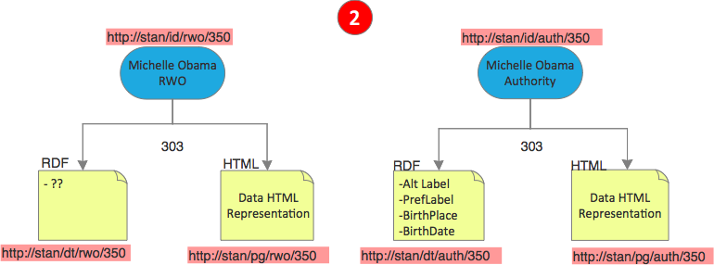
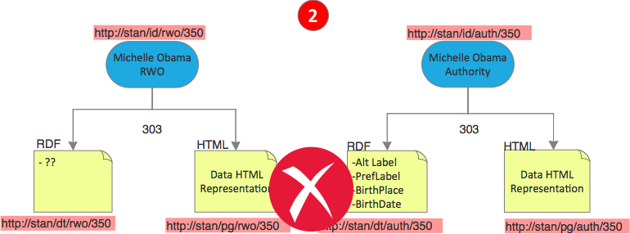
Interpretation 2: Both the RWO and the Authority are Resource with Description
Problems:
  L-d principles states that the Description that is returned by dereferencing an URI should be about the Resource that the URI identifies.
    If the Authority Record contains authoritative information about both the RWO and the control Vocabulary element that represent it, what exactly does the RWO description returns ? Non Authoritative information ? Like what ?

Slide 13
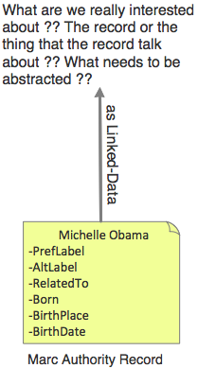
Root of the Issue: Bad Abstraction over Marc Authority Record

Slide 14
Dissecting a Marc Authority Record

Slide 15
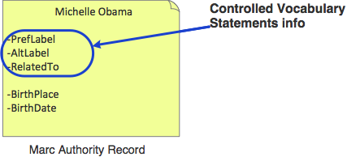
Dissecting a Marc Authority Record

Slide 16
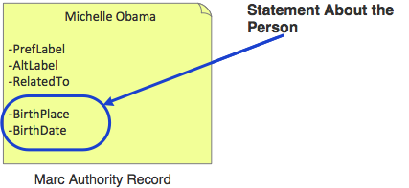
Dissecting a Marc Authority Record

Slide 17
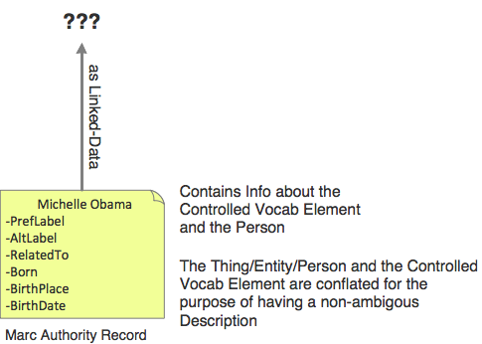
Dissecting a Marc Authority Record

Slide 18
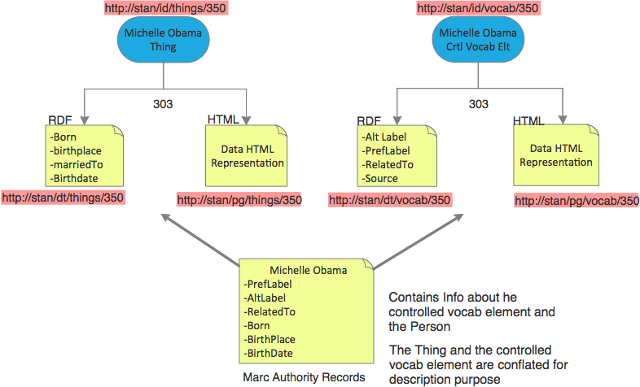
Thing vs Ctrl Vocab Elt
RWO vs Authority
Solution:
In compliance with W3c recommendations
  abstract the “Thing/Entity” (Information recourse or non-information resource) on one side and the “Controlled Vocabulary elements” on the other and use Uris to identify them
    Use 303 Redirection for relating non-information resources to their description
    Use simple content Negotiation to relate information resources to their representation
    Only state information concerning the Thing/Entity in its description
    Only state information concerning the Controlled Vocabulary Element in its description
    Relates Things to their Controlled Vocabulary Element using properties such as foaf:focus.
Notes:
If you need metadata admin info like change and provenance, well those are still statement about the resource. Either the control vocabulary element or the Thing can have change information, last update and so on, because they are resource after all. There Ontology to describe resource changes.
Why Thing, because thing emcompass RWO, Abstract or imaginary things

Slide 19
Thing vs Ctrl Vocab Elt
RWO vs Authority
Solution:
Remember the Design Smell: RWO vs Authority but not Abstract thing vs Authority, Imaginary thing vs Authority, etc…
It is no more: “Thing” encompass everything (RWO, Abstract Thing, imaginary things and so on)
  => It is either the “Thing/Entity” or the “controlled vocabulary Element” which have both different set of information.

Slide 20
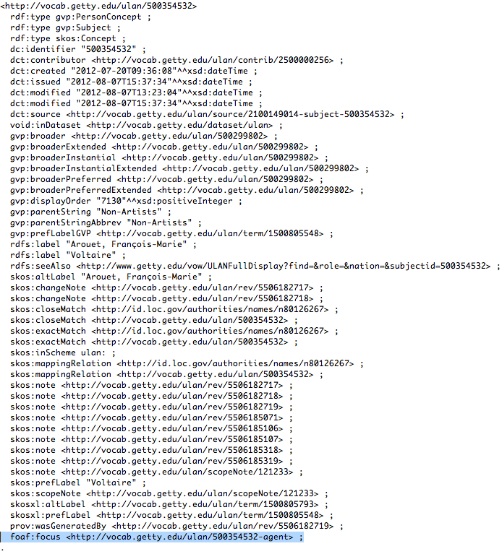
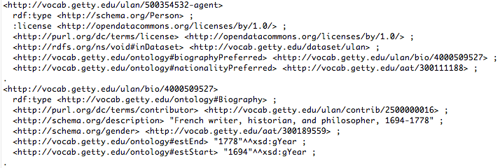
Examples: Getty

Slide 21
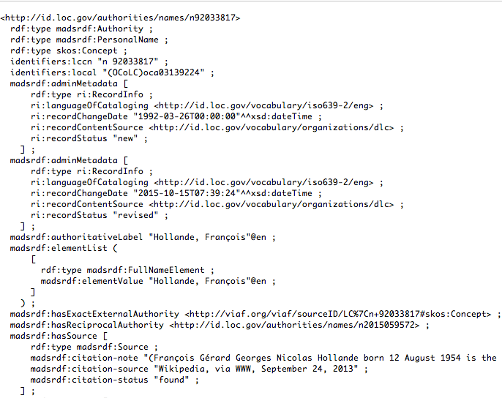
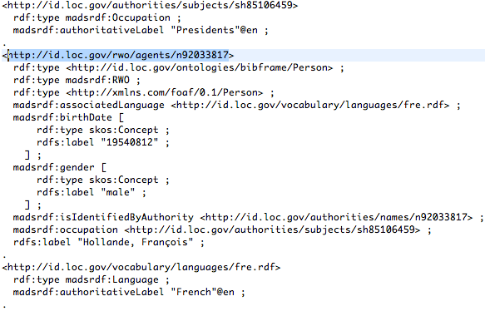
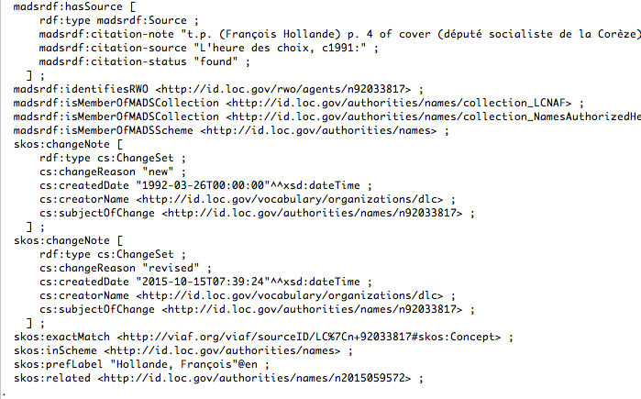
Examples: LC* - Authority vs Thing
Notes:
As Before. In addition one can see the admin metada of the resource. When did it change, for what reason and so on

Slide 22
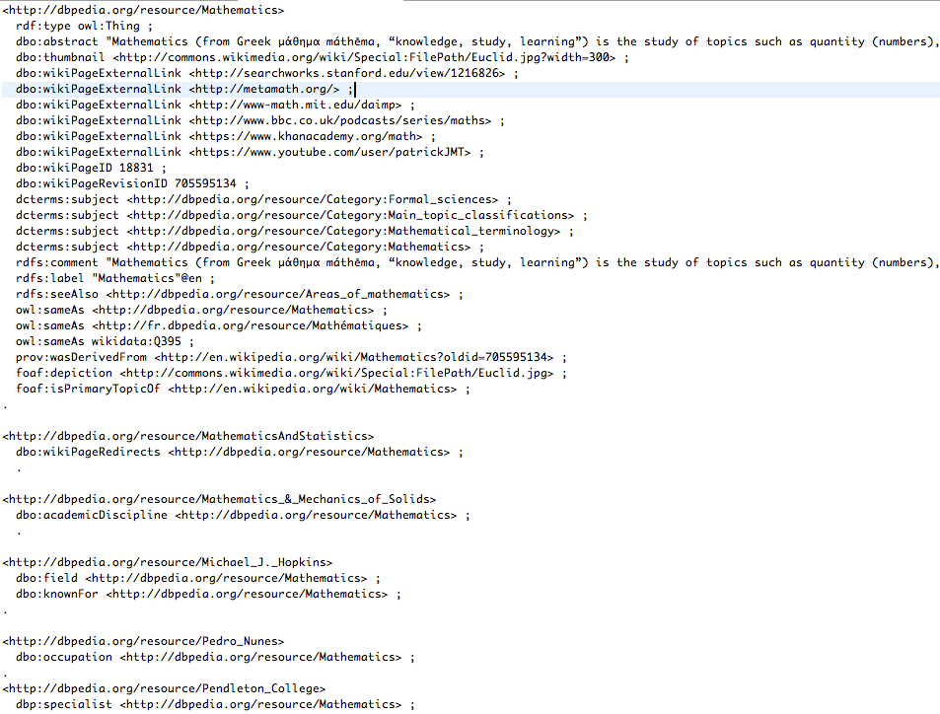
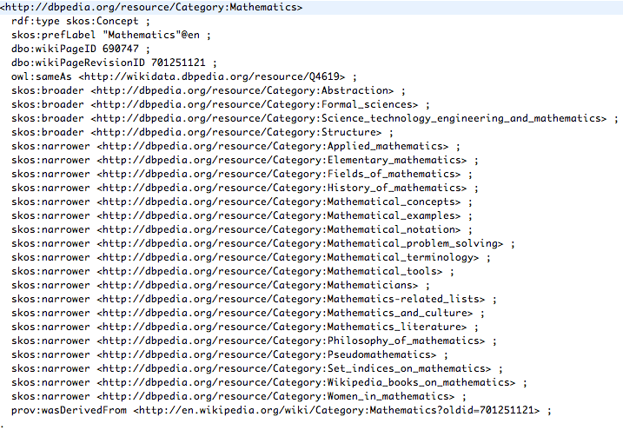
Examples: DbPedia
Notes:
The control Vocab only posses control vocab statement
The thing has other statement

