Slide 1

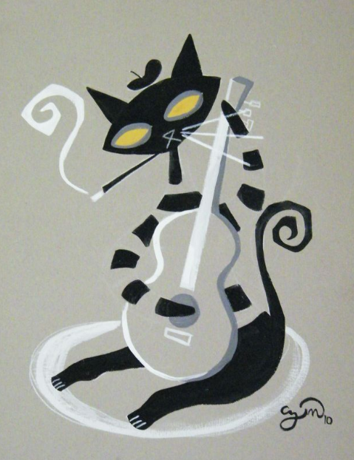
Modeling Metadata for Sound Archives:
Linked Data for Production
extending bibframe 2.0 for archival sound resources
Caitlin hunter
nancy Lorimer
arsc san antonio 2017

Slide 2
Overview
Context: Moving beyond MARC into BIBFRAME/linked data
LD4P and the Performed Music Ontology (PMO)
PMO work accomplished so far
Future efforts

Slide 3
Library and Archival Descriptive Standards
Data Content Standards
  A set of formal rules that specify the content, order, and syntax of information to promote consistency*
  AACR2, RDA, DACS + more
Data Value Standards
  An established list of normalized terms used as data elements to ensure consistency*
  Medical Subject Headings, Library of Congress Subject Headings + more
Data Structure Standards
  A formal guideline specifying the elements into which information is to be organized*
  MARC 21, Dublin Core, MODS + more
  * Definitions from SAA Glossary of Archival and Records Terminology, http://www2.archivists.org/glossary/

Slide 4
What About MARC?
The MARC formats are standards for the representation and communication of bibliographic and related information in machine-readable form. (https://www.loc.gov/marc/)
Some known challenges for users
  Descriptive data embodied in single, flat records
  MARC fields, subfields, and indicators are not understood by web indexing services
  Few libraries have presented MARC data in a manner that is openly searchable on the web. In general, patrons must navigate to OPACs associated with individual institutions and search for items within those OPACs.

Slide 5
Sound Recording Data in MARC
Some of the known issues:
No distinct field or subfield specifically for “take” information
Great variety in what patrons are looking for
  Publications
  Individual selections, tracks, events
    Information defining individual selections/tracks is often spread across various note fields.
    Identification generally relies on human readability and comprehension, not machine readability

Slide 6
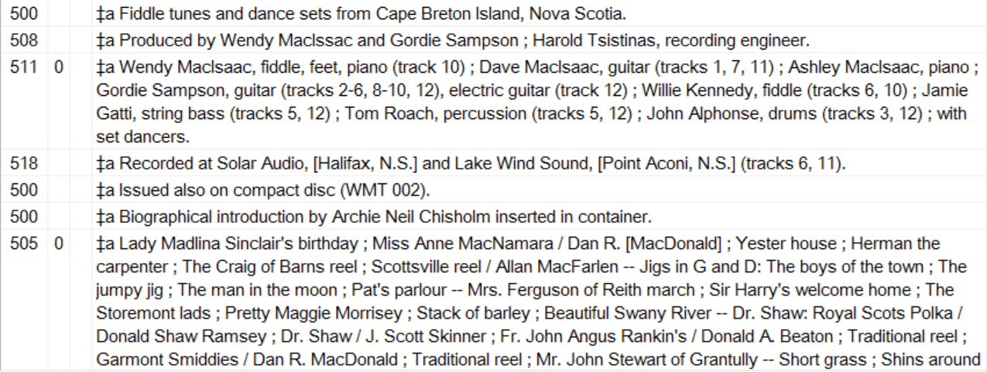
MARC Example (excerpt)

Slide 7
Possibilities of Linked Data & the Semantic Web
“The Semantic Web is an extension of the current web in which information is given well-defined meaning, better enabling computers and people to work in cooperation.”
  -(Tim Berners-Lee et al., “Semantic Web,” Scientific American, May 2001, p. 29-37)
Links between things, not text strings
Emphasis on real world objects (such as people, places, concepts) and relationships

Slide 8
BIBFRAME
2008: Report by the Library of Congress Working Group on the Future of Bibliographic Control (http://www.loc.gov/bibliographic-future/news/lcwg-ontherecord-jan08-final.pdf)
2012: Library of Congress announces intent to “develop a linked data alternative to MARC,” later named BIBFRAME
2014: BIBFRAME A/V Modeling Study released
2016: Version 2.0 of BIBFRAME released. Includes the concept of “Event.” (https://www.loc.gov/bibframe/)

Slide 9
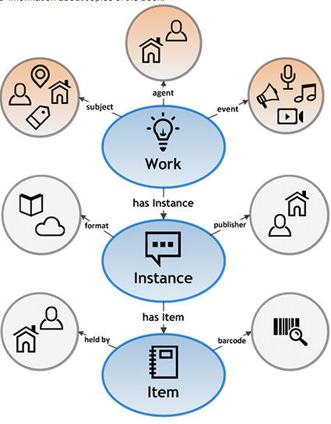
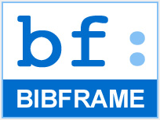
BIBFRAME 2.0
A very quick introduction…

Slide 10
Linked Data for Production (LD4P)
Public website: https://wiki.duraspace.org/pages/viewpage.action?pageId=74515029
Core Members: Columbia, Cornell, Harvard, the Library of Congress, Princeton, and Stanford
LD4P projects which touch specifically on audio:
  LC BIBFRAME Metadata Production Pilot
  Cornell Hip Hop Archive
  Performed Music Ontology (PMO)

Slide 11
Performed Music Ontology (PMO)
Team consists of representatives from Stanford, PCC, Library of Congress, Music Library Association, and ARSC (via the ARSC Cataloging Committee)
Regular team meetings, including an initial two-day meeting during which use cases were generated, largely from user stories gathered from MLA and the ARSC Cataloging Committee, as well as team members
Notes:
The PMO team has representatives from our two primary domain associations—ARSC and MLA, as well as representatives from LC, PCC, and Stanford. To keep us from descending too far into a music silo, three of the Stanford people are non-music in their daily focus—our a-v cataloger, our metadata coordinator (who like our av cataloger is a silent film buff), and a humanities cataloger (who just happened to work on the Linked Jazz project). We kick started our work last April in a two-day meeting at Stanford, in which we generated some use cases, developed from user stories gathered from MLA and ARSC. Since then, we have meet regularly, weekly when possible, via videoconferencing.

Slide 12
Project description for PMO
Develop a BIBFRAME-based ontology for performed music in all formats
  Domain-specific enhancements and/or extensions of BIBFRAME for use by the library community as a common standard
  Establish a model by which these standards can be created, endorsed, and maintained by the community
Do this through partnering with domain communities and the PCC
Notes:
The primary goal of our project is develop a performed music extension to BIBFRAME, covering description of recorded sound from wire recordings to streamed audio to music video. Using BIBFRAME as a core ontology, we will recommend domain-specific vocabularies, enhancements and/or extensions to BIBFRAME for use by the library community as the initial basis for a common standard. As we do this, we hope to establish a model whereby similar standards can be created, endorsed, and most importantly maintained by the library community. Clearly, the ontology will change and develop over time, but we hope to create here a strong base for development.
Because we are emphasizing a particular domain, community is of paramount importance to this project. We can develop a beautiful ontology, but it is of no use if it is not acceptable to the domain-communities who might use it. And of course, all the domain experts are to be found primarily in that same community and it would be detrimental to not make use of that expertise. Stanford has thus been partnering with domain communities—the Music Library Association and the Association of Recorded Sound Collections, as well as keeping Program for Cooperative Cataloging (PCC) in the loop.

Slide 13

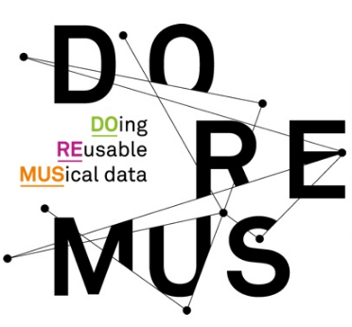


Why BIBFRAME?
Other ontologies:
  RDA registry (http://www.rdaregistry.info)
  Music Ontology (http://musicontology.com)
  DOREMUS (http://www.doremus.org)
BIBFRAME is:
  for all types of library materials, not just sound recordings
  compatible with a variety of cataloging content standards (or no standard)
  customizable, while still providing a common framework
Notes:
And so why use BIBFRAME? The usual context of this question is in reference to RDA—if we are using the RDA cataloging standard, why not use the RDA ontology? That is a perfectly reasonable question. There are also already some other music ontologies already available—the Music Ontology has been around several years and is even based on FRBR; lately the Bibliotheque National de France, Radio France, and the Philharmonie Francaise have been developing Doremus, based on FRBRoo and CIDOC-CRM. Why aren’t we using them?
In our modeling, we are hoping to create an ontology that works with multiple content standards, or even with a lack of a content standard, but still be part of a shared cataloging environment. While we use RDA, others may not, and we want to be able to have easy interoperability despite these differences. So that is why we chose BIBFRAME over RDA. The other two ontologies have almost the opposite problem—being intended only for music materials they run the risk of not being compatible with or at least too separate from modeling for all our other resources in libraries—we want them all to interact. There are also requirements for performed music that overlap with other formats, and we would like our modelling to be able to be useful for those formats as well as just music.
So in sum, we are using BIBFRAME because it is for all types of library materials, not just sound recordings; it is compatible with a variety of cataloging content standards, including no standard, and it is customizable while still providing a common framework.

Slide 14
New classes/subclasses/properties
Subclass of bf:Identifier
  bf:AudioTake
  bf:Gtin14Number
  bf:MusicDistributorIdentifier
  pmo:VideoGamePlatformIdentifer
  pmo:Allmusic
  pmo:MusicBrainz
  pmo:Discogs
  pmo:Imdb
Other classes/properties
  pmo:Tempo
  pmo:DiscCuttingType
  pmo:ThematicCatalogStatement
  pmo:OpusNumberStatement
  pmo:KeyModeStatement
  pmo:phonogramCopyrightDate
Subclasses & properties for:
    medium of performance
    events
    works
Notes:
The first step we took was to look through the ontology and add new classes, subclasses and/or properties required for cataloging performed music that were missing. For instance, we added several new subclasses to bf:Identifier: :AudioTake, :Gtin14Number (a number used by the publishing industry in describing packaging), :MusicDistributorIdentifier (recently defined in the MARC21 format), :VideoGamePlatformIdentifier, and links to Allmusic, MusicBrainz, Discogs, and IMDb. Yes, video game platform identifier does seem a little out of scope, but we do have an avid video game cataloger in our group.
These were very simple extensions to BIBFRAME, following a pattern already present. And while they initially were part of the performed music extension they have since been incorporated into LC’s core BIBFRAME ontology, which is why I list them in the bf: namespace. We also added a few other classes—sound recording label (so we can differentiate it from a publisher or distributor), tempo, disc cutting type and tape configuration for our sound archivists, and one new property—phonogram copyright date, the copyright date for a performance.
Besides the classes listed, we are also currently working on classes and properties for medium of performance, events, and works. More about some of that later.

Slide 15
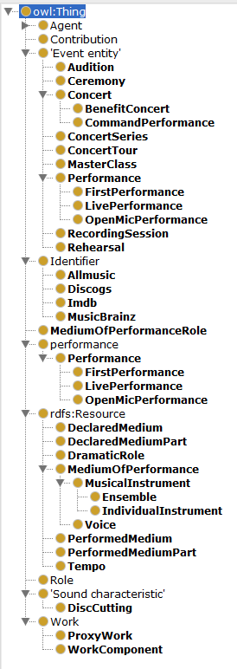
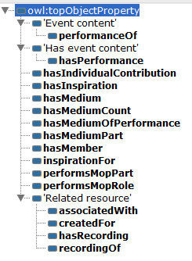

Notes:
These additions are thus far contained in Protégé, a well-known ontology editor coming from the biomedical field that is based at Stanford. You can access the ontology through the web version (WebProtégé), though you need to register first.

Slide 16
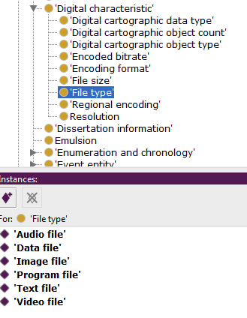
Vocabularies
Why?
  to provide specific relationships not already in
  BIBFRAME
  to provide values for the objects of triples
Example:
  bf:FileType
    no subclasses/individuals in BIBFRAME
    want to add in:
Notes:
Besides adding classes and properties, we were also looking at vocabularies outside BIBFRAME. We needed more vocabulary to define specific relationships through properties and to provide values for the objects of triples. It is all very well to say that a work has a file type, but we want to know what that file type is. As individual members of the subclass “File type” these are known as “individuals” or “instances” of the class.

Slide 17
Addition of vocabularies to:
  RDA vocabularies:
    bf:AppliedMaterial
    bf:BaseMaterial
    bf:Carrier
    bf:Content
    bf:EncodingFormat
    bf:FileType
    bf:MusicFormat
    bf:MusicNotation
    bf:TactileNotation
    bf:GrooveCharacteristics
    bf:PlaybackChannels
    bf:Generation
  RDA unconstrained properties
    work relationship properties
  id.loc.gov vocabularies
    bf:Role
  Doremus
    keys, modes
  New vocabularies
    playing speed
    pitch center
    colloquial & more specific terms for carriers
    “mechanical” added to bf:RecordingMethod for rolls
      bf:PlaybackCharacteristic
      bf:RecordingMedium
      bf:RecordingMethod
      bf:TrackConfig
      bf:TactileNotation
      bf:GrooveCharacteristics
      bf:PlaybackChannels
      bf:PlaybackCharacteristic
      bf:RecordingMedium
      bf:RecordingMethod
      bf:TrackConfig
Notes:
To fill these out we suggest that RDA vocabularies serve as individual members of various bf:Class(es). We chose the RDA vocabularies since they are the most comprehensive in coverage of our needs, and because of their relative simplicity in modeling (the term list is just that—a list of terms) they are an easy application of reuse. We have, however, chosen to use the MARC relators as found in id.loc.gov rather than RDA properties for roles. Roles are highly interconnected with other aspects of performance, and we need use the role as a class so these can be all brought together. We also suggest the use of Doremus vocabularies for keys and modes.
While we have primarily reused already existing vocabularies, we also have created one of our own. The RDA vocabularies for recorded sound carriers, as many of you know, are quite generic. So to augment that list, we have created more specific and colloquial terms for some audio carriers that may be used. For example, you can say “78”, “45”, piano roll or SACD.

Slide 18
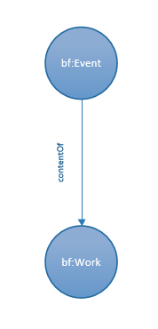
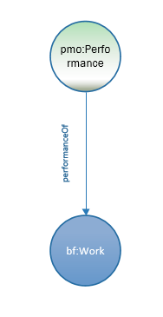
addition of:
  pmo:Performance (subclass of bf:Event)
  pmo:performanceOf
other subclasses of bf:Event:
  Audition
  Ceremony
  Concert
    Benefit concert
    Command concert
  ConcertSeries
  ConcertTour
  MasterClass
  Performance
    FirstPerformance
    LivePerformance
    OpenMicPerformance
  RecordingSession
  Rehearsal
Notes:
A big part of our work in the last few months has been the modeling of the relationships of events, works, medium, and performers with one another. This entails a complex set of relationships we were never satisfactorily able to express in a MARC record.
Events are a new thing for catalogers to model. Events in MARC tend to be relegated to subjects or notes; only really festivals and meetings get access points, as Caitlin mentioned earlier. BF does include events in its modeling, but it is very barebones, as you can see above. A bf:Event can be the event content of a bf:Work, or inversely, a bf:Work can have Event Content in an Event. This is a bit generic to be really useful, so one of the first things we did was to create subclasses of bf:Event, and of bf:contentOf. For a performance, the basic relationship is that a performance is the performance of a generic bf:Work, and that covers a large percentage of recordings. You can see other subclasses over on the right of the screen, including subclasses of pmo:Performance.

Slide 19
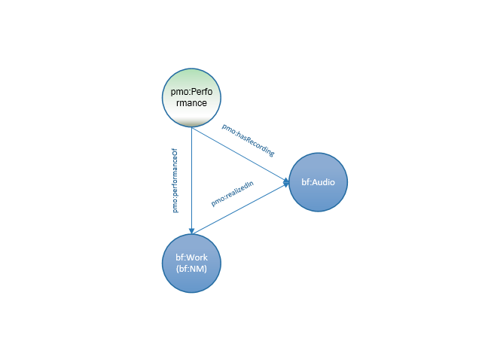
The basic triad of relationships:
  pmo:Performance
  bf:Work
  bf:Audio
added properties:
  pmo:hasRecording/ recordingOf
  pmo:realizedIn/ realizationOf
Notes:
In our previous screen, you saw a individual relationship of a work to a performance. It does not, however, include the actual recording only that the performance is the performance of a work. So there is a third circle—a bf:Audio—which completes our basic relationship triad.
This triad could in fact be reduced to two once more, by the removal of bf:Work (the generic one). Some events, including musical ones, are not performances of pre-existing works—improvisations, etc., and so would not need the generic work component.

Slide 20
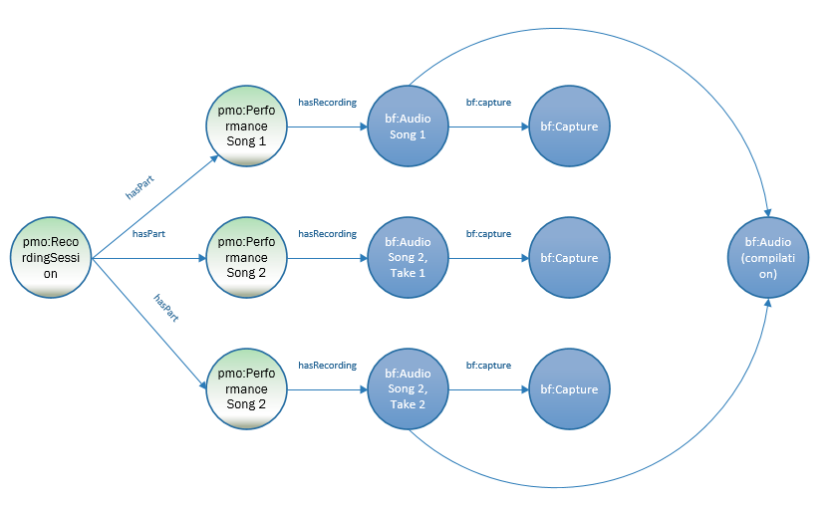
Recording session
  2 songs, 3 takes
  Song 1 + Song 2 (Take 2) are included in the final compilation
Notes:
A little dive into the bf:Event makeup. Here is an example of what one might do with a bf:Event in which you know all the separate performances at a recording session. On the left we have pmo:RecordingSession, a subclass of bf:Event, which contains 3 performances (also bf:Events)—1 take of 1 song, and 2 takes of another. All the performances become bf:Audio works. Song 1 & Song 2, take 2 become part of the final audio work, a compilation. Song 2, take 1 does not.
While there is a lot you can do with this simple extension of bf:Event subclasses, you may want, or sometimes want, something with which you can model that recording session more precisely. For that, we are suggesting you move to the Doremus ontology, based on FRBRoo or the Music Ontology. We have provided a formal link from pmo:Performance to frbr:Performance, to allow for a seamless move into Doremus.

Slide 21
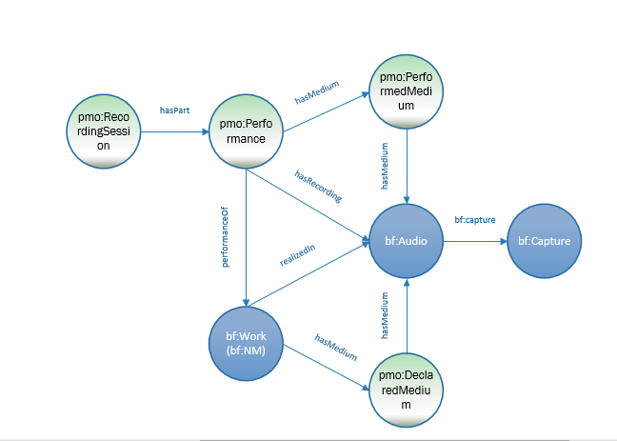
Integrating medium of performance
Addition of:
  pmo:PerformedMedium
  pmo:DeclaredMedium
Notes:
So getting back to our original diagram, I have now added in the recording session and what, in the library world, is generally called “medium of performance” or those instruments, voices, etc. and numbers defined for or used as the medium of a musical work and/or performance. Note that we have two basic classes for this: PerformedMedium & DeclaredMedium. DeclaredMedium is the mop as noted in a score, a title in a CD or other resource. PerformedMedium, on the other hand, is the mop that is actually used in performance of a work.

Slide 22
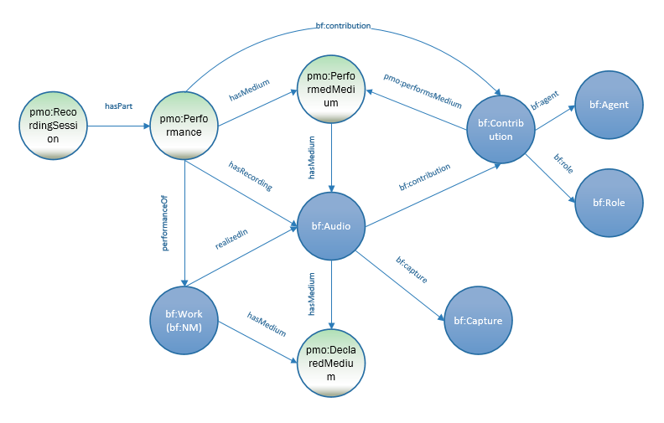
Linking in the performer through bf:Contribution
Addition of:
  pmo:performsMedium
Notes:
So now we have event, work, recording (another work) and medium. Next we add the performer(s) via the bf:Contribution class. The contribution made by a performer is linked to both the performance and the audio work since a performer contributes to both. Note that then the performer name (bf:Agent) and role (bf:Role) hang off the bf:Contribution node. I’ve also added in this diagram the pmo:RecordingSession extension.

Slide 23
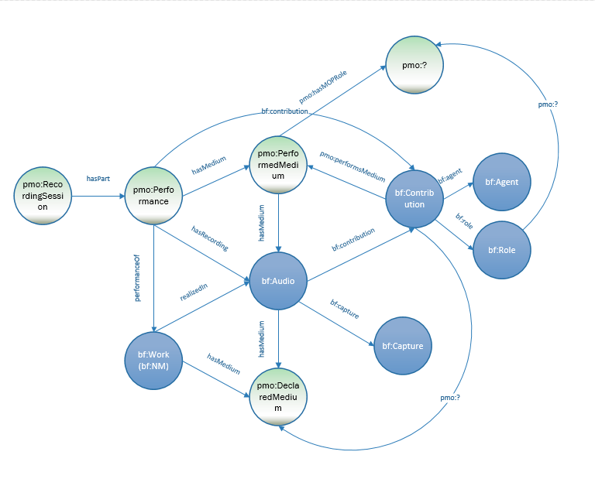
Individual instrument role (e.g., Violin 1)
Addition of:
  as yet unnamed class that defines individual music parts…
Still tentative…
Notes:
Finally, I’ve added a layer, as yet unofficially named. Here a performed medium is linked to a particular “role” or “part” that it performs in a work—Violin1 for instance, or Soprano 2. This is a very new addition to our model and still under revision.

Slide 24
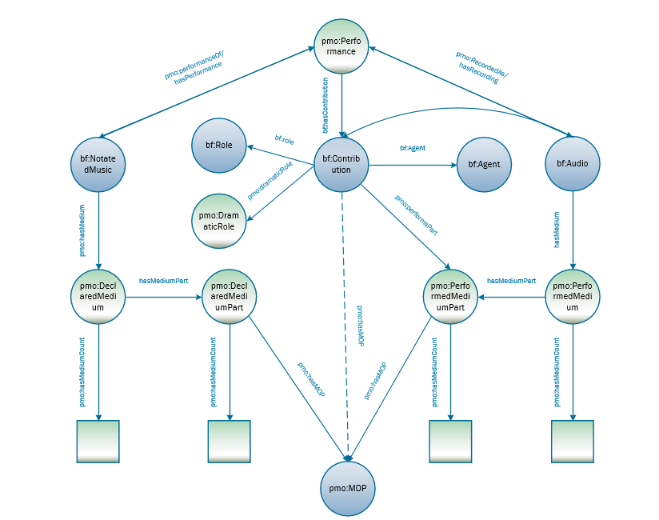
Medium of performance
addition of
  pmo:DeclaredMedium
  pmo:PerformedMedium
  pmo:DeclaredMediumPart
  pmo:PerformedMediumPart
  pmo:hasMedium
  pmo:hasMediumCount
  pmo;performsPart
Notes:
So let’s go deeper into medium of performance, and area that has been a bit of an obsession in the music cataloging community over the last couple years with the introduction of the Library of Congress medium of performance thesaurus for music and the ever more complex MARC 382 field that holds it.
This is our current model for medium of performance, with both declared medium (on the left) and performed medium (on the right). These are linked to a performance (or an audio work) and to a performer. With this we are able to state that a performer plays a particular instrument at a particular performance and whether that was the intended instrument for that part. This certainly pertains closely to our use cases. We can also count—each instrument, the total instruments, and total number of performers. We have also added a lightweight method to state the dramatic role that a person might have—such as “Griselda” in the musical “Cats” or “Papageno” in the Magic Flute.

Slide 25
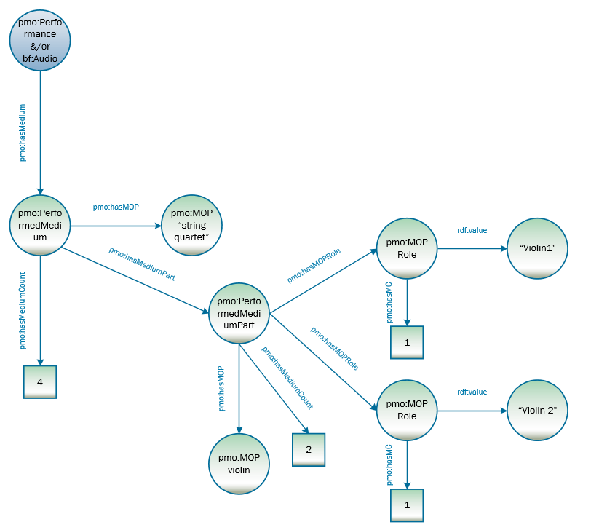
Notes:
Medium of performance combined with the performer can look complex in a model. Here for example, is a modeling for the violins in a string quartet. We have a performed medium of a “string quartet” with a count of 4 parts. There is then a medium part for the instrument “violin” which has a count of “2”. In a full model there would also be medium parts for the viola and the cello, each with a count of 1. The violin medium part then is subdivided into two roles, each with one player “violin 1” and violin 2. The model thus is able to say this performance is carried out by a string quartet that it has 2 violins, a viola, and a cello and that the violins are divided into violin 1 & 2. It is not always necessary to define all these levels, but it is there if you want to.

Slide 26
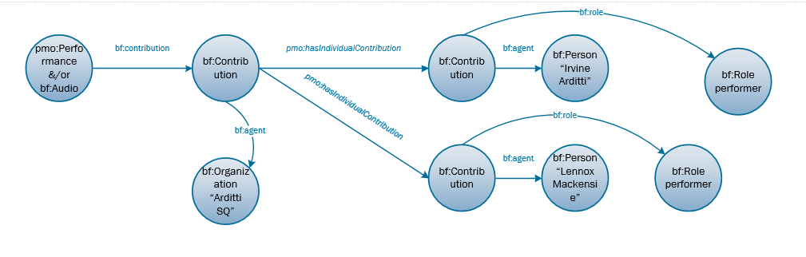
contribution of individual member of a string quartet
pmo:hasIndividualContribution
Notes:
On the other hand, is the contribution of the performers under bf:Contribution. bf:Contribution has a single bf:Organization as a contributor: the Arditti SQ. This contribution, however, includes 4 individual contributions. Here only two are shown—the violins only-Irvine Arditti and Lennox Mackensie.

Slide 27
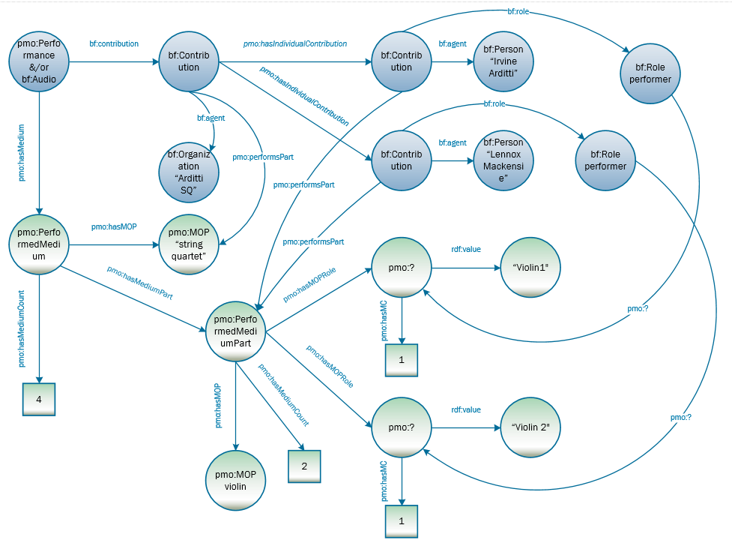
Extending the modeling of medium:
  individual parts of a string quartet (violins 1 & 2)
Notes:
Tie the performers to the violin 1 & 2 parts and this is the model you get this—a model that ties together a work or performance, the ensemble and its parts, the performers who perform that ensemble & parts, and what parts they play. Link that to the triadic work model at the beginning and you have a semantically rich model to work with.
Now I realize this looks pretty daunting and well, it is. But remember, this is the model, not how you will actually catalog something. Cataloging can take place through a semantically enabled template that will help you with all these relationships.

Slide 28
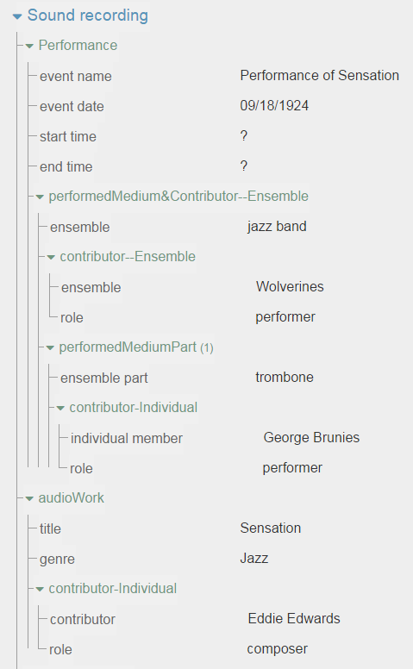
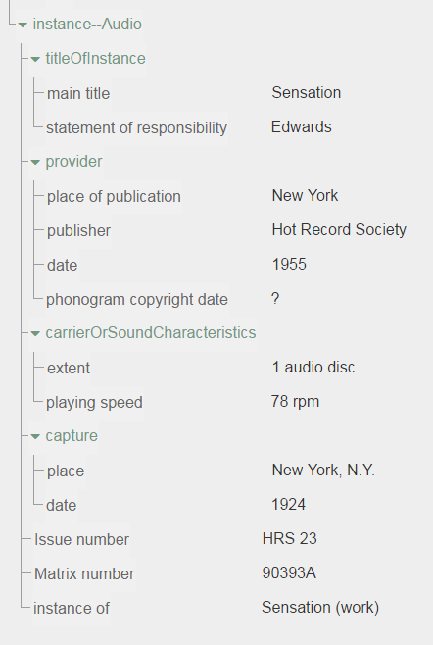
Notes:
Here is a prototype of a cataloging form, an extension of a form developed by the CEDAR team at the Stanford Bioinformatics Lab. The CEDAR template encodes properties and classes in the template and you can end up with an easy to use form for entering metadata, including the possibility of pull down menus of controlled terms and other features not shown here. I created this particular form myself—it does not take a developer to create—and elements of it can be reused in other templates. And the other thing it does of course, is hide all that complexity behind a human friendly form, allowing for quick metadata entry, that produces linked data.

Slide 29
Ontology extension summary
Extension work to BF2.0
  added classes, properties, vocabularies
Modeling:
  thematic catalog numbers
  opus numbers
  music key and mode
  declared medium & performed medium (medium of performance)
  multi-movement Works
Working on:
  Events
  Aggregate works/Compilations
  Sequencing
Notes:
So that was a whirlwind tour of our ontology work.
In summary, we have extended BIBFRAME 2.0 to better accommodate performed music by adding classes, properties, and vocabularies to the current BIBFRAME model. We also have extended through modeling music-specific description and identification: thematic catalog numbers, opus numbers, music keys and modes, medium of performance, and multi-movement works. Currently, we are working on models for events, aggregate works, and sequencing, perhaps to help inform the development of BIBFRAME not only for music, but for the general library community.

Slide 30
Future Efforts
create demonstration descriptions
finalize everything and write up report
publish ontology initially in Bioportal at Stanford; later with LC
publish accompanying web page
Notes:
For the near future—we are reaching the end of this current phase of development and hope to make it available soon to our partners and the music communities for comment and critique. We will create demonstration descriptions, finalize everything, and write up a report, both for Mellon and for the public. The ontology will likely first be hosted on Bioportal at Stanford, but will later be hosted (if not yet backed!) by the Library of Congress, with an accompanying web page.

Slide 31
For more information
BIBFRAME 2.0:
http://www.loc.gov/bibframe/
PMO public website: https://wiki.duraspace.org/display/LD4P/Performed+Music+Ontology
PMO in WebProtégé (registration required):
http://webprotege.stanford.edu/#projects/23a0b33a-f0f8-47cd-b8da-379107daa36d/edit/Classes
Linked Data for Production public website:
https://wiki.duraspace.org/pages/viewpage.action?pageId=74515029

Slide 32
PMO Team members
Kirk-Evan Billet (MLA)
Chiat Naun Chew (PCC)
Greta de Groat (Stanford)
Arcadia Falcone (Stanford)
Caitlin Hunter (ARSC)
Kevin Kishimoto (Stanford)
Nancy Lorimer (Lead-Stanford)
Wendy Sistrunk (ARSC)
Jim Soe Nyun (MLA)
Hilary Thorsen (Stanford)
Valerie Weinberg (LC)

Slide 33
Thanks!
Caitlin Hunter
chun@loc.gov
Nancy Lorimer
nlorimer@stanford.edu

Slide 34
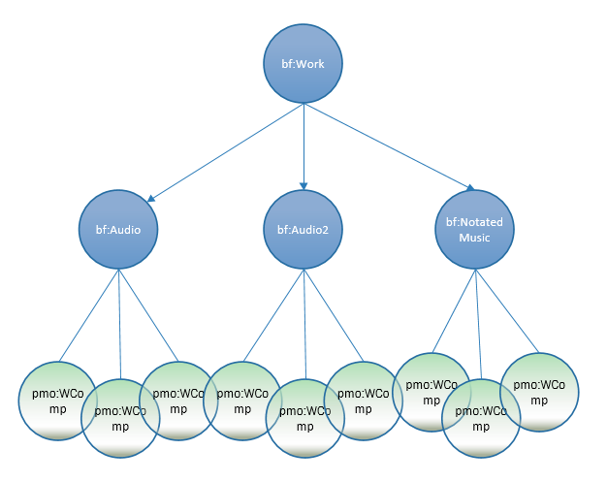
bf:Work layered to create a collecting work (= FRBR work)
pmo:ComponentWork
pmo:hasOrder

Slide 35
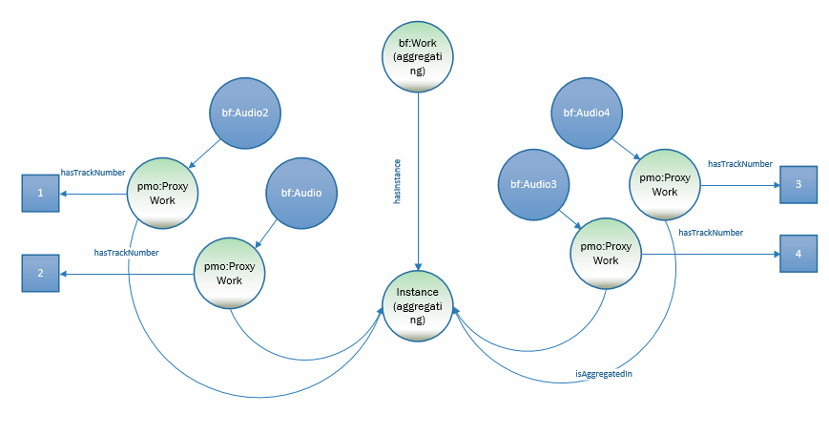

Slide 36
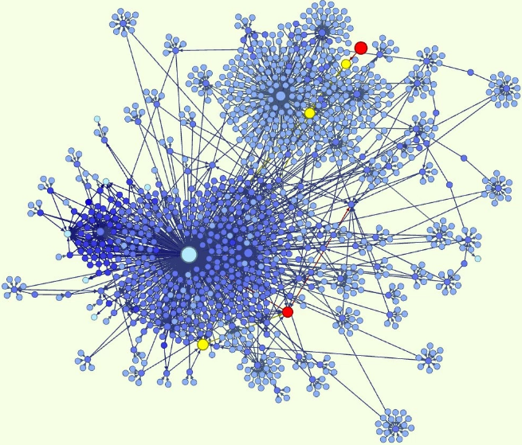
Why ontologies?
“An ontology is a formal naming and definition of the types, properties, and interrelationships of the entities that really or fundamentally exist for a particular domain of discourse. It is thus a practical application of philosophical ontology, with a taxonomy.”*
  note this is an intellectual as well as a structural framework
*Wikipedia, viewed January 2, 2017
Notes:
Before we embark on how we’ve doing in this wild adventure, let’s take a step back and think about why we are doing this. What are ontologies anyway and why do we need them? An ontology is “…a formal naming and definition of the types, properties, and interrelationships of the entities that really or fundamentally exist for a particular domain of discourse. It is thus a practical application of philosophical ontology, with a taxonomy.”
While this is a Wikipedia definition, it does sum things up nicely. An ontology is where you name & define the entities contained in your domain and the relationships among them. As a practical application of philosophical ontology, creating an ontology is an intellectual endeavor, with choices based on structural and practical knowledge of the domain being modeled. A linked data ontology is built on RDF & its basic data model RDFS or OWL, the Web Ontology language, but these can only express very basic relationships—this is a subclass of this; this entity is related to this entity—highly abstracted relationships. An ontology brings in the specific vocabularies and relationships that define your domain, providing structure and vocabulary (or taxonomy as Wikipedia puts it).

Slide 37
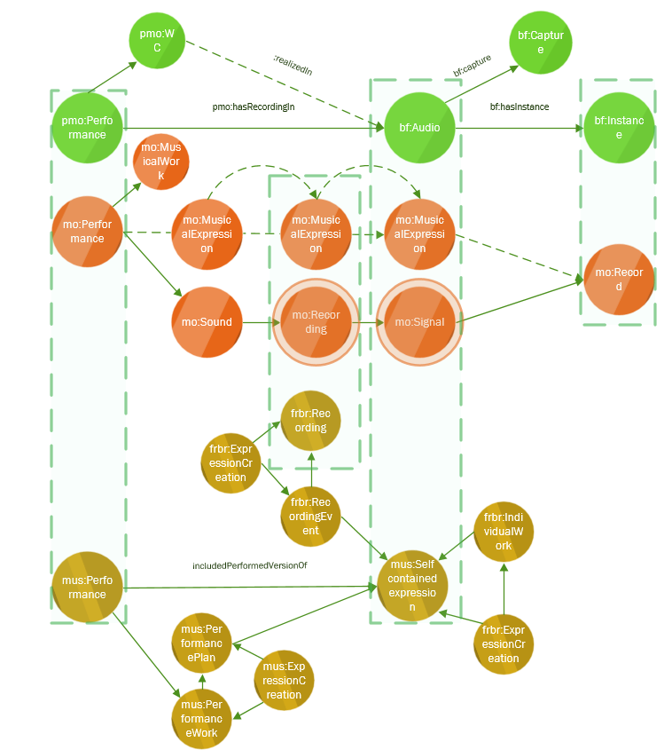
Events in BIBFRAME, MUSIC ONTOLOGY & DOREMUS
Notes:
This diagram shows where the 3 ontologies align (BF at the top, MO in the middle, and Doremus at the bottom. PMO has formally defined pmo:Performance as being a subclass of frbroo:Performance. This means you can easily move from one ontology to the other.

