Slide 1

Linked Data for Production:
Stanford Projects
Linked Data for Production/Linked Data for Performed Music
technical services workflows
performed music ontology

Slide 2
Projects
Workflows in Technical Services (“tracer bullets”/«balles traçantes»)
  Vendor-supplied cataloging (Tracer bullet #1)
  Original cataloging (Tracer bullet #2)
  Single deposit to digital repository (Tracer bullet #3) [2017]
  Bulk deposit to digital repository (Tracer bullet #4) [2017]
Performed Music Ontology (PMO)
  Extension to BIBFRAME 2.0
Notes:
Stanford has 2 primary local projects as part of Linked Data for Production. The first of these, and to us the basis for this project, is to move selected technical services workflows into a linked data environment. We know these as “tracer bullets” a term used by developers to describe a lightweight process that follows a workflow from beginning to end. We chose 4 primary workflows: vendor-supplied cataloging—MARC cataloging that is sent to us along with the materials; original cataloging by our local metdata staff; the deposit of a single item into our digital repository; and, bulk deposit of materials into our digital repository. Of these, we have been concentrating on the first two workflows in this year; the digital repository materials will be worked on in 2017-18.
Our other workflow is our contribution to the development of extensions of Bibframe to accommodate various special domains of library materials. In our case, we chose performed music—basically sound recordings.
I’ll note here that while we call these “local” projects and are based on our workflows, and to a certain extent our needs, the outcome should be easily applicable or adaptable to the needs of other libraries.

Slide 3
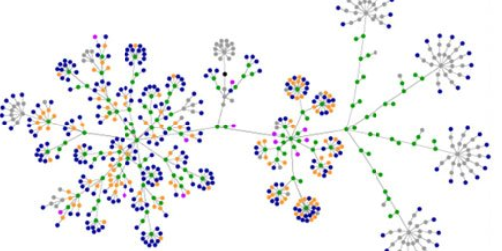
Tracer bullets 1 & 2
(«balles traçantes 1 & 2»)
#1: Vendor-supplied cataloging
#2: original cataloging
Notes:
LD4P grew out of a desire on our part to move away from record conversion and to create native linked data as part of our technical services workflow. But we soon realized that given that most of our cataloging (80%) comes from sources outside of Stanford, and that cataloging would for the forseeable future be in MARC, that we would be converting records. So, although our original plan to provide original linked data cataloging is our second tracer bullet, our first is to move cataloging supplied by vendors into the linked data environment.

Slide 4
Assumptions (for now)
MARC & linked data will coexist in our catalog for some time to come
  Vendors will still be providing MARC records for many years to come
  Some aspects of our database will remain as they are, and will require a MARC “operational” record to link to
    ordering from traditional vendors
    receipt, payments, holdings, circulation
various enhancements to MARC records will improve conversion
  URIs, additional fields
  best to start with a vendor who does authority work
  = Casalini Libri
Notes:
As we delved further into this, we came up with some assumptions that would guide our process. The first of these is the realization that MARC & linked data would coexist in our discovery layer for some time to come. The move of library data into linked data will take a long time, and we will be receiving MARC records from vendors and through copy cataloging for years to come. Also, there are simply some aspects of our library system that will not move into linked data—ordering, receipts, payments at the very least will remain in a relational database, and will, at least for now require what has come to be called an “operational” record, a MARC record, however minimal that holds everything together. Another assumption is that it should be possible to enhance a MARC record to improve conversion. Clearly, associating URIs with controlled terms is important, but also making use of particular fields or term sets can help.

Slide 5
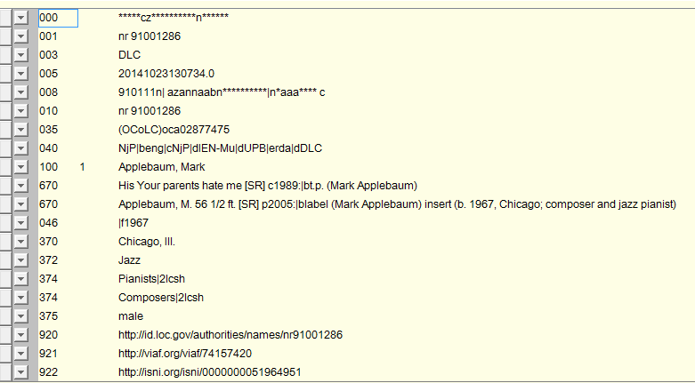
Enhanced authority records
Notes:
Well before we received this particular grant, Stanford decided to enhance its local file of authority records by adding URIs. We were not sure then how to use them, but our authority vendor was willing. We added them in as local fields so that any changes to the record would not cause them to be deleted. When converting data, we can query the authority file and add any URI to the MARC XML before we then transform it to Bibframe.

Slide 6
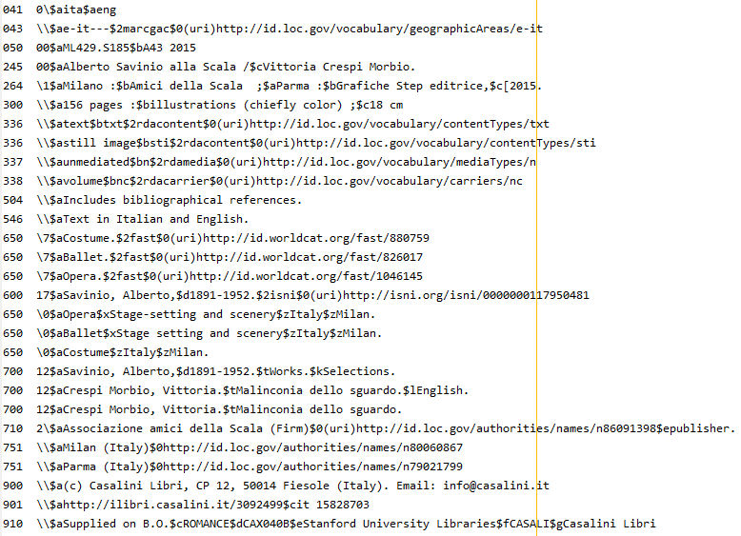
Enhanced bibliographic records
Vendor-supplied URIs from Casalini Libri
URIs
Addition of 043
FAST headings
[Translators]
“Instance” URI
Notes:
We are also experimenting with Casalini with the addition of URIs to bibliographic records that they send us. In addition, we also requested the addition of other fields not always used in bibliographic records. For example, we requested the addition of the geographic code (043) when applicable, along with its URI, FAST headings alongside Library of Congress subject headings (they are easier to convert), and the required addition of editors and translators as access points, to make it simpler to know when there is a new work or not. Note that still there are some access points with no URIs—we will have to add local ones for these.

Slide 7
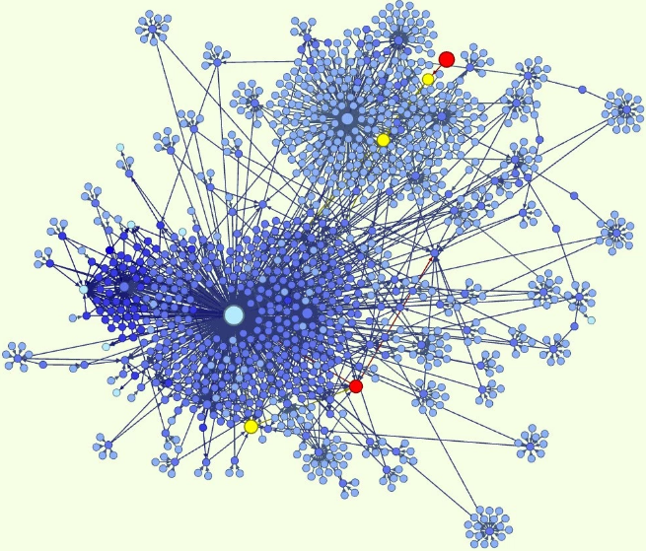
Workflows
Tracer bullet #1: Vendor-supplied cataloging
Notes:
So that was our preparation—now for the workflows themselves.

Slide 8
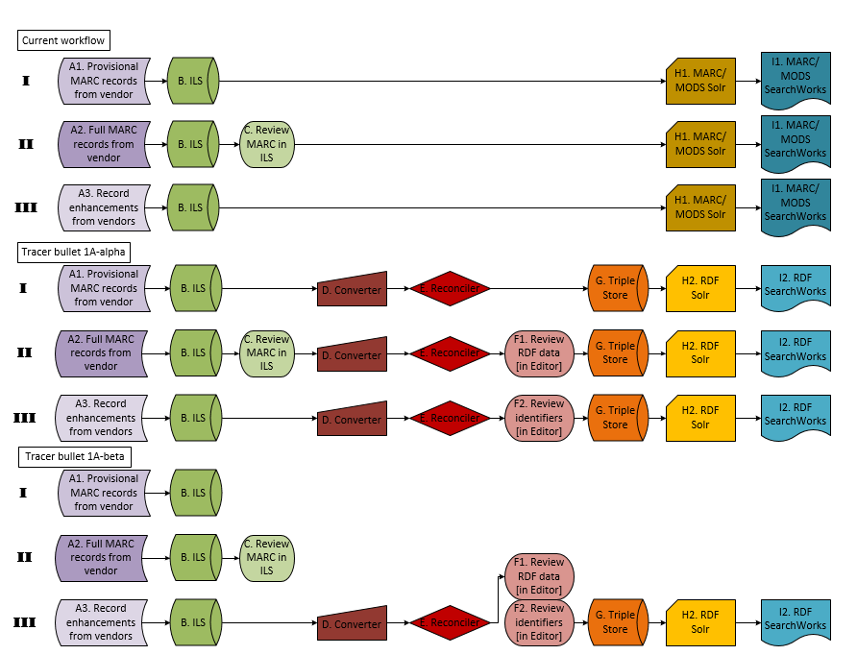
Current MARC-based workflow
Notes:
This is our current workflow of vendor-supplied cataloging, which has 3 phases. The first phase (Roman numeral I) is the ordering the item, which is done by creating provisional MARC records (from the vendor or elsewhere) in our local system with the order attached. These are indexed as on order items in our SOLR indexes and displayed in our discovery layer. The next step (Roman numeral II) is the receipt of the item with full MARC records from our vendor Casalini. These are loaded into our system, reviewed, and then are again indexed and visible in our discovery layer. Finally (Roman numeral III), these records are sent for various types of enhancement—to our authority vendor for new authority records, the addition of contents notes, book jackets, and to OCLC where we get the OCLC number. From receipt to full enhancement takes about a week. From ordering it takes about a month with Casalini, but orders, can of course vary widely in fulfillment.

Slide 9
Tracer bullet 1a-alpha: early & iterative conversion
Notes:
We came up with two conversion workflows, the first being illustrated here. In this tracer bullet, we are looking at the RDF as the primary view for the user. Conversion occurs multiple times, once for each phase of the workflow—first after we load the provisional record, then when we load the full records, and finally once we have received all our record enhancements.
This is a heavy weight process. It involves not only multiple conversions, but the need to reconcile each time with what had been sent before. There is also the need for a receiver to review the metadata in RDF rather than in MARC. Our receivers are not professional catalogers and this would take a fair amount of training.
In the end, while we felt this would be the path eventually that it was too complex for now. So we went with a simpler method.

Slide 10
Tracer bullet 1a-beta: single, late conversion
Notes:
So this is what we are currently working toward. The vendor data remains in MARC until all the enhancements are complete. Then it is converted. This has the drawback that we need to display both MARC and RDF data and those MARC records may remain in that state for a month or more. On the other hand, we don’t have to deal with reconciliation to the same extent.

Slide 11
Current workflow
MARC-based
Tracer bullet 1a-alpha
early & iterative conversion
Tracer bullet 1a-beta
later, single conversion
Notes:
So here the three workflows together to show the contrast between them—MARC at the top, followed by the complex workflow, followed by the simpler workflow we will use for now.
I have spoken only about our vendor-supplied cataloging workflow so far, but it turns out that original cataloging is not much different, since there will also be an operational record to convert. The primary difference, of course, will be the need for a robust editor and lookups. While we are not as far ahead with this workflow, it will likely look more like our complex one displayed in the middle here as Tracer bullet 1a-alpha.

Slide 12
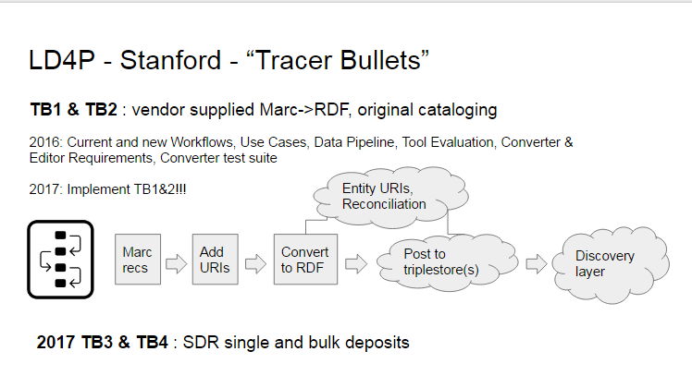
Systems Overview
Notes:
So that is what the workflow looks like from the Metadata end. From the Systems side it looks a little different. In fact, it can look very simple! We take MARC records, add URIs to them, convert, reconcile, post to a triple store and publish for discovery. Easy right?

Slide 13
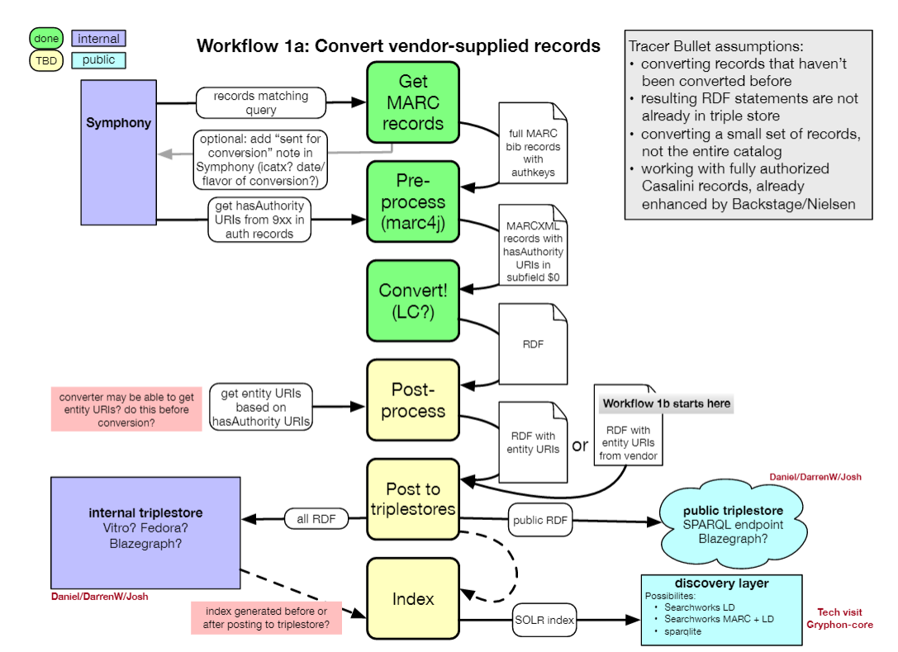
Notes:
Well this is more what it really looks like. I won’t go into full detail, but generally it goes like this: Step 1 at the top, We take the MARC records and their links to our local authority file from our system. Step 2 is pre-processing. The MARC record is converted to MARC XML and URIs either from the $0 of the bib record, or from the local fields in the authority record are added in. Step 3, we convert to RDF. Step 4, post-processing might include getting or deriving entity URIs from the authority URIs. Step 5, we post to the triplestore, which will have two instances—a public triplestore and an internal triplestore. The internal triplestore we can use as an internal cache and it will also hold our proprietary data that cannot be shared. Finally the data will be indexed into our SOLR indexes and appear in our discovery layer.
So far in all of this, we have got as far as conversion (the cubes in green), but the rest is on its way and it should be complete at the end of April. It will not be ideal, but it will work.

Slide 14
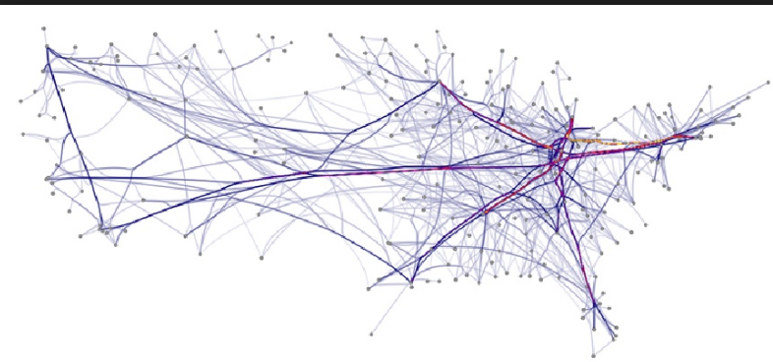
Tools
converters, templates, editors, triple stores…
Notes:
I’ve given you a quick overview of our Workflows 1 & 2, and I thought you might be wondering what tools we are using so far. The tools we are using are not by any means our final or even approved choice—mostly it has been just what is around that we can use. Part of this exercise is to understand what our tools need to do and how they can be made to work better.

Slide 15
Tools (Front end)
Converters
  BIBFRAME 1.0 converter
    Library of Congress
    2.0 converter when available
  ALIADA (Casalini Libri)
    BIBFRAME 2.0 data for analysis
Conversion validator
  Stanford validator
Editors/Metadata Templates
  BIBFRAME 1.0 editor & profiles
    Library of Congress
    2.0 editor when available
  VIVO/Vitro
    Cornell University
  CEDAR
    Stanford Bioinformatics Lab
  WeCat?
    Casalini Libri
Notes:
But this is what we have so far. For converters, we are currently using the BF 1.0 converter from the Library of Congress. Not ideal, since we would prefer BF 2, but that’s not available yet. As soon as it is, we will switch. We are also experimenting with Casalini Libri’s Aliada converter, but do not yet have the mapping set up to work with BF. It does,however, seem to have a lot of potential as well as flexibility, since it is intended for use with multiple ontologies, not just one. Josh Greben, one of our developers at Stanford is also building a validator, with which we can test converter output.
For editors or templates, we currently have the BF 1 editor and profile maker from LC, and will explore the 2.0 editor as soon as it is available. We are also looking at the VIVO/Vitro editor from Cornell University, and possibly Casalini’s WeCat. Finally, we are looking at a ontology template being developed in the Stanford Bioinformatics Lab at Stanford. All these editors have different strengths and weaknesses and our catalogers will be trying them all out.

Slide 16
Tools (Back end)
RDF Store
  BlazeGraph
    in the process of being installed
Display
  Blacklight with SOLR indexes
    mapping will begin soon
Discovery
  Our own Blacklight instance “SearchWorks”
  Casalini SHARE-VDE
Notes:
On the back end, we are currently installing an instance of Blazegraph as a triplestore. Again, this doesn’t mean it’s our final choice, but it is available, and Casalini uses it as well. For public display, we will be mapping BF to our SOLR indexes for display in our discovery layer SearchWorks, which will eventually likely be our first mode of discovery. We are also looking at the Casalini SHARE-VDE product as well.
So that is a short introduction to our workflows project. Now onto Performed music.

Slide 17

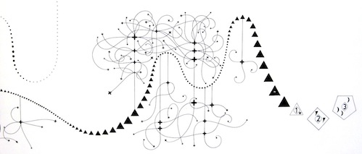
Performed Music Ontology
(PMO)
Notes:
The Performed Music Ontology is one of several domain subprojects part of the Linked Data for Production grant. Metadata people at Stanford have a long running interest and connection with music metadata—both Philip Schreur, our head of Technical and Access Services and I were once music catalogers, and our director in his early days was a music librarian. We also have a separate technical services unit for music, and other metadata and digital library staff also have strong music and/or av backgrounds. For us, looking at the working with the description of performed music as linked data was an obvious thing to explore.

Slide 18
Project description
Develop a BIBFRAME-based ontology for performed music in all formats
  Domain-specific enhancements and/or extensions of BIBFRAME for use by the library community as a common standard
  Establish a model by which these standards can be created, endorsed, and maintained by the community
Do this through partnering with domain communities and the PCC
Notes:
The primary goal our project is develop a performed music extension to BIBFRAME, covering description of recorded sound from wire recordings to streamed audio to music video. Using BIBFRAME as a core ontology, we will recommend domain-specific vocabularies, enhancements and/or extensions to BIBFRAME for use by the library community as the initial basis for a common standard. As we do this, we hope to establish a model whereby similar standards can be created, endorsed, and most importantly maintained by the library community. Clearly, the ontology will change and develop over time
Because we are emphasizing a particular domain, community is of paramount importance to this project. We can develop a beautiful ontology, but it is of no use if it is not acceptable to the domain-community who may use it. And of course, all the domain experts are to be found primarily in that same community and it would be detrimental to not make use of that expertise. Stanford is thus partnering with domain communities—the Music Library Association and the Association of Recorded Sound Collections, as well as keeping PCC in the loop.

Slide 19
New classes/subclasses
Subclass of bf:Title
  pmo:AnnouncedTitle
  pmo:CommonlyKnownTitle
  pmo:ContainerSpineTitle
  pmo:CreditsTitle
  pmo:DevisedTitle
  pmo:EmbeddedMetadataTitle
  pmo:MediaSurfaceTitle
  pmo:MenuTitle
  pmo:ReferenceSourceTitle
  pmo:TitleScreenTitle
Subclass of bf:Identifier
  bf:AudioTake
  bf:Gtin14Number
  bf:MusicAvDistributorIdentifier
  bf:VideoGamePlatformIdentifer
  pmo:ThematicCatalogNumber*
  pmo:OpusNumber*
Subclass of bf:Publisher
  pmo:MusicRecordingLabel
Notes:
The first and seeming most obvious thing to add were subclasses for bf:Title. Cataloging sound recordings in RDA requires that the cataloger always specify the source of every title that is recorded, and there was already the suggestion to add these as subclasses of bf:TitleVariant in the LC position paper on Titles. While seemingly simple (along with pleasant wrangling over names), a couple questions rose immediately, the primary one being that these could not be subclasses of bf:TitleVariant. Since any of these title subclasses could be a preferred title for the instance (and in some cases the work), we instead made them direct subclasses of bf:Title.
Finally, we went through bf:Identifer. We changed some definitions to existing music identifiers and added 3 other music-related identifiers—the music av distributor number (recently defined in MARC), take numbers, and the Gtin-14 number, a number used by the publishing industry in describing packaging. As a bonus, and because we have a specialist in video game cataloging as part of our group, we added the identifier for Video game platforms. A little out of scope, but video games do indeed have music.
These were simple extensions to BIBFRAME, and our most successful to date—if not already, they will very soon no longer be extension vocabulary, but will be part of LC’s core BIBFRAME ontology
We also added a few other random classes—sound recording label, disc cutting type, tape configuration and tempo, and one new property—phonogram copyright date, the copyright date for a performance. More are coming, as our community is coming forward with further areas they would like to have expanded.

Slide 20
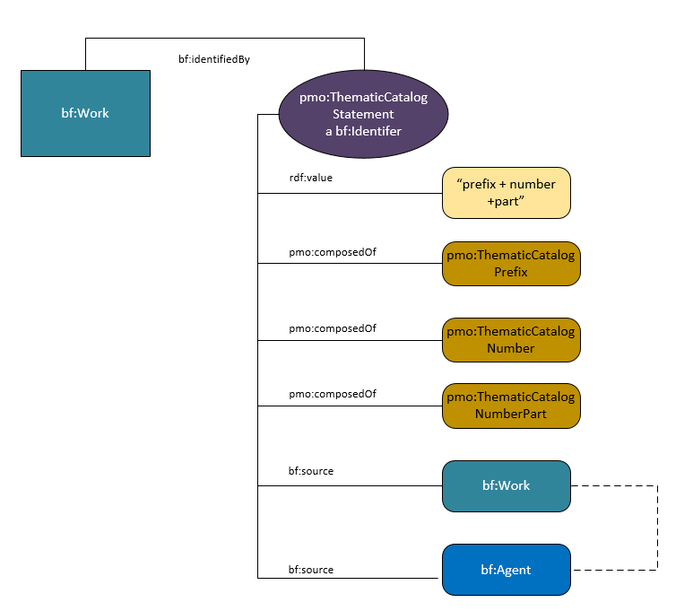
Thematic Catalog numbers, Opus Numbers, musical key/mode
Thematic catalog & opus number currently literals
pmo changes them to subclasses of bf:Identifier
  further divided into parts of the number for better discovery
Notes:
Besides the 4 new subclasses of bf:Identifier, derived from data properties already present in BF, the PMO group felt that two other very important music identifiers were missing from the bf:Identifier class—Thematic catalog numbers, which are numbers assigned in catalogs of composers’ works, and opus numbers, work numbers assigned either by the composer or a publisher. In a domain where titles are often generic (Symphony, Concerto) and composers might compose hundreds of works in a lifetime (Vivaldi wrote 120 violin concertos and 39 bassoon concertos), these can be very important for identifying works.
In BF, thematic catalog numbers and opus numbers are actually present, but both are literals or strings, and are represented only by the properties bf:musicThematicNumber and bf:musicOpusNumber. They are considered only in their relationship to the title string. this is limiting; nothing further can be stated about the number. The PMO group decided this was not adequate for music cataloging purposes—thematic catalog numbers make sense in the context of their catalogs, and it seemed reasonable to provide the source for the number, especiallyl since some composers might have multiple catalogs. And even something seemingly simple as an opus number sometimes needs a source and perhaps even a date—numbers get changed by publishers or by the composers themselves. To allow for this the PMO has created two additional new subclasses of bf:Identifer: ThematicCatalogStatement and OpusNumberStatement. This involved our first real experience in modeling, since they are multifaceted identifiers. Both follow the same modeling, so we’ll just look at pmo:ThematicCatalogStatement. The thematic catalog number can be expressed as an rdf:value (such as the string “BWV 465” and/or it may be split into three other classes pmo:ThematicCatalogPrefix, pmo:ThematicCatalogNumber, and pmo:ThematicCatalogPart. The are linked to pmo:ThematicCatalogStatement by the predicate pmo:composedOf. By splitting the prefix from the number, the number can be discovered on its own without the string being correct.
Besides improved discovery, another huge benefit in making these subclasses is that the statement may now be linked to a source. Thus BWV 465 can be linked directly to the Bach Werk Verzeichnis, even to a particular edition.

Slide 21
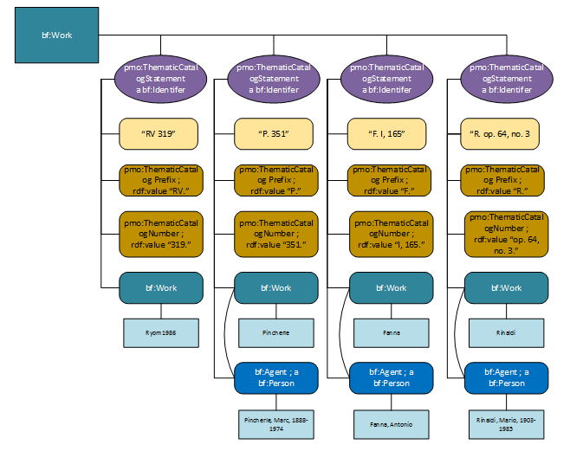
Notes:
Just to show the complexity possible. In this case we have a work by Vivaldi. There are 4 different possible thematic catalog numbers and all can be modeled…

Slide 22
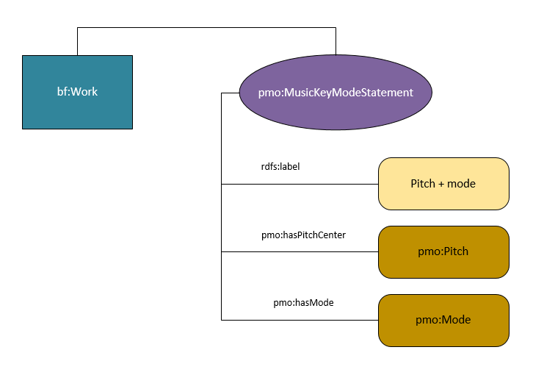
pmo:MusicKey
and for music keys…
music pitch & mode are separated
[work_1] a bf:Work ;
bf:hasKeyMode [
rdf:value “F major” ;
pmo:hasPitchCenter [
a pmo:Pitch ;
rdf:value “F” ;
] ;
pmo:hasMode [
a pmo:Mode ;
rdf:value “major” ;
] ;
] .
Notes:
On other piece of lightweight modeling was for musical key and mode. Again, as with the thematic catalog number this is only represented in BIBFRAME as a literal. PMO wanted to achieve two things here: make key/mode a resource rather than a literal, and bring in some flexibility to allow only the pitch center or only the mode to be recorded, so that the class can accommodate key and mode from various systems in use around the world, not just Western music. To achieve this, we separated out pitch and mode, with a model very similar to thematic catalog numbers. A cataloger still has the option of only entering a string (but here still a value, and therefore a resource) or to subdivide. So one can record “F major’, but you can also record Arabic maqamat or Indian ragas along with other pitch systems.

Slide 23
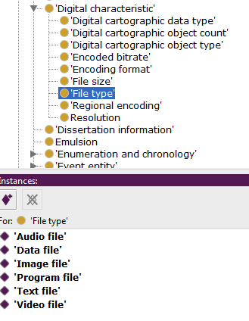
Vocabularies
why?
  to provide specific relationships not already in
  BIBFRAME
  to provide values for the objects of triples
Example:
  bf:FIleType
    no subclasses/individuals in BIBFRAME
    want to add in:
Notes:
Meanwhile, we were also looking at vocabularies outside BIBFRAME. We needed more vocabulary to define specific relationships through properties and to provide values for the objects of triples. It is all very well to say that a work has a file type, but we want to know what that file type is. As individual members of the subclass “File type” these are known as “individuals” or “instances” of the class.

Slide 24
Addition of RDA vocabularies to:
  bf:AppliedMaterial
  bf:BaseMaterial
  bf:Carrier
  bf:Content
  bf:EncodingFormat
  bf:FileType
  bf:MusicFormat
  bf:MusicNotation
    bf:TactileNotation
    bf:GrooveCharacteristics
    bf:PlaybackChannels
    bf:PlaybackCharacteristic
    bf:RecordingMedium
    bf:RecordingMethod
    bf:TrackConfig
Notes:
To fill these out we brought in RDA vocabularies to serve as individual members of various bf:Class(es). For some classes, basically the same vocabulary was also modeled in id.loc.gov and it took some time to decide which to use. We have ended up choosing the RDA vocabularies since they cover all these classes, rather than a few, and because of their relative simplicity in modeling (the term list is just that—a list of terms) they are an easy application of reuse.

Slide 25
PMO Additions to bf:Carrier
Additional vocabulary for bf:Carrier
  :CdAudio
  :DAT
  :DvdAudio
  :EnhancedCDAudio
  :EpRecord
  :HybridSACD
  :LpVinyl
  :SACD
  :SeventyEight
  :FortyFive
Labels:
  CD audio
  DAT
  DVD audio
  Enhanced CD audio
  EP (Extended play)
  Hybrid SACD
  LP/Vinyl
  SACD
  78
  45
Note: In RDA, these would be used in addition to the RDA terms (Audio disc, Audiocassette)
Notes:
One interesting aspect of the RDA terms (and also id.loc.gov if we used them) and BIBFRAME is that all these vocabularies are expressed as individuals—individual members of a class. This heavy use of individuals is not completely usual in linked data modeling, which tends to emphasize subclassing, but it seems to have been brought about by the FRBR entity/attribute model itself, which has emphasized relationships between classes rather than subclassing to express relationships. I’ll talk some more about that this afternoon. The main point here is this vocabulary, expressed as individuals, cannot be subclassed. This came up as an issue with PMO in relation to vocabulary for bf:Carrier. RDA uses very general terms—for performed music, the most commonly used being audio disc and audiocassette. There are, however, as you all know, several kinds of audio disc and we would like to name them. But because the term “audio disc” is an individual we cannot subclass; we can only add more specific terms as other individuals of the bf:Carrier class, and use skos:broader and skos:narrower to define the relationship. Our ontology will suggest that in implementing the ontology these terms be used in addition to bf:AudioDisc in RDA cataloging. Please note that these terms are currently being reviewed by our communities and subject to change. It is surprisingly difficult to come with names for individual types of audio discs…

Slide 26
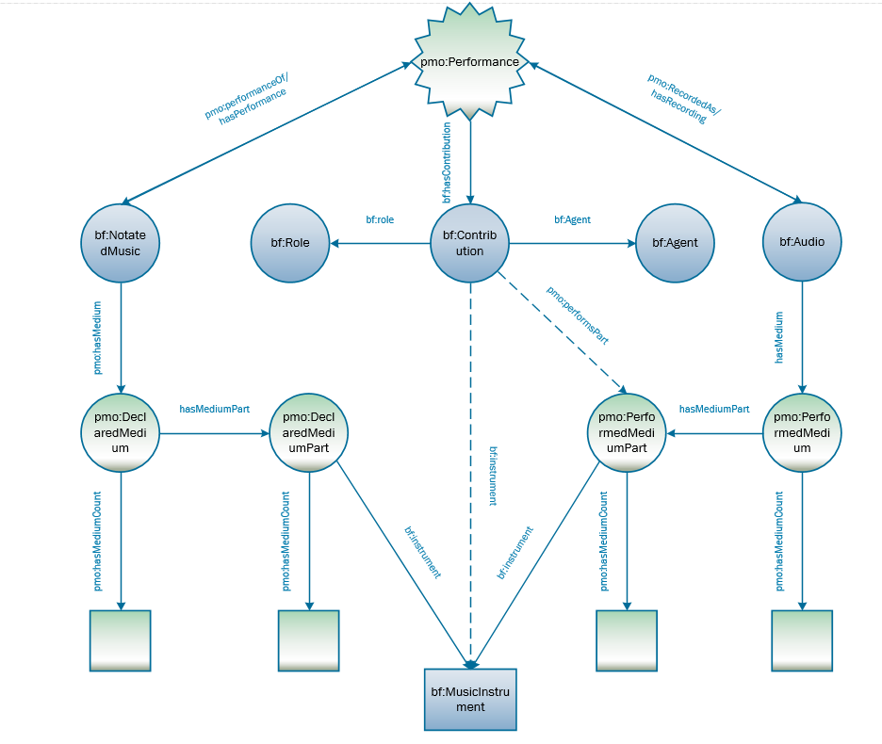
Declared Medium & Performed Medium
Notes:
Now we had got our feet wet with a bit of modeling and vocabulary development we turned back to that first web of relationships we drew, starting with medium of performance. Medium of performance has been a bit of a obsession in the music cataloging community over the last couple years with the introduction of the LC mop thesaurus for music and the ever more complex 382 field that holds it.
So this is our initial model for mop. On the one hand we have what we call DeclaredMedium (on your left), which is what the composer intended, and on the right PerformedMedium. These we have connected in what is still a rudimentary way to both an event (generally a performance) and to a performer. With this we are able to state that a performer plays a particular instrument at a particular performance and whether that was the intended instrument for that part. This certainly pertains closely to our use cases.
This is still an imperfect model—it doesn’t cover all our use cases as yet, particularly the modeling of cast—the roles of singers in an opera for instance, and what voices those roles are intended to be. We feel, however, that we have gone as far as we can without first modeling events, which are so closely intertwined with medium, and works. We are now working on rough models for both, the events model based on one developed by Doremus, a music ontology group in France. We hope these will serve until there is a more general consensus on how to deal with these in BIBFRAME.

Slide 27
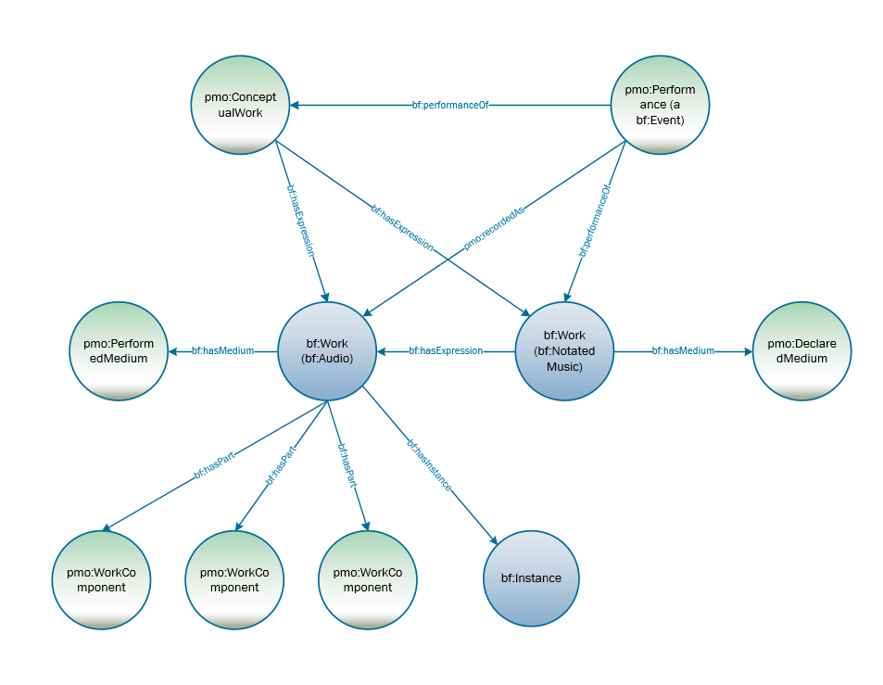
Multi-movement work
addition of
  pmo:ConceptualWork
  pmo:ComponentWork
  pmo:DeclaredMedium
  pmo:PerformedMedium
Notes:
We have also just lately turned to modeling works. One thing that BF does not have is the concept of a FRBR work or a FRBRoo complex work. Works are generally equivalent to the FRBR expression instead. This causes problems in modeling performed music; for every single recorded performance becomes a work and there is no way to connect them. And besides performances, there are also scores, arrangements, etc. While not all bibliographic materials need that FRBR work, music, particularly classical music does. We thus have added what we call a “Conceptual work”, a work that is basically equivalent to the FRBR work or the IFLA-LRM work. The graph here shows the relationships between the conceptual work, the audio and notated works, and the performance.
Another aspect that we have been looking at is the modeling of movements of works. Again, this is important, particularly in classical music, where most works have multiple movements. These movements might be performed in isolation of the whole but still be considered part of it. Because of this we brought in another subclass of work pmo:WorkComponent. These are “works” that are part of a greater work, but unlike with an aggregate work or compilation, they are always associated as part of that greater work even if performed in isolation.

Slide 28
Ontology extension summary
Extension work to BF2.0
  added classes, properties, vocabularies
Modeling:
  thematic catalog numbers
  opus numbers
  music key and mode
  declared medium & performed medium (medium of performance)
  multi-movement Works
Working on:
  Events
  Aggregate works/Compilations
  Sequencing
Notes:
So to some up our work since last June:

Slide 29
Danke schön!
Questions?

Slide 30
Pre-conversion enhancements
uris & added fields in authority & bibliographic records

Slide 31
User stories/Use cases--Examples
  Find works in a particular music key or melodic mode (Western & non-Western)
  Recording music takes and associating them with recording sessions
  sequencing of works or movements in a recording
  performances part of large musical or non-musical programmes (TV or radio shows, concerts, films, theatre)
  Inspirations for composition
  area or ethnic group origin/source
  medium of performance
  tempo
  awards/ratings
  all of this in relationship to a performer
Notes:
Use cases covered a wide variety of needs but there were some predominant themes. Many or our use cases centered around the relationships of works to other works, to events, to performers, and to the instruments used in all of these. Others refined those relationships by defining geographical place, ethnic groups, musical keys and modes, tempo. Finally, sequencing, the ordering of interior parts of a work also came through as important.

Slide 32
Medium of performance
Notated work
Performance
Performer
“Conceptual” work
Geography
Performed music recording
Notes:
Leaving aside the more detailed aspects, such as tempo, our use cases suggest needs for our ontology to express a whole web of complex interrelationships—the recording to a notated work, to a performer, to a medium of performance, to geographic regions or locations, and even, dare I say, that element missing in BIBFRAME, the FRBR work… More about that later.
As a group of experienced catalogers and metadata librarians, though fairly neophyte ontologists, you can imagine that we found the prospect of modeling all this fairly daunting. We spent the better part of our second day together, playing with aspects of this, and came up with some preliminary diagrams, that more state the issues, rather than offer resolutions. We then decided that since much of this modeling overlapped with other groups, particularly the core ontology group, we would turn to smaller, better defined issues first, such as filling out classes already present in BIBFRAME.

