Slide 1

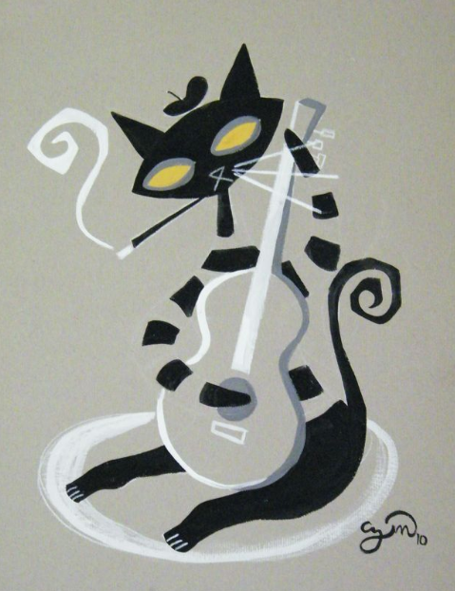
Linked Data for Performed Music
Linked Data for Production
a performed music ontology extension to bibframe 2.0
kevin kishimoto
nancy Lorimer
MLA Orlando 2017
Notes:
Linked Data for Performed Music is a sub-project of Linked Data for Production, a Mellon-funded grant led by Stanford University Libraries in collaboration with 5 other research libraries: Columbia, Cornell, Harvard, Princeton, and the Library of Congress. While the overall focus of the grant is to lay the groundwork for moving technical services workflow into a linked data environment, a number of the subprojects concentrate on ontology development for specific domains. Metadata people at Stanford have a long running interest and connection with music metadata—both Philip Schreur, our head of Technical and Access Services and I were once music catalogers, and our director in his early days was a music librarian. We also have a separate technical service unit for music, now ably led by Kevin Kishimoto, a separate music library and sound archive, and other staff in our digital library program also have strong music backgrounds. For us, looking at the issues of performed music as linked data was an obvious thing to explore.

Slide 2
Project description
Develop a BIBFRAME-based ontology for performed music in all formats
  Domain-specific enhancements and/or extensions of BIBFRAME for use by the library community as a common standard
  Establish a model by which these standards can be created, endorsed, and maintained by the community
Do this through partnering with domain communities and the PCC
Notes:
The primary goal of our project is develop a performed music extension to BIBFRAME, covering description of recorded sound from wire recordings to streamed audio to music video. Using BIBFRAME as a core ontology, we will recommend domain-specific vocabularies, enhancements and/or extensions to BIBFRAME for use by the library community as the initial basis for a common standard. As we do this, we hope to establish a model whereby similar standards can be created, endorsed, and most importantly maintained by the library community. Clearly, the ontology will change and develop over time, but we hope to create here a strong base for development.
Because we are emphasizing a particular domain, community is of paramount importance to this project. We can develop a beautiful ontology, but it is of no use if it is not acceptable to the domain-community who might use it. And of course, all the domain experts are to be found primarily in that same community and it would be detrimental to not make use of that expertise. Stanford has thus been partnering with domain communities—the Music Library Association and the Association of Recorded Sound Collections, as well as keeping Program for Cooperative Cataloging (PCC) in the loop.

Slide 3
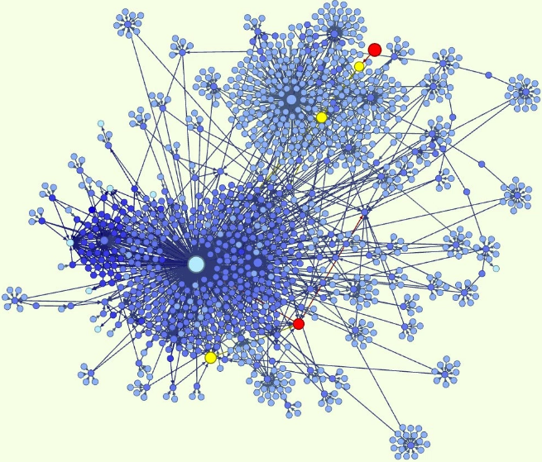
Why ontologies?
“An ontology is a formal naming and definition of the types, properties, and interrelationships of the entities that really or fundamentally exist for a particular domain of discourse. It is thus a practical application of philosophical ontology, with a taxonomy.”*
  note this is an intellectual as well as a structural framework
*Wikipedia, viewed January 2, 2017
Notes:
Before we embark on how we’ve doing in this wild adventure, let’s take a step back and think about why we are doing this. What are ontologies anyway and why do we need them? An ontology is “…a formal naming and definition of the types, properties, and interrelationships of the entities that really or fundamentally exist for a particular domain of discourse. It is thus a practical application of philosophical ontology, with a taxonomy.”
While this is a Wikipedia definition, it does sum things up nicely. An ontology is where you name & define the entities contained in your domain and the relationships among them. As a practical application of philosophical ontology, creating an ontology is an intellectual endeavor, with choices based on structural and practical knowledge of the domain being modeled. A linked data ontology is built on RDF & its basic data model RDFS or OWL, the Web Ontology language, but these can only express very basic relationships—this is a subclass of this; this entity is related to this entity—highly abstracted relationships. An ontology brings in the specific vocabularies and relationships that define your domain, providing structure and vocabulary (or taxonomy as Wikipedia puts it).

Slide 4

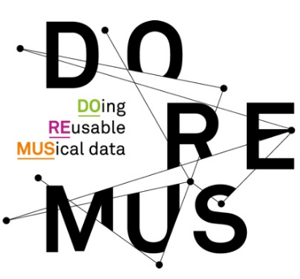


Why BIBFRAME?
Other ontologies:
  RDA registry (http://www.rdaregistry.info)
  Music Ontology (http://musicontology.com)
  DOREMUS (http://www.doremus.org)
BIBFRAME is:
  for all types of library materials, not just sound recordings
  compatible with a variety of cataloging content standards (or no standard)
  customizable, while still providing a common framework
Notes:
And so why use BIBFRAME? The usual context of this question is in reference to RDA—if we are using the RDA cataloging standard, why not use the RDA ontology? That is a perfectly reasonable question. There are also already some other music ontologies already available—the Music Ontology has been around several years and is even based on FRBR; lately the Bibliotheque National de France, Radio France, and the Philharmonie Francaise have been developing Doremus, based on FRBRoo and CIDOC-CRM. Why aren’t we using them?
In our modeling, we are hoping to create an ontology that works with multiple content standards or even with a lack of a content standard, but still be part of a shared cataloging environment. While we use RDA, others may not, and we want to be able to have easy interoperability despite these differences. So that is why we chose BIBFRAME over RDA. The other two ontologies have almost the opposite problem—being intended only for music materials they run the risk of not being compatible with or at least too separate from modeling for all our other resources in libraries—we want them all to interact. There are also requirements for performed music that overlap with other formats, and we would like our modelling to be able to be useful for those formats as well as just music.
So in sum, we are using BIBFRAME because it is for all types of library materials, not just sound recordings; it is compatible with a variety of cataloging content standards, including no standard, and it is customizable while still providing a common framework.

Slide 5
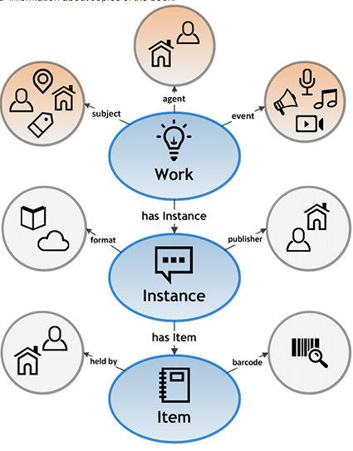
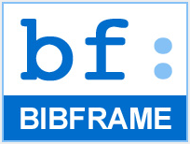
BIBFRAME 2.0
A very quick introduction…
Notes:
So, a short introduction to Bibframe for those of you unfamiliar with it. The United States Library of Congress initiated the development of BibFrame as a replacement for the MARC format. BibFrame is designed to enable the discovery of bibliographic information on the web and in the broader networked world. It utilizes Resource Description Framework (RDF), a data model consisting of statements expressed in triples. In RDF, every entity (such as author, subject, place, etc.) will have a corresponding unique identifier, or URI.
BIBFRAME is loosely based on the (Functional Requirements of Bibliographic Records) or FRBR model and is centered on three primary entities—Works, Instances, and Items. Other entities are defined in relation to one of those entities. Works are basically equivalent to the FRBR expression, whilst Instances are equivalent to the FRBR manifestation. There is no equivalent to the FRBR Work in the BIBFRAME conceptual model, but as we will see later it still can be expressed.
BIBFRAME is intended as a lightweight framework, not a fully developed ontology. To use BIBFRAME, the framework requires the “filling out” of vocabularies and relationships, either drawing on other ontologies or developing new subclasses or vocabularies within in BIBFRAME. This is what we are doing in the Performed Music Ontology project.

Slide 6
New classes/subclasses/properties
Subclass of bf:Title
  pmo:AnnouncedTitle
  pmo:CommonlyKnownTitle
  pmo:ContainerSpineTitle
  pmo:CreditsTitle
  pmo:DevisedTitle
  pmo:EmbeddedMetadataTitle
  pmo:MediaSurfaceTitle
  pmo:MenuTitle
  pmo:ReferenceSourceTitle
  pmo:TitleScreenTitle
Subclass of bf:Identifier
  bf:AudioTake
  bf:Gtin14Number
  bf:MusicAvDistributorIdentifier
  bf:VideoGamePlatformIdentifer
Other classes/properties
  pmo:MusicRecordingLabel
  pmo:Tempo
  pmo:DiscCuttingType
  pmo:TapeConfiguration
  pmo:phonogramCopyrightDate
Working on classes & properties for:
    medium of performance
    events
    works
Notes:
The first step we took was to look through the ontology and add new classes, subclasses and/or properties required for cataloging performed music that were missing. For example, since the cataloging of sound recordings in RDA requires that the cataloger always specify the source of every title that is recorded, we added several subclasses of bf:Title to make these integral to the ontology rather than relying on notes. We also added 4 new subclasses to bf:Identifier: :AudioTake, :Gtin14Number (a number used by the publishing industry in describing packaging), :MusicAvDistributorIdentifier (recently defined in the MARC21 format), and :VideoGamePlatformIdentifier. This last may seem a little out of scope, but we do have an avid video game cataloger as part of our group, and it is true that most video games do include music.
These were very simple extensions to BIBFRAME, following a pattern already present. And while they initially were part of the performed music extension they have since been incorporated into LC’s core BIBFRAME ontology, which is why I list them in the bf: namespace.
Besides the classes listed, we are also currently working on classes and properties for medium of performance, events, and works. More about some of that later.
We also added a few other classes—sound recording label (so we can differentiate it from a publisher or distributor), tempo, disc cutting type and tape configuration for our sound archivists, and one new property—phonogram copyright date, the copyright date for a performance. More are coming, as our community is coming forward with further areas they would like to have expanded.

Slide 7
Thematic Catalog Numbers, Opus Numbers
Current BIBFRAME properties
bf:musicThematicNumber
  literal
bf:musicOpusNumber
  literal
Notes:
As we worked through the current and new list of Bibframe Identifiers, the Performed Music Ontology group felt that two very important types of music numbers would benefit by being included in the bf:Identifier class: Thematic catalog numbers, which are numbers assigned in catalogs of composers’ works, and opus numbers, work numbers assigned either by composers or publishers. In a domain where titles are often generic (Sonata, Concerto, Symphony) and composers might compose hundreds of works in a lifetime (Vivaldi wrote 120 violin concertos and even 39 bassoon concertos), these are very important for identifying works and distinguishing one from another.
In the current version of Bibframe, thematic catalog numbers and opus numbers are actually present, but both are literals, or strings, and are represented by the properties bf:musicThematicNumber and bf:musicOpusNumber. They are considered only in their relationship to the work title string. This is limiting; nothing further can be stated about the number.

Slide 8
Thematic Catalog Numbers, Opus Numbers
Performed Music Ontology subclasses
bf:Identifier
  pmo:ThematicCatalogStatement
    pmo:ThematicCatalogPrefix
    pmo:ThematicCatalogNumber
    pmo:ThematicCatalogNumberPart
  pmo:OpusNumberStatement
    pmo:OpusNumberPrefix
    pmo:OpusNumber
    pmo:OpusNumberPart
pmo:hasSource
Notes:
The Performed Music Ontology group decided this was not adequate for music users—thematic catalog numbers make sense in the context of their catalogs, and it seemed reasonable to provide the source for the number, especially since some composers might have multiple catalogs. And even something seemingly simple as an opus number sometimes needs a source and perhaps even a date—numbers get changed by publishers or by the composers themselves.
To allow for this the Performed Music Ontology has created two additional new subclasses of bf:Identifer: pmo:ThematicCatalogStatement and pmo:OpusNumberStatement. This involved our first real experience in modeling, since they are multifaceted identifiers. Both follow the same modeling, so we’ll just look at pmo:ThematicCatalogStatement.
The thematic catalog number can be expressed as an rdf:value (such as the string “BWV 1000”) and/or it may be split into three other classes pmo:ThematicCatalogPrefix, pmo:ThematicCatalogNumber, and pmo:ThematicCatalogPart. They are linked to pmo:ThematicCatalogStatement by the predicate pmo:composedOf.
By splitting the prefix from the number, the numeral can be discovered on its own without the entire string being correct.

Slide 9
Thematic Catalog Numbers, Opus Numbers
Performed Music Ontology subclasses
bf:Identifier
  pmo:ThematicCatalogStatement
    pmo:ThematicCatalogPrefix
    pmo:ThematicCatalogNumber
    pmo:ThematicCatalogNumberPart
  pmo:OpusNumberStatement
    pmo:OpusNumberPrefix
    pmo:OpusNumber
    pmo:OpusNumberPart
pmo:hasSource
BWV 1000 = S. 1000
“K.” = “KV” = “Köchel”
Notes:
One can also imagine a linked data discovery tool that would understand BWV numbers could also sometimes be searched with the abbreviation “S.” Or that the designations “K.” and “KV” and “Köchel” (spelled-out) all refer to the Mozart thematic catalog.
Now, this won’t happen automatically--someone will have to put in the work and create the vocabulary. But this model allows for these capabilities in the future.
Besides improved discovery, another huge benefit in making these subclasses is that the thematic catalog statement may now be linked to a source. Thus BWV 1000 can be linked directly to the Bach Werke Verzeichnis, even to a particular edition. Users (and librarians) who come across an obscure or unfamiliar catalog number could more easily solve THIS type of problem: “It says ‘S. 1000’, but I don’t know what ‘S.’ means.”

Slide 10
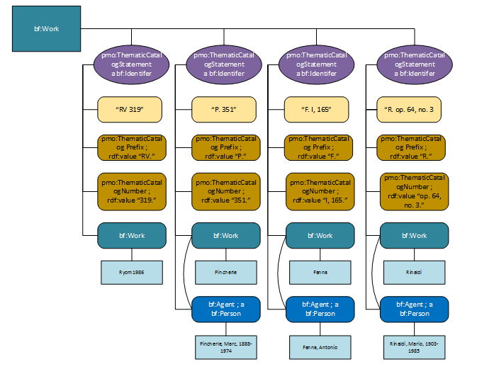
Notes:
Here’s an example showing a fairly complex situation. In this case we have a single work by Vivaldi, but there are four different thematic catalogs and each assigns its own thematic catalog number to this work. In the Performed Music Ontology these numbers all can be modeled and related to one another, and the single Vivaldi work they identify.
We are able to code these different thematic catalog numbers in our current MARC systems, but MARC forces us to choose only ONE as the preferred number, and user access to the variant numbers is often difficult, if possible at all.

Slide 11
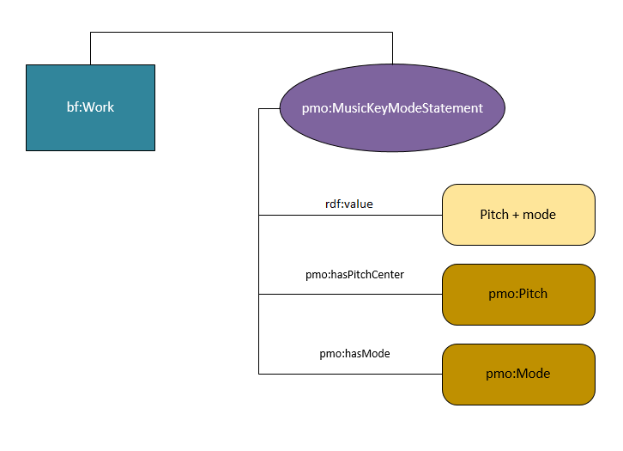
pmo:MusicKeyModeStatement
and for music keys…
music pitch & mode are separated
[work_1] a bf:Work ;
pmo:MusicKeyModeStatement [
rdf:value “F major” ;
pmo:hasPitchCenter [
a pmo:Pitch ;
rdf:value “F” ;
] ;
pmo:hasMode [
a pmo:Mode ;
rdf:value “major” ;
] ;
] .
Notes:
One other piece of lightweight modeling was for musical key and mode. Again, as with the thematic catalog number, this is currently only represented in BIBFRAME as a literal. The Performed Music Ontology group wanted to achieve several things here: make key/mode a resource rather than a literal; bring in some flexibility to allow for only-pitch-center or only-mode to be recorded; and allow the class to accommodate musical modes from various systems in use around the world, not just Western music.
To achieve this, we separate pitch and mode with a model very similar to thematic catalog numbers. One has the option of only entering a string for the pmo:MusicKeyModeStatement (but here still a value, and therefore a resource) or to subdivide into pmo:Pitch and pmo:Mode.
This class can easily accommodate “F major” or “C minor”, but also an Arabic maqam or Indian raga.

Slide 12
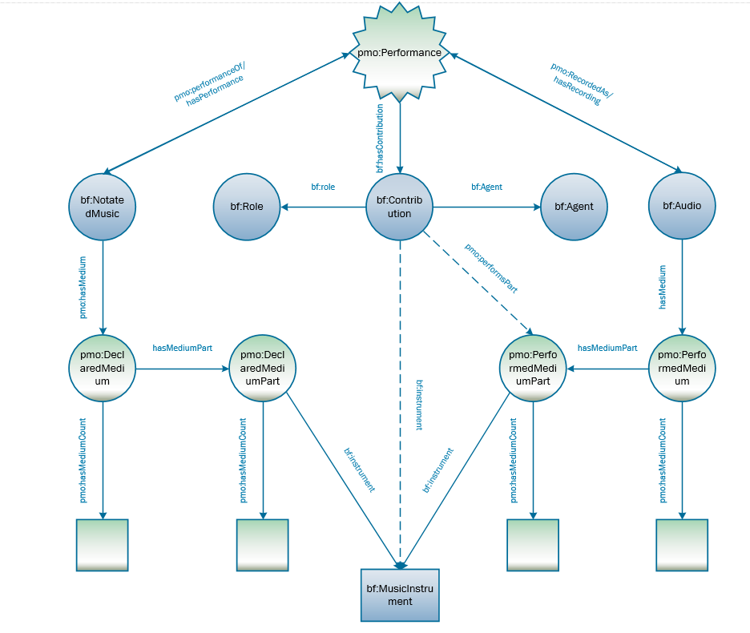
Medium of performance
addition of
  pmo:DeclaredMedium
  pmo:PerformedMedium
  pmo:DeclaredMediumPart
  pmo:PerformedMediumPart
  pmo:hasMedium
  pmo:hasMediumCount
  pmo;performsPart
Notes:
After getting our feet wet with the simpler modeling, we turned back to some more difficult concepts, starting with medium of performance. Medium of performance has been a bit of an obsession in the music cataloging community over the last couple years with the introduction of the Library of Congress medium of performance thesaurus for music and the ever more complex MARC 382 field that holds it.
So this is our initial model for medium of performance. On the one hand we have what we call pmo:DeclaredMedium (on the left), which is the prescribed medium—like, for which instruments the composer originally wrote the piece. On the right the pmo:PerformedMedium, the medium used in the actual realization of the work—the performance. These we have connected in what is still a rudimentary way to both an event (generally a performance) and to a performer. With this we are able to state that a performer plays a particular instrument at a particular performance and whether that was the intended instrument for that part. This certainly pertains closely to our use cases.
This is still an imperfect model—it doesn’t cover all our use cases as yet, particularly the modeling of cast—the roles of singers in an opera for instance, and what voices those roles are intended to be. We feel, however, that we have gone as far as we can without first modeling events and works. We are now working on rough models for both, the events model based on one developed by Doremus, a music ontology group in France. We hope these will serve until there is a more general consensus on how to deal with these in BIBFRAME.

Slide 13
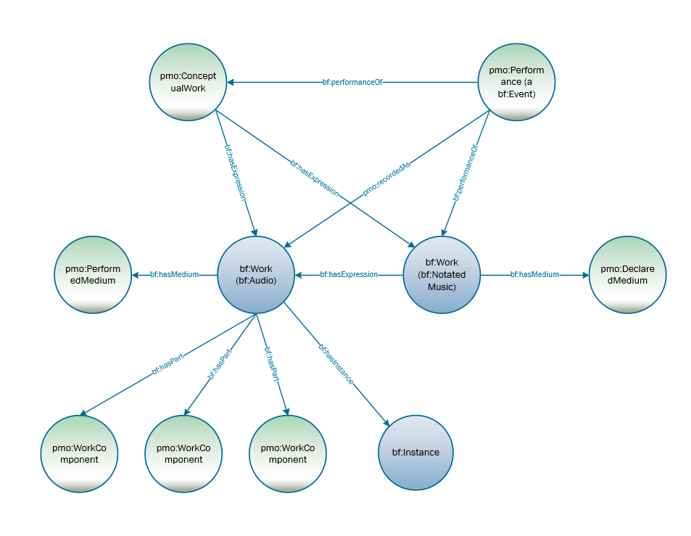
Multi-movement work
addition of
  pmo:ConceptualWork
  pmo:ComponentWork
  pmo:recordedAs
  pmo:performanceOf
Notes:
We have also recently turned our attention to modeling works. One thing that BF does not have is a specific concept of a FRBR work or a FRBRoo complex work, that is, the work in its conceptual abstract form. BIBFRAME works are generally equivalent to the FRBR expression instead.
This causes problems in modeling performed music. Every single recorded performance becomes a work and there is no direct way to connect recordings of the same written music. And besides performances, there are also scores, arrangements, etc. While not all bibliographic materials need that FRBR work, music, particularly classical music, does. We thus have added what we call a pmo:ConceptualWork, a work that is basically equivalent to the FRBR work or the IFLA-LRM work. The graph here shows the relationships between the conceptual work, the audio and notated works, and the performance.
Another aspect that we have been looking at is the modeling of movements within works. Again, this is important, particularly in classical music, where many works have multiple movements. These movements might be performed in isolation of the whole, but still be considered part of it. Because of this we brought in another subclass of work pmo:WorkComponent. These are “works” that are part of a greater work, but unlike with an aggregate work or compilation, they are always associated as part of that greater work even if performed in isolation.

Slide 14
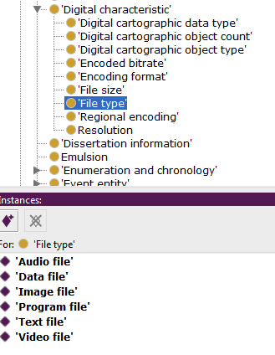
Vocabularies
why?
  to provide specific relationships not already in
  BIBFRAME
  to provide values for the objects of triples
Example:
  bf:FileType
    no subclasses/individuals in BIBFRAME
    want to add in:
Notes:
Meanwhile, we were also looking at vocabularies outside BIBFRAME. We needed more vocabulary to define specific relationships through properties and to provide values for the objects of triples. It is all very well to say that a work has a file type, but we want to know what that file type is. As individual members of the subclass “File type” these are known as “individuals” or “instances” of the class.

Slide 15
Addition of vocabularies to:
  RDA vocabularies:
    bf:AppliedMaterial
    bf:BaseMaterial
    bf:Carrier
    bf:Content
    bf:EncodingFormat
    bf:FileType
    bf:MusicFormat
    bf:MusicNotation
      bf:TactileNotation
      bf:GrooveCharacteristics
      bf:PlaybackChannels
      bf:PlaybackCharacteristic
  RDA unconstrained properties
    work relationship properties
  id.loc.gov vocabularies
    bf:Role
      bf:RecordingMedium
      bf:RecordingMethod
      bf:TrackConfig
      bf:TactileNotation
      bf:GrooveCharacteristics
      bf:PlaybackChannels
      bf:PlaybackCharacteristic
      bf:RecordingMedium
      bf:RecordingMethod
      bf:TrackConfig
Notes:
To fill these out we brought in RDA vocabularies to serve as individual members of various bf:Class(es). For some classes, basically the same vocabulary was also modeled in id.loc.gov and it took some time to decide which to use. We have ended up choosing the RDA vocabularies since they cover all these classes, rather than a few, and because of their relative simplicity in modeling (the term list is just that—a list of terms) they are an easy application of reuse. We have, however, chosen to use the MARC relators as found in id.loc.gov rather than RDA properties for roles. Roles are highly interconnected with other aspects of performance, and we need the role as a class so these can be all brought together.

Slide 16
PMO Additions to bf:Carrier
Additional vocabulary for bf:Carrier
  :CdAudio
  :DAT
  :DvdAudio
  :EnhancedCDAudio
  :EpRecord
  :HybridSACD
  :LpVinyl
  :SACD
  :Shellac78
  :Single45
Labels:
  CD audio
  DAT
  DVD audio
  Enhanced CD audio
  EP (Extended play)
  Hybrid SACD
  LP/Vinyl
  SACD
  78/Shellac
  45/Single
Note: In RDA, these would be used in addition to the RDA terms (Audio disc, Audiocassette)
Notes:
One interesting aspect of the RDA terms (and also id.loc.gov if we used them) and BIBFRAME is that all these vocabularies are expressed as individuals—individual members of a class. This heavy use of individuals is not completely usual in linked data modeling, which tends to emphasize subclassing, but it seems to have been brought about by the FRBR entity/attribute model itself, which has emphasized relationships between classes rather than subclassing to express relationships. The main point here is this vocabulary, expressed as individuals, cannot be subclassed. This came up as an issue with PMO in relation to vocabulary for bf:Carrier. RDA uses very general terms—for performed music, the most commonly used being audio disc and audiocassette. There are, however, as you all know, several kinds of audio disc and we would like to name them. But because the term “audio disc” is an individual we cannot subclass; we can only add more specific terms as other individuals of the bf:Carrier class, and use skos:broader and skos:narrower to define the relationship. Our ontology will suggest that in implementing the ontology these terms be used in addition to bf:AudioDisc in RDA cataloging. Please note that these terms are currently being reviewed by our communities and subject to change. It is surprisingly difficult to come with names for individual types of audio discs…

Slide 17
Ontology extension summary
Extension work to BF2.0
  added classes, properties, vocabularies
Modeling:
  thematic catalog numbers
  opus numbers
  music key and mode
  declared medium & performed medium (medium of performance)
  multi-movement Works
Working on:
  Events
  Aggregate works/Compilations
  Sequencing
Notes:
So to sum up our work since last June:
We are extending BIBFRAME 2.0 to better accommodate performed music by adding classes, properties, and vocabularies to the current BIBFRAME model. We are also creating a separate Performed Music Ontology to be used as an extension to BIBFRAME. In this ontology we are modeling music-specific information: thematic catalog numbers, opus numbers, music keys and modes, medium of performance, and multi-movement works. Finally, we are working on models for events, aggregate works, and sequencing, perhaps to help inform the development of BIBFRAME not only for music, but for the general library community.

