Slide 1

Linked Data for Performed Music
an extension to BIBFRAME 2.0 for production & archival cataloging of sound recordings & music videos
Nancy Lorimer
Stanford University
ALA Midwinter 2017
Notes:
Linked Data for Performed Music is one of several domain subprojects part of the Linked Data for Production grant, and one of two being led by Stanford University (the other being for overall technical services workflow). Metadata people at Stanford have a long running interest and connection with music metadata—many have a background in music cataloging, librarianship, or musicology. For us, looking at the working with the description of performed music as linked data was an obvious thing to explore.

Slide 2
Project description
Develop a BIBFRAME-based ontology for performed music in all formats
  Domain-specific enhancements and/or extensions of BIBFRAME for use by the library community as a common standard
  Establish a model by which these standards can be created, endorsed, and maintained by the community
Do this through partnering with domain communities and the PCC
Notes:
The primary goal our project is develop a performed music extension to BIBFRAME, covering description of recorded sound from wire recordings to streamed audio to music video. Using BIBFRAME as a core ontology, we will recommend domain-specific vocabularies, enhancements and/or extensions to BIBFRAME for use by the library community as the initial basis for a common standard. As we do this, we hope to establish a model whereby similar standards can be created, endorsed, and most importantly maintained by the library community. Clearly, the ontology will change and develop over time
Because we are emphasizing a particular domain, community is of paramount importance to this project. We can develop a beautiful ontology, but it is of no use if it is not acceptable to the domain-community who may use it. And of course, all the domain experts are to be found primarily in that same community and it would be detrimental to not make use of that expertise. Stanford is thus partnering with domain communities—the Music Library Association and the Association of Recorded Sound Collections, as well as keeping PCC in the loop.

Slide 3
User stories/Use cases--Examples
  Find works in a particular music key or melodic mode (Western & non-Western)
  Recording music takes and associating them with recording sessions
  sequencing of works or movements in a recording
  performances part of large musical or non-musical programmes (TV or radio shows, concerts, films, theatre)
  awards/ratings
  Inspirations for composition
  any possible relationship to a performer
  area or ethnic group origin/source
  medium of performance
  tempo
Notes:
Use cases covered a wide variety of needs but there were some predominant themes. Many or our use cases centered around the relationships of works to other works, to events, to performers, and to the instruments used in all of these. Others refined those relationships by defining geographical place, ethnic groups, musical keys and modes, tempo. Finally, sequencing, the ordering of interior parts of a work also came through as important.

Slide 4
Medium of performance
Notated work
Performance
Performer
“FRBR” work
Geography
Performed music recording
Notes:
Leaving aside the more detailed aspects, such as tempo, our use cases suggest needs for our ontology to express a whole web of complex interrelationships—the recording to a notated work, to a performer, to a medium of performance, to geographic regions or locations, and even, dare I say, that element missing in BIBFRAME, the FRBR work… More about that later.
As a group of experienced catalogers and metadata librarians, though fairly neophyte ontologists, you can imagine that we found the prospect of modeling all this fairly daunting. We spent the better part of our second day together, playing with aspects of this, and came up with some preliminary diagrams, that more state the issues, rather than offer resolutions. We then decided that since much of this modeling overlapped with other groups, particularly the core ontology group, we would turn to smaller, better defined issues first, such as filling out classes already present in BIBFRAME.

Slide 5
New classes/subclasses
Subclass of bf:Title
  pmo:AnnouncedTitle
  pmo:CommonlyKnownTitle
  pmo:ContainerSpineTitle
  pmo:CreditsTitle
  pmo:DevisedTitle
  pmo:EmbeddedMetadataTitle
  pmo:MediaSurfaceTitle
  pmo:MenuTitle
  pmo:ReferenceSourceTitle
  pmo:TitleScreenTitle
Subclass of bf:Identifier
  bf:AudioTakeIdentifier
  bf:Gtin14Number
  bf:MusicDistributorIdentifier
  bf:VideoGamePlatformIdentifer
  pmo:ThematicCatalogNumber*
  pmo:OpusNumber*
Subclass of bf:Publisher
  pmo:MusicRecordingLabel
Notes:
The first and seeming most obvious thing to add were subclasses for bf:Title. Cataloging sound recordings in RDA requires that the cataloger always specify the source of every title that is recorded, and there was already the suggestion to add these as subclasses of bf:TitleVariant in the LC position paper on Titles. While seemingly simple (along with pleasant wrangling over names), a couple questions rose immediately, the primary one being that these could not be subclasses of bf:TitleVariant. Since any of these title subclasses could be a preferred title for the instance (and in some cases the work), we instead made them direct subclasses of bf:Title.
Finally, we went through bf:Identifer. We changed some definitions to existing music identifiers and added 3 other music-related identifiers—the music av distributor number (recently defined in MARC), take numbers, and the Gtin-14 number, a number used by the publishing industry in describing packaging. As a bonus, and because we have a specialist in video game cataloging as part of our group, we added the identifier for Video game platforms. A little out of scope, but video games do indeed have music.
These were simple extensions to BIBFRAME, and our most successful to date—if not already, they will very soon no longer be extension vocabulary, but will be part of LC’s core BIBFRAME ontology
We also added a few other random classes—sound recording label, disc cutting type, tape configuration and tempo, and one new property—phonogram copyright date, the copyright date for a performance.

Slide 6
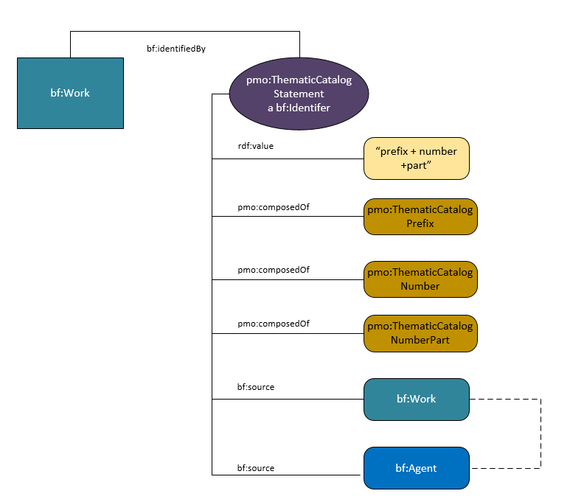
Thematic Catalog numbers, Opus Numbers, musical key/mode
Thematic catalog & opus number currently literals
pmo changes them to subclasses of bf:Identifier
  further divided into parts of the number for better discovery
Notes:
Besides the 4 new subclasses of bf:Identifier, derived from data properties already present in BF, the PMO group felt that two other very important music identifiers were missing from the bf:Identifier class—Thematic catalog numbers, which are numbers assigned in catalogs of composers’ works, and opus numbers, work numbers assigned either by the composer or a publisher. In a domain where titles are often generic (Symphony, Concerto) and composers might compose hundreds of works in a lifetime (Vivaldi wrote 120 violin concertos and 39 bassoon concertos), these can be very important for identifying works.
In BF, thematic catalog numbers and opus numbers are actually present, but both are literals or strings, and are represented only by the properties bf:musicThematicNumber and bf:musicOpusNumber. They are considered only in their relationship to the title string. this is limiting; nothing further can be stated about the number. The PMO group decided this was not adequate for music cataloging purposes—thematic catalog numbers make sense in the context of their catalogs, and it seemed reasonable to provide the source for the number, especiallyl since some composers might have multiple catalogs. And even something seemingly simple as an opus number sometimes needs a source and perhaps even a date—numbers get changed by publishers or by the composers themselves. To allow for this the PMO has created two additional new subclasses of bf:Identifer: ThematicCatalogStatement and OpusNumberStatement. This involved our first real experience in modeling, since they are multifaceted identifiers. Both follow the same modeling, so we’ll just look at pmo:ThematicCatalogStatement. The thematic catalog number can be expressed as an rdf:value (such as the string “BWV 465” and/or it may be split into three other classes pmo:ThematicCatalogPrefix, pmo:ThematicCatalogNumber, and pmo:ThematicCatalogPart. The are linked to pmo:ThematicCatalogStatement by the predicate pmo:composedOf. By splitting the prefix from the number, the number can be discovered on its own without the string being correct.
Besides improved discovery, another huge benefit in making these subclasses is that the statement may now be linked to a source. Thus BWV 465 can be linked directly to the Bach Werk Verzeichnis, even to a particular edition.

Slide 7
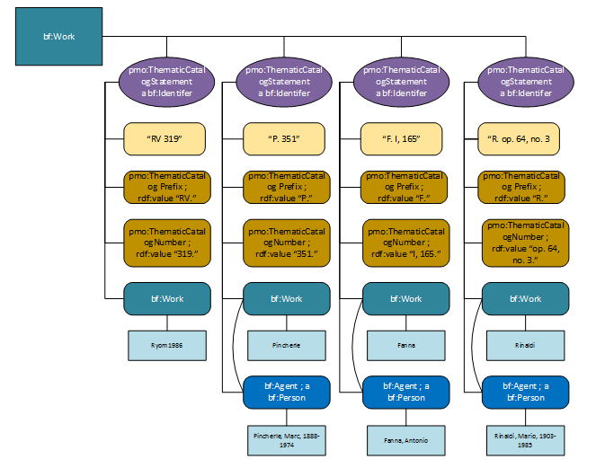
Notes:
Just to show the complexity possible. In this case we have a work by Vivaldi. There are 4 different possible thematic catalog numbers and all can be modeled…

Slide 8
Addition of RDA vocabularies to:
  bf:AppliedMaterial
  bf:BaseMaterial
  bf:Carrier
  bf:Content
  bf:EncodingFormat
  bf:FileType
  bf:MusicFormat
  bf:MusicNotation
    bf:TactileNotation
    bf:GrooveCharacteristics
    bf:PlaybackChannels
    bf:PlaybackCharacteristic
    bf:RecordingMedium
    bf:RecordingMethod
    bf:TrackConfig
Notes:
We also began to bring in RDA vocabularies to serve as individual members of various bf:Class(es). For some classes, basically the same vocabulary was also modeled in id.loc.gov and it took some time to decide which to use. We have ended up choosing the RDA vocabularies since they cover all these classes, rather than a few, and because of their relative simplicity in modeling (the term list is just that—a list of terms) they are an easy application of reuse.

Slide 9
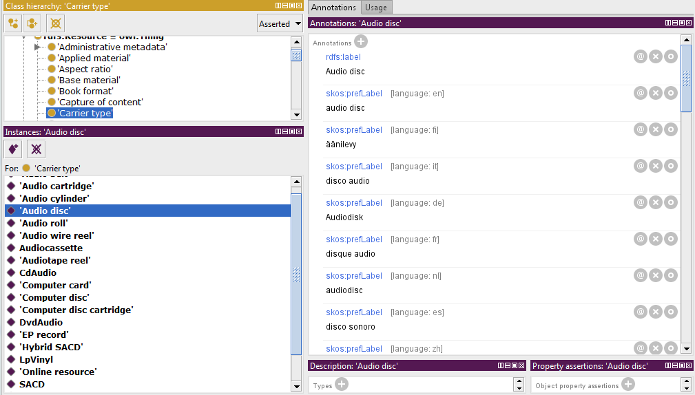
Notes:
An added bonus about these vocabularies (in this case the individuals for bf:Carrier type shown on the lower left), the vocabularies are multilingual as you can see by the labels on the right. We all liked this idea of providing multilingual vocabularies and perhaps it hits home especially since our next meeting of the Music Library Association, at which we are also presenting, is a Pan-American meeting, including people from Canada, Mexico, and the Carribean. Having those extra languages at a fairly international meeting will be a good thing!

Slide 10
PMO Additions to bf:Carrier
Additional vocabulary for bf:Carrier
  :CdAudio
  :DAT
  :DvdAudio
  :EnhancedCDAudio
  :EpRecord
  :HybridSACD
  :LpVinyl
  :SACD
  :Shellac78
  :Single45
Labels:
  CD audio
  DAT
  DVD audio
  Enhanced CD audio
  EP (Extended play)
  Hybrid SACD
  LP/Vinyl
  SACD
  78/Shellac
  45/Single
Note: In RDA, these would be used in addition to the RDA terms (Audio disc, Audiocassette)
Notes:
One frustrating aspect of the RDA terms (and also id.loc.gov if we used them) and BIBFRAME is that all these vocabularies are expressed as individuals—individual members of a class. This heavy use of individuals is not completely usual in linked data modeling, which tends to emphasize subclassing, but it seems to have been brought about by the FRBR entity/attribute model itself, which has emphasized relationships between classes rather than subclassing to express relationships. I’ll talk some more about that this afternoon. The main point here is this vocabulary, expressed as individuals, cannot be subclassed. This came up as an issue with PMO in relation to vocabulary for bf:Carrier. RDA uses very general terms—for performed music, the most commonly used being audio disc and audiocassette. There are, however, as you all know, several kinds of audio disc and we would like to name them. But because the term “audio disc” is an individual we cannot subclass; we can only add more specific terms as other individuals of the bf:Carrier class. Our ontology will suggest that in implementing the ontology these terms be used in addition to bf:AudioDisc in RDA cataloging. Please note that these terms are currently being reviewed by our communities and subject to change. It is surprisingly difficult to come with names for individual types of audio discs…

Slide 11
New named individuals
  pmo:DiscCutting
    :HillAndDale
    :LateralOrCombined
  pmo:KindOfRecording
    :Instantaneous
    :MasterTape
  bf:TapeConfig
    EightTrack
    HalfTrack
  bf:PlayingSpeed
    RPM78
    IPS3.75
Notes:
Finally, to our added classes, we needed to add our own individuals to fill out the vocabularies for the classes. As with the class itself, these terms came, surprisingly enough from the MARC formats—the 007 field, which for sound recordings contains a lot of technical data. This slide doesn’t contain an exhaustive list of terms—just examples..

Slide 12
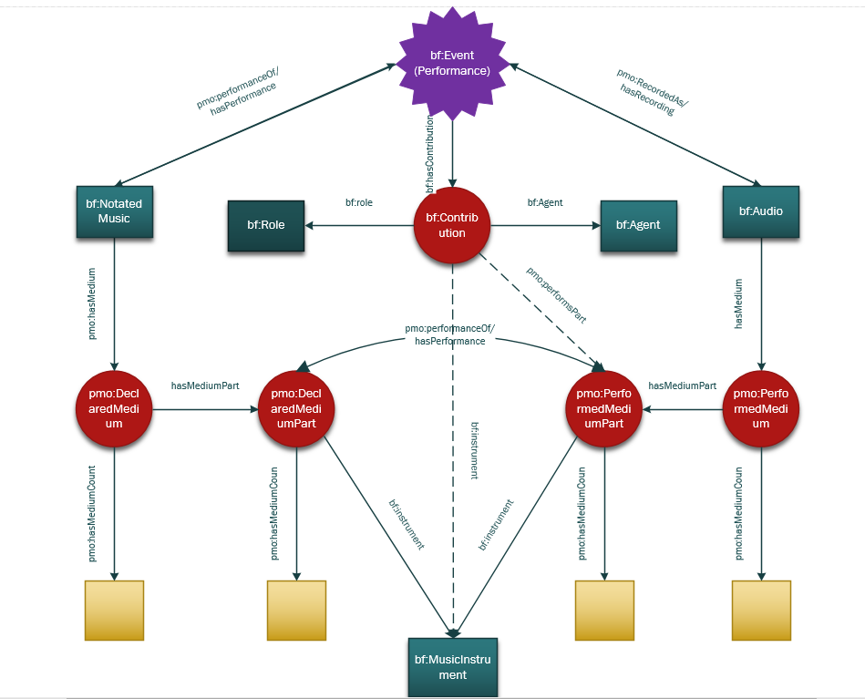
Instrumentation & Performed Medium
Example: Trio for 2 oboes or 2 flutes and bassoon; performed by 2 flutes (2 performers) and 1 bassoon (1 performer)
Notes:
Now we had got our feet wet with a bit of modeling and vocabulary development we turned back to that first web of relationships we drew, starting with medium of performance. Medium of performance has been a bit of a obsession in the music cataloging community over the last couple years with the introduction of the LC mop thesaurus for music and the ever more complex 382 field that holds it.
So this is our initial model for mop. On the one hand we have what we call DeclaredMedium (on your left), which is what the composer intended, and on the right PerformedMedium. These we have connected in what is still a rudimentary way to both an event (generally a performance) and to a performer. With this we are able to state that a performer plays a particular instrument at a particular performance and whether that was the intended instrument for that part. This certainly pertains closely to our use cases.
This is still an imperfect model—it doesn’t cover all our use cases as yet, particularly the modeling of cast—the roles of singers in an opera for instance, and what voices those roles are intended to be. We feel, however, that we have gone as far as we can without first modeling events, which are so closely intertwined with medium, and works. We are now working on rough models for both, the events model based on one developed by Doremus, a music ontology group in France. We hope these will serve until there is a more general consensus on how to deal with these in BIBFRAME.

Slide 13
Ontology extension summary
Extension work to BF2.0
  added classes, properties, vocabularies
Modeling:
  thematic catalog numbers
  opus numbers
  music key and mode
  declared medium & performed medium (medium of performance)
Working on:
  Events
  Aggregate works/Compilations/Multi-movement works
Notes:
So to some up our work since last June:

Slide 14
Further work
Finalize new vocabularies
Finalize instrumentation/performed medium & cast
Basic model for events in relation to Bibframe work
Basic model for compilations & multi-movement works
Examples
Final writeup on project

Slide 15
Participants
Kirk-Evan Billet (Peabody)
Chiat Naun Chew (Cornell)
Greta De Groat (Stanford)
Arcadia Falcone (Stanford)
Caitlin Hunter (LC)
Kevin Kishimoto (Stanford)
Nancy Lorimer (Stanford)
Jim Soe Nyun (UCSD)
Wendy Sistrunk (UMKC)
Hilary Thorsen (Stanford)
Valerie Weinberg (LC)
… and participants of the Music Library Association Linked Data Working Group (LuDWiG) and the ARSC Cataloging Committee!

Slide 16
Thank you!
Nancy Lorimer
nlorimer@stanford.edu

Slide 17
Other needs
extend vocabulary to accommodate RDA requirements & relationships not full modeled in BF
  relationships between works
  vocabularies for named individuals
extend vocabulary for general performed music requirements
  identifiers
  new subclasses, properties
  medium of performance
Notes:
There are some other requirements that were not addressed directly by our use cases—more probably than not they were taken for granted. First we needed to expand the vocabulary to accommodate RDA requirements that were not part of BF. This includes relationships between works, and various vocabularies. Second, we needed to extend the vocabulary generally beyond RDA if necessary for performed music requirements. Some of our vocabulary here comes from what might seem a surprising place—the 007 of the MARC format. We also needed to make sure all the music identifiers were present and model for medium of performance.

