Slide 1
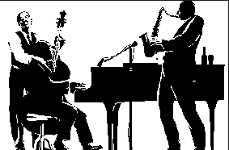
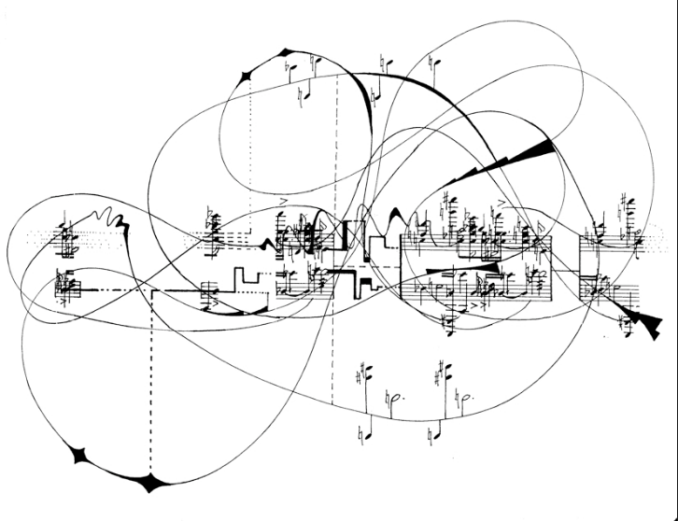
Linked Data for Performed Music: a LINKED DATA FOR PRODUCTION
PROJECT
Nancy Lorimer
Stanford University
ALA Annual 2016
Notes:
Linked Data for Performed Music is a sub-project of Linked Data for Production, a Mellon-funded grant led by Stanford University Libraries in collaboration with 5 other research libraries: Columbia, Cornell, Harvard, Princeton, and the Library of Congress. While the overall focus of the grant is to lay the groundwork for moving technical services workflow into a linked data environment, a number of the subprojects concentrate on ontology development for specific domains. Metadata people at Stanford have a long running interest and connection with music metadata—both Philip Schreur, our head of Technical and Access Services and I were once music catalogers, and our director in his early days was a music librarian. We also have a separate technical service unit for music, now led by Kevin Kishimoto, and other staff in our digital library program also have strong music backgrounds. For us, looking at the issues of performed music was an obvious thing to explore.

Slide 2
Background
Linked data seen as an opportunity for enhancing the description & discovery of music resources in the library and other domains
  Improved expression and machine-processing of relationships found in sound recordings
  Moving away from restrictions of the flat file format of MARC
Possibility of the community being involved in modelling from the beginning
Ability to link out to the already rich linked data for performed music on the web
Notes:
As music catalogers or former catalogers, we were well aware of the restraints placed on access to music resources imposed by the MARC format and by a flat database structure in general, as well as working in an environment that was initially modeled around books. Sound recording resources contain a complex of associations—between the resources and often multiple works; between performers and those individual works; between works and multiple expressions of those works; and between works and other works. Many of these relationships can only be expressed through notes in MARC; to understand the relationships, reading of the entire record is required.
Linked data, including BIBFRAME, provides a major opportunity for advancing the description of performed music resources. The rich complex of associations in and among sound recording resources can be expressed through machine-linking of the data elements, and made available for further enhancement as linked open data on the Web. Without the restrictions imposed by the MARC format, more subtle relationships amongst performed music instances, the interrelationships of musical groups and musicians, the relationships between works, all can potentially be better expressed in linked open data. The caveat of course, is that the data be modeled in such a way that we can express those relationships.

Slide 3

Building blocks for ld4PM
Linked Data for Production planning grant
Music Library Association BIBFRAME task force report
LC A-V Modeling Study
BIBFRAME A-V Assessment: Technical, Structural, and Administrative Metadata
Notes:
Music-domain related work already completed has built a strong base for us to build a performed music ontology. The Music Library Association BIBFRAME task force report set an exemplary model for critiquing and commenting on the BIBFRAME model as it then appeared, with suggestions for further work. The LC A-V modeling study provided in depth modeling of events and works that have fed into BIBFRAME 2.0 and our thinking about modeling of performed music. There is also the BIBFRAME A-V assessment, which talks about technical metadata in the a-v world, including music. With the backing of the larger grant, we seemed to be in a good position to begin a formal ontology development.

Slide 4
PROJECT DESCRIPTION
Develop a BIBFRAME-based ontology for performed music in all formats
  Domain-specific enhancements and/or extensions of BIBFRAME for use by the library community as a common standard
  Establish a model by which these standards can be created, endorsed, and maintained by the community
Do this through partnering with domain communities and the PCC
Notes:
So the project itself. Basically our project is develop a BIBFRAME-based ontology for performed music in all formats, from wire recording to streamed audio. Using BIBFRAME as a core ontology, we will recommend domain-specific vocabularies, enhancements and/or extensions to BIBFRAME for use by the library community as the basis for a common standard. As we do this, we hope to establish a model whereby similar standards can be created, endorsed, and most importantly maintained by the library community.
Because we are emphasizing a particular domain, community is of paramount importance to this project. We can develop a beautiful ontology, but it is of no use if it is not acceptable to the domain-community who may use it. And of course, all the domain experts are to be found primarily in that same community and it would be detrimental to not make use of that expertise. Stanford is thus partnering with domain communities.

Slide 5
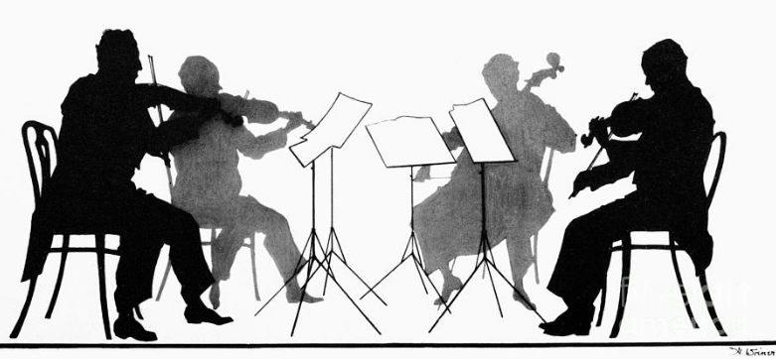
pARTNERS
Stanford University Libraries (SUL)
Music Library Association (MLA)
Association for Recorded Sound Collections (ARSC)
Library of Congress (LC)
Program for Cooperative Cataloging (PCC)
Notes:
These communities are:

Slide 6
members
Kirk-Evan Billet (Peabody)
Chiat Naun Chew (Cornell)
Greta De Groat (Stanford)
Arcadia Falcone (Stanford)
Caitlin Hunter (LC)
Kevin Kishimoto (Stanford)
Nancy Lorimer (Stanford)
Wendy Sistrunk (UMKC)
Jim Soe Nyun (UCSD)
Hilary Thorsen (Stanford)
Valerie Weinberg (LC)
… and participants of the Music Library Association and Association for Recorded Sound Archives!
Notes:
To do this, we formed a core group of participants, loosely respresenting our domain groups and Stanford. In turn, MLA & ARSC have formed internal groups to which we turn to for help, such as with the use cases. These are the core group, whom I won’t read out

Slide 7
goals
Provide a written evaluation of the BIBFRAME ontology in describing performed music, including a set of use cases to justify extending and/or expanding the ontology
Define a linked data ontology with a BIBFRAME core with for describing performed music
Provide a representative selection of resource descriptions created using the Performed Music Ontology
Notes:
Goals… [read]
An unwritten goal is to see whether we can also make the ontology flexible enough that it serves the needs of sound recording collectors, who make up a large part of ARSC, as well as librarians and sound archivists. It would be great if the data between discographies and bibliographic descriptions could link into each other.
Use cases are in bold, because they are the first task we have taken on. Our core group came up with their own use cases, but also gathered them from members of their core domains. A couple weeks ago we gathered at Stanford to collate and refine these use cases and see how they might guide our work.

Slide 8

use cases—Performer related
  Linking individual performers in a group to works
    When the group changes membership over time
    As a group member and not a soloist
    As a group member of a particular type of ensemble (orchestra vs jazz trio)
  Linking performers to the instruments they play in the work
  Reuse of data from related domains (discographies, etc.)
Notes:
Here are some examples of use cases we are considering, these ones particularly centered around performers and reuse.

Slide 9
use cases—work/event related
  Events within events/Works within works
    Concert tours
    Festivals
    Video games
  Works created from works
    Parodies
    Medleys
    Filks
Sequencing
  Movements of a work
  Works on an album
Melodic modes & keys
Notes:
And these are some that are more work/event related.
You’ll notice I’ve kept event and works together. The relationship between these two classes is complex for audio and a-v resources and we spent a good part of an afternoon discussing it.

Slide 10
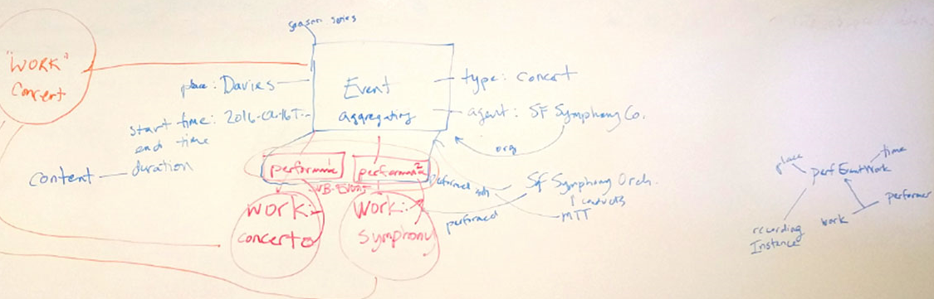
Work/EVENT modeling
Notes:
Here is a pictorial version of some our thinking—trying to fit in all the possible relationships we could think of…

Slide 11
MEDIUM OF performance
A complex aspect of music to model
Some initial work completed by MLA, led by Kimmy Szeto
Decision made to develop a separate ontology from BIBFRAME
A few issues…
  Performer vs instrumental part
  Numbers associated with performers/parts (2 clarinets)
  Collating of individual instruments into a an ensemble
Notes:
Our other looming issue is how to express medium of performance as linked data. (Use slide from here)

Slide 12

Next steps
Further refine our use cases
Analyze BIBFRAME 2.0 support for selected use cases
  Performer as part of a group
  Performer linked to instrument
Further analysis of Event/Work relationships, sequences in collaboration with LD4P ontology group
Initial development of a medium of performance ontology

Slide 13



THANK YOU!!!
nlorimer@stanford.edu
ld4p@duraspace.org

