Slide 1

BIBFRAME beyond books
Linked Data for Production/Linked Data for Performed Music
explorations in extending BIBFRAME 2.0 to improve discovery of performed music
Nancy Lorimer
Michelle Futornick
Stanford University
ALA Midwinter 2017

Slide 2
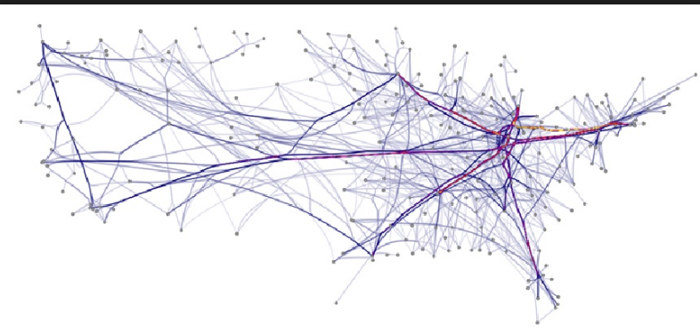
Linked Data for Production
a quick overview

Slide 3
Linked Data for Production (LD4P) Overview
To create linked data descriptions of library resources…
How do cataloging workflows change?
What standards are needed?
What tools are needed?

Slide 4
Linked Data for Production (LD4P) Overview
Partners
Columbia
Cornell
Harvard
Princeton
Stanford
Library of Congress

Slide 5
Linked Data for Production (LD4P) Overview
Partners
Analysis and Modeling
ArtFrame
Cartographic Extension
Rare Materials Ontology
Performed Music Ontology
Workflows for conversion and cataloging

Slide 6
Linked Data for Production (LD4P) Overview
Partners
Analysis and Modeling
Library Collections
Columbia Art Properties
Cornell Hip Hop LPs
Harvard Cartographic
Harvard Film Archive
Princeton Derrida Archive

Slide 7

Linked Data for Production (LD4P) Overview
Partners
Analysis and Modeling
Library Collections
Tools
Community Input
Gramophone by Paola Oliani, from the Noun Project

Slide 8
Linked Data for Production (LD4P) Overview
Outcomes
Partners
Analysis and Modeling
Linked data
Standards and
best practices
Tool evaluations and recommendations
Library Collections
Tools
Community Input
Gramophone by Paola Oliani, from the Noun Project

Slide 9
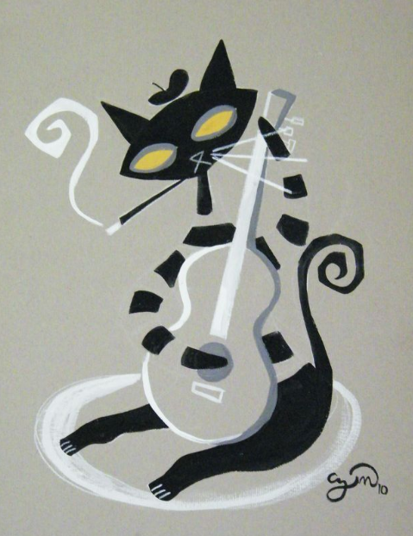
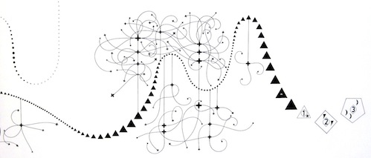
Linked Data for Performed Music
the performed music ontology (PMO)
Notes:
As you have heard from Michelle, Linked Data for Performed Music is one of several domain subprojects part of the Linked Data for Production grant, and one of two being led by Stanford University (the other being for overall technical services workflow). Metadata people at Stanford have a long running interest and connection with music metadata—both Philip Schreur, our head of Technical and Access Services and I were once music catalogers, and our director in his early days was a music librarian. We also have a separate technical services unit for music, now led by Kevin Kishimoto, and other metadata and digital library staff also have strong music and/or av backgrounds. For us, looking at the working with the description of performed music as linked data was an obvious thing to explore.

Slide 10

Project description
Develop a BIBFRAME-based ontology for performed music in all formats
  Domain-specific enhancements and/or extensions of BIBFRAME for use by the library community as a common standard
  Establish a model by which these standards can be created, endorsed, and maintained by the community
Do this through partnering with domain communities and the PCC
Notes:
The primary goal our project is develop a performed music extension to BIBFRAME, covering description of recorded sound from wire recordings to streamed audio to music video. Using BIBFRAME as a core ontology, we will recommend domain-specific vocabularies, enhancements and/or extensions to BIBFRAME for use by the library community as the initial basis for a common standard. As we do this, we hope to establish a model whereby similar standards can be created, endorsed, and most importantly maintained by the library community. Clearly, the ontology will change and develop over time
Because we are emphasizing a particular domain, community is of paramount importance to this project. We can develop a beautiful ontology, but it is of no use if it is not acceptable to the domain-community who may use it. And of course, all the domain experts are to be found primarily in that same community and it would be detrimental to not make use of that expertise. Stanford is thus partnering with domain communities—the Music Library Association and the Association of Recorded Sound Collections, as well as keeping PCC in the loop.

Slide 11
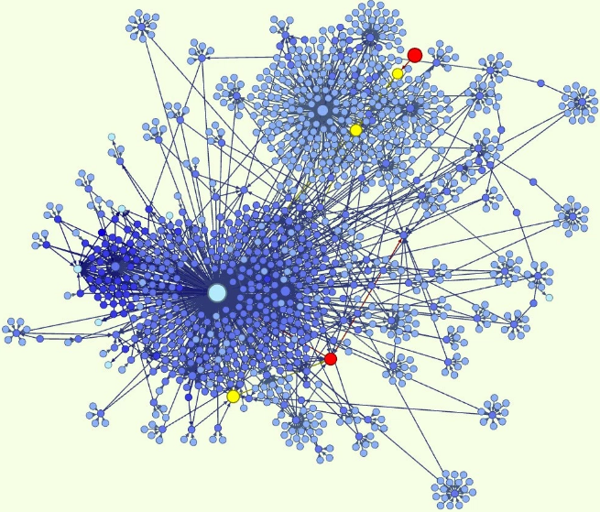
Why ontologies?
“An ontology is a formal naming and definition of the types, properties, and interrelationships of the entities that really or fundamentally exist for a particular domain of discourse. It is thus a practical application of philosophical ontology, with a taxonomy.”*
  note this is an intellectual as well as a structural framework
*Wikipedia, viewed January 2, 2017
Notes:
Before we embark on how we’ve doing in this wild adventure, let’s take a step back and think about why we are doing this. What are ontologies anyway and why do we need them? An ontology is… [read].
While this is a Wikipedia definition, it sums things up nicely. An ontology is where you name & define the entities contained in your domain and the relationships among them. As a practical application of philosophical ontology, creating an ontology is an intellectual endeavor, with choices based on structural and practical knowledge of the domain being modeled. A linked data ontology is built on RDF & its basic data model RDFS or OWL, the Web Ontology language, but these can only express very basic relationships—this is a subclass is this; this entity is related to this entity—highly abstracted relationships. An ontology brings in the specific vocabularies and relationships that define you domain, providing structure and vocabulary (or taxonomy as Wikipedia puts it).

Slide 12

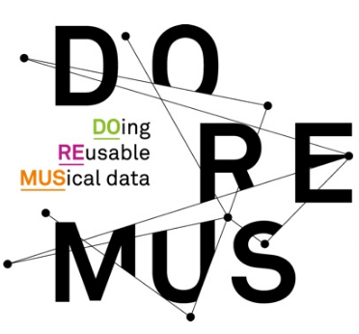


Why BIBFRAME?
Other ontologies:
  RDA registry (http://www.rdaregistry.info)
  Music Ontology (http://musicontology.com)
  DOREMUS (http://www.doremus.org)
BIBFRAME is:
  for all types of library materials, not just sound recordings
  compatible with a variety of cataloging content standards (or no standard)
  customizable, while still providing a common framework
Notes:
And so why use BIBFRAME? The usual context of this question is in reference to RDA—if we are using the RDA cataloging standard, why not use the RDA ontology? That is a perfectly reasonable question. There are also already some music ontologies available—the Music Ontology has been around several years and is even based on FRBR; lately the BNF has been developing Doremus, based on FRBRoo and CIDOC-CRM. Why aren’t we using them?
In our modeling, we are hoping to create an ontology that works with multiple content standards or even with a lack of a content standard, but still be part of a shared cataloging environment. While we use RDA, others may not, and we want to be able to have interoperability despite these differences. So that is why we chose BIBFRAME over RDA. The other two ontologies have almost the opposite problem—being intended only for music materials they run the risk of not being compatible with or at least too separate from modeling for all our other resources in libraries—we don’t want to become a library silo.
So in sum, we are using BIBFRAME because it is for all types of library materials, not just sound recordings; it is compatible with a variety of cataloging content standards, including no standard, and it is customizable while still providing a common framework.

Slide 13
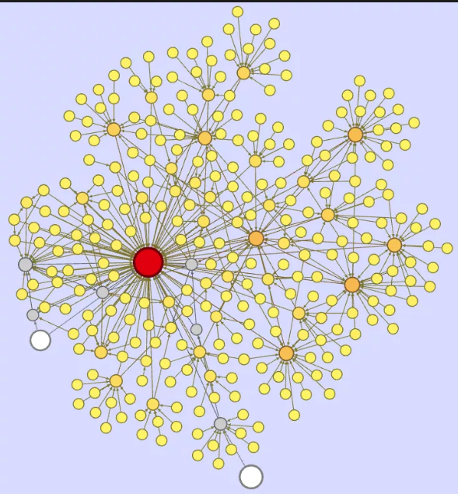
User stories & Use cases
Notes:
So to the project itself. When I reported on this project at ALA Annual, our group had just finished collecting, sorting, and analyzing user stories and/or use cases that would guide the shaping of our ontology. Our sources for use cases were our user communities—librarians in MLA and ARSC who were willing to participate. These were primarily music catalogers, but also included sound archivists, reference librarians, and others.

Slide 14
User stories/Use cases--Examples
  Relationships of Works to Events (performances, ceremonies) to Performers
  Recording music Takes and associating them with Recording Sessions
  Performances as part of large musical or non-musical programs (TV or radio shows, concerts, films, theatre)
  Relationship of Peformers to Instruments & Performing groups
  Area or ethnic group origin/source
  Medium of performance
  Sequencing of works or movements in a recording
  Works in a particular music Key or melodic Mode (Western & non-Western)
  Works in a particular Tempo
Notes:
Use cases covered a wide variety of needs but there were some predominant themes. Many or our use cases centered around the relationships of works to other works, to events, to performers, and to the instruments used in all of these. Others refined those relationships by defining geographical place, ethnic groups, musical keys and modes, tempo. Finally, sequencing, the ordering of interior parts of a work also came through as important.

Slide 15
Medium of performance
Notated work
Performance
Performer
“FRBR” work
Geography
Performed music recording
Notes:
Leaving aside the more detailed aspects, such as tempo, our use cases suggest needs for our ontology to express a whole web of complex interrelationships—the recording to a notated work, to a performer, to a medium of performance, to geographic regions or locations, and even, dare I say, that element missing in BIBFRAME, the FRBR work… More about that later.
As a group of experienced catalogers and metadata librarians, though fairly neophyte ontologists, you can imagine that we found the prospect of modeling all this fairly daunting. We spent the better part of our second day together, playing with aspects of this, and came up with some preliminary diagrams, that more state the issues, rather than offer resolutions. We then decided that since much of this modeling overlapped with other groups, particularly the core ontology group, we would turn to smaller, better defined issues first, such as filling out classes already present in BIBFRAME.

Slide 16
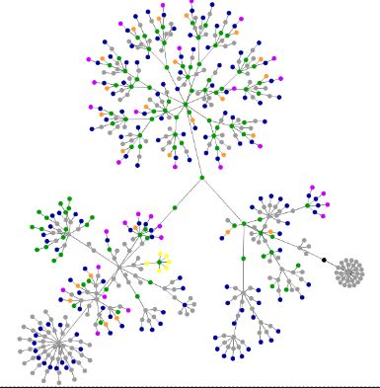
Filling out the ontology
added classes & vocabularies
Notes:
BIBFRAME, by design, is a fairly sparse—it provides a framework for bibliographic metadata, but does not define all possible subclasses and properties that might be necessary to use it for cataloging. This provides flexibility to adopt a variety of standards or source vocabulary from different places without losing that overall framework that allows the data to interact. Our next task then, was to look at the classes and properties relevant to performed music, and decide what was missing or what could be better modeled, and what we needed to add.

Slide 17
Added Classes/Properties
Subclasses of bf:Title
Other
  pmo:AnnouncedTitle
  pmo:CommonlyKnownTitle
  pmo:ContainerSpineTitle
  pmo:CreditsTitle
  pmo:DevisedTitle
  pmo:EmbeddedMetadataTitle
  pmo:MediaSurfaceTitle
  pmo:MenuTitle
  pmo:ReferenceSourceTitle
  pmo:TitleScreenTitle
pmo:SoundRecordingLabel
subclass of bf:Publisher
pmo:DiscCuttingType
subclass of bf:SoundCharacteristic
pmo:TapeConfiguration
subclass of bf:SoundCharacteristic
pmo:Tempo
subclass of rdfs:Resource
pmo:phonogramCopyrightDate
Notes:
The first and seeming most obvious thing to add were subclasses for bf:Title. Cataloging sound recordings in RDA requires that the cataloger always specify the source of every title that is recorded, and there was already the suggestion to add these as subclasses of bf:TitleVariant in the LC position paper on Titles. While seemingly simple (along with pleasant wrangling over names), questions rose immediately. First, we could not make these subclasses of bf:TitleVariant, since any one of them could be the chosen title. Second, these really did not seem to us to be subclasses of title, but rather title sources. A case was made to LC through the LD4P ontology group to create a class for title source that these would then be part of. This was accepted as a possibility in principle by LC, but they are not currently implementing it. For now, we are making these direct subclasses of bf:Title.
We also added a few other random classes—sound recording label, disc cutting type, tape configuration and tempo, and one new property—phonogram copyright date, the copyright date for a performance.

Slide 18
Added: bf:Identifier subclasses
bf:MusicAVDistributorIdentifier
bf:AudioTake
bf:Gtin14Number
bf:VideoGamePlatformIdentifier
Changes to definitions
  bf:MusicPublisherNumber
  bf:Matrix
  bf:IssueNumber
Notes:
Finally, we went through bf:Identifer. We changed some definitions to existing music identifiers and added 3 other music-related identifiers—the music av distributor number (recently defined in MARC), take numbers, and the Gtin-14 number, a number used by the publishing industry in describing packaging. As a bonus, and because we have a specialist in video game cataloging as part of our group, we added the identifier for Video game platforms. A little out of scope, but video games do indeed have music.
These were simple extensions to BIBFRAME, and our most successful to date—if not already, they will very soon no longer be extension vocabulary, but will be part of LC’s core BIBFRAME ontology.

Slide 19
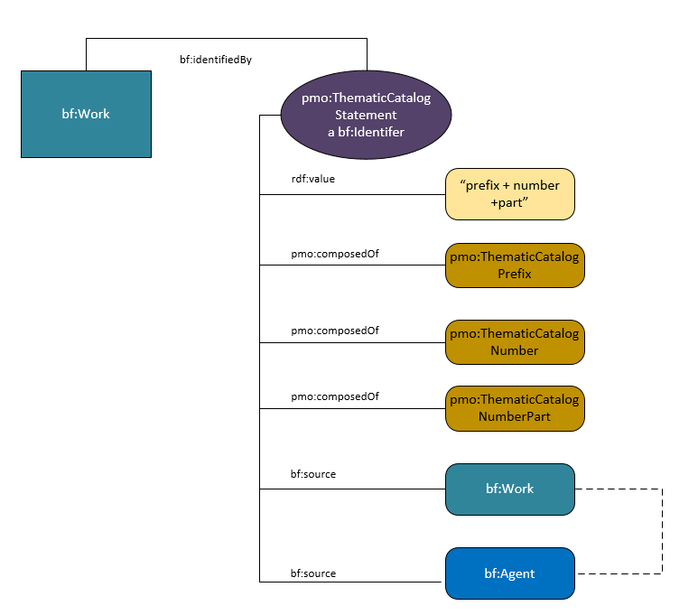
Thematic catalog & Opus numbers
Thematic catalog & opus number currently literals
pmo changes them to subclasses of bf:Identifier
[work_1] a bf:Work ;
bf:identifiedBy [
a bf:ThematicCatalogStatement ;
rdf:value “Opus 45, no. 2” ;
pmo:composedOf [
a pmo:ThematicCatalogPrefix ;
rdf:value “BWV” ;
] ;
pmo:composedOf [
a pmo:ThematicCatalogNumber ;
rdf:value “465” ;
] ;
] .
Notes:
Besides these 4 identifiers, the PMO group felt that two other very important music identifiers were missing from the bf:Identifier class—Thematic catalog numbers, which are numbers assigned in catalogs of composers’ works, and opus numbers, work numbers assigned either by the composer or a publisher. In a domain where titles are often generic (Symphony, Concerto) and composers might compose hundreds of works in a lifetime (Vivaldi wrote 120 violin concertos and 39 bassoon concertos), these can be very important for identifying works.
In BF, thematic catalog numbers and opus numbers are actually present, but both are literals or strings, and are represented only by the properties bf:musicThematicNumber and bf:musicOpusNumber. They are considered only in their relationship to the title string. this is limiting; nothing further can be stated about the number. The PMO group decided this was not adequate for music cataloging purposes—thematic catalog numbers make sense in the context of their catalogs, and it seemed reasonable to provide the source for the number, especiallyl since some composers might have multiple catalogs. And even something seemingly simple as an opus number sometimes needs a source and perhaps even a date—numbers get changed by publishers or by the composers themselves. To allow for this the PMO has created two additional new subclasses of bf:Identifer: ThematicCatalogStatement and OpusNumberStatement. This involved our first real experience in modeling, since they are multifaceted identifiers. Both follow the same modeling, so we’ll just look at pmo:ThematicCatalogStatement. The thematic catalog number can be expressed as an rdf:value (such as the string “BWV 465” and/or it may be split into three other classes pmo:ThematicCatalogPrefix, pmo:ThematicCatalogNumber, and pmo:ThematicCatalogPart. The are linked to pmo:ThematicCatalogStatement by the predicate pmo:composedOf. By splitting the prefix from the number, the number can be discovered on its own without the string being correct.
Besides improved discovery, another huge benefit in making these subclasses is that the statement may now be linked to a source. Thus BWV 465 can be linked directly to the Bach Werk Verzeichnis, even to a particular edition.

Slide 20
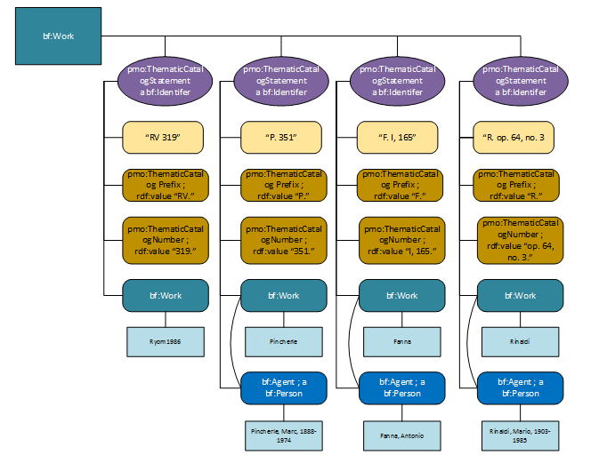
Thematic catalog numbers and their origins can be very complicated!
Notes:
Just to show the complexity possible. In this case we have a work by Vivaldi. There are 4 different possible thematic catalog numbers and all can be modeled…

Slide 21
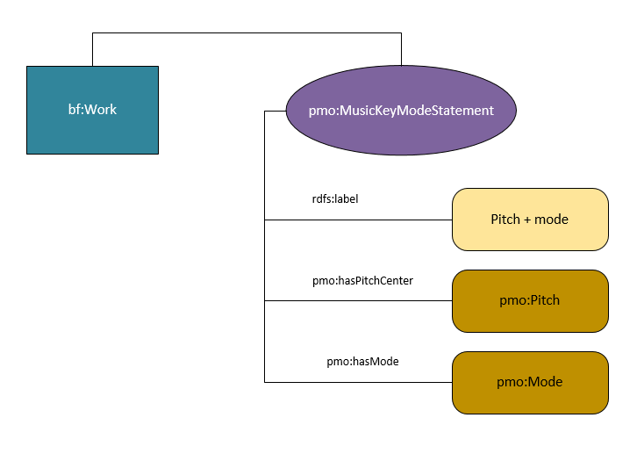
pmo:MusicKey
and for music keys…
music pitch & mode are separated
[work_1] a bf:Work ;
bf:hasKeyMode [
rdf:value “F major” ;
pmo:hasPitchCenter [
a pmo:Pitch ;
rdf:value “F” ;
] ;
pmo:hasMode [
a pmo:Mode ;
rdf:value “major” ;
] ;
] .
Notes:
On other piece of lightweight modeling was for musical key and mode. Again, as with the thematic catalog number this is only represented in BIBFRAME as a literal. PMO wanted to achieve two things here: make key/mode a resource rather than a literal, and bring in some flexibility to allow only the pitch center or only the mode to be recorded, so that the class can accommodate key and mode from various systems in use around the world, not just Western music. To achieve this, we separated out pitch and mode, with a model very similar to thematic catalog numbers. A cataloger still has the option of only entering a string (but here still a value, and therefore a resource) or to subdivide. So one can record “F major’, but you can also record Arabic maqamat or Indian ragas along with other pitch systems.

Slide 22
Vocabularies from outside BIBFRAME

Slide 23
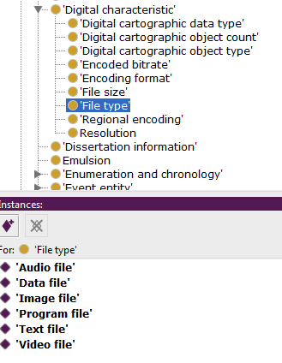
Vocabularies
why?
  to provide specific relationships not already in
  BIBFRAME
  to provide values for the objects of triples
Example:
  bf:FIleType
    no subclasses/individuals in BIBFRAME
    want to add in:
Notes:
Meanwhile, we were also looking at vocabularies outside BIBFRAME. We needed more vocabulary to define specific relationships through properties and to provide values for the objects of triples. It is all very well to say that a work has a file type, but we want to know what that file type is. As individual members of the subclass “File type” these are known as “individuals” or “instances” of the class.

Slide 24
Sources
Attributes of works and instances
  RDA term list (http://www.rdaregistry.info/termList)
  LCGFT (http://id.loc.gov/authorities/genreForms.html)
  LCMPT (http://id.loc.gov/authorities/performanceMediums.html)
  PMO vocabulary
Agent roles
  MARC relators (http://id.loc.gov/vocabulary/relators.html)
Relationships between works
  RDA unconstrained properties (http://www.rdaregistry.info/Elements/u/)
Notes:
For these vocabularies, we turned first to library vocabularies, primarily through the RDA registry and id.loc.gov. There were several reasons for this: Most basic, was that we were all familiar with these vocabularies; some of us had participated in their creation and so, you might say, had a vested interest! They also simply have a lot of the vocabulary we want. The biggest decision was choosing between RDA and id.loc.gov when the vocabularies overlap as they do. In the end we chose to use the RDA term list for much of the vocabulary. For us, it was easier to use; a bonus is that it is supports multilingual cataloging. We also are choosing to use RDA unconstrained properties to define the relationships between works—no other vocabulary that we know of is so thorough. On the other hand, we are using the MARC relators rather than the RDA properties for relationships between an agent and a work. And then of course, the usual suspects for other vocabularies.

Slide 25
More advanced modeling
Notes:
Now we had got our feet wet with a bit of modeling and vocabulary development we turned back to that first web of relationships we drew, starting with medium of performance. Medium of performance has been a bit of a obsession in the music cataloging community over the last couple years with the introduction of the LC mop thesaurus for music and the ever more complex 382 field that holds it.

Slide 26
Medium of performance--Requirements
Intended instrumentation (what the composer wrote)
  instruments
  total number of instruments
  number of parts for each instrument
  alternate and doubling instruments
Performing Forces (actual instruments)
  performers
  total number of performers
  instruments
  number of performers per instrument
  doubling of instruments
Notes:
Our own requirements and initial modeling address some of the difficulties expressing medium of performance in MARC. One issue has always been that the field combines both the mop (instruments and numbers of performers) intended by the composer and the actual performing forces in a recording. A trio may be composed for two flutes and a bassoon, but it might be performed by 4 saxophones and a cello for all we know. More simply a song could be sung by one or a hundred people. Separating out the two seemed to be the best way forward.

Slide 27
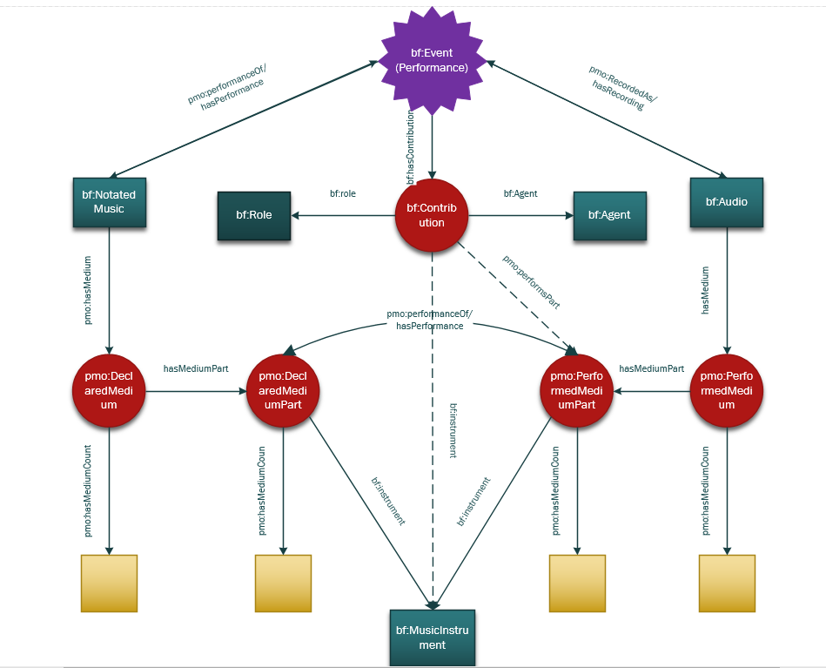
working model of medium of performance:
pmo:Declared Medium
pmo:PerformedMedium
Notes:
So this is our initial model for mop. On the one hand we have what we call DeclaredMedium (on your left), which is what the composer intended, and on the right PerformedMedium. These we have connected in what is still a rudimentary way to both an event (generally a performance) and to a performer. With this we are able to state that a performer plays a particular instrument at a particular performance and whether that was the intended instrument for that part. This certainly pertains closely to our use cases.
An closely related aspect we have not yet delved into too far, is the idea of a cast—the roles of singers in an opera for instance, and what voices those roles are intended to be. We are intending to model that separately once we have gone further into event structure.

Slide 28
Issues
Notes:
So these are a few of the things we have been working on. In this last bit, I want to talk a little about some of the issues we have run into in doing this work.

Slide 29
General
Creating an ontology is not easy!!!
  it is particularly difficult to involve a large number of people
  things that we glossed over in MARC, must be modeled in an RDF ontology
  it is easy to present a biased viewpoint of a domain.
Notes:
First and foremost, developing an ontology, even an extension to an ontology is not simple. As I mentioned earlier, it is an intellectual exercise, and because of that it is very difficult to involve a large number of people in the development process as we have been trying to do with MLA and ARSC. It seems to be working best in two ways—one, to gather an intentionally large and disparate amount of information—such as collecting use cases, or getting basic information about event ontologies on the web; or in vetting vocabularies and modeling already done. Perhaps this is not so different from what we do now with MARC & RDA however, so it is not so bad.
Ontology work with RDF is also very precise and somewhat unforgiving. In MARC, we have long practiced fuzzy modeling to shove our metadata into a framework that it doesn’t really fit in. Once you start working in RDF, however, those relationships we glossed over in MARC must be modeled. We really have to know what we are saying.
Finally, it is, as with most intellectual work very easy to present a biased viewpoint of a domain. This is just something we need to be aware of and to compensate for as much as possible.

Slide 30
Vocabulary reuse
the ideal in linked data, but there are many pitfalls
  you must use the terms in the way they were originally intended
  you shouldn’t turn individuals into classes or vice versa
  you shouldn’t declare classes from another ontology to be subclasses of yours
  you need to be careful when using SKOS vocabularies in an OWL ontology
Notes:
When you start into linked data, you will always hear the refrain “reuse, reuse, reuse” as in classes, subclasses, vocabularies from other ontologies. This makes perfect sense—the more you reuse, the less you need to map between different ontologies or vocabularies—you are more easily integrated into the web of data. However, in practice, this can be difficult and there are many pitfalls. When you use someone else’s ontology or vocabulary, you can’t just coopt it for whatever purpose you want. That class or property is already within a context and you can’t violate that context. When it comes to vocabularies, the relationship of OWL and SKOS in which most of our library vocabularies are written is complex and one needs to be careful. When you hear reusue, you will also start hearing terms like “ontology hijacking”, which is not a good thing, and punning, which may or may not be okay depending on what you do.

Slide 31
Classes vs Individuals
Traditional Linked Data
Library linked data
heavily class-based
relationships are primarily in the form of subclassing
relatively few properties
  often each class has only one
heavily property-based
relationships are between separate classes rather than through subclassing
many properties
  a single class may have several
origins in the entity/relationship model of FRBR
  everything is an attribute of an entity
  translates to being a property
Notes:
Another interesting issue or maybe just a observation is that our library ontologies tend to end up structured differently than what I’ll call “traditional” linked data. This has come clearer to me as I have been working with people in Stanford’s bioinformatics lab, a centre known for its teaching and support of linked data and its ontology tool Protégé. The linked data they are used to working with is very class-weighted. Relationships between entities are primarily in the form of subclassing. There are relatively few properties, and often each class will only have one.
Library linked data, on the other hand, tends to be heavily property-based. Relationships are between two separate classes rather than through subclassing. There are thus many properties—a single class may have several. This is apparent both in BF and in the RDA ontology.
The origins of this seem to be from the modeling of FRBR itself which is entity/attribute-based. A work has attributes, not subclasses, and once in linked data those attribute translate to many properties and resulting individuals as object properties.

Slide 32
bf:Work subclasses vs bf:ContentType
bf:Work subclassed:
  bf:Audio
  bf:Cartography
  bf:Dataset
  bf:MixedMaterial
  bf:MovingImage
  bf:Multimedia
  bf:NotatedMovement
  bf:NotatedMusic
  bf:Text
  bf:Object
  bf:StillImage
RDA Content type vocabulary:
  cartographic dataset
  cartographic image
  computer dataset
  computer program
  notated movement
  notated music
  performed music
  sounds
  spoken word
  still image
  tactile image
RDA Content type vocabulary:
  tactile notated music
  tactile notated movement
  tactile text
  tactile three-dimensional form
  text
  three-dimensional form
  three-dimensional moving image
  two-dimensional moving image
Notes:
This dichotomy of style is evident in BIBFRAME when you look at the subclasses of bf:Work and the class bf:ContentType. The subclasses of bf:Work are fairly closely modeled on the MARC formats; bf:ContentType is of course directly out of RDA. While the RDA vocabulary is more granular, we end up with two competing vocabularies within BF, since they really are describing the same things. However, one is a subclass one is an attribute. If we make content type a subclass, we are leaving the FRBR model, but to use both seems redundant in some cases, and difficult for discovery. We might all find that it will be necessary to choose one over the other in our implementations of BF.

Slide 33
Added individuals to bf:Carrier
pmo:Single
pmo:LpVinyl
pmo:78Shellac
pmo:Sacd
pmo:HybridSacd
pmo:DvdAudio
pmo:CdAudio
pmo:Dat
In RDA, these may be used in addition to the required rdact:AudioDisc and rdact:Audiocassette.
[work_1] a bf:Work ;
bf:carrier http://rdaregistry.info/termList/RDACarrierType/1004 ;
pmo:carrier http://www.ld4p.org/ontologies.owl/performedMusic/Sacd .
http://rdaregistry.info/termList/RDACarrierType/1004 ;
a bf:Carrier ;
rdfs:label “Audio disc” .
http://www.ld4p.org/ontologies.owl/performedMusic/Sacd ;
a bf:Carrier ;
rdfs:label “SACD” .
Notes:
The FRBR concentration on properties has a major drawback—the object of a triple most often is an individual of that class, generally a vocabulary term expressed as a value. As individuals, these terms cannot be subclassed. This came up with PMO in relation to vocabulary for bf:Carrier. RDA uses very general terms—for performed music, the most commonly used being audio disc and audiocassette. There are, however, as you all know, several kinds of audio disc and we would like to name them. But because the term “audio disc” is an individual we cannot subclass; we can only add more specific terms as other individuals of the bf:Carrier class. Our ontology will suggest that in implementing the ontology these terms be used in addition to bf:AudioDisc in RDA cataloging.

Slide 34
Issues—Works
Notes:
Finally a couple notes about works. I said that early on we had delved into works some, but put it aside for things we could extend rather than create from scratch. However, I will give you a glance at one of these early models to show the things that stymied us.

Slide 35
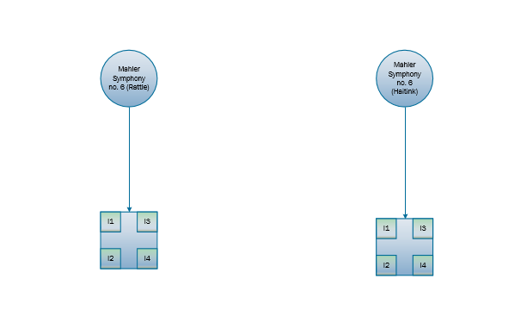
Notes:
Here is a digram of two performances of Mahler’s 6th symphony, one conducted by Simon Rattle, the other by Bernard Haitink. Since in BF every recording of a discrete performance is a work, these constitute two works. They are obviously very closely related, but indirectly. The performances themselves are unrelated but the work itself is. What is missing is that indirect link between the two.

Slide 36
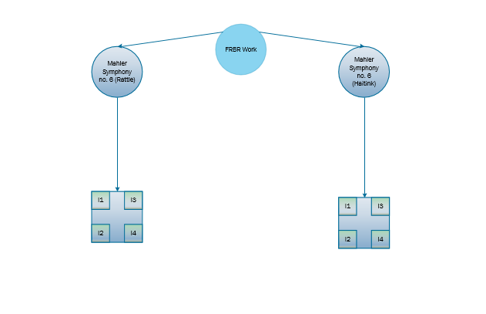
Notes:
In RDA of course this is the FRBR work and it really seems, that in the realm of classical music anyway, that that added level is necessary. Mahler’s 6th may have only a few performances, but think of Beethoven’s 5th—hundreds of recorded performances, hundreds of music scores, arrangements, adaptations, etc. We really need that link. This is also apparent with some identifiers—our new opus number and thematic catalog numbers don’t refer to individual recordings or scores but to the abstract work as a whole.

Slide 37
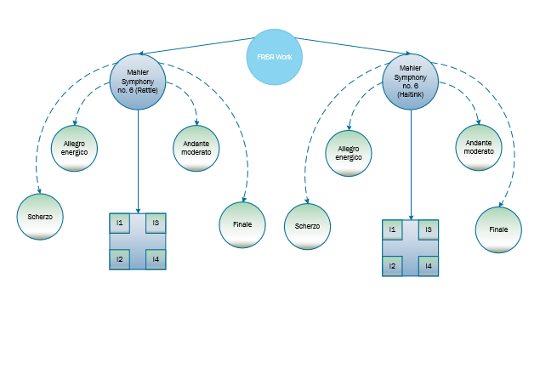
Notes:
Another issue with these works, is that like most symphonies and many other musical works, it has multiple movements. These are of course related to the overall work, but how do they relate to the instance? Each of these movements can be broken off and performed separately, each becoming a work in its own right, but they also have their own instances within the instance of the overall work.

Slide 38
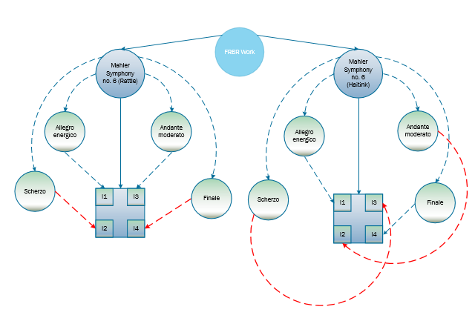
Notes:
So that is what those little squares are, instances within the instance. There is at least one particular use case for having these subinstances or perhaps an aggregate instance that contains individual instances—stating the order of the internal works. This is the case with multipart works such as this but also with compilations such as recordings of rock groups where the sequence of works within the aggregate work is important.
In this particular example, there is actually a difference in the sequencing between the two performances. There is some disagreement with Mahler’s 6th as to which is the 2nd and which is the 3rd movement. In Simon’s performance, the scherzo comes before the andante moderato; in Haitinks’ the andante comes first. This gives a very different listening experience. Something for all of us to think about.

Slide 39
Next steps
Finalize new vocabularies
Finalize instrumentation/performed medium & cast
Basic model for events in relation to Bibframe work
Basic model for compilations & multi-movement works
Examples
Final writeup on project
Notes:
So that is where we are so far. Next we are moving on to the modeling of events in relation to works, performers, and medium of performance. We are likely to borrow from the Doremus ontology here, either reusing its model or mirroring it in our own ontology. After that, since we need it and we have no other source at this time, we will create a basic modeling for aggregate works and compilations—music cataloging cannot exist without them. Finally, we will solidify our vocabularies with input of our communities and then present the entire model to them for review. Finally, we will look for a way to make the ontology available to the community at large for testing and further development.
With that I’ll close—perhaps a little longwindedly. Thank you all for coming.

Slide 40
Questions?
nlorimer@Stanford.edu
futo@Stanford.edu

