Slide 1
Linked Data for Production (LD4P)
technical services workflow evolution through tracer bullets (Stanford projects)
Arcadia Falcone
Josh Greben
Nancy Lorimer

Slide 2
Introduction:
LD4P, its goals & its context in the current library technical services paradigm
Notes:
Linked Data for Production, hereafter LD4P, is a Mellon-funded grant for 6 research libraries—Columbia, Cornell, Harvard, the Library of Congress, Princeton, and Stanford, which leads the project [click]

Slide 3
Linked Data for Production
Overall focus:
Lay the groundwork for moving library technical services workflow into a linked data environment
Subprojects within each institution:
    ontology development
    tools investigation
    workflow analysis
Notes:
LD4P is focused on the transition of basic Technical Services workflows to ones rooted in linked open data through active engagement with the semantic web. This transition will be a critical one for libraries, and involves many facets. As part of the grant, different institutions took on various subprojects concentrating on one of these facets: ontology development in various focused domains, such as rare materials; tools investigation, both current and forthcoming; and workflow analysis, from both the metadata and systems sides.

Slide 4
Stanford Projects
Performed Music Ontology (PMO)
  Extension to BIBFRAME 2.0
Workflows in Technical Services (“tracer bullets”)
  MARC-based workflows (vendor-supplied cataloging, original cataloging)
  digital repository workflows (individual & bulk deposit of metadata)
Notes:
For our part, we at Stanford chose two areas of work to concentrate on. The first is an extension to BIBFRAME 2.0 for performed music, which we carried out in collaboration with representatives from the Music Library Association, the Association for Recorded Sound Collections, and the Library of Congress. While we won’t be talking about this today, I’ll be happy to answer any questions after if you have them.
Our larger project is aimed directly at the focus of the grant—shifting workflows in technical services to a linked data environment. From our current workflows, we chose 4—2 from our more traditional MARC-based work (vendor-supplied cataloging and original cataloging), and 2 from our digital repository workflows (individual and bulk deposit). While based on local workflows, the outcomes of this project should be readily applicable and/or adaptable to other institutions needs. This project is the primary focus of our presentations today.

Slide 5
Workflows
Conversion
Tools
Themes
Enhancements
Data creation
Notes:
Our presentation today is based around 4 recurring themes. [click] The first, clearly, is workflows, the trajectory of metadata as it moves through our technical services and digital repository and the requirements for making that happen. We have dubbed these our “tracer bullets”, in that they chart a lightweight course and proof of concept with the bare minimum of development. Arcadia will be speaking about our workflow analysis and tracer bullet development in our first talk.
After that we will delve more deeply into the pieces of these workflows, first looking at data conversion and enhancement, an integral part of our vendor-supplied cataloging workflow. Josh will talk about our experiments with data conversion and enhancement from the developer’s pont of view. I will follow up with some discussion about various questions and issues surrounding enhancement and conversion we have delved into, and an introduction to our work with Casalini Libri. In the last portion of our talk today, Josh and I will talk about data creation as we work to implement original cataloging in a linked data framework.
Key to all of this, and running through our entire presention, are tools. Tooling is vital to any linked data transition, and throughout our talks we will be discussing converters, enhancement methods, and metadata editors, and how they all work together.
Unlike what your program may suggest, this is going to be a single presentation, rather than multiple ones. We ask that you hold your more complex questions to the end; there should be plenty of time to discuss things.

Slide 6
Workflows:
Modeling metadata processes for a hybrid linked data environment
Arcadia Falcone
Notes:
As Nancy mentioned, a large part of the Stanford project is implementing four technical services workflows as “tracer bullets.” I will provide some context for this approach, describe the analysis and modeling process for two of these workflows, and discuss how that informed our approach to implementation.

Slide 7
Goals
  To understand current technical services workflows both as specific tasks and generalized processes
  To model the processes of parallel linked data workflows, with their relationships to each other and to current workflows
  To begin identifying implementation specifications for systems, tools, and training
Notes:
First, goals.
One goal for this process was to develop a comprehensive understanding of our current technical services workflows from start to finish, as we found that many of us were familiar with our own parts of the workflow, but did not have a clear conception of the whole or how all the parts fit together. Our intent here was not to formulate a model that would be directly translated to linked data, but as context for rethinking some of the same functions for linked data.
So when we say that our second goal was to model the processes of parallel linked data workflows, “parallel” should not be taken to mean a one-to-one correspondence between the processes in each workflow. Rather, we wanted to model linked data workflows that could run in parallel with current practices, in a hybrid environment (and I’ll say more about that in a moment).
And finally, we sought to lay the groundwork for implementation, to start thinking about the resources, both technological factors and human skillsets, we would need to develop along the way.

Slide 8
The “tracer bullet” paradigm
  Lightweight, end-to-end implementation with real data
Purchasing
Operations
Holdings
Descriptive metadata
Discovery environment
Digital objects in repository
Publishing metadata elsewhere
Notes:
We’ve referred to our approach as “tracer bullets,” by which we mean focusing on end-to-end coverage rather than building out any one stage of the workflow in depth.
The first step in this approach is determining what the endpoints are – where we’re starting from, and what the target is.
(click)
For us, we defined the starting point as data, specifically descriptive metadata, at the point which we create it or receive it from other sources.
(click)
The endpoint is making this metadata available for use in a discovery environment – the delivery of the data to our users.
(click)
So the tracer bullet is the shortest line from the start point – metadata – and the end point – discovery.
This may seem the simplest of diagrams, but keeping this paradigm in mind was invaluable for determining what was in and out of scope for our implementation, and avoiding the constant temptation of scope creep.
(click)
Some of these related functions – purchasing and acquisitions, managing holdings, and operations such as circulation – we’re considering handling via a MARC “operational record” in the ILS, that could support these kinds of administrative processes but would not be used for discovery.
Others, such as linking descriptive metadata to digital objects in our repository, and making our RDF metadata available for use more broadly, we’re planning to return to in the future.
For our current work, however, our focus is the flow of data from inception to discovery.

Slide 9
Parameters
  A hybrid environment involving MARC, MODS, BIBFRAME, and other standards will continue to exist both locally and globally
    “Hybrid production” workflows
  The endpoint is a discovery layer that integrates MARC, MODS, and BIBFRAME data
  Processes should be scalable and require no additional human intervention beyond current workflows
  Processes should be defined so as to be modular and tool-agnostic
Notes:
Before turning to the workflows themselves, I’d like to cover some of the additional parameters we set for the modeling process.
We started with the understanding that we are working in a hybrid environment in which multiple data standards and structures are in play, both for the other institutions we share data with and in the systems we use locally at Stanford, as well as of course in the larger data ecosystem. Our models represent what I’ll call a hybrid production workflow, which allows production work in BIBFRAME to begin for selected resources, workflows, and functions, while MARC continues to be in use for others. This is also conducive a more agile attitude wherein we may iterate and adjust our new workflows quickly over time.
This approach informs our second parameter, which is that our present target is a discovery environment that integrates all library descriptive metadata regardless of format – in our case, a Solr index powering our Blacklight-based discovery layer, SearchWorks. While this of course does not take advantage of the specific affordances of RDF, it does maintain a single, consistent discovery environment, enabling us to begin using BIBFRAME in production without negatively impacting our users. We are, however, also considering future possibilities for a linked-data-specific discovery environment.
And finally, we had some guidelines looking towards implementation – the workflow models should not introduce any more human intervention than currently exists, so that the implementation will be scalable; and, the models should represent processes separately, even if the same tool or system currently performs multiple processes, or if only one tool is currently available for that process, to allow the models to continue to be useful as tooling evolves.

Slide 10
Four selected workflows
1. Vendors supply MARC records that an automated process loads into our ILS
          …and into our triplestore as linked data
2. Metadata staff create original description of resources
…natively in a linked data editor
3. Users create description as part of digital object self-deposit in a web-based interface
…that is stored as linked data
4. A bulk process transforms structured metadata for a large collection of digital objects
…into linked data describing objects in our digital repository
Notes:
Again, the four workflows we’re addressing:
-Vendor-supplied MARC records (note that this is not copy cataloging, but MARC records delivered directly to our ILS without human intervention)
-Original cataloging
-User self-deposit of digital files with metadata, currently stored as MODS XML
-Transforming metadata for a large collection of digital objects accessioned to our digital repository; currently this is usually in the form of a spreadsheet that gets transformed to MODS XML via a local mapping
(click)
And, in our hybrid approach, parallel linked data workflows.
-transforming MARC to linked data as an ongoing process
-creating descriptive metadata that is structured as linked data
-digital objects described individually
-batch transformation for large-scale digital collection metadata supplied in some other format
In discussing our analysis and modeling work, I will focus on the first two of these, vendor-supplied MARC and original cataloging.

Slide 11
Roadmap for workflow analysis
Comprehensive representation of current workflow
High-level model of current workflow
High-level model of linked data workflow
Merged high-level model of hybrid workflow
Tracer bullet implementation of hybrid workflow
Notes:
First, a high-level overview of the elements of our workflow analysis:
-we started by constructing a detailed, task-level representation of the workflow as it currently stands
-from that we generated a more abstract, process-level model for the current version of the workflow
-which we used to inform and contextualize the modeling of the linked data workflow
-ultimately merging these into a hybrid workflow model, which will form the basis for the tracer bullet implementation

Slide 12
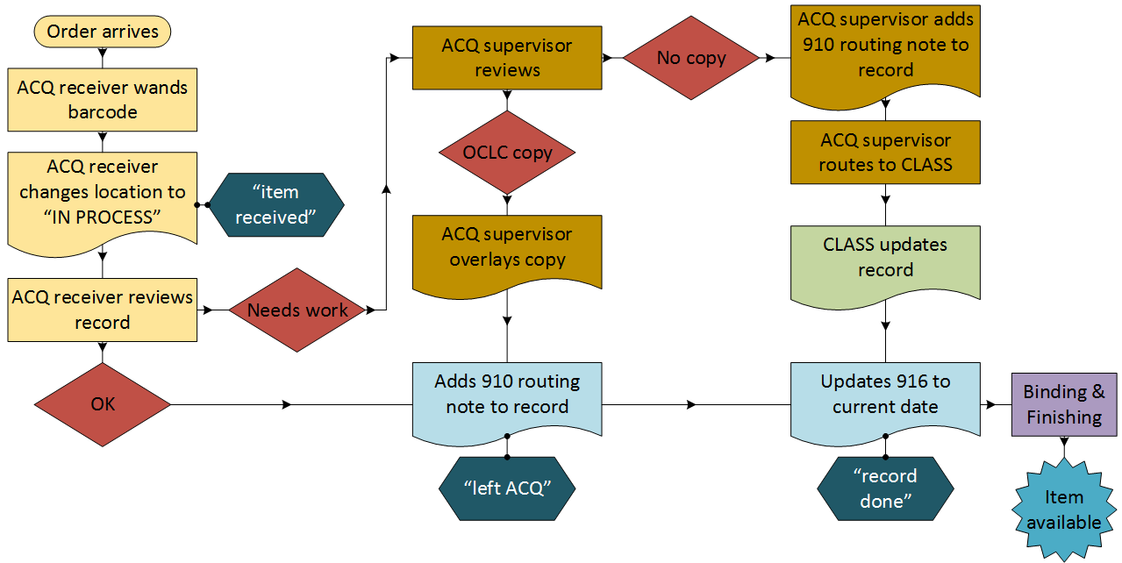
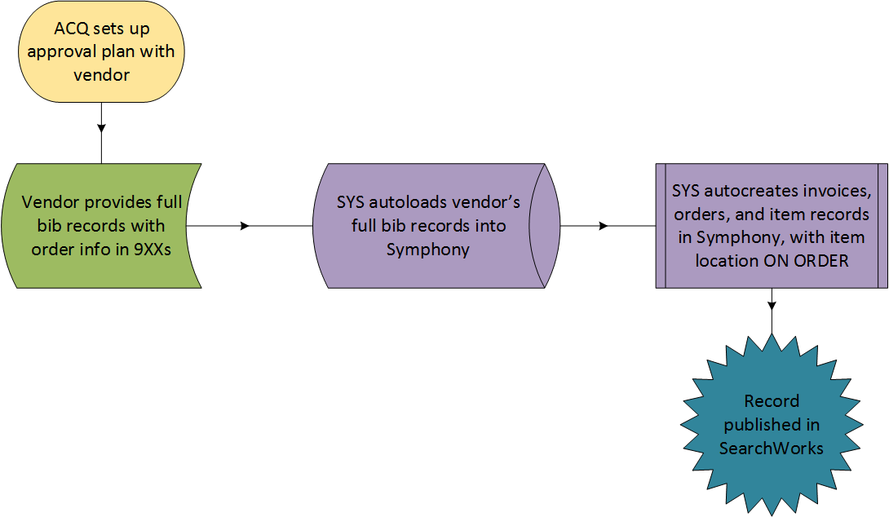
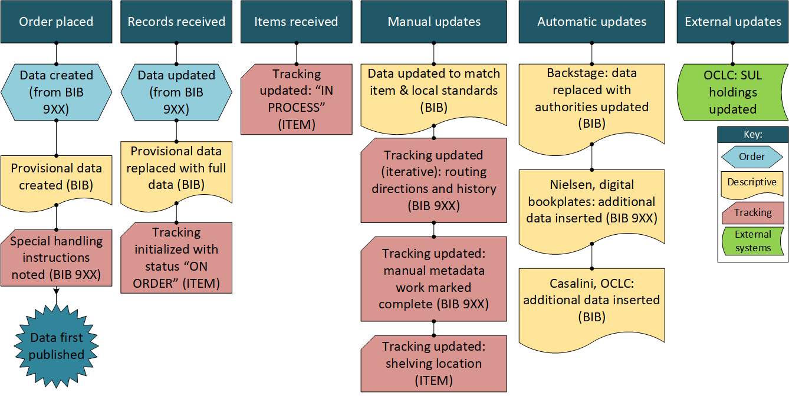
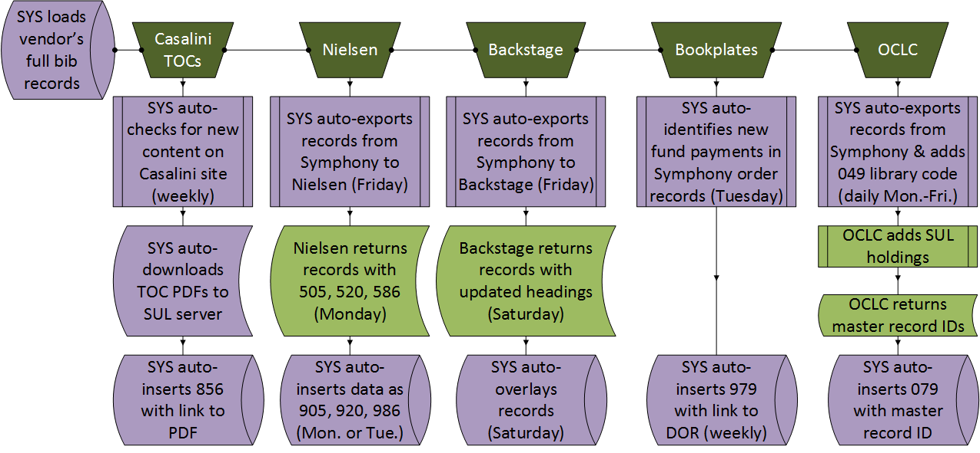
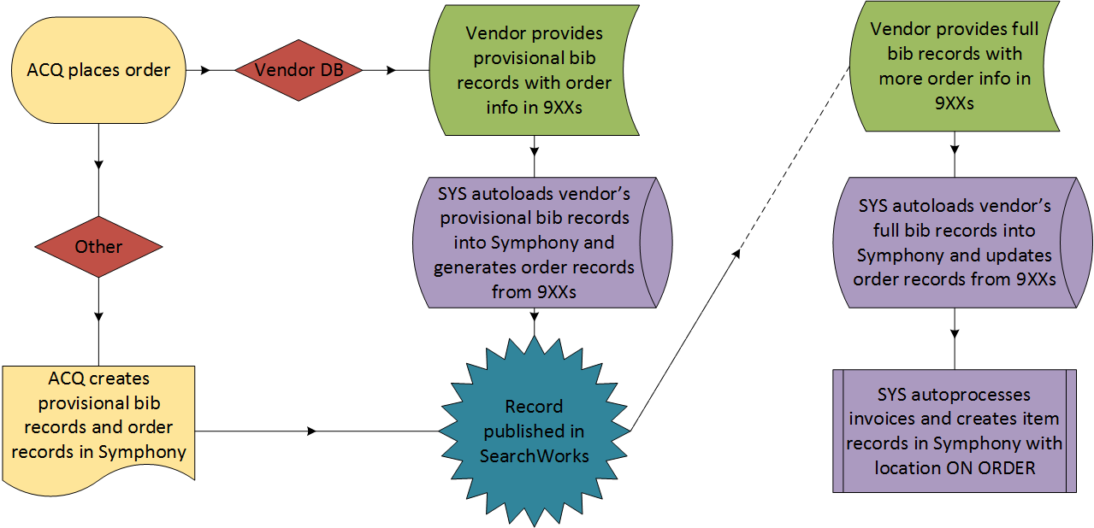
Workflow #1: task-based model
Notes:
This is a task-level diagram we created as part of the analysis of the current workflow for vendor-supplied MARC– I’m not going to go through this in detail, as it’s very Stanford-specific, but I include it to give you a sense of the analytic process.
This was the first workflow we tackled, so there was some trial and error in figuring out what we needed to know.
(click)
But by the end of the process, we had brought together the in-depth knowledge that each unit had about their individual processes and put them all in context, developing a shared understanding of what this workflow involved.

Slide 13
Workflow #1: process-based model
enhance
MARC data
Vendors
ILS
Vendor
provide MARC records & updates
map & index
link to operational record
Unified discovery layer
pass updates
Index
provide
indexed data
MARC to BIBFRAME converter
SPARQL endpoint/API
send data
Triplestore
expose
data
map & index
send data
Reconciliation services
return reconciled data
Notes:
We were then able to generalize this into a model of our current version of workflow #1, underpinned by the comprehensive knowledge developed in the previous phase.
In documenting this workflow, we found that vendor-supplied MARC records commonly get updated several times over the course of weeks – the vendor may send a preliminary record initially and provide a full record later, in addition to enhancements provided by other vendors, such as authority data or a table of contents.
(click)
Thus for the linked data parallel workflow, we modeled a data pipeline where updates could be passed continuously, and automatically, from the ILS to a converter, rather than the one-time conversion we had initially planned for the tracer bullet. Josh will talk in more detail about how this pipeline was implemented.
(click)
Expanding the workflow beyond the tracer bullet will involve reconciling the URIs generated by a converter against our own triplestore and external data sources, and determining what is needed to link an operational record in the ILS with descriptive metadata in a triplestore.

Slide 14
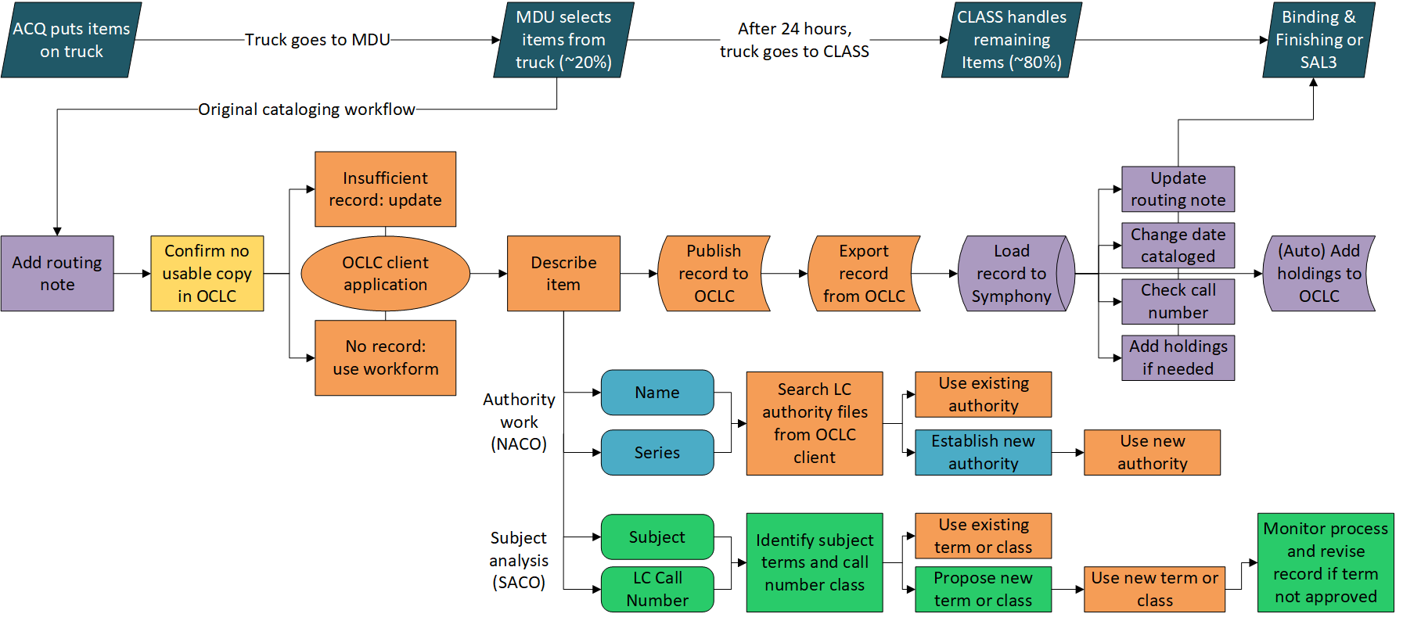
Workflow #2: task-based model
Notes:
Here is the task-level diagram for workflow #2, original cataloging, and its relationships to other related processes in different departments. Again, I’m not going to go through this in detail, but representing the tasks at this level of granularity gave us a better understanding of the larger contexts of data, systems, and operations that intersect with the original cataloging workflow.

Slide 15
Workflow #2: process-based model
External bib. & authority records
update
search & import
enhance
MARC data
MARC editor
Vendors
External RDF & URIs
ILS
pass record
Unified discovery layer
map & index
Index
provide
indexed data
update(?)
link to operational record
lookup
SPARQL endpoint/API
map & index
BIBFRAME editor
lookup
Triplestore
expose
data
send data
Reconciliation services
return reconciled data
Notes:
From that we again generalized to a more abstract model, which we found involved more two-way processes compared to the previous workflow, as catalogers were both pulling in data from other sources and sending that data back out into shared systems, and doing so directly from the editor tool.
(click)
We also realized that tracer bullet 3, description of a single digital object, is very similar to the tracer bullet 2 linked data workflow. We had originally conceived of it as separate because in our current environment it uses an entirely separate system, with a different interface, a different metadata standard, and a different relationship with the repository. But abstracting to this level brought out the commonalities, with the main addition being the linking of descriptive metadata to an object in our digital repository.

Slide 16
MARC TO BIBFRAME
EXPERIMENTS IN DATA ENHANCEMENT AND CONVERSION
Josh Greben
Nancy Lorimer

Slide 17
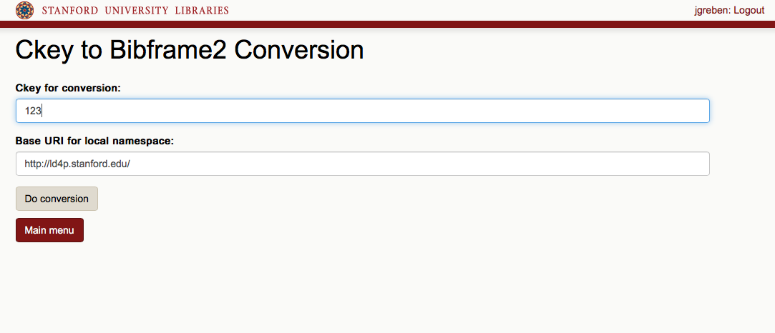
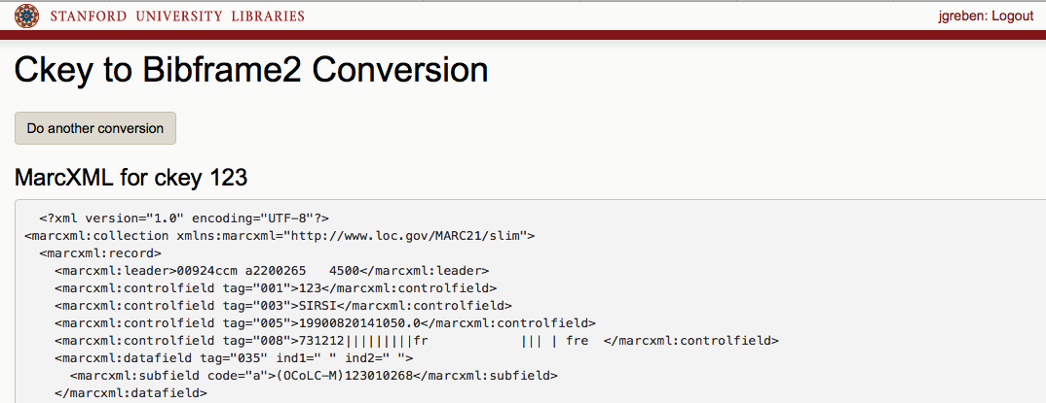
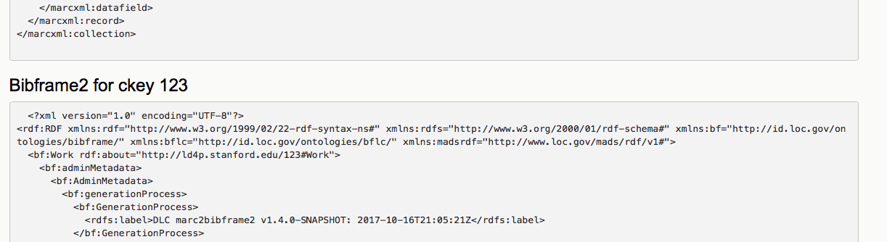
Ckey2Bibframe2

Slide 18
Bulk Conversion with URIs or Fingerprints
Authority Lookups
.mrc
#MARCXML
BIBFRAME
ModBibFrame
.
.
.
Notes:
ModBibFrame was an early attempt at simple reconciliation across a static set of bulk-converted records using the “fingerprinting” method

Slide 19
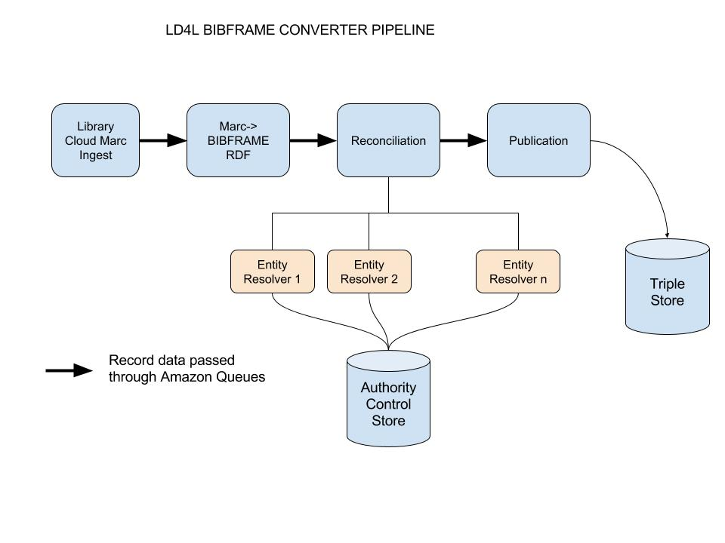
LD4L BIBFRAME Converter Pipeline

Slide 20
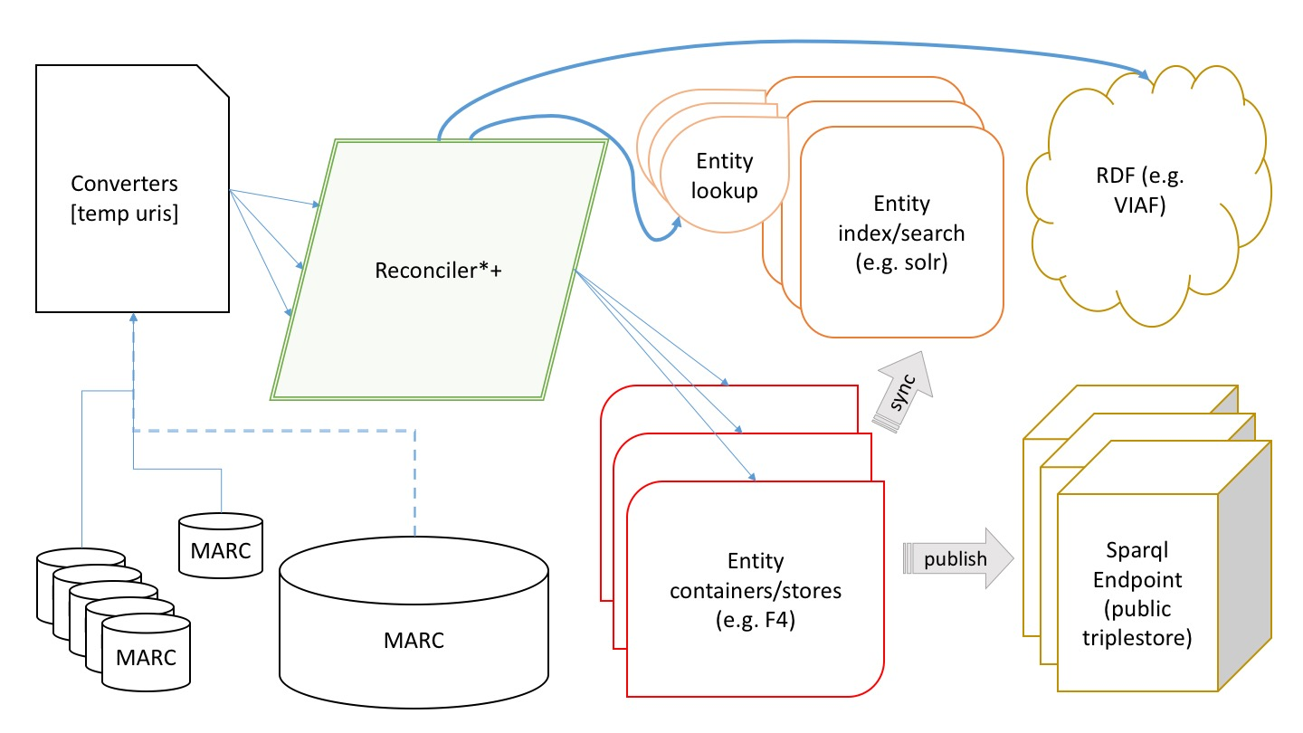
Component Straw-man for Conversion with Reconciliation Workflow

Slide 21
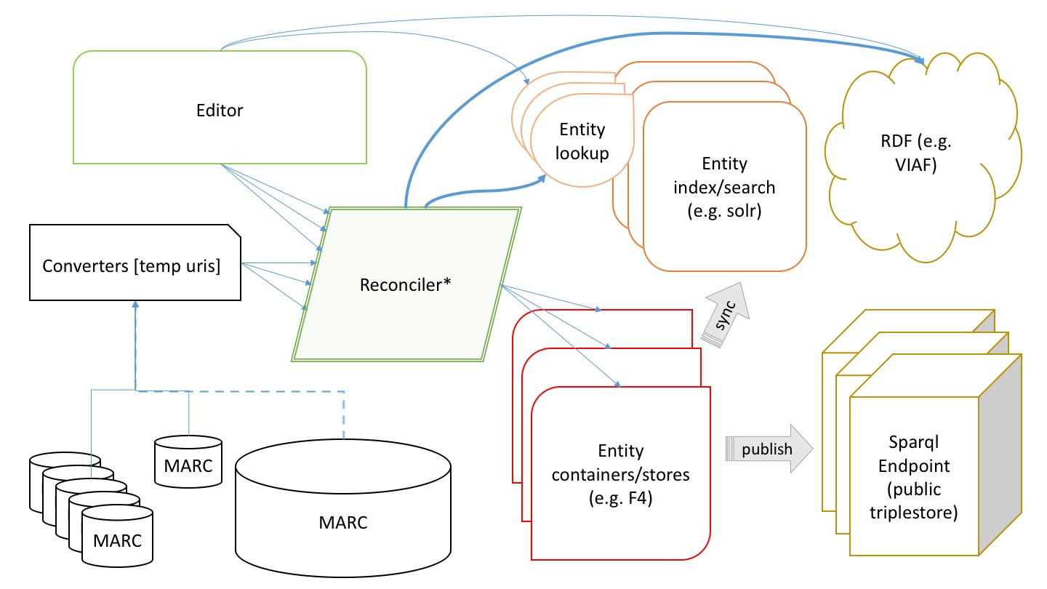
Component Straw-man for Conversion + Editor + Reconciliation Workflow

Slide 22
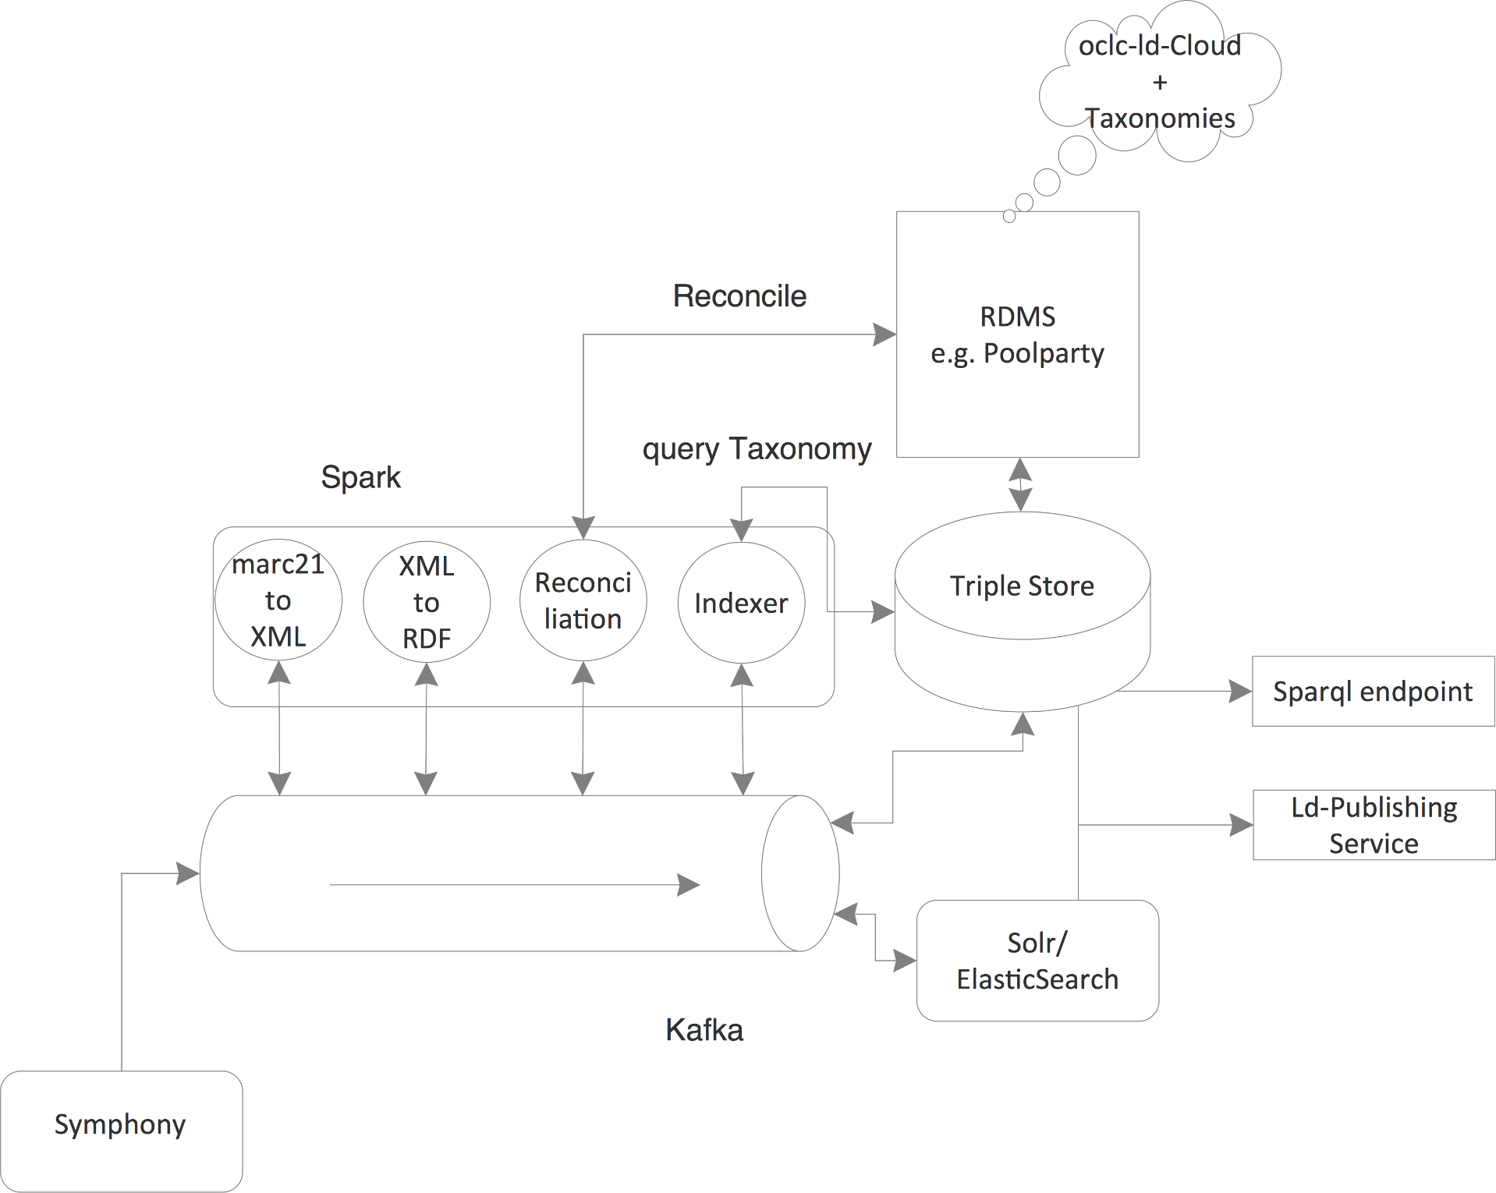
Component Diagram for Conversion with Reconciliation
Workflow with Pipeline Architecture

Slide 23
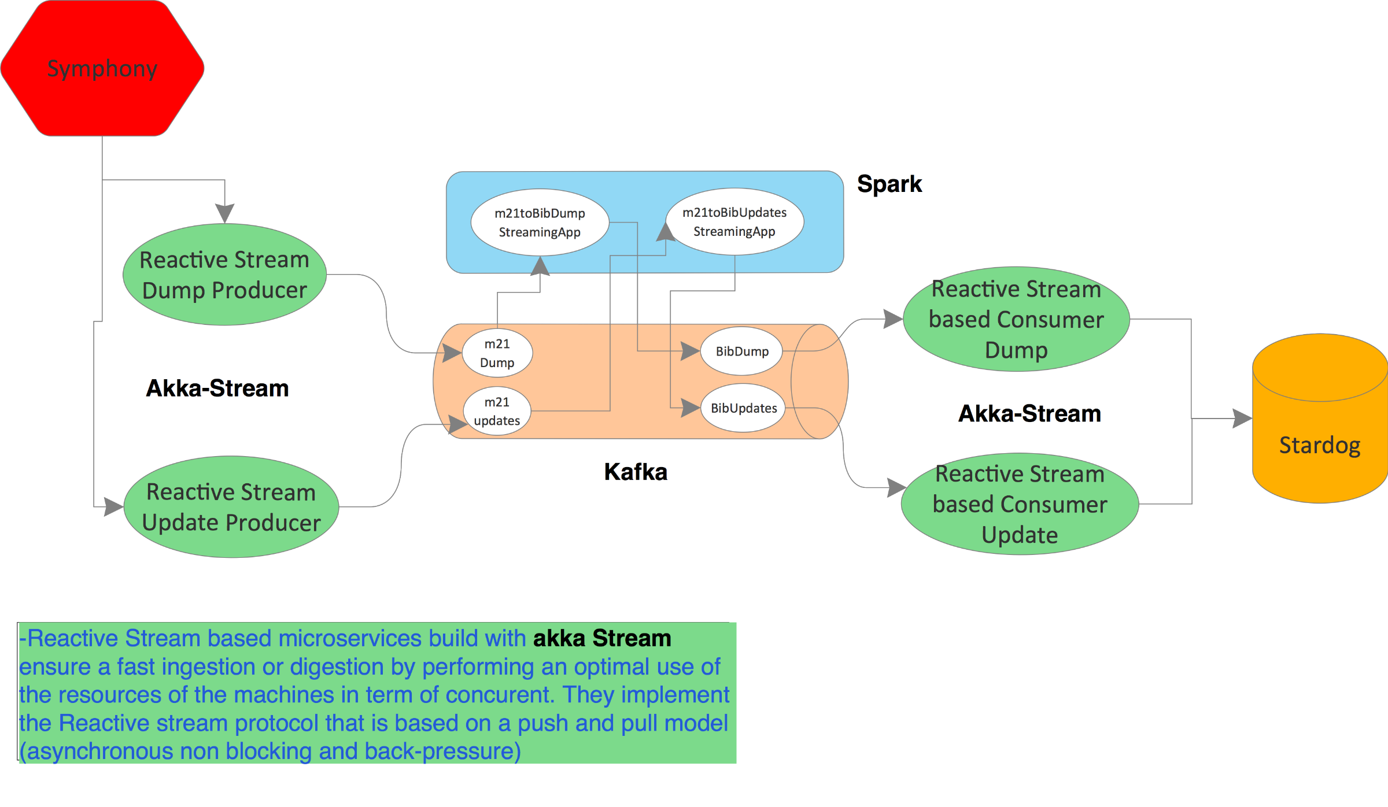
Component Diagram for Conversion Workflow with
Pipeline Architecture, Reified

Slide 24
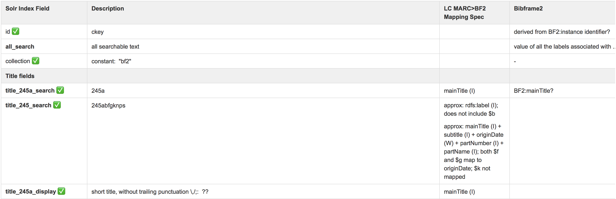
BIBFRAME 2 to Solr Mapping
Notes:
Reify discovery service in a mixed MARC + RDF data environment
Instance-based
Sparql queries for each solr doc property
Ontology-bound to bibframe

Slide 25
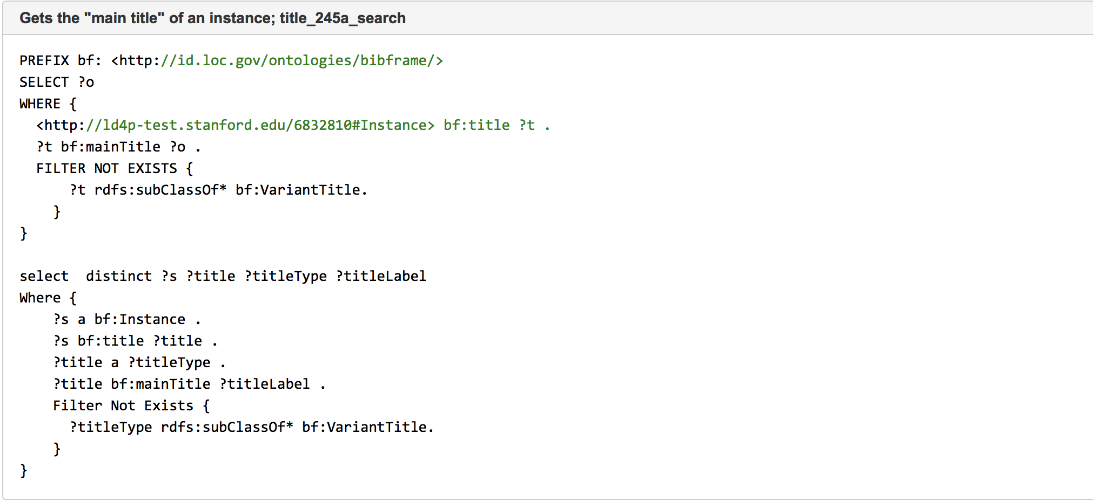
BIBFRAME 2 SPARQL Queries

Slide 26
Conversion Questions
URIs—where do you get them?
are there other enhancements you can do?
granularity of conversion
adding local field conversions to a more generic converter
  converter maintenance
compatibility with other conversions and original metadata creation
Notes:
In preparing for and working with the converter and viewing its output, several questions came to mind. Very early in the process, before we even had a grant, we explored ways of getting URIs into our data and other ways to enhance MARC records to get better outcomes in conversion. URIs in MARC bib records are the topic of an entire Program for Cooperative Cataloging Task Force, to which I am a consultant. But there are other possible enhancements/policies that could aid in conversion—always adding access points for editors and translators, for instance, something that better identifies different works/expressions; or always adding title access points, to better generate work titles. We have also considered issues in granularity of conversion—do we just convert at the level of BF itself, or do we want to add in RDA properties that are more granular and expressive? And like many insitutions, we have several local fields that need to be converted. Both of these bring up questions of how to maintain a generic converter with local additions. Finally, looking at converter output (and we now have used two converters) vs editor output, we have come to the realization that we need to keep in mind that even within our datastore data will look somewhat different.

Slide 27
Getting URIs
BACKSTAGE LIBRARY WORKS
  Providing LC-NAR, VIAF, ISNI URIs for a few years now in authority records
  Recently began adding selected URIs directly in bib records
SHARE-Virtual Discovery Environment
  Has taken converted our entire bib file
  Can convert MARC to BIBFRAME, and soon MODS to BIBFRAME
  Has ability to reconcile at basic and enhanced levels
Notes:
I will only go into more detail here about that first question—getting URIs into our data. For several years now, we have been getting URIs from LC-NAF, VIAF and ISNI from Backstage Library Works as part of our authority control services with them, something they now provide as a general service. We add the URIs in local fields for a couple reasons—at the time, one couldn’t add them to authorities, and even if we did, if the authority record were replaced, we would lose the URI. This is the basis of our initial workflow 1 as Josh described. We have now also started getting URIs, again from Backstage, but this time directly in our bibliographic records, though we have not begun to use them as yet.
We are also looking at a whole other way of doing this—using an outside service to do at least part of our conversion. Stanford is a member of SHARE-VDE (Virtual Discovery Environment) a project of Casalini Libri to convert, reconcile, and display data from multiple insitutions in the same environment. Casalini has a very powerful converter, ALIADA, that not only converts MARC to BIBFRAME, but basically anything you put in to what you want out (with the caveat of course that it has to be mapped!). Casalini has converted our entire bib file (as well as others). Casalini is also able to reconcile data at two levels—a very basic level of exact string matches that have qualifiers, to quite sophisticated reconciliation, that takes context and bibliographic notes into account. Because of these capabilities, we are now seriously considering performing some or all of our copy cataloging using SHARE-VDE as it develops.
And now we turn back to Josh, who will talk about data creation, the basis of our Tracer bullet #2—Original cataloging.

Slide 28
DATA CREATION
REQUIREMENTS & TOOLS
Josh Greben
Nancy Lorimer

Slide 29
The Bibframe Editor…
Needs prefabricated triples (i.e. profiles) and a way to apply them to your work
Needs a place to temporarily remember the data
  Memory store
  Loopback API Server (a la loopback.io)
Needs a way to fetch changes made to profiles
  Profile-edit server with http file endpoint
  Trigger file download
Needs a way to do lookups to id.loc.gov and other sources
  Cross-domain Scripting
Needs a way and a place to permanently store the triples data
  Reformat JSON to suit needs of posting to triplestore
Needs a way to handle Reconciliation…

Slide 30
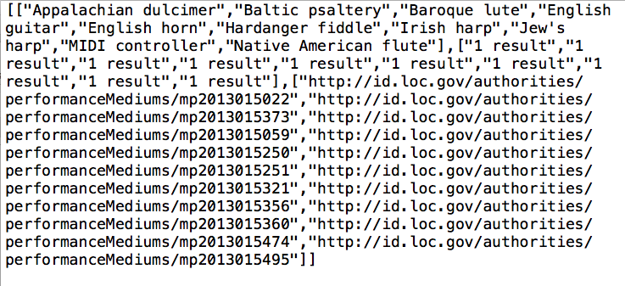
Lookups: LOC Suggest API
http://id.loc.gov/authorities/performanceMediums/suggest/?ensemble

Slide 31
Lookups: rdaregistry.info & id.loc.gov getting ID and English label
Object
Object
@graph
@id, schema (URI)
@id, ConceptScheme (label)
$.[1]['@id']
$.[1]['ToolkitLabel'].en
($.[1]['@id']).split(“,”)[0]
If ($.[1]['http://www.loc.gov/mads/rdf/v1#authoritativeLabel'][0]['@language'] == “en”)
{$.[1]['http://www.loc.gov/mads/rdf/v1#authoritativeLabel'][0]['@value']}
($.[1]['@id']).split(“,”)[0]
If ($.[1]['http://www.loc.gov/mads/rdf/v1#authoritativeLabel'][0]['@language'] == “en”)
{$.[1]['http://www.loc.gov/mads/rdf/v1#authoritativeLabel'][0]['@value']}
$.[1]['@id']
$.[1]['ToolkitLabel'].en
$.[1]['@id']
$.[1]['ToolkitLabel'].en
http://rdaregistry.info/termList/RDAproductionMethod.jsonld
http://id.loc.gov/authorities/performanceMediums.json
Notes:
Parsing lookup json responses.
vs
JSON-LD and linked data tools
Vs reliance on vendor-provided APIs.

Slide 32
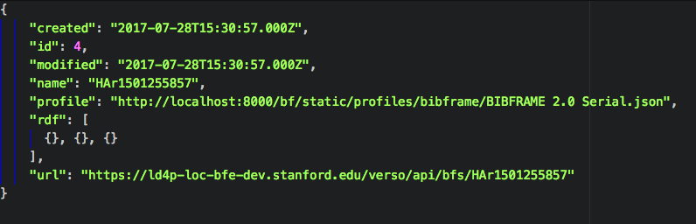
RDF to TripleStore (BFE Produced)
Notes:
if(typeof value == 'object'), e.g. “rdf”: []

Slide 33
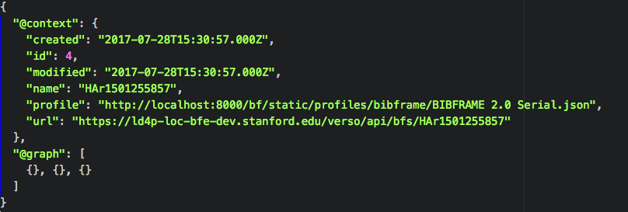
RDF to TripleStore (JSON-LD)
Notes:
Slightly different but should still work with existing function.

Slide 34

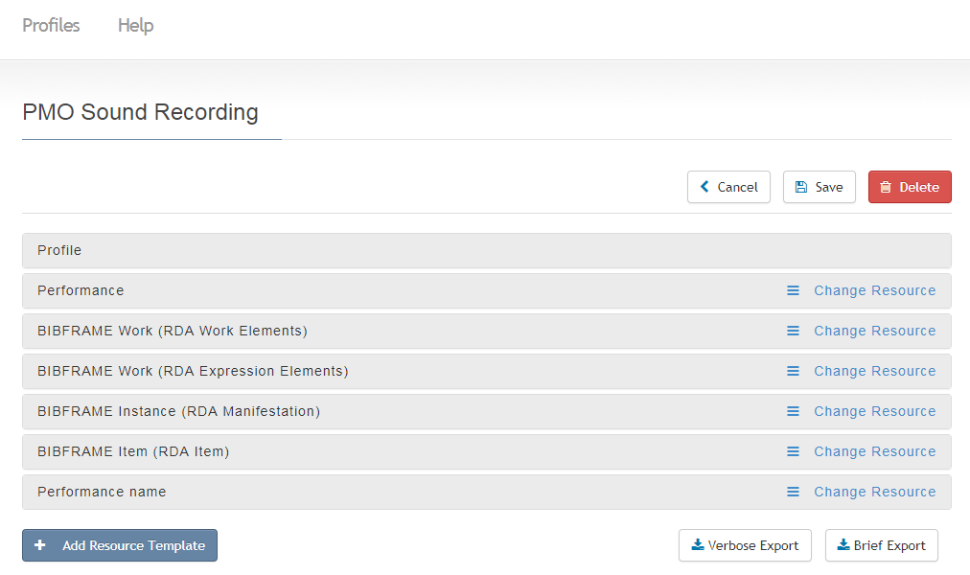
Notes:
So, yes, what does the metadata practitioner see? This is a not-quite-finished profile for the Performed Music Ontology, an extension of Bibframe. You can see the profile is divided into multiple smaller profiles. When you open up the profile for say, RDA Work Elements, you get this:

Slide 35
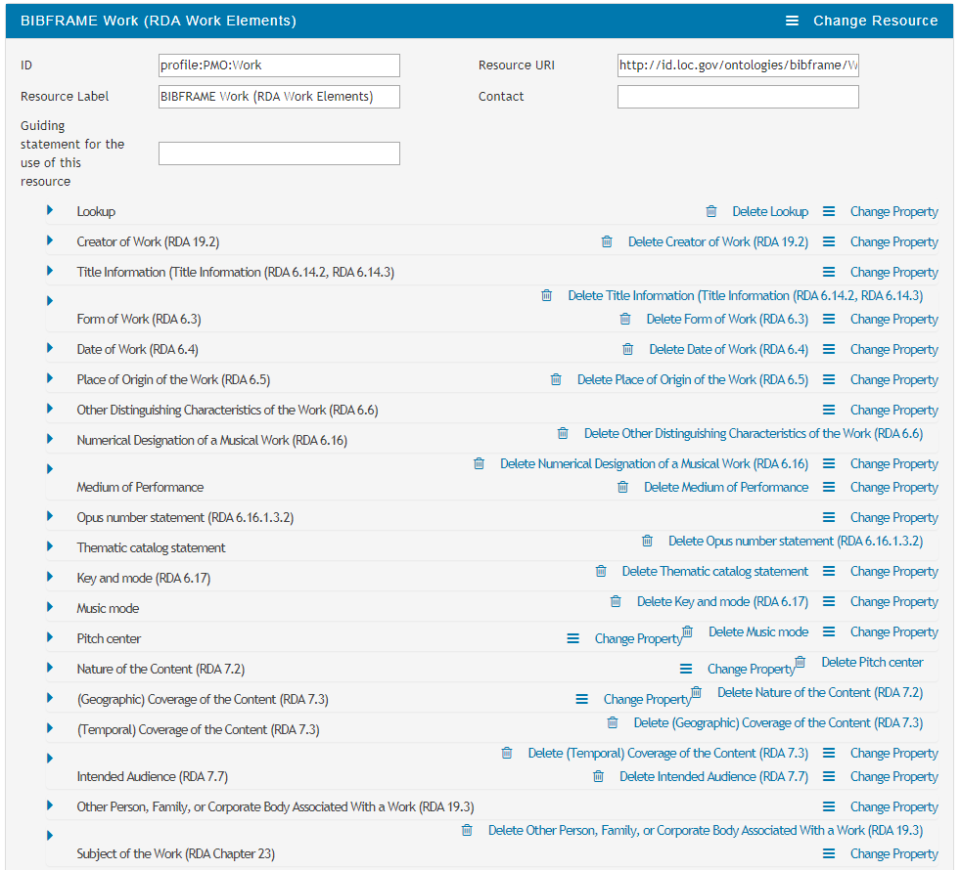
Notes:
Basically, this is the RDA/PMO work, with all its possible properties. Note that we’ve included (as LC does) RDA rules; you can even provide a link that takes you right to the spot in the RDA toolkit.

Slide 36
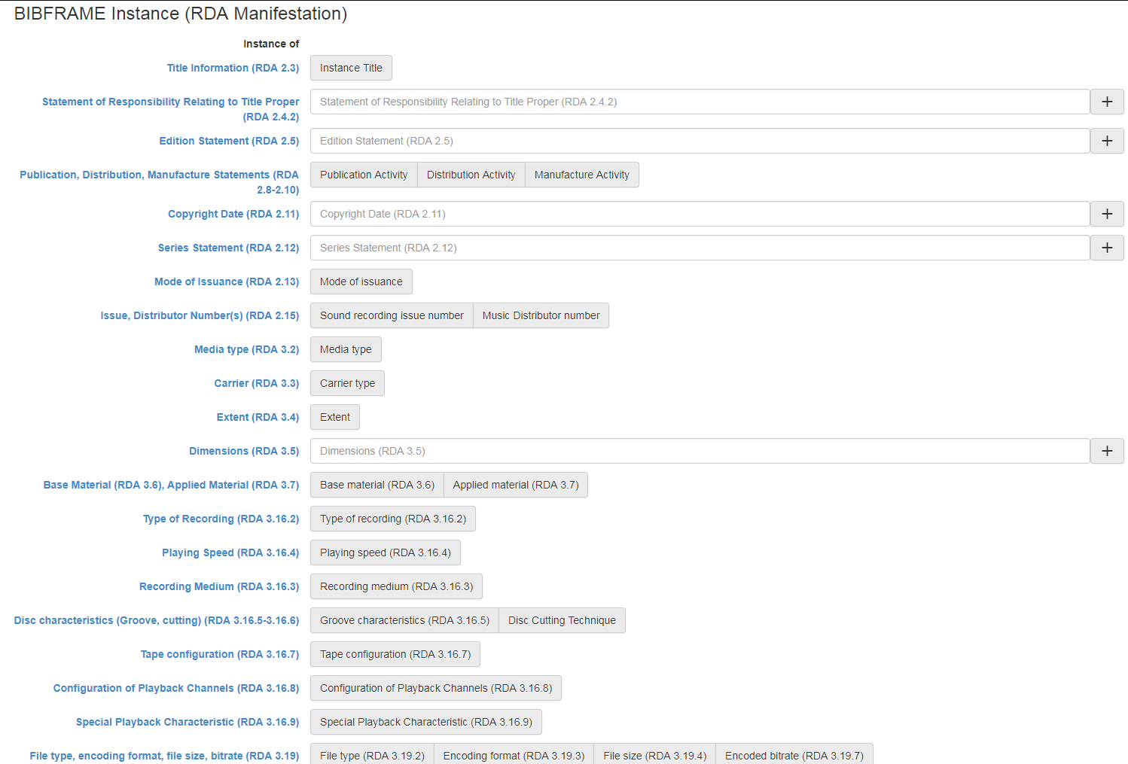
Notes:
The data entry screen looks like this, the white boxes being data properties, and the grey boxes object properties. When you click on a grey box, a new form opens up [click]

Slide 37
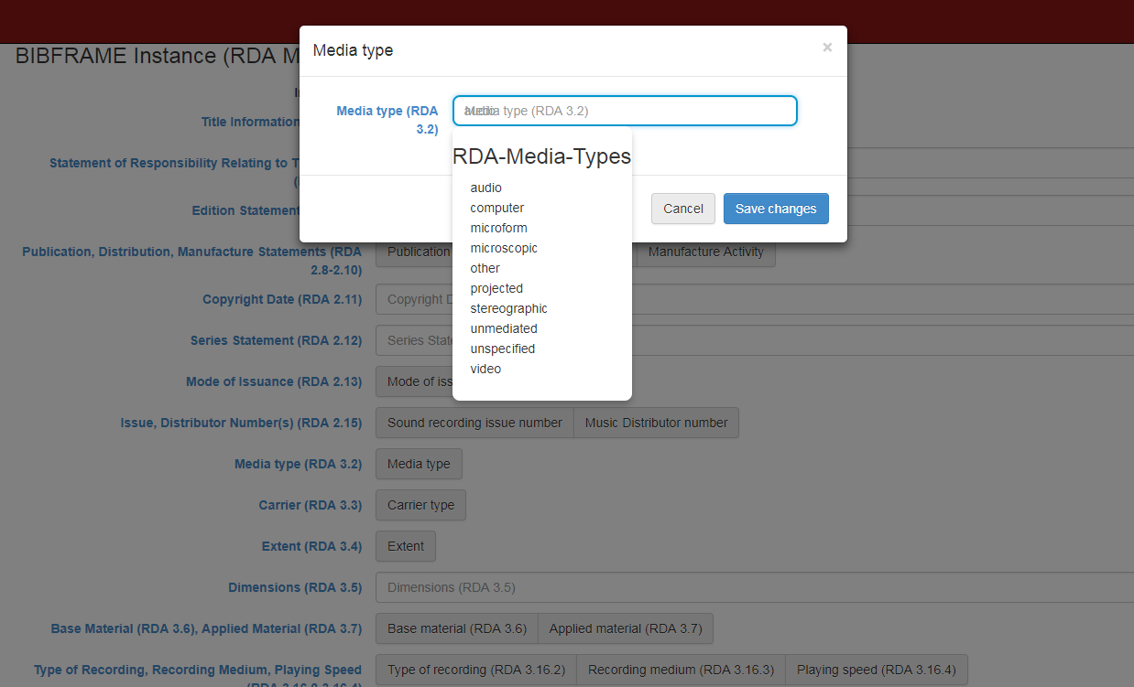
Notes:
…and you also may have a lookup for the particular vocabulary. So far we are only able to do lookups in id.loc.gov, but we are working on lookups to the RDA registry.
Now many of you have probably seen the BF Editor/Profile Editor in some fashion; it has been around a while. I’d like to introduce you to another editor, that we have also been testing in collaboration with people in the BioInformatics Group at Stanford.

Slide 38

BioPortal/BiblioPortal
repository of biomedical ontologies
provides
  ontology summaries & histories
  viewing statistics
  ontology details—classes & properties in hierarchies
  mapping ability
new “slice” called BiblioPortal
  are working to make it a more independent portal
Notes:
The Bioinformatics Group has maintained for some years now “BioPortal” a respository of biomedical ontologies. Besides simply the ontologies, it provides summaries & histories of the ontology, viewing statistics, ontology details in hierarchies, and the ability to map between ontologies. We have created what is called a “slice” in BioPortal, currently named BiblioPortal, in which we are loading relevant library ontologies. BioPortal is working to make this a more independent repository for us.

Slide 39
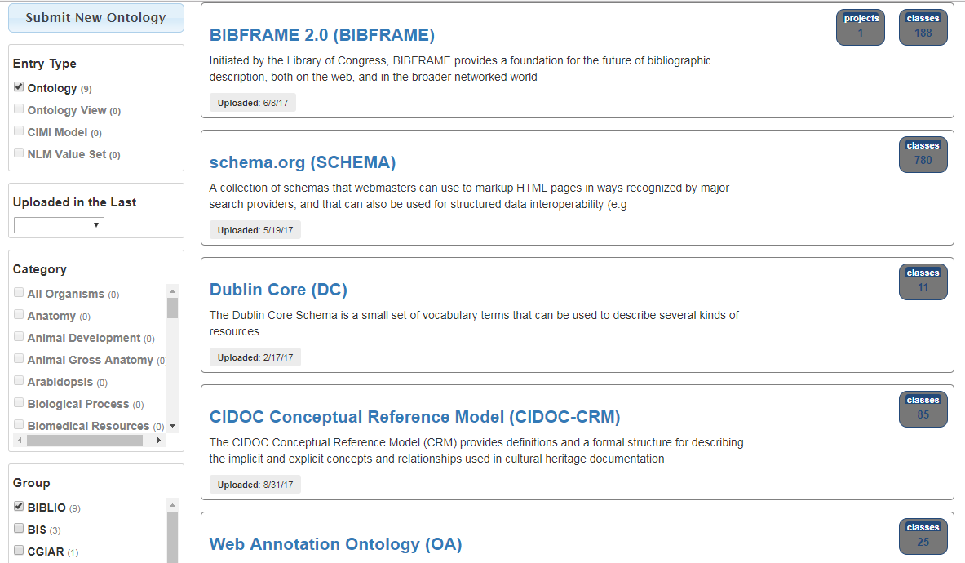
Notes:
Here is a snapshot of part of BiblioPortal. You can see it includes BIBFRAME, SCHEMA, DC, CIDOC-CRM, and the Web Annotation Ontology. It also contains MADS RDF, the Performed Music Ontology, and Bibliothek-O, and we will keep adding.

Slide 40
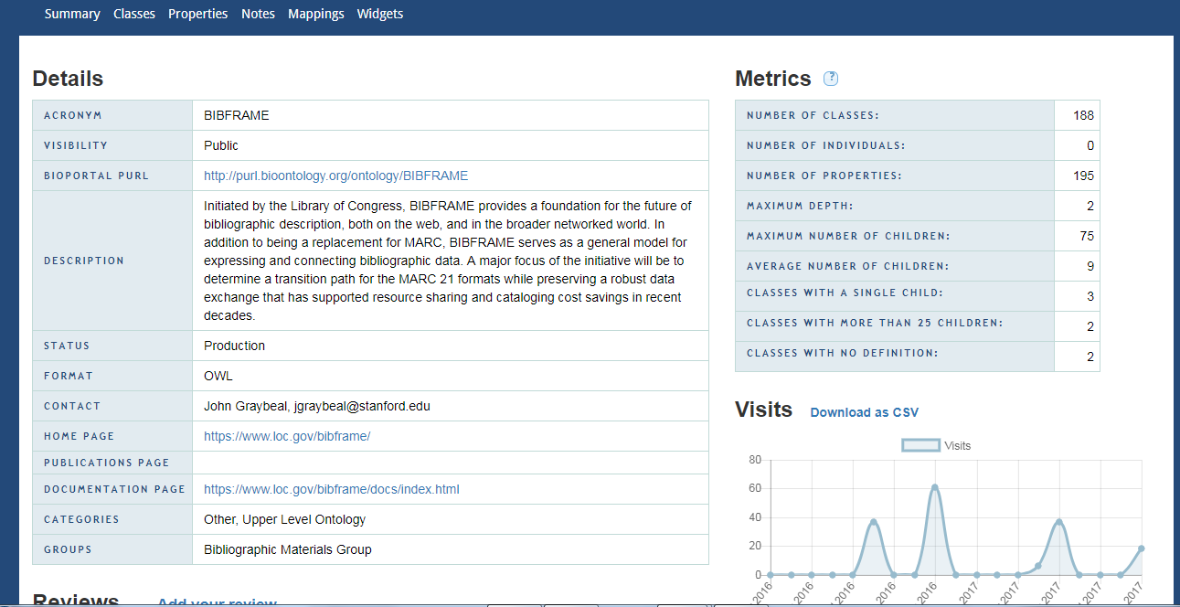
Notes:
Here is the details page for BF in BiblioPortal.

Slide 41
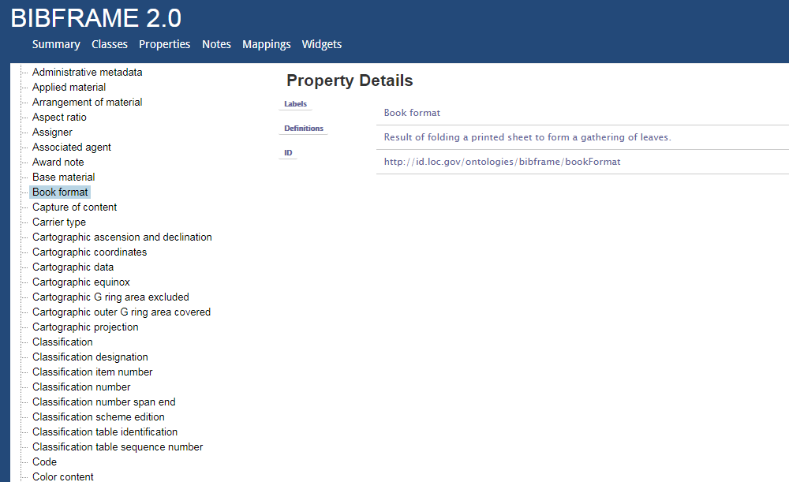
Notes:
And here are the properties…

Slide 42

CEDAR
CEDAR = The Center for Expanded Data Annotation and Retrieval
Mission: CEDAR will develop information technologies that make authoring complete metadata much more manageable, and that facilitate using the metadata in further research.
Elements:
  Interfaces and tools built and tested specifically for metadata creation
  Consistency in terminology
  Machine learning
  Editing capabilities
  Training and outreach
  Building on past work and leveraging ongoing collaborations
Notes:
Now of course BioPortal is simply a repository for various ontologies. For data creation, a group from the Bioinformatics Lab, called CEDAR is developing a metadata tool that creates templates for data entry based on ontologies and vocabularies (for now) that reside within BioPortal or whatever repository you dock it on. Their mission is “to….”, emphasizing user interfaces for metadata creation, consistent terminology, and editing capabilities. Creating a template does not require a developer, either to create the template or to link it to the metadata entry form.

Slide 43
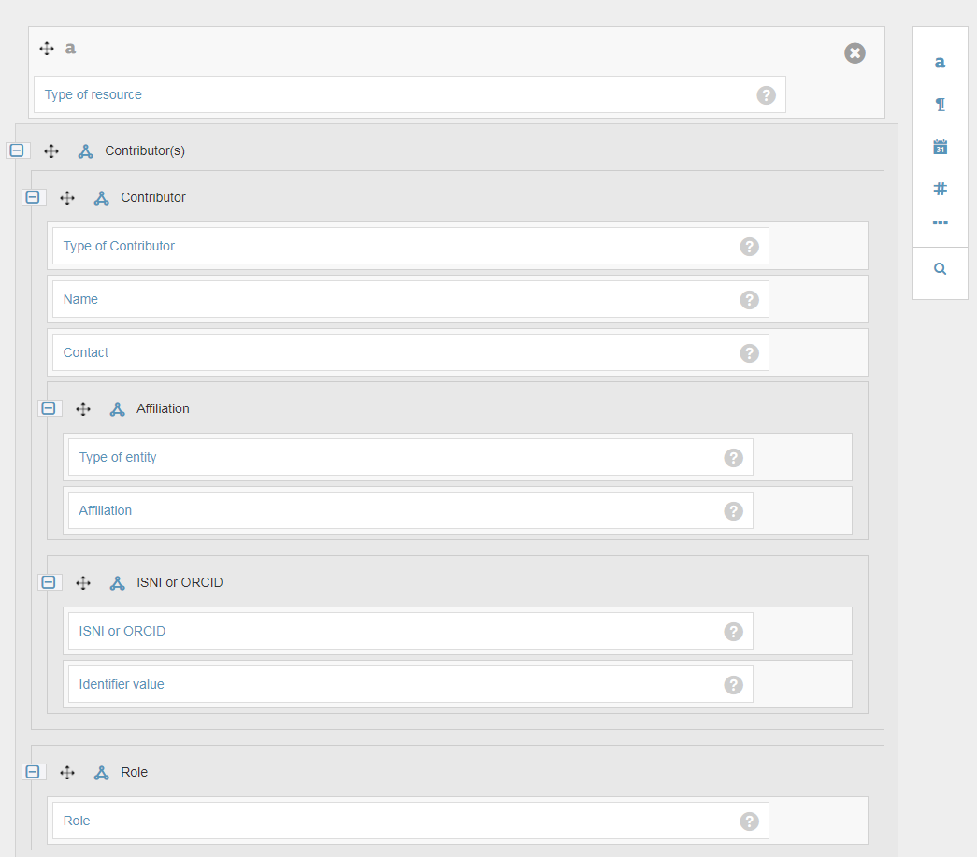
Template
Notes:
Here is a template for our third tracer bullet, individual deposit to the Stanford Digital Repository. It makes use both of RDA rules (to a limited extent), BIBFRAME, MADS-RDF and couple other ontologies. Each class and property are linked directly to the term in the ontology through an interna lookup [click]

Slide 44
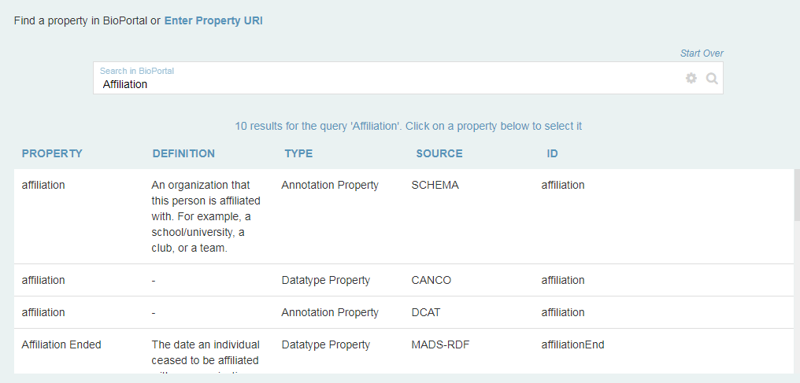
Notes:
Here for instance is a lookup to the term “affiliation”. You then click on your choice and it becomes part of your template.

Slide 45
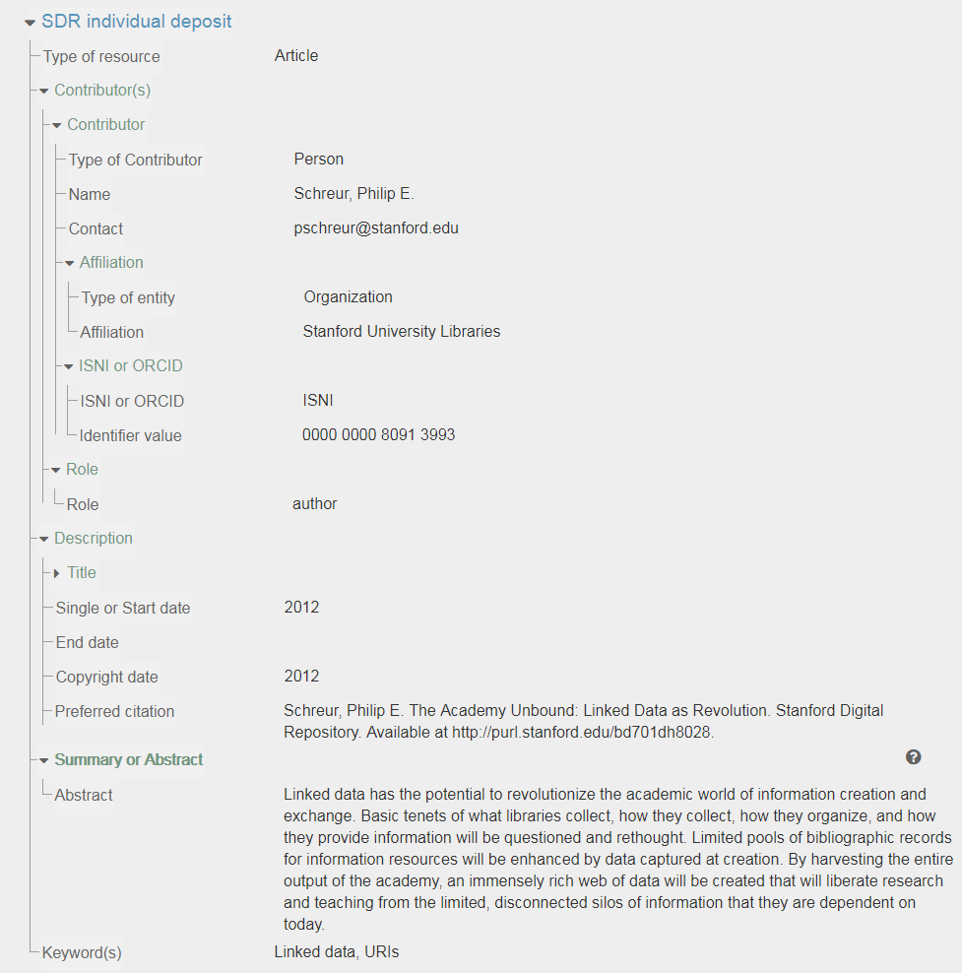
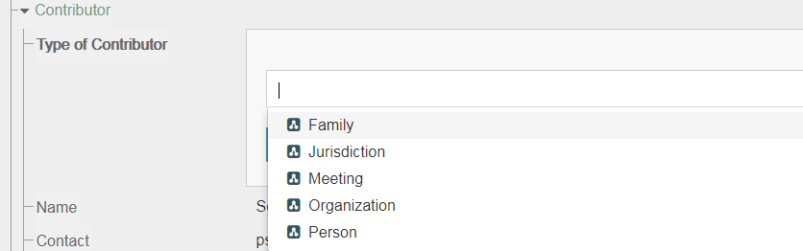
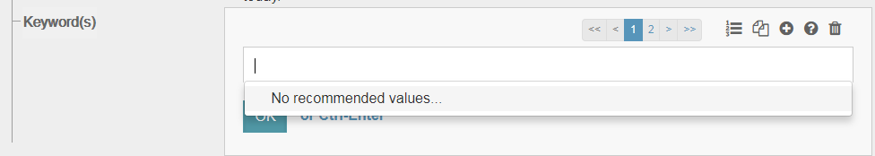
CEDAR entry form
Notes:
The entry form (here filled out) looks like this. The arrows are expandable and collapsible, so that the template requires no scrolling. You can provide dropdown menus, here of types of agents, that are also linked directly to the ontology. Other features include the ability to repeat individual fields or groupings of fields (called elements), specifying types of fields (e.g., dates) and suggested terms, as I have with our keyword entry, though unfortunately it has not yet been used enough to have any…

Slide 46
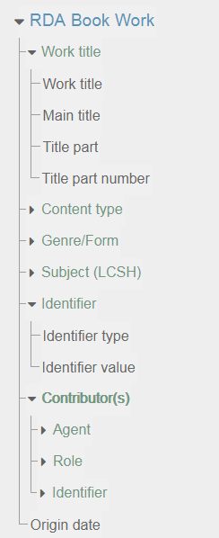
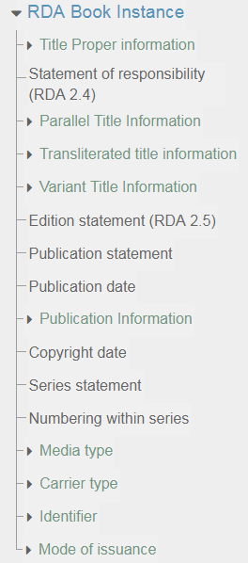
BF templates for RDA book cataloging
Notes:
CEDAR is quite flexible. Here are some initial templates for a book (Work & Instance templates) cataloged in RDA.

Slide 47
LC Editor vs CEDAR: Similarities
ability to do custom labelling that “hides” the ontology terms
ability to do lookups to value vocabularies
default values
ability to repeat “fields”
can use multiple ontologies
primary output in JSON-LD
neither deals well at the moment with multiple properties for the same class
the profile/template provides the primary definition of the application profile
Notes:
In some ways, the LC Editor and CEDAR are similar.

Slide 48
LC Editor vs CEDAR: Differences
LC
Cedar
properties & classes entered manually by profile creator
individual elements are reusable, using the same profile; when the element changes in one place, it changes in every profile it is used in
look ups restricted to full vocabularies (e.g. all LCGFT)
no validation or extended application profile ability (e.g. date type) beyond basic profile
properties and classes added through lookup & directly linked to ontology
individual elements are reusable, but must be duplicated in each template; when the element changes in one place, it does not change in other places
look ups can be restricted to individual children of a class or to hand-picked values
validation of entries including text, date (provides xsd:date), URIs, numbers
Notes:
But there are also some differences.

Slide 49
Moving forward…
Internal
  working to complete workflow analysis
  making current tracer bullets more robust & integrating SHARE-VDE & BSLW
  further enhancement of CEDAR templates
SHARE-VDE
  more conversion (MODS to BF and MARC to BF extensions)
  reconciliation of URIs
  data enhancements
  exploring potential for sharing data
Broader Community
  work with the PCC to host a linked data sandbox for community experimentation
  filling out application profiles to include relationships from RDA Registry
  working with the community to make BF a more community-based ontology
Notes:
So that sums up the work we have been doing to begin the move of some of our Technical Services workflows to a linked data environment. But where do we intend to go from here.
Internally…
with SHARE-VIDE….
with the broader library community..

