Slide 1

Pour Jacques…
Encoding annotations for rare book and special collections materials
ALA – June 26, 2016
Joyce Bell, Princeton University
Notes:
Thank you for this opportunity to talk about Princeton’s linked data project. The “Jacques” referenced in my title is Jacques Derrida, the Algerian-born French philosopher.

Slide 2
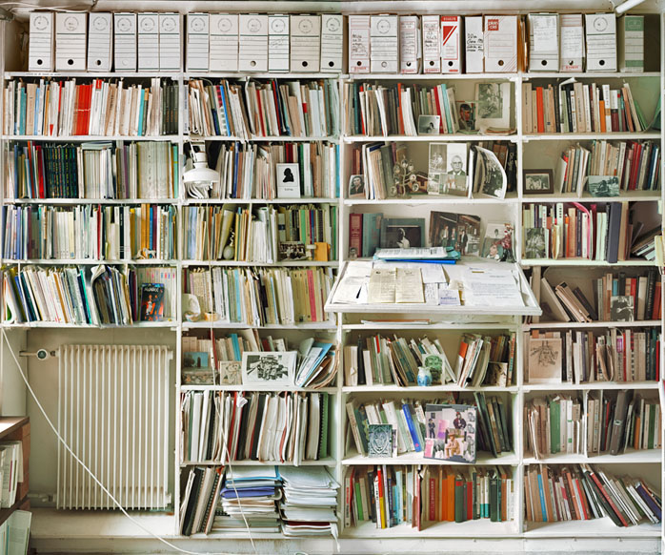
Derrida’s library
Portion of Jacques Derrida’s library at his home in Ris-Orangis.
Copyright ©2001 Andrew Bush. Used with permission.
Notes:
Last March Princeton acquired Derrida’s personal library. This wonderful photo by Andrew Bush gives you an idea of what it looked like in situ—it was a working library. His collection consumed large portions of his home with material stored on all 4 walls of his studio, and through the living room and attic of his house. It had been preserved by his family as he left it on his death in 2004. An inventory was done which assigned a number to each item based on its location in the room, which wall, bookcase, shelf, and position on the shelf, so we have the data to reflect the context of individual items.
The collection consists of nearly 19,000 books and other items. Almost 6000 of them are annotated, and 6,770 contain personal dedications to Derrida. These last are the ones we will focus on.

Slide 3






LD4P @ Princeton
Mellon-funded collaboration among six institutions
  Led by Stanford, with Columbia, Cornell, Harvard, the Library of Congress, and Princeton
Princeton’s core group:
  Joyce Bell
  Jennifer Baxmeyer with:
  Peter Green Regine Heberlein
  Tim Thompson Don Thornbury
Notes:
Our project is part of a collaboration with 5 other institutions in the LD4P Mellon-funded project. Over the last two+ years Princeton’s Cataloging and Metadata Services division has been learning about and discussing linked data. Led by a core group of catalogers, half of the division participated in LC’s BIBFRAME Testbed Initiative. We are joined by members of Princeton’s Department of Rare Books and Special Collections for our Derrida project.

Slide 4

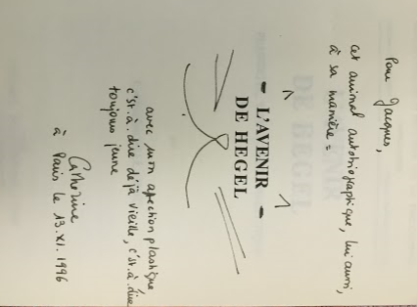
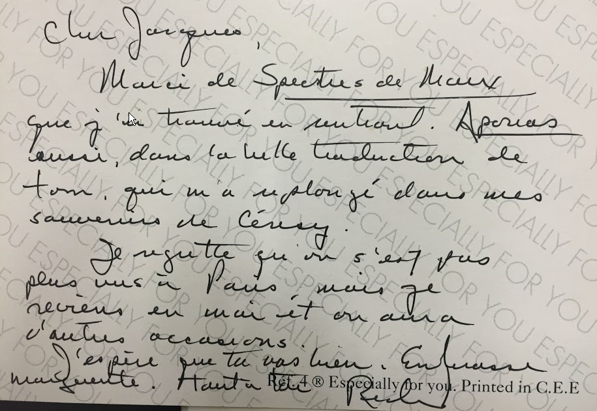
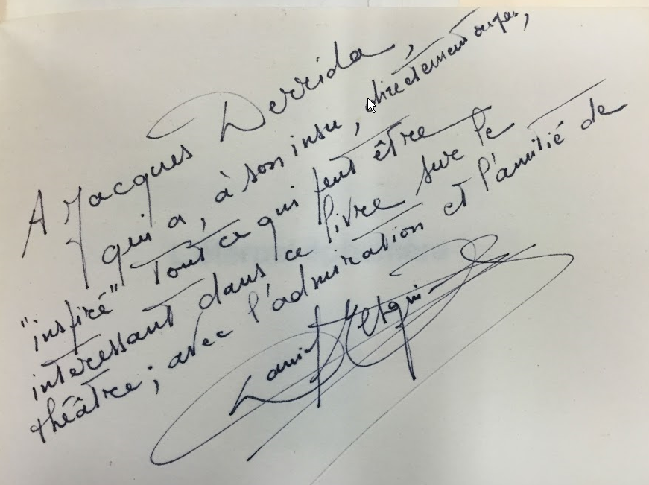
Dedications
Notes:
Derrida’s own interactions with his library were varied and primarily relate internally to the source. A particular page is turned down, or words and phrases within the text are underlined or circled. The many gift books Derrida received with personal inscriptions represent a different type of annotation, and these seemed a more fertile ground for our project as they reference people, places, and events which could be identified and made machine-actionable if they were presented as linked data rather than in a textual note in a MARC record.
You can see from these examples that the dedications are often more than a simple “to Jacques, from X” … including the charming example where Catherine has turned the title into a cat—presumably a play on her name.
During our project we are committed to creating from scratch, or converting and enhancing, bibliographic data in BIBFRAME for 500 objects dedicated to Derrida. We will code the dedications as linked data as well, improving on the access afforded by traditional cataloging options, and make the entire dataset publically available.

Slide 5
Enhancing dedications
For Jacques – on his first day at Irvine – affectionately as ever! Hillis Mar. 30, 1987
For Jacques / 15.7.1997
Pour Jacques Derrida et Marguerite, hommage et amitié, JF Lyotard, octobre 1986
Notes:
The dedications come in many forms and lengths. Some mention other members of the Derrida family. Some are signed more familiarly than others—or not at all. Dates are frequent with occasional mentions of an event, other people or publications.

Slide 6
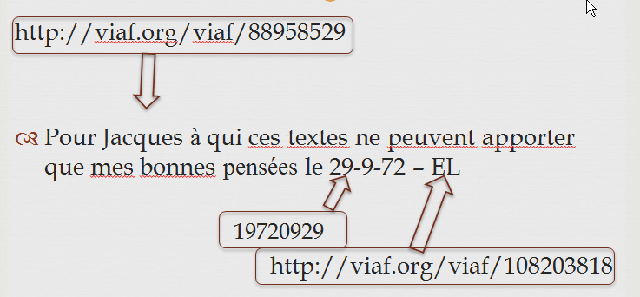
Enhancing dedications
Notes:
Beyond merely transcribing the dedications, we will be identifying people and places mentioned, providing identifiers, and coding dates using a standard format.

Slide 7
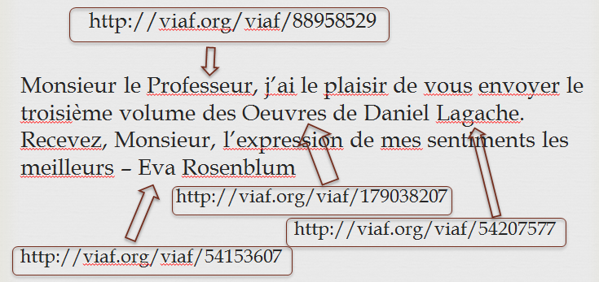
Enhancing dedications
Notes:
The model we are using allows us to associate the identifier with the particular text string it relates to, and positions it within the larger text block. As well as facilitating hyperlinking within a display form of the dedication, this can also allow searchers to access the many different forms in which Derrida was addressed, and perhaps understand more about his relationship with the dedicators based on their familiarity or formality.

Slide 8
Research questions
What do presentation volumes tell us about Derrida’s connections with members of the “Yale School”?
Derrida isn’t known for work in religion, so who sent him all those books on Judaism?
When did Derrida begin to be more influential and known to American scholars as compared to French scholars?
Notes:
We expect the resulting data set we create will allow scholars to delve more deeply into Derrida’s social and intellectual network. The combination of traditional cataloging elements like subjects, publication places and dates, together with the encoded dedication data, will allow scholars to flexibly navigate relationships over the collection as a whole.

Slide 9
Sample Query link to DBpedia
# Find dedicators who were also philosophers.
SELECT?anno ?creator2 ?label ?desc
WHERE
{
{
?anno dcterms:creator ?creator .
?creator skos:prefLabel ?label .
FILTER(?creator != <http://library.princeton.edu>)
}
{
SERVICE <http://dbpedia.org/sparql>
{
?creator2 owl:sameAs ?creator .
?creator2 dbp:shortDescription ?desc .
FILTER(regex(?desc, "philosopher", "i"))
FILTER(lang(?desc) = "en")
}
}
} ORDER BY ?label
Notes:
My colleague, Tim Thompson, set up a sample query to show how we can use our coded annotation data to query dbpedia to find philosophers amongst those who sent books to Derrida.

Slide 10
Sample Query results (partial)
Annotation | Creator | Label | Dbpedia data
http://library.princeton.edu/derrida/resource/4.1.3.2 | http://dbpedia.org/resource/Louis_Althusser | Althusser, Louis, 1918-1990 | French political philosopher
http://library.princeton.edu/derrida/resource/4.1.3.4 | http://dbpedia.org/resource/Louis_Althusser | Althusser, Louis, 1918-1990 | French political philosopher
http://library.princeton.edu/derrida/resource/1.2.14.5 | http://dbpedia.org/resource/Pierre_Bourdieu | Bourdieu, Pierre, 1930-2002 | French anthropologist, sociologist and philosopher
http://library.princeton.edu/derrida/resource/4.2.9.22 | http://dbpedia.org/resource/Jürgen_Habermas | Habermas, Jürgen | German philosopher
Notes:
The far right-hand column shows data not stored in our dataset which can be leveraged to enhance the context and support scholarly research into Derrida’s intellectual network.

Slide 11

LD4P @ Princeton
Timeline:
  Preproject
  Phase 1 (April-September 2016)
    Focus: ontology, modeling, preparation
  Phase 2 (October 2016-March 2017)
    Focus: data conversion, tools, data creation
  Phase 3 (April-September 2017)
    Focus: data creation, sharing
  Phase 4 (October 2017-March 2018)
    Focus: finalize dataset, ontology, etc.
Notes:
Our timeline is keyed to the Mellon grant Stanford received on behalf of the group, and is broken down into 6-month phases, each with a particular area of focus. Phase one began April 1st – we are trying not to read too much into that!

Slide 12
Pre-project activities
Selected 45 items with personal dedications.
Hand-coded RDF data using Web Annotation Model and Vocabulary as framework.
Developed exploratory queries.
Met with faculty stakeholder to discuss use cases.
Notes:
To understand more fully what we were getting into, we hand-coded an assortment of annotations. Doing so gave us a sense of what tools we would need to have in place for production work, what aspects would be routine work, and what aspects would require greater knowledge and training.

Slide 13
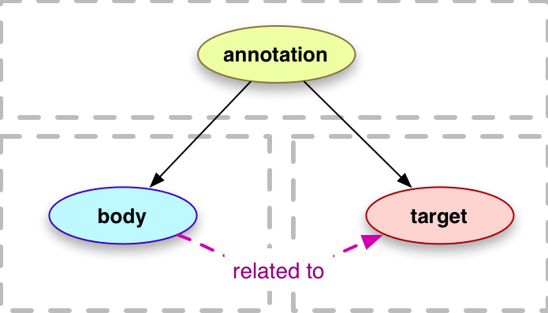
W3C Web Annotation Model
Notes:
We are using the W3C Web Annotation model for the dedications.
The core purpose of this model fits our situation: “Annotations are typically used to convey information about a resource or associations between resources.” Our components fit into the structure of the model –the text of the dedication is the body, and the publication the dedication is written in is the target. The fit isn’t ideal as this model is designed for annotations taking place on the web and pointing to a digital target rather than on a real world object.

Slide 14
Partial encoding of a dedication
<http://princeton.edu/1.4.2.42> a oa:Annotation ;
dcterms:creator <http://viaf.org/viaf/19675770> ;
dcterms:created "19770303T12:00:00Z" ;
oa:hasBody <http://princeton.edu/1.4.2.42/body1> ;
oa:hasTarget <http://library.princeton.edu/1.4.2.42/pageX> ;
oa:motivatedBy <http://example.org/dedicating> .
<http://princeton.edu/1.4.2.42/meta1> a oa:Annotation ;
dcterms:creator <http://library.princeton.edu/> ;
oa:hasBody [ oa:hasSource <http://viaf.org/viaf/163091629> ;
oa:role "tagging" ] ;
oa:hasTarget [
oa:hasSelector [
a oa:TextQuoteSelector ;
oa:exact "Mme Marguerite Derrida" ;
oa:prefix "Pour " ;
oa:suffix " tres cordialement" ;
] ;
oa:hasSource <http://library.princeton.edu/1.4.2.42/body1>
] ;
oa:motivatedBy oa:identifying .
Notes:
I put this slide up to distract you while I admit that we will need to be creative with the model we are pursuing.
The “motivation” or reason for creating the annotation is controlled by a vocabulary which doesn’t currently include a value appropriate to our use case. We can supply the “created” date information for many of the dedications, although we will not be able to follow the recommendation to use a form including a timestamp and timezone. The resulting coding doesn’t allow ut to distinguish between the creator of the physical annotation and the creator of the transcribed annotation.

Slide 15
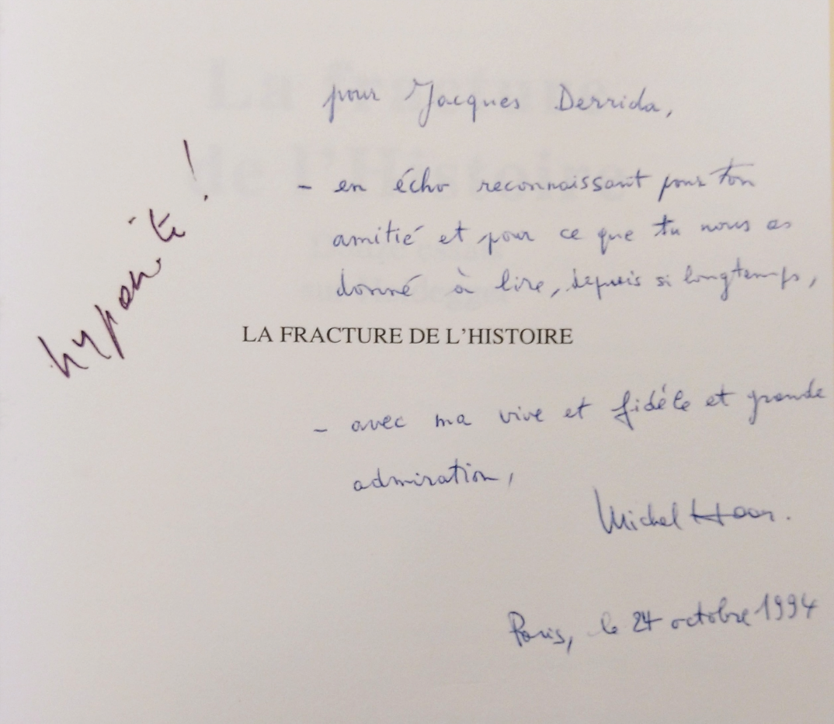
Encoding challenges
Notes:
A further encoding challenge is presented by layers of annotation, as in this example where Derrida appears not to believe in the sincerity of the presenter and has added his own annotation in the form of the response “hypocrite”.

Slide 16
Misc.
Princeton project website:
  https://library.princeton.edu/tsd/cams/ld4p
LD4P project wiki:
  https://wiki.duraspace.org/pages/viewpage.action?pageId=74515029
Related projects
  Princeton Center for Digital Humanities project
Notes:
In addition to a general website for the group LD4P project, we have a Princeton-specific website where we are regularly posting short updates on our project. Princeton’s Center for Digital Humanities is supporting another project related to the Derrida library focused around his publication Of grammatology and the source material from his collection which he cited or quoted in its creation.

