Slide 1

An Update from the PCC URIs in MARC Task Group
ELUNA | OKC | 2016
Image credit: http://www.whorange.net/
Notes:
Talk Description:
In recent years the MARC format has been extended to provide for identifiers for a wide range of entities represented in bibliographic and authority records, but thus far these new elements have not consistently been populated. Moreover, the current practice is generally to supply an alphanumeric string rather than a URI (a key requirement for the effective dissemination of data on the Semantic Web) even though URIs are available in many cases. This session will be an update from the Program for Cooperative Cataloging (PCC) URIs in MARC Task Group which has been working since the Fall of 2015 to define best practices for capturing URIs in MARC. These best practices have the potential to enable for easier management of our data in our local systems, new use cases in our discovery environments, and ultimately result in more interconnected data when we convert our legacy data to linked data.

Slide 2
Talk Outline
Role of URIs and the Semantic Web
Brief History of “Linking” Identifiers in MARC
Why the PCC Cares
PCC URIs in MARC Task Group Activities
Use cases for URIs in PNX

Slide 3
In linked data a URI identifies the thing.
The thing can have labels (even preferred labels) and relationships to other things, but none of these traits *identify* the thing.
Notes:
So how do we get there?

Slide 4
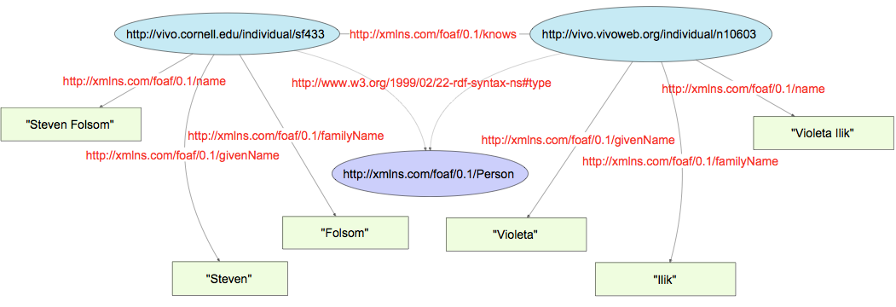
URIs Continued
Notes:
The URI stands-in or symbolizes the actual thing. We can say that thing has traits. In this case the URI on the left stands in for me. I am a person as defined by the FOAF ontology. I have a name, “Steven Folsom”. I know another person, Violeta who is identified by a different URI.

Slide 5
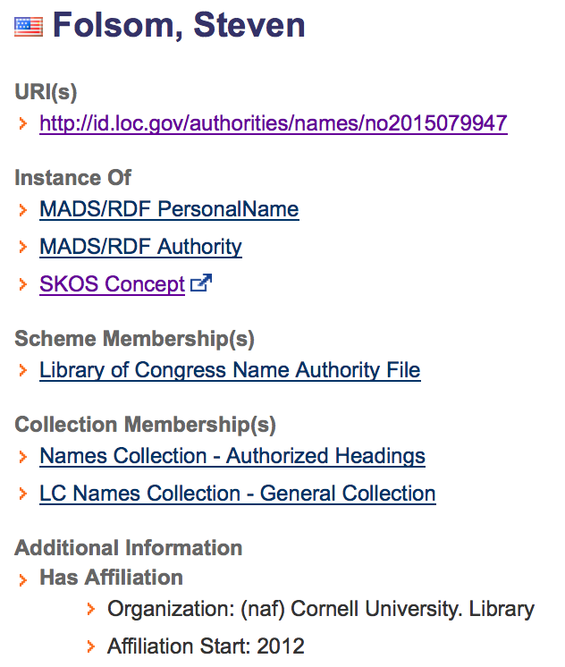

Records/Authorities and the Things They Describe
Notes:
Libraries have Records/Authorities about things
The web has webpages about things
When we talk about linked data we mean URIs that identify the things themselves, with associated data.
We need information resources (websites and authorities) to be separate entities from the things themselves
A Person and Record/Authority/Website About a Person have different traits, e.g.
Creators/Creation dates (You can do the math.)
Size (height and weight vs. bytes)
Suppressed means something completely different when talking about a person (or class of persons) vs. a record
RDA and 3XX’s go a long way toward generating RWOs. The problem is that the RWO data in these authorities don’t have a separate URI for the thing they describe, making them hidden in the record.
A big and meaningful change would be to give the persons in these records their own URI and relate them to the authority. LOC is currently underway with introducing separate URIs for the Authority and the Things they are about.

Slide 6
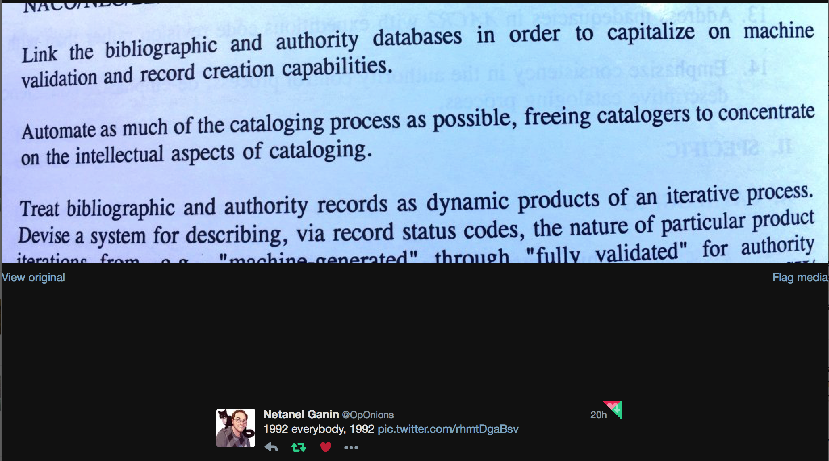
How did we come to this point in history?
Notes:
Turns out this was 1994, but you get the point.
Towards a New Beginning in Cooperative Cataloging, History, Progress, and Future of Cooperative Cataloging Council by Library of Congress.
(https://babel.hathitrust.org/cgi/pt?id=mdp.39015034240682;view=1up;seq=35).

Slide 7
History of URIs an the $0
http://www.loc.gov/marc/marbi/2009/2009-dp01-1.html
http://www.loc.gov/marc/marbi/2009/2009-dp06-1.html
http://www.loc.gov/marc/marbi/2010/2010-dp02.html
http://www.loc.gov/marc/marbi/2010/2010-dp03.html
http://www.loc.gov/marc/marbi/2010/2010-06.html
http://www.loc.gov/standards/sourcelist/standard-identifier.html
Notes:
In 2009-2010, there was a flurry of MARBI Discussion Papers about the use of URIs. After some back and forth, including considering using the $1 for URIs and keeping the $0 for control numbers, the MARBI group decided to have both control numbers and URIs in the $0.
Consider this foreshadowing…

Slide 8
Led to Current Specification for URIs
100 1#$aBach, Johann Sebastian,$d1685-1750 $0(uri)http://id.loc.gov/authorities/names/n79021425
_________________________________________
600 17$aBach, Johann Sebastian,$d1685-1750 $0(uri)http://id.loc.gov/authorities/names/n79021425$2naf
_________________________________________
024 7#$ahttp://id.loc.gov/authorities/names/n79021425$2naf

Slide 9

Related Work
http://kcoyle.blogspot.com/2013/07/linked-data-first-steps-catch-21.html
Local Library Practice/Experimentation
  GW
  Stanford
  Princeton
  Cornell
OCLC FAST $0’s
Univ. of Mannheim & Amsterdam
Image credit: www:papercitymag.com
Notes:
Karen Coyle in 2013 was calling for libraries to double down on using URIs, and to make local decisions outside of the MARC spec to allow URIs to be more useful upon conversion to RDF.
Many libraries around that same time began adding URIs to their MARC records experimentally in a more concerted effort. George Washington under Jackie Shieh began adding them as a part of their RDA reclamation work. More on this in a second.
Stanford began working with vendors like Backstage to have URIs added to local fields in the MARC because (my understanding) of the complications of how OCLC does or doesn’t treat them.
Princeton and Cornell began experimenting as well.
Sentiment for $0s seemed to shift with the addition of FAST to the OCLC database. For each FAST heading in a bib there is now a $0 linking it to the FAST entity.
On the Primo front, Univ. of Mannheim & Amsterdam began enhancing PNX data to connect with RDF in the Dutch National Library Repository. (http://www.slideshare.net/lukask/the-drawbridge-to-knowledge)

Slide 10
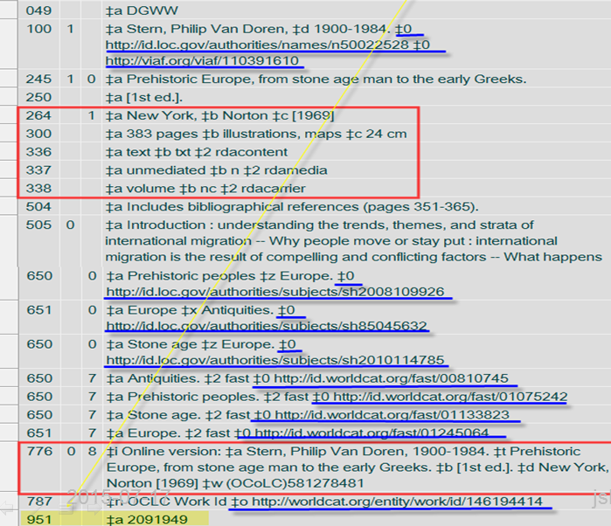
Notes:
Jackie Shieh and George Washington University’s RDA records.

Slide 11
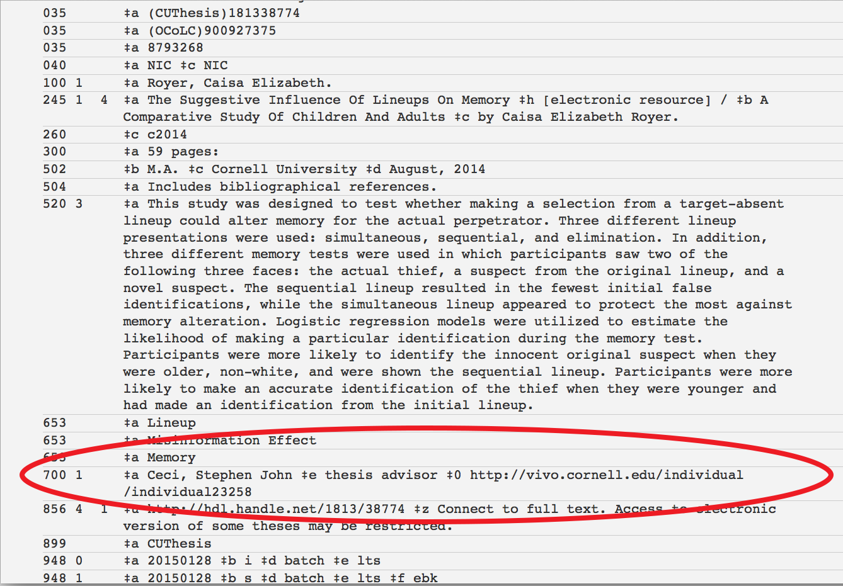
Notes:
Cornell’s use of VIVO URIs for Cornell Faculty, in this case to control advisors in records for theses, derived from the Graduate School Database. The names aren’t using LCNAF, but instead as they appear in the Grad database.
Opportunistically both the grad database and VIVO have faculty share faculty id’s so the script that creates the MARC records can look up URIs in VIVO for faculty.

Slide 12

May 2015
Call for best practices posted to the PCC list (white paper: http://bit.ly/1BMQ0ed)
Image credit: https://www.pinterest.com/eamesoffice/dogs-and-eames-chairs/
Notes:
Some of the same functions that URIs serve in Linked Data (to identify, collate, and disambiguate) are functions they could serve in MARC right now.
Adding URIs to MARC records would also make the transition to linked data less bumpy; MARC to linked data converters would require less reconciliation if we were adding URIs to records now.

Slide 13
PCC Strategic Direction 3
“Existing methods of library authority control are based on constructing unique authorized access points as text strings (literals). This string-based approach works somewhat well in the closed environment of a traditional library catalog, but not in an open environment where data are shared and linked, and so require unique identifiers. The web presents both a challenge and an opportunity for libraries, which are now in a position to take advantage of authorities created outside of the library world, and also to contribute library authority data for use by other communities.”
Notes:
The PCC Strategic plan anticipates the need to move away from using unique text strings to as we share our data on the wider web.

Slide 14
PCC URIs Task Group Activities
MAC Discussion Papers (Submitted this cycle)
  Removal of (uri)
  Adding $0 to select fields where currently not permitted.
    Bibliographic Format: Country of Producing Entity (257)
    Bib and Authority Format: Associated Language (377)
  URIs for $4 (proposal from British Library in consultation with the PCC Task Group on URIs)

Slide 15

[Tenative/Hopeful] Blockbuster
Summer Releases
Formulating and Obtaining URIs: A Guide to Commonly Used Vocabularies and Reference Sources
RWO Discussion Paper
Notes:
Hoping to share with the community later this year two documents
Formulating and Obtaining URIs: A Guide to Commonly Used Vocabularies and Reference Sources will:
Outline for the commonly used vocabularies and data sources in MARC
how their related systems construct URIs
Where in the interface you can go to find them
Link to the RWO discussion paper
RWO Discussion Paper will outline the differences between URIs for Authorities, Things, and Related Websites.
Link to the Formulating and Obtaining URIs: A Guide to Commonly Used Vocabularies and Reference Sources document.

Slide 16
Unanswered Questions in MARC
Repeatability, and how to perform heading maintenance if $0’s are repeated?
Consideration being given to accommodating various cataloger realities
  Access to Authority Records
    Single URI per $a, other URIs linked to from Authority/Thing
  No access to related Authority Records
    Repeated $0s in Bib per $a

Slide 17
Unanswered Questions in MARC
How to capture URIs in order to provide the clearest semantics? (URIs for things vs. URIs for authorities about things)
Currently only one subfield ($0 or $w) to capture URIs in BIBs per field; current MARC semantics is “record control number”.

Slide 18
*Draft* solution to the unanswered questions
Bib Format
100 1# $a[Name] $d[date] $0[AuthorityURI]$1[ThingURI] $2[Source of $a]
Authority Format
024 [New Second Indicator for Authority or Thing] $a [URI]
Notes:
The PCC URIs in MARC Task Group hasn’t come to an agreement for solutions to the outstanding questions, but here is a sketch of what we might propose.
Part of the reason to propose a talk like this is to get real time peer review of your work.
Goals of this proposal:
We can continue to use authorities for as long as they are useful.
We can allow catalogers to repeat $0 and $1 in bib’s because the $2 can be used to designate which Data Source to use to maintain the heading in MARC.
We can note URIs for Authorities, distinct from URIs for Things so that we can convert our data to RDF more meaningfully.

Slide 19
<ex:ThisPresentation>
dcterms:creator
<http://orcid.org/0000-0003-3427-5769> .
<http://orcid.org/0000-0003-3427-5769> ,
owl:sameAs
<http://vivo.cornell.edu/individual/sf433> ,
<http://viaf.org/viaf/316560733> ,
<http://worldcat.org/entity/person/id/2630057950> .
<http://id.loc.gov/authorities/names/no2015079947>
mads:identifiesRWO
<http://orcid.org/0000-0003-3427-5769> .

Slide 20
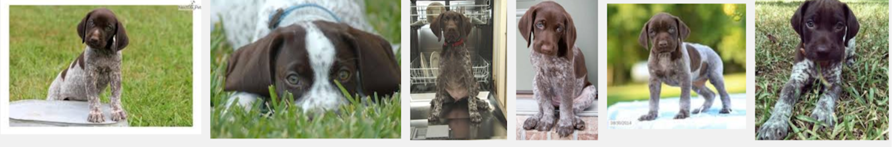
Ex Libris 2016 Linked Data Collaboration Program
Current discussions on what we can do in Primo once the URIs are in PNX
  What to display (VIAF, id.loc,gov, MESH, etc.)?
  What to index from various data sources (VIAF, id.loc,gov, MESH, etc.)?

Slide 21
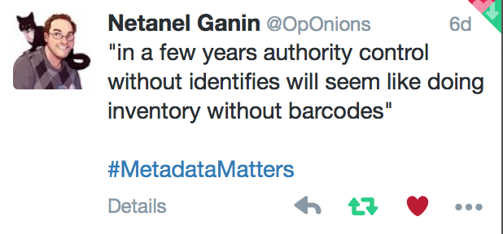
[A Chew Chiat Naun quote from a Back Stage Metadata Matters event.]
Notes:
A Chew Chiat Naun (from Cornell) quote from a Back Stage Metadata Matters event.

Slide 22

So if barcodes don’t excite you, maybe dogs and chairs.
Image credit: https://www.instagram.com/p/2giK7lOZa8/
Notes:
So if Barcodes don’t excite you… Maybe Dogs and Chair can better characterize how I hope the library community reacts to the use of URIs in MARC.
Like dogs, hopefully chance encounters with URIs will provide positive feelings because of the promise of they provide. Eventually like chairs, URIs will be ubiquitous and well designed, where form meets function.

