Slide 1
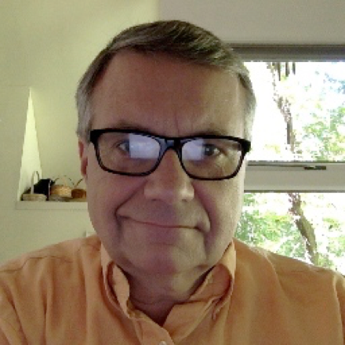
Mike Conlon
PhD, Statistics, 1982, Univ of Florida
Biostatistics faculty member, 82-15
Collaborating statistician 75-02
IT director for Liberal Arts 94-97
CIO UF Health Center 97-02. Led UF Identity management efforts.
Assoc Univ CIO 02-10. Led UF PeopleSoft implementation
Director of Biomedical Informatics, 08-15. Led creation of Integrated Data Repository
VIVO Principal investigator 09-12. $12M NIH ARRA award. 7 school consortium.
Co-director UF CTSI, 10-15. 190 employees. Grew from $4M to $17M annually.
PI or co-PI on $128M in sponsored research
Retired from UF May, 2015. VIVO Project Director 15-current
Interests in translational science, identity management, information representation, open science
Here’s Mike on a conference
call from his home. Mike
spends a lot of time on
conference calls from his home,
and from coffee
shops in and around
Gainesville, Florida

Slide 2
Translational Science
T4 – Translation to population health. Studies outside care settings E.g. Weight loss, access to care, behavioral studies
Population Health/
Scientific Discovery
Human Applications
Therapies
Practice
T3 – Translation to practice. How to increase uptake of new approaches. E.g. Clinical Outcomes, Health Services Research
T1 – Translation to humans. Scientific discoveries applied to human health. E.g. Genetics, engineering
T2 – Translation to patients. Demonstrate use is safe and effective. E.g. Clinical Trials

Slide 3
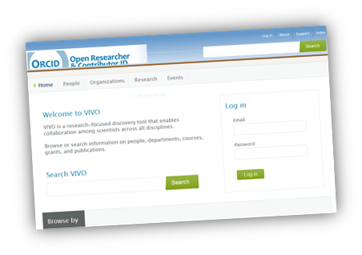
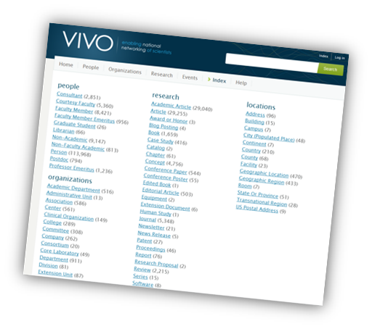
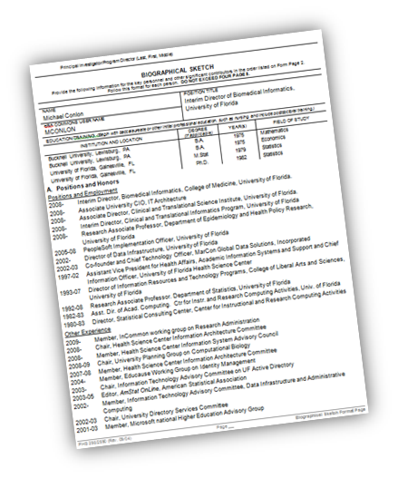
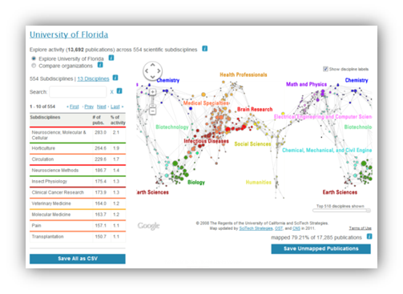
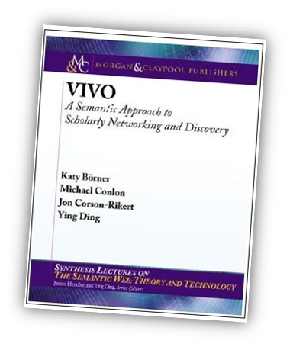
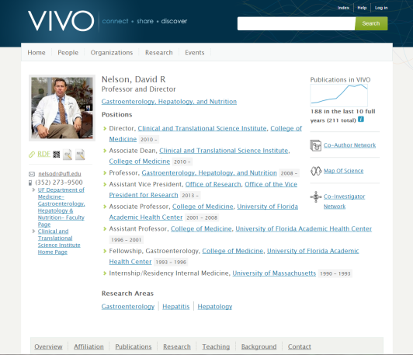
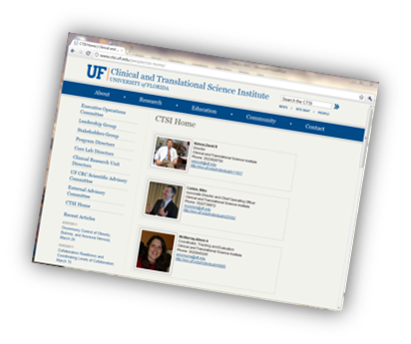
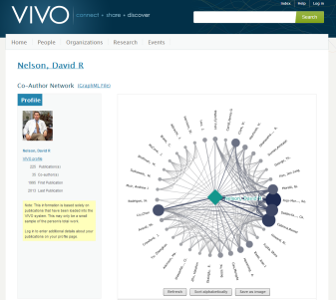
VIVO
Open Source, Semantic Web software, ontology and community for research discovery
Creates an integrated view of the scholarly work of an organization.
At UF: all faculty, research staff, colleges, departments, centers, institutes
All papers (54,000), grants (24,000), courses taught (87,000) since 2008
Search, co-author networks
Data used for social network analysis, evaluation, expert finding
Conference in Cambridge MA, Aug 12-14
Vivo.ufl.edu
Vivoweb.org

