Slide 1
Digital Preservation of the
NLM Digital Collections
October 8, 2015
John Doyle
Doron Shalvi
National Library of Medicine

Slide 2
Goals
Safeguards for long-term viability
of digital content
Technical measures and institutional policies aligned with best practices,
notably TDR/ISO 16363
Replication of content with external institutions and organizations

Slide 3
Content Overview
Current:
  Books: 2.7M pages
  Videos: 200
  Citations: 3.8M
Future:
  Images
  NLM-developed Software
  Oral Histories
  Modern Manuscripts
  Web Content
  Born Digital

Slide 4
Preservation Architecture
On-site
Off-site
Digitization
Compute fixity
Scanning & Processing
Masters
5
Validation
Characterization
Normalization
Verify fixity
QA
Masters
4
Ingest content
Cross-check with ILS
Verify fixity
Fedora
(Preserv.)
Masters
1
Masters
2
Masters
3
Read-only access
Fedora
(Access)
Resolver
Permalinks

Slide 5
Preservation Components
Off the shelf code
  Fedora
  FITS (including JHOVE, File Utility, Exiftool, Driod, NLNZ Metadata Extractor, OIS File Information, FFIdent)
  NetApp SnapMirror, SnapShot
Custom code
  Post-digitization validity checks
  Management of automated QA review
  Manage fixity checks with Fedora
  Cross-check with ILS
  Resolve permalinks

Slide 6
Preservation File Formats
Master – highest quality for a given resource
Varies according to content type and source
Page Image
  Current standard: TIFF, 24 bit color, 400 dpi
    File sizes ~21 MB, up to 180 MB
  Others: JPG, typically 1 MB
Video
  Current standard: MPEG-2 from access DVD or BetacamSP analog preservation master
  Future: Motion JPEG2000, ProRes, FFV1?

Slide 7
Workflow at a Glance
Obtain Digital Content
  Generate Masters, some derivatives, fixity
Perform Automated QA Review
  Check completeness, normalization, fixity
Create Submission Information Package
  Generate access derivatives, objects
Ingest into Digital Repository
  Check fixity
Operations and Maintenance
  Check fixity
  Referential integrity

Slide 8
Identifiers
ILS ID 8400408
Repository ID nlm:nlmuid-8400408-bk
Permalink http://resource.nlm.nih.gov/8400408
IHM ID (still images) C06249
Resolver service routes permalink to current implementation
Notes:
Add IHM identifier

Slide 9
Automated QA Review
Homegrown tool to manage automated QA process
Batch processing with manual review
FITS (including JHOVE, File Utility, Exiftool, Droid, NLNZ Metadata
Extractor, OIS File Information, FFIdent)
Checks being performed for digitized texts:
  Empty file (OCR)
  Checksum (Master files, ALTO, OCR)
  XML Schema/Syntax (all XML files)
  Image File Format (Master files)
  Number of Files (all files)
  Filename (master image, ALTO, OCR)
  UID in MARCXML (MARCXML)
Results stored permanently in Oracle DB

Slide 10
Automated QA Review
Checks being performed for videos:
  Counts correct number of files in SIP
  Checks appropriate file naming convention syntax and file extensions (file names manually created so there is chance for human error)
  Illegal XML characters in caption file such as M-dashes, umlauts, ampersands; empty paragraphs (affects video player transcript display)
  Empty files (faulty caption/transcript export event; faulty video conversion)
  Audio and Video technical characteristics via MediaInfo report:
    Script compares pre-defined values/parameters against report output:
    Format/format version (MPEG-2; AVC)
    Frame rate/bit rate (throttle h.264 esp. for video player derivative)
    Audio format (AC-3/MPEG Audio/AAC); channel position; sampling rate; bit rate (again throttle h.264)

Slide 11
Multiple Copies of content
NLM Goal:
  Three copies of masters in geographically separate locations
  One copy offsite and offline?
Current status:
  First full copy at primary NLM data center (onsite, online)
  Second full copy at backup NLM data center (offsite, online)
  Third full copy at off-site storage facility (offsite, offline)
  Additional partial copies at partner institutions, including Internet Archive (incl. masters), Wellcome Library
Future work
  Explore cloud-based storage and services solutions for third copy
  Collaborative preservation services – e.g. HathiTrust
Challenges
  Offline solutions difficult to implement in enterprise data center

Slide 12
Primary Storage
Spinning disk in RAID 6 array
Continuous scrubbing in background
NetApp Snapshots, NLM Data Center standard
Snapshots
  Schedule: 4x per day
  Retention: 13 monthly, 14 daily, 4 hourly
Mirror to backup data center
  Schedule: Every 20 minutes via SnapMirror
Notes:
Lastly, update the Snap Mirror schedule: 4 hourly, 14 daily, 0 weekly, and 13 monthly
See also Digital Repository Infrastructure
Enterprise storage architecture:
Dedicated spinning disk in a RAID 6 array (double parity)
16 disks per rack
3TB disks for large, static data such as websites, digital repository master datastreams
?GB disks for transactional or volatile data such as databases
First line data backup and restore:
NetApp OnTap service features
Continuous Media Scubbing in the background to find media errors and reconstruct data using horizontal and diagonal parity
Weekly RAID-level scrubs run every Sunday from 1:00am to 7am. RAID-level scrubbing checks the disk blocks of all disks in use in aggregates (or in a particular aggregate, plex, or RAID group) for media errors and parity consistency.
If Data ONTAP finds media errors or inconsistencies, it uses RAID to reconstruct the data from other disks and rewrites the data.
RAID-level scrubs help improve data availability by uncovering and fixing media and checksum errors while the RAID group is in a normal state (for RAID-DP, RAID-level scrubs can also be performed when the RAID group has a single-disk failure)
SnapShot and SnapMirror
Digital repository "ext" and "master" volumes are currently snapshotted daily at 8am, 12pm, 4pm, and 8pm; nightly at midnight; weekly on Sunday
We currently retain 4 hourly, 14 daily, 13 monthly SnapShots for data recovery
Snapshots are local, not filer to filer, separate at Bethesda and NCCS instances
Offsite COLO services at NCCS in Sterling, Va.
Data and applications replication via SnapMirror
Cycles every 20 minutes

Slide 13
Fixity
NLM Goals:
  Re-compute and confirm fixity of masters on a routine basis
  Store evidence of fixity checking, ideally with the object
  Retain fixity checks for a time period TBD
Current fixity workflow
  Checksum computed when content is generated
  Checksum verified during automated pre-ingest QA
  Checksum verified at Fedora ingest time
  Checksums stored with content in Fedora

Slide 14
Post-Ingest Fixity Checking
Custom code for manage fixity process
  Query Fedora for objects expected to have MASTER datastream
  Ask Fedora to verify fixity of each MASTER datastream
  Store results in external file
  Summarize, record and store results
  Code is launched manually, could be scheduled job
Most recent results
  2.7 million objects, mostly page images with JPG or TIFF masters
  160K checksums per day; 3 weeks to check all content
  No errors except for transient network issues for very large vid files

Slide 15
Auditing
Current Audit Logs
  Ingest, modifications to Fedora
  Fixity – QA, Fedora, external
  scripts - all have audit logs
  Characterization audit trail
Future Audit Work
  Crisp goals for audit specificity
  location, retention
  Better management tools

Slide 16
Referential Integrity
Ensure the repository contains what it is supposed to
Two-way check: ILS(Voyager) ← → Repository (Fedora)
Ingest Processing workflow:
  Item selected for digitization
  MARC 998a field updated with DREP code
  Item digitized, processed, ingested into repository
  MARC 998b field updated with date of ingest
Custom code implements post-ingest regular ref. integrity check:
  Runs weekly
  Extract ID lists from Voyager, Fedora
  Check for differences
Initial run identified discrepancies
Challenges – not all repository resources are in ILS

Slide 17
Possible Fedora Enhancements
Durability Management Module
Ask Fedora to check objects and descendants for:
  Model (object) validity, Fixity
  Other checks possible (virus, characterization, obsolescence)
  Support redundant storage strategies
  Check would include datastreams and possibly descendants
Management tools for checks
  Check periodically on a scheduled basis
  Store checks with object audit trail
  Summary reporting, error notifications
If these are not in core Fedora, at least work towards community guidelines /best practices

Slide 18
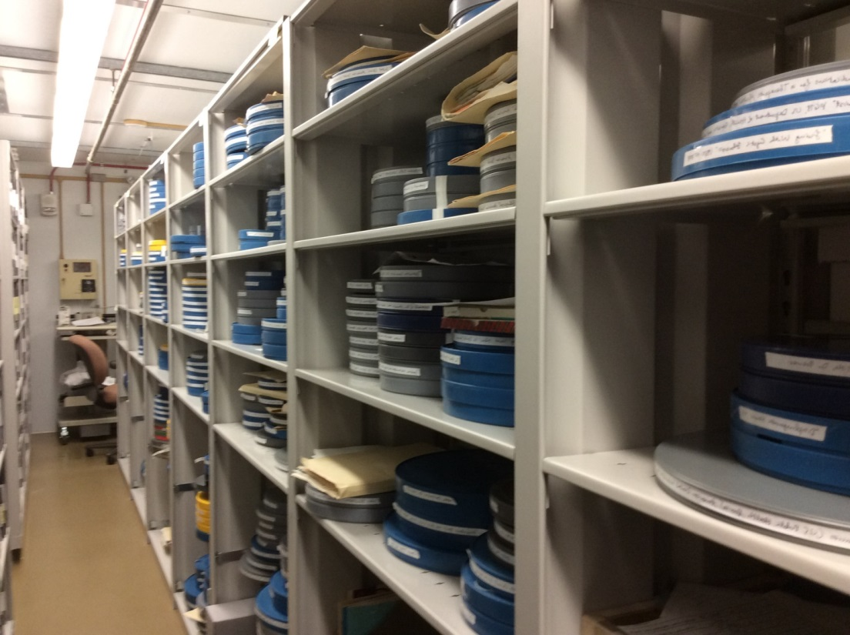
NLM’s Audiovisual Holdings
Est. 39,000 titles
  Est. 29,000 in the general collection
  Est. 10,000 in the HMD collection
    6,100 cataloged
    3,900 to be processed

Slide 19
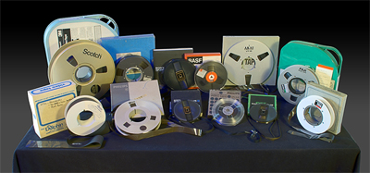
AVs - Media Types
Film:
  16mm
  35mm
  8mm
DVDs
Slide sets
Filmstrips
Audiocassettes
¼ inch open reel audio

Slide 20
AVs – Media Types
Analog videotape:
  U-matic
  BetacamSP
  VHS
  1 inch Type C
  2 inch quadruplex
Digital videotape:
  DVCPro
  DigiBeta

Slide 21
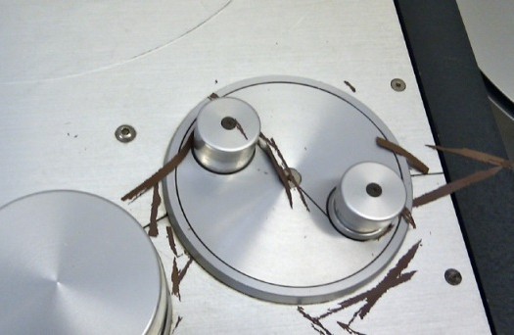
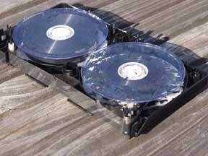
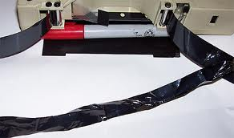
AVs – Risk of Degradation
Deterioration of the media or the AV signal on the media.

Slide 22
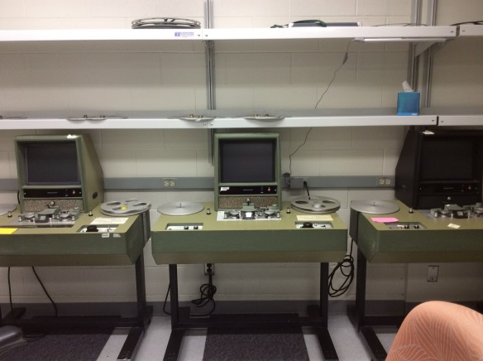
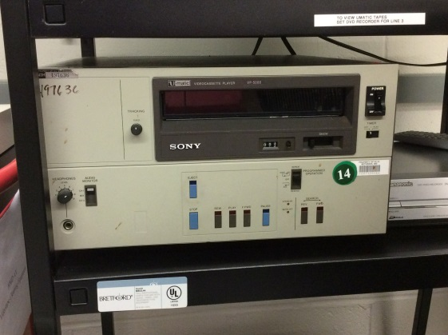
AVs – Risk of Obsolencence
Loss of availability of playback devices and the expertise of their use and upkeep.

Slide 23
AVs – Consultation
Consultant to provide guidance on:
  File formats and codecs
    Film: Uncompressed, HD, 10 bit, 4:4:4 in MOV; 718 GB/hr
    Video: FFV1 SD 8 bit, 4:2:2 in Matroska; 35 GB/hr
    ProRes, MJPEG2000 ?
  Requirements for contracted services
  Metadata
  Accessibility
    Transcripts & Captioning
    Audio Description

Slide 24
AVs – Pilot Project
Pilot will digitize 100 Public Domain AV titles
  Film and U-matic formats
  Preservation & access via repository
Future Digitization
  Continue with Public Domain titles
  Expand to in-copyright holdings
  Dark or Grey access? Fair use?

Slide 25
Future Directions
Leverage the preservation-minded features native to Fedora 4
  Fixity service for routine post-ingest checking
  Audit service, incl. PREMIS terms for documenting events
Redundant cloud storage of repository content
Continued use of TDR/ISO16363 requirements to inform policy and technical development
Tools under exploration
  Archivematica, for standardizing SIPs for content not coming through mass digitization workflow

Slide 26
Questions ?
NLM Digital Collections, http://collections.nlm.nih.gov
Acknowledgements: Walter Cybulski, Felix Kong, John Rees, Ben Petersen

