Slide 1
NLM Update and
Still Image Serving
April 27, 2016
John Doyle, Doron Shalvi, TA Nguyen
National Library of Medicine

Slide 2

Content Overview
Current Counts:
  Books: 2.8M pages, 17k volumes
  Videos: 227
  Citations: 3.7M
  Still Images: 68k

Slide 3
Coming Soon: Born-Digital
  Historical Software
                NDSR Project
                NLM-created software as cultural heritage
                GratefulMed Tutorial
                MS-DOS program
  PDF Resources
  Acquired and catalogued for collection
  Normalized PDF/A derivative added
  IR-type file access, no integrated viewer

Slide 4
Coming… Not Quite As Soon
  Digitized Archival Collections
    - Profiles in Science - collection & exhibit
    - Modern Manuscripts
    - Oral Histories
  Web-Harvested Content
    - Archive-It subscription

Slide 5
Digitization Changes
  Texts
  Upgrade of scanning solution
  Hardware – better ergonomics, more scanners
  Software – more flexibility
  Change from JPG to TIFF for master files
  Films
  Working with AV consultant
    Specifications
    Workflow recommendations
  Pilot digitization project later this year
    Outsource digitization & transcription
    Storage TBD!

Slide 6
  Metadata Overhaul
  Revised MARC-to-repository metadata maps
  Refresh of values from ILS
  Replacement of datastreams
  Solr and Blacklight updates
  Provides metadata support for still images, also upcoming new content types

Slide 7
  Still Images - Background
  Images from the History of Medicine
  Approximately 70k images
  Illustrating social and historical aspects of medicine from Middles Ages to present
  1/3 are portraits
  Each image separately cataloged
  Online public access via Luna Imaging, Inc. software since 2009
  2015 – decision to move off of Luna ASAP

Slide 8
Image Data Model
NLM Digital Repository
Fedora Video Object
DC
Solr Search Server
Voyager Catalog Record
XSLT Transform
DMDINDEX descriptive metadata
RELS-EXT
Loris Image Server
Master TIFF
JPEG2000
Image Magick
JPEG2000
JPG
Kakadu
Preview (JPG)
Blacklight Discovery UI
Thumbnail (JPG)
Browse and search for images
View image
Download TIFF, JPG, DC

Slide 9
Image Subsystem Architecture
Browser
https://collections.nlm.nih.gov
Blacklight
viewer
Blacklight
server
Solr
Search
Filesystem
https://iiif.nlm.nih.gov
TIFF
JPEG2000
Thumbnail JPG
Preview JPG
OpenSeaDragon
JPG
Loris
IIIF Server
JPEG2000
Fedora
repository
Thumbnail
Preview
Apache
HTTP Server
TIFF
Thumbnail
Preview
TIFF

Slide 10
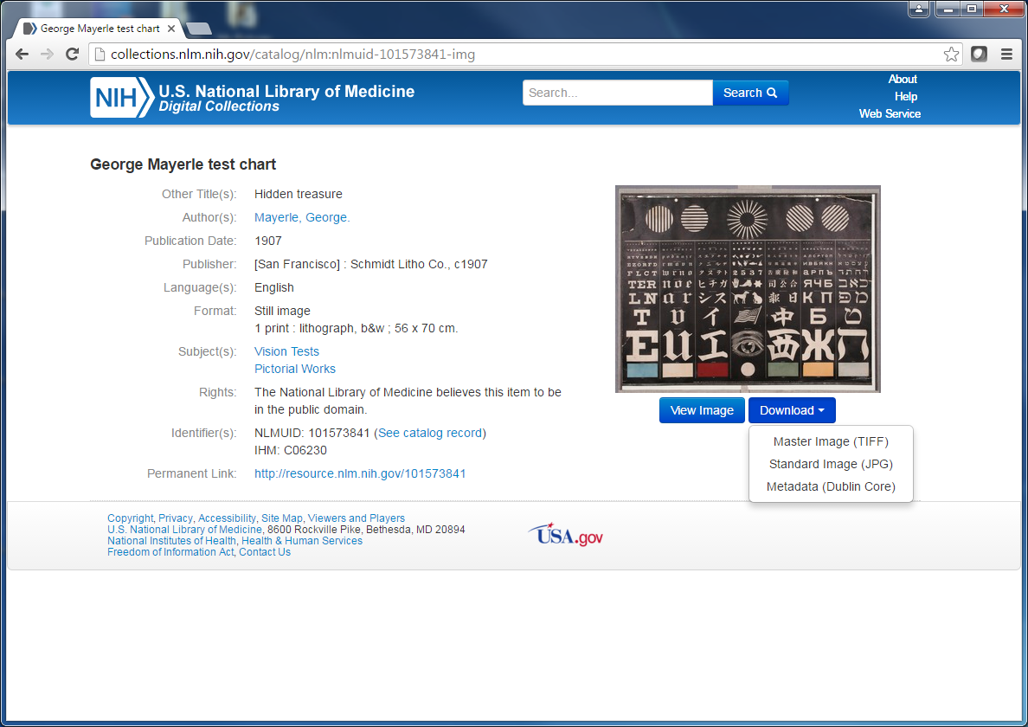
Blacklight Image Resource Page

Slide 11
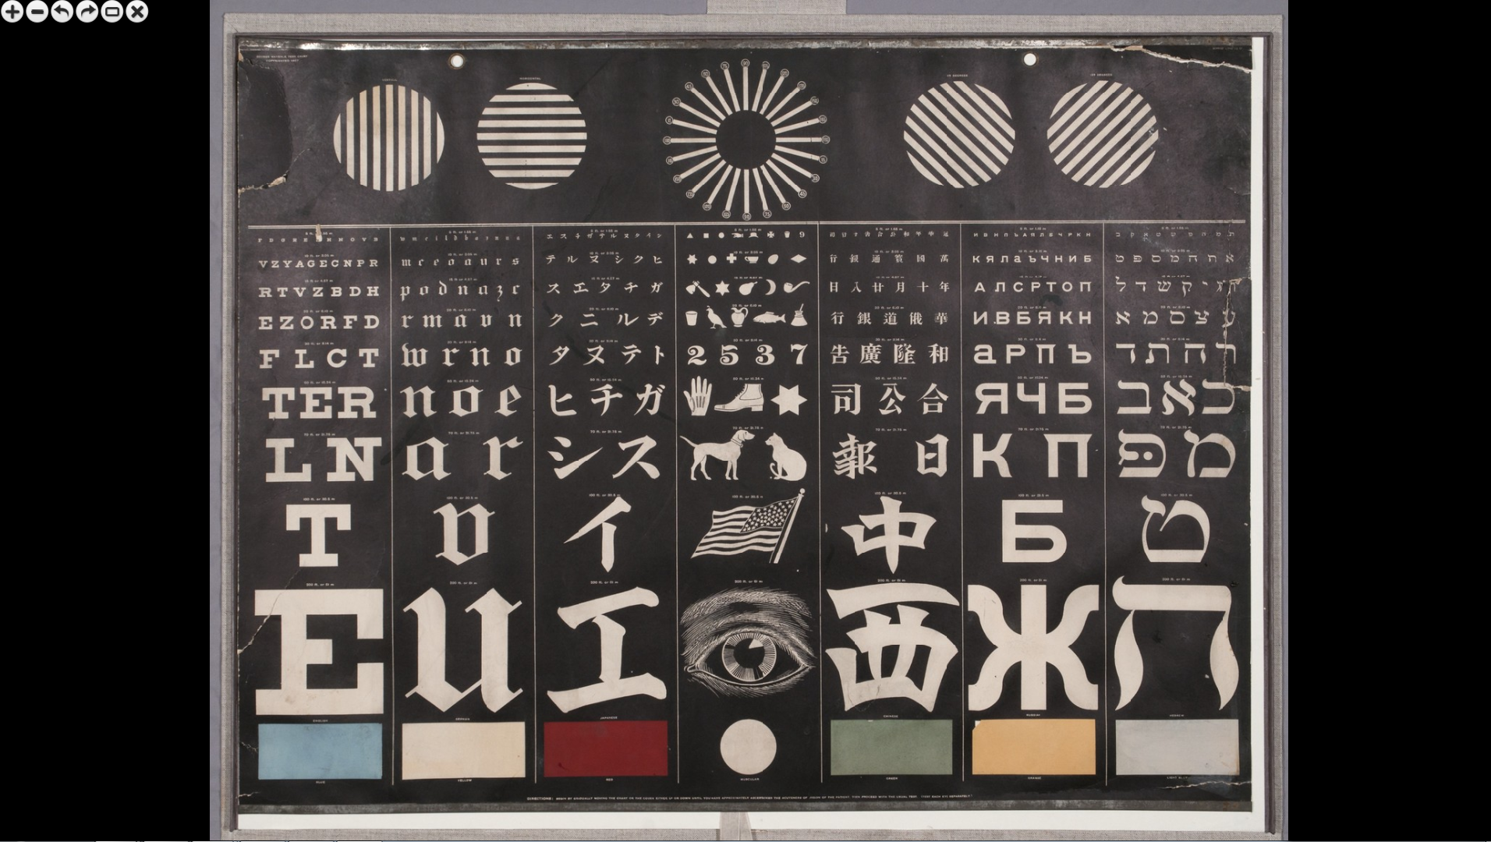
OpenSeaDragon Image Viewer

Slide 12
Local Customizations
Loris
  Adjust cache to work with both HTTP and HTTPS
  Fix issue of not resolving JPEG2000 using kdu
  Fix permission issues for local cache, log generation
  Downgrade local environment to Python 2.7
  10 GB cache, FIFO
  JPEG2000 (could use TIFF)
OpenSeaDragon
  Port to Blacklight
  Open directly into full screen mode
  Custom button controls
  3x max zoom
  Workaround for hang on exiting large images

Slide 13
IIIF Server
IIIF 2.0, https://iiif.nlm.nih.gov
Request: https://iiif.nlm.nih.gov/nlm%3Anlmuid-101573841-img/info.json
Response:
    {"profile": ["http://iiif.io/api/image/2/level2.json",
    {"supports": ["canonicalLinkHeader", "profileLinkHeader", "mirroring", "rotationArbitrary", "sizeAboveFull"],
    "qualities": ["default", "bitonal", "gray", "color"],
    "formats": ["jpg", "png", "gif", "webp"]}],
    "tiles": [{"width": 128, "scaleFactors": [1, 2, 4, 8]},
    {"width": 256, "scaleFactors": [16, 32]}],
    "protocol": "http://iiif.io/api/image",
    "sizes": [{"width": 94, "height": 74}, {"width": 188, "height": 147}, {"width": 375, "height": 293}, {"width": 750, "height": 586}, {"width": 1500, "height": 1172}, {"width": 3000, "height": 2343}],
    "height": 2343, "width": 3000,
    "@context": "http://iiif.io/api/image/2/context.json",
    "@id": "https://iiif.nlm.nih.gov/nlm%3Anlmuid-101573841-img"}

Slide 14
Issues encountered
Missing and corrupt master images
Master TIFF file contains multiple images
Missing, incomplete, incorrect catalog records
Kakadu could not recognize some TIFFs – save as a new TIFF using ImageMagick
Increase JVM heap size (1G) for Kakadu to process large TIFFs (137 MB)

Slide 15
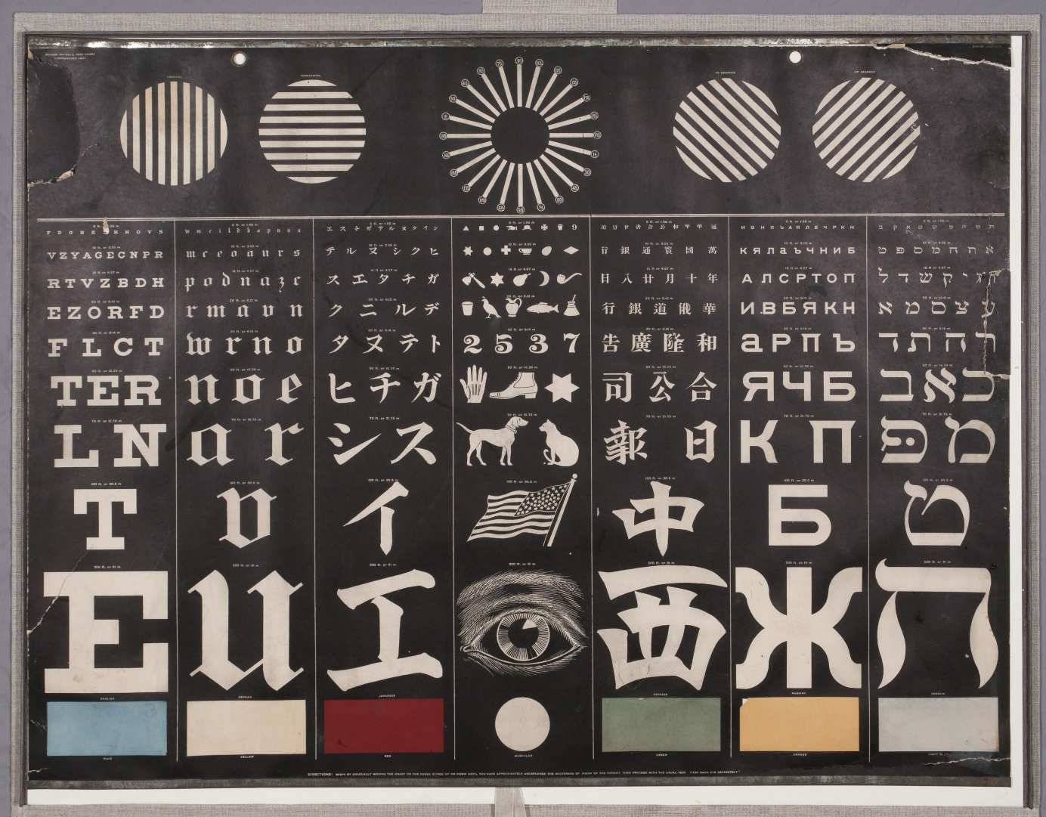
https://iiif.nlm.nih.gov/nlm:nlmuid-101573841-img/full/full/0/default.jpg

Slide 16
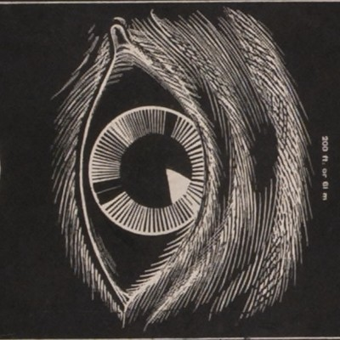
https://iiif.nlm.nih.gov/nlm:nlmuid-101573841-img/1300,1600,400,400/full/90/default.jpg

Slide 17
Demonstration
https://collections.nlm.nih.gov

Slide 18
Still Images – Future Development
  Collection Maintenance
    - Replacement of master images
    - Metadata updates
  IIIF
    Presentation API
    Upgrade of Book Viewing solution
  OAI-PMH Providing

