Slide 1

Presentation Title
DSpace UI Prototype 7
Subtitle
Spring, Angular.js, and the DSpace REST API

Slide 2
Why We Chose Spring & Angular
Spring-boot
  Prominent Java framework loaded with many modern web development conveniences
  Strong Open Source Community
  Outstanding training and documentation resources
Angular
  Tamed client side javascript with strong MVC compatible structures object oriented principles.
  Very strong community.
  Fully testable client side code.
  Automated API documentation generation using ng-docs
Notes:
We needed to solve two problems: 1, what to do after play 1, and 2 how to fix out client side javascript mess.
Spring: Successor to J2EE
As we were developing all our new apps (Library Directory, MyLibrary, Subject Librarian, MAGPIE) we started refactoring common code into a seed app and ultimately a framework. This framework has now been adopted by TDL for Vireo 4.

Slide 3
Architectural Overview
The Spring-boot Webservice
  Built with the TAMU Webservice Core as a parent project
  Combined API endpoint mappings for both REST and websocket communications
  Session-less token based authentication
  Custom Aspect Oriented injections that simplify controller logic
  Built in WRO for dynamic theming
Notes:
- And Webservice Core has Spring Boot as its parent project
-The goal of the framework in many ways was to make controller code as lean as possible
WRO is Web Resource Optimizer

Slide 4
Architectural Overview
The Angular UI
  Built with the TAMU UI Core as module dependency
  Common client-server communication concerns handled by the core.
  Asynchronous Data from the server is automatically unwrapped upon arrival and made available to the controllers
  Many re-usable directives

Slide 5
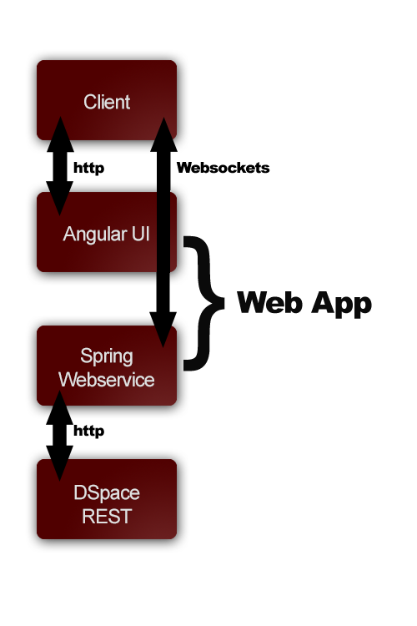
Architectural Overview
Notes:
On these slides demo the basic functionality
Build around DSpace rest calls –
Communities
Collections
Item
Breadcrumb built from recursive call

Slide 6
Customizing Stylesheets
Dynamic runtime application of sass variables
  This feature uses WRO for runtime transpiling of sass.
Notes:
Demo the theming page

Slide 7
Customization:
Headers, Footers, Navigation, Breadcrumbs
In current demo, achievable by editing HTML templates or stylesheets
Could be done dynamically as with the styles
Notes:
Open an editor and do page reloads

Slide 8
Customization: Metadata Display
Straightforward: Edit the item view template to show more stuff from the JSON response
Better: Persist Entities that have their own associated field lists and develop a form for editing these lists on a per handle basis – then it could be customizable for any part of the hierarchy

Slide 9
Customization: Navigation Menu
Would need a form to edit values of a persisted Menu Entity
Notes:
Same story as metadata display

Slide 10
Modularization Capabilities
On the webservice side, scan for jars. Enable testing and configuration in a module management interface.
On the Angular side, the entire Angular framework is built around modularity. Our core code is included in the UI through this very mechanism.

Slide 11
Installation Procedure
Distributed deployment
  Currently all of our production applications are deployed as individual distributed applications.
  The Webservice is deployed with maven
  The UI is deployed with npm and bower.
Single Webapp deployment
  For Vireo we modified our deployment strategy to allow the entire application to be deployed in one web app using maven
Future development
  Work is being done to develop maven driven strategy that will allow for either distributed or standalone deployment

Slide 12
Internationalization?
This has been achieved in the context of angular.

Slide 13
Authentication
Prototype supports Shibboleth (currently using a mock service provider)
  More recent code allows username/password
Webservice authenticates against REST API as a DSpace admin.
In this scheme, permissions must be handled at the Spring webservice level rather than by the REST API itself

Slide 14
Authentication
Questions to be answered?
  How much responsibility for user management should lie with the REST webapp, the UI, or some other webapp?
  How do we put the REST API is behind Shibboleth?
DSpace could utilize a web app dedicated to authorization. This web app could live behind a service provider and distribute session tokens for all other DSpace components.
Notes:
The users persisted in the UI Webservice should correspond to epersons in DSpace.

Slide 15

Click to add your credits
Thanks! Questions?
Subtitle

