Slide 1
MODS and RDF Descriptive Metadata Subgroup
Bria Parker
Metadata Librarian
Notes:
Today I wanted to report on the discussions and work being done by the MODS and RDF Descriptive Metadata Subgroup. This subgroup is under the umbrella of the Hydra Metadata Working Group Descriptive Metadata Subgroup. It is a subgroup of a subgroup. You can find us in the duraspace wiki

Slide 2
Participants
NYPL
Boston Public Library
Indiana
Northwestern
USDA/NAL
Amherst
Emory
University of Tennessee
York University
University of Alberta
University of Maryland
WGBH
Notes:
The subgroup includes members from NYPL, Boston Public Library, Indiana University, Emory, Northwestern, NAL, Amherst, University of Tennessee - we have wide representation.

Slide 3
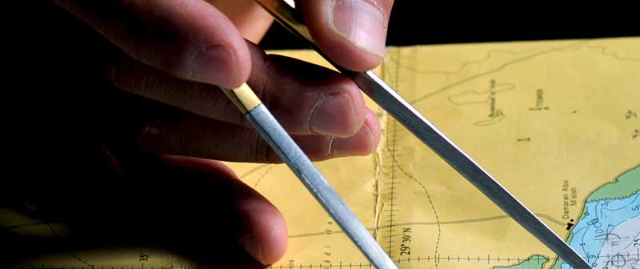
Goals
Weems & Plath, Chart Plotting, by Sierragoddess (CC BY-ND)
https://flic.kr/p/bxEVoG
Notes:
This group convened as a way to Discuss problematic mapping issues of getting from MODS XML to RDF for Fedora4 and to look at what mappings are possible for a particular MODS field to different non-MODS namespaces

Slide 4



Goals
An "unofficial" standard for what many institutions of this group plan to implement
Notes:
The end goal is to develop an "unofficial" standard for what many institutions of this group plan to implement.
This then would allow their local communities (as well as other implementers of Islandora, Hydra, etc) to then have shared code to support that standard.

Slide 5
Maryland’s involvement
Well, we don’t use MODS
BUT, our local descriptive metadata schema (UMDM) is a lot like MODS
Initial attempt at RDF went:
  UMDM → MODS XML → MODS RDF
Notes:
Maryland’s involvement may seem rather dubious, since we do not actually use MODS. However, our local metadata schema, [University of Maryland Descriptive Metadata Schema) UMDM, is MODS-like in many different ways, so we thought it beneficial to participate and help with a problem we, too, were having. Our initial trials of getting our metadata to RDF involved a transformation from UMDM to MODS XML, then MODS XML to MODS RDF.

Slide 6

Initial results?
NOPE by Scott Beale/Laughing Squid (CC BY-NC-ND)
https://flic.kr/p/6r7iZm
Notes:
We were unhappy with the outcome, particularly with the proliferation of blank nodes the MODS RDF standard allowed (at least a million, I think, for 10,000-ish records),

Slide 7
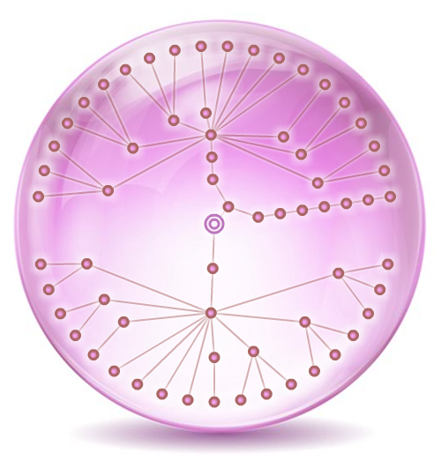
Why not MODS RDF?
Hierarchical structure of MODS RDF not suitable for RDF in Fedora4
Node Globe Pics by danzen(CC BY)
https://flic.kr/p/9yaQmt
Notes:
the hierarchical structure was just not suitable for working with RDF (it was valid RDF/XML, but from my naivete, I learned an important lesson: all RDF is not equal). Other members of this working group had experienced similar frustration. MODS RDF was just not ready for Fedora 4

Slide 8

Challenges
Windswept by Oli4 (CC BY-NC-ND)
https://flic.kr/p/w4hXfD
Notes:
Some of the challenges the subgroup has faced so far are
-backwards compatibility:some institutions still want/need the capability to transform from the RDF back to MODS XML. I believe one institution has some type of integrated discovery system they plan to use that will require MODS XML, but they will still be using Fedora4 for storage, and cannot keep the original MODS XML around for storage reasons.
-This brings up the issue of granularity. Some institutions are okay with some loss of the granularity of how the metadata is broken down in MODS. But those that want to be able to transform back to MODS XML are hampered. There is concern that we could restrict ourselves too much by making reverse mapping a particular requirement.
(I’ll note here that MODS doesn’t HAVE to be granular. Simple MODS is still valid MODS).
-So a HUGE challenge to our group is that each institution has different needs/wants, and it’s going to be impossible accommodate all of that and still provide useful recommendations.

Slide 9
The Plan
recommend a mapping that has two tracks:
  Simple (at least do this)
  complex one (if you have X level of complexity/granularity, try this)
Notes:
So the plan is to recommend a mapping that has two tracks, basically: a simple one (as in, at least do this), and a more complex one (if you have X level of granularity, try this).

Slide 10
MODS Title element
Simple: support for main and alternative titles
    MODS Title → dcterms:title
    MODS alt title → dcterms:alternative
Complex: support for supplied, uniform, translated, and parallel titles
    Involves the use of custom-minted URIs
Notes:
So for example let’s look at MODS:title.
The proposed simple track is to support main and alternative titles, mapping to the dcterms title and alternative respectively. For institutions okay with losing granularity, alternative can be a bit of a “dumping ground” for all other title types that aren’t the main title.
The proposed complex track provides support for main, alternative, as well as supplied, uniform, translated, parallel titles, as well as potentially non-sort and subtitle metadata. This complex path involves minting a local URI and basically an authority for the title that captures all of this. (Some institutions are coming from MODS XML that were created from MARC, and they have an interest in maintaining that granularity).
(That all is pretty intense for us at UMD.
Much of the content in our current Fedora instance is archival content, so we just do not have that level of description. For monographs, where we DO have that metadata (or at least as much as we could cram into UMDM), the full metadata will still exist in our local ILS/discovery service. So as far as we at UMD are concerned, we should not lose anything by trending toward the more simple approach.

Slide 11
MODS Name element
Simple: map to the relevant MARC relator term based on mods:role. (If no role, use creator or contributor.)
    Using MARC relator terms as predicates
    @prefix marcrel: <http://id.loc.gov/vocabulary/relators/> .
    <subject> marcrel:ill <http://viaf.org/viaf/266258836>
Notes:
The other element we’ve looked is MODS:Name.
Our current proposal for the simplest track is to use marc relator terms as predicates and map names to a marc relator term, choosing the term based on what appears in mods:role. If there isn’t a mods:role, could use the relators creator or contributor, as appropriate. ID.LOC.GOV did have some foresight regarding these relators and all are subproperties of either dcterms:creator and/or dcterms:contributor, which require non-literal values (a.k.a. URIs), which may be a challenge.

Slide 12
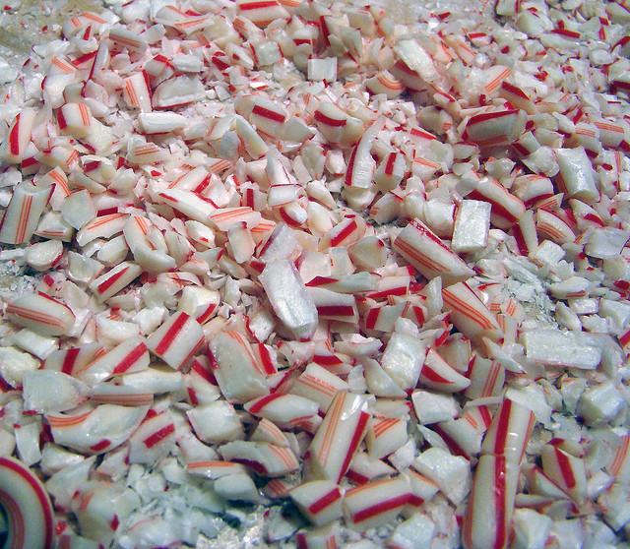
MODS Name element, cont.
Complex: custom minted URIs
Crushed Peppermint by dutchbaby (CC BY-NC-ND)
https://flic.kr/p/7ouvPF
Notes:
The more complex option involves minting local /authorities/URIs for each name. This option still involves using the marc relator term, but the actual authority requires additional mapping.
NYPL is doing this for all names, due to some institutional requirements.
The benefit? You have a local copy in case linked data source ever goes down (reminder that id.loc.gov has gone down a couple times in the past couple month)
Also a benefit for collections of local interest where many names do not have URIs in the usual linked data sources.
This may seem rather extreme, to create a local copy for all authorities, but some of the participants have very strong use cases for why they are moving in this direction.

Slide 13
MODS:Name - Complex
<http://yoururlhere.org/names/n1234>
a edm:Agent ;
skos:prefLabel "Reeve, John, 1608-1658" ;
skos:exactMatch http://viaf.org/viaf/52564489 ;
schema:affiliation http://yoururlhere.org/affiliations/a999 .
Notes:
This complex option models the work of both EDM and DPLA and may be an ideal path for institutions with the resources to put in this type of work. And it still allows for linking to the linked data source uri like viaf, LCNAF, etc., using skos:exactMatch.
(this sample includes affiliations, which hasn’t been completely worked out, but probably involves additional custom minting of URIs).

Slide 14

Future Work
Use Crosswalk by ThomasThomas (CC BY-ND)
https://flic.kr/p/961DT
Notes:
So that’s a rundown of where we’re at so far. We’ve only been working at this a couple months, and a lot of that time was spent working out expectations.

Slide 15
Implications for UMD
Simpler use cases than many of the other institutions
Hoping to adopt the more simplified track whenever possible
Notes:
To speak just for UMD - we are definitely shooting for a more simplified model. While UMDM does have a hierarchical structure like MODS, it does not often delve into the granularity that can be found in MODS.

Slide 16
Questions?

Slide 17
Thanks!
Bria Parker
blparker@umd.edu
Subgroup website: http://go.umd.edu/4ti

