Slide 1
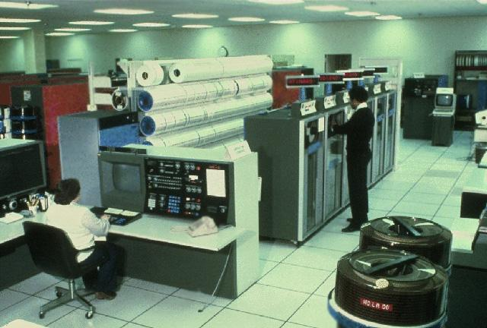
Preserving NLM-Developed Software
Nicole Contaxis
National Digital Stewardship Resident
email: nicole.contaxis@nih.gov
twitter: @ncontaxis
Notes:
1976 NLM computer room; explain NDSR

Slide 2
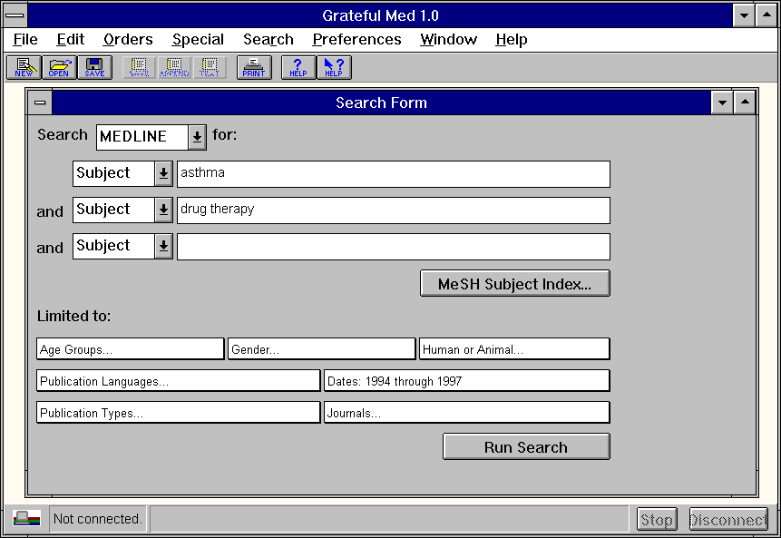
Goals
Create software inventory
Establish criteria for preservation
Develop strategy for repository ingest
Notes:
Overall goal: preserve the software; why software preservation is important (preserve computational abilities - not just data & ASCL; historical importance of software); these bullet points are how we hope to do it; we’ve been working since late June;

Slide 3
Progress
Challenges
Constructed and completed (mostly) the inventory
Conducted interviews with current and former staff members
Developing curatorial guidelines that include historical importance and technical feasibility
Exploring options for the preservation strategies
Defining the boundaries of a piece of software within a larger system
Locating copies of the software
Locating documentation of the software
Further research:
  Disk image options
  Emulation service options
  Metadata options
Notes:
No agreed upon preservation strategy yet; considering one of several options - Stanford model (disk image when possible followed by emulation through a service at a later date); Stanford has more copies of things than we do - we need need actual copies of that software; BOUNDARY issue: use ILL has an example: DOCLINE and many kinds of services within the system - affects the scope and curatorial choices

Slide 4
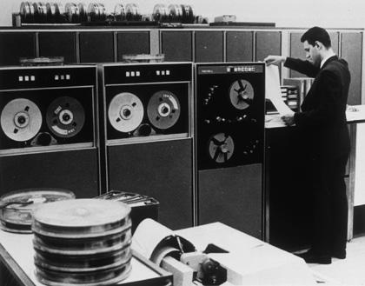
Contact:
Nicole Contaxis
National Digital Stewardship Resident
nicole.contaxis@nih.gov
t: @ncontaxis
Notes:
1969 NLM computer room

