Slide 1
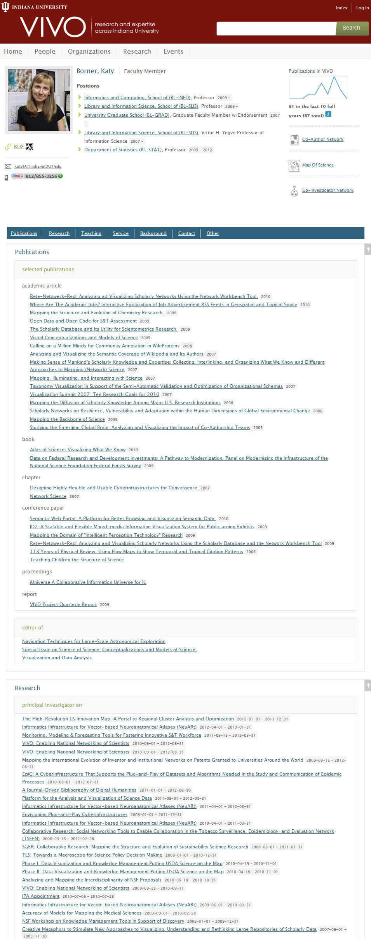
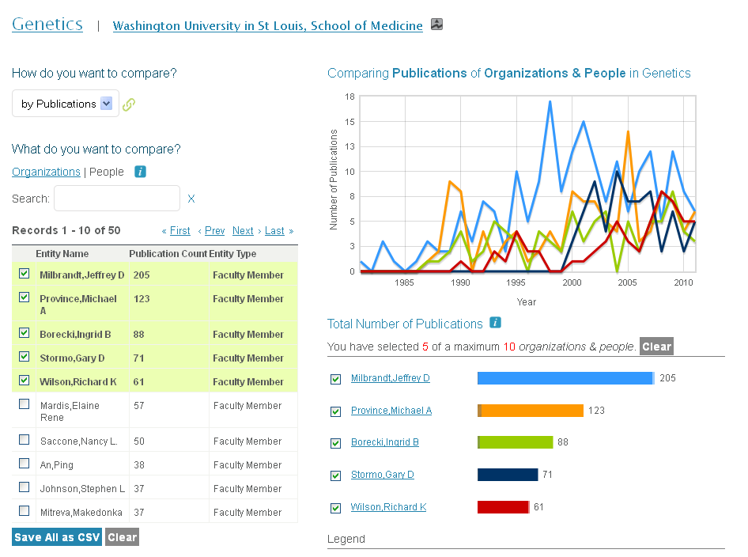
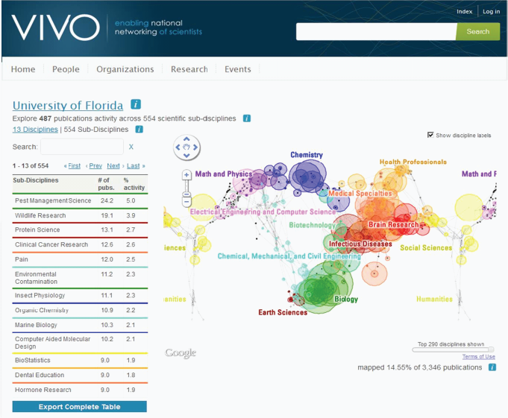
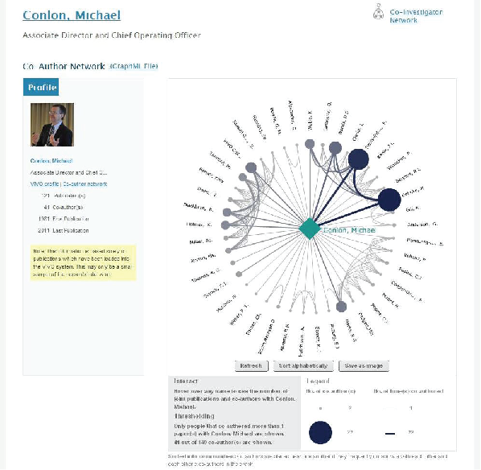

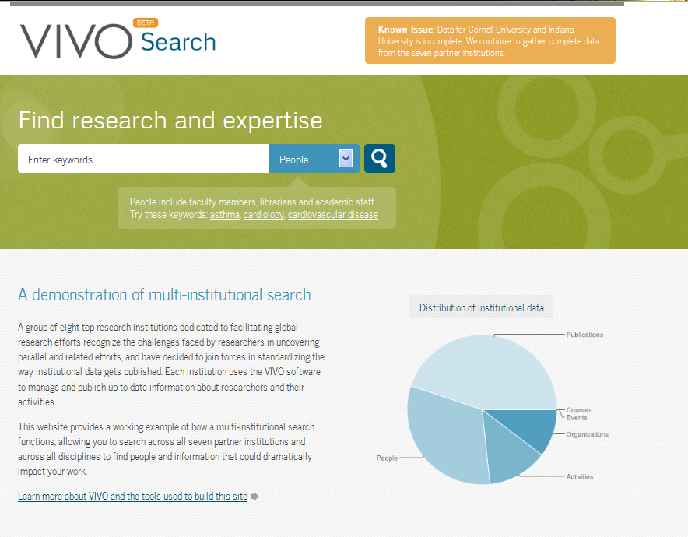

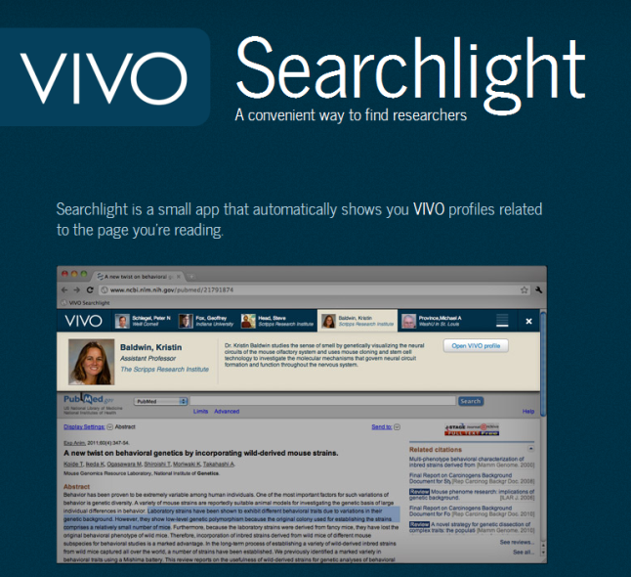
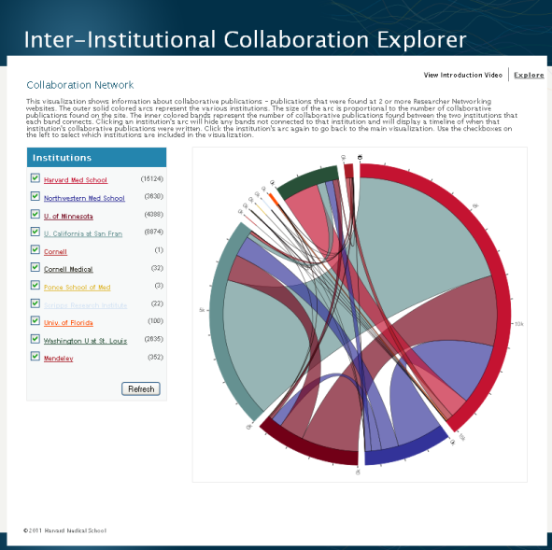
What is VIVO?
Visualizing Scholarship
Duraspace
VIVO is an open source semantic web platform that enables the discovery of research and scholarship across disciplinary and administrative boundaries through interlinked profiles of people and other research-related information. VIVO is being adopted by institutions and organizations in the United States and abroad - offering a dynamic platform which facilitates collaboration and discovery across all scholarly disciplines.
VIVO uses an open, extensible ontology, VIVO-ISF, to represent scholarly activity and to serve as an interchange standard for sharing activity across all institutions engaged in discovery.
VIVO is populated with information about researchers – allowing them to highlight areas of expertise, display academic credentials, visualize academic and social networks and display information such as publications, grants, teaching, service, and more. Profile information can be programmatically imported from authoritative data sources such as institutional records, local repositories and bibliographic and grant databases.
VIVO and other compatible applications produce a rich network of information across institutions, organizations, and agencies that can be searched to foster collaboration and enable open research discovery. The VIVO software and ontology are publicly available along with content that supports implementation, adoption, and development efforts around the world. To learn more, visit http://vivoweb.org/.
VIVO provides network analysis and visualization tools to maximize the benefits afforded by the data available in VIVO. VIVO enables high quality data to be revealed about researchers, their collaborators, their funding sources, and more, offering elegant visualizations of the research enterprise on the individual, local, and global levels.
DuraSpace leads the development and improvement of open technologies that provide long-term, durable access to digital assets and is an independent 501(c)(3) not-for-profit born from a vision to help save our shared scholarly, scientific and cultural record. DuraSpace supports VIVO with infrastructure and guidance to continue support for a diverse array of project efforts while continuing to develop the core VIVO software and expand the VIVO community.
The VIVO project is an open source! project model that provides access to expanded community affiliations, organizational tools, and mentorship towards adopting open source best practices.
VIVO is committed to facilitating the advancement of research and discovery by integrating and sharing information about scholars, scholarly activities, and scholarly outputs using Semantic Web technologies. Development and enhancement of the VIVO platform along with associated tools, standards, data, services, and expertise will continue to the benefit of all interested parties. VIVO is a fully open platform with a growing worldwide community focused on the collection, connection, sharing, and discovery of information about research.
Vivo is a member-supported project. Financial support sustains technical coordination, and direction.
Temporal visualizations showcase grants and publications over time.
To date, more than 100 institutions representing more than 1 million scholars and support staff across more than 25 countries are implementing VIVO or producing VIVO compatible data.
“
Get Involved & Follow the Project!
The Map of Science visualization allows exploration of the scientific strengths of a university, school, department or person
Co-author and co-investigator networks
Would you like to learn more about VIVO and how it works? Interested in collaborating? Have a specific question about supporting VIVO at your institution? Would you like to give us feedback or schedule a demonstration? Please send us a note at info@vivoweb.org
Data Sources & Using VIVO Data
Search Across Semantic Data
”
VIVO uses data ingested from institutional sources of record and authoritative external sources and can be supplemented with manual entry. Harvester, an extensible data ingest and updating framework, reduces the burden on local implementation teams as they populate their local data stores with publication, grants, and human resources data. VIVO even provides a way to highlight the efforts of an organization’s researchers in Open Access journals and offers institutions an elegant way to highlight their institutional repository as a critical campus resource.
VIVO data conform to a public ontology of types and relationships that can be extended for local needs. VIVO's ontology supports faceted searching for quick retrieval of people, organizations, events, and research-related information.
http://vivoweb.org
A multi-site search prototype at http://vivosearch.org allows users to sample the rich data available in VIVO from people, papers, grants, events, organizations, and concepts at eight universities. The VIVO search tool can provide meaningful search across a set of semantically available endpoints using the VIVO ontology, whether populated from VIVO or any of several other research networking tools.
http://twitter.com/VIVOcollab
http://www.facebook.com/VIVOcollaboration
https://github.com/vivo-project
Research discovery is facilitated via content browsing and the structured data lends itself to a variety of applications that can make use of these data. A SPARQL query builder is part of the standard VIVO distribution and allows for end-user data requests from a VIVO implementation, enabling access to data for subsequent analysis, evaluation, and visualization of the research enterprise. Across institutions, VIVO provides a uniform semantic structure to enable a new class of tools that can use the data to advance science at all levels.
VIVO Open Source Community
VIVO enjoys a robust open source, open development space on GitHub. The VIVO wiki provides extensive material on VIVO implementation, and project participation including project governance, standing workgroups, and project task forces. The VIVO software and ontology are publicly available, along with content that supports implementation, adoption, and development efforts around the world.
VIVO is funded by member institutions. Visit our web site to find out more about becoming a member.
vivoweb.org

