Slide 1
VIVO
Connect Share Discover

Slide 2
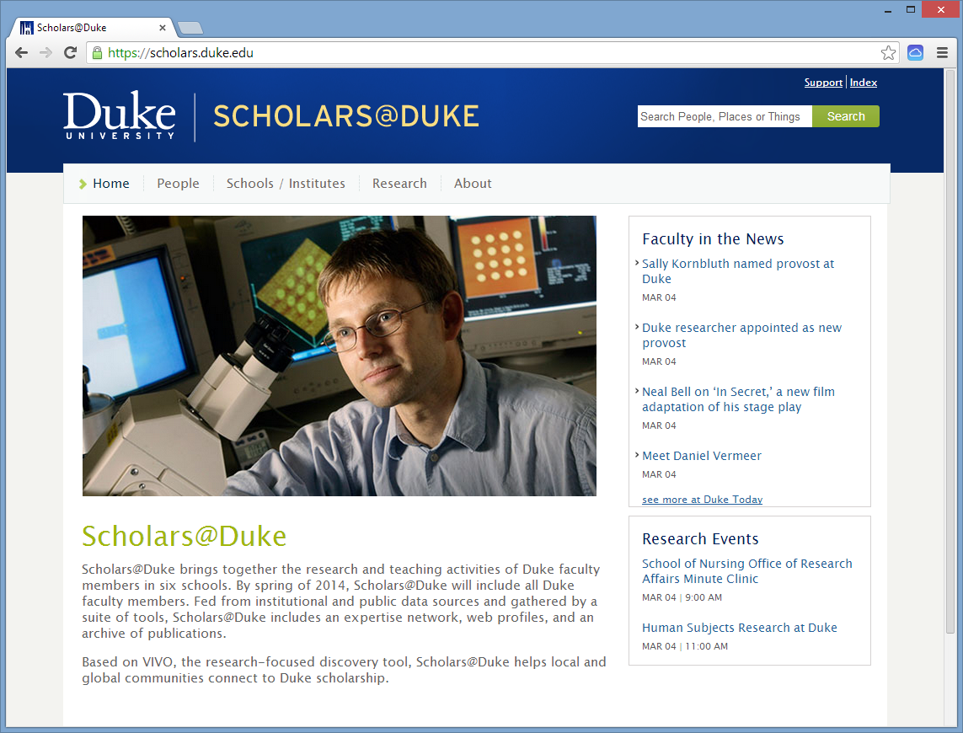

Slide 3
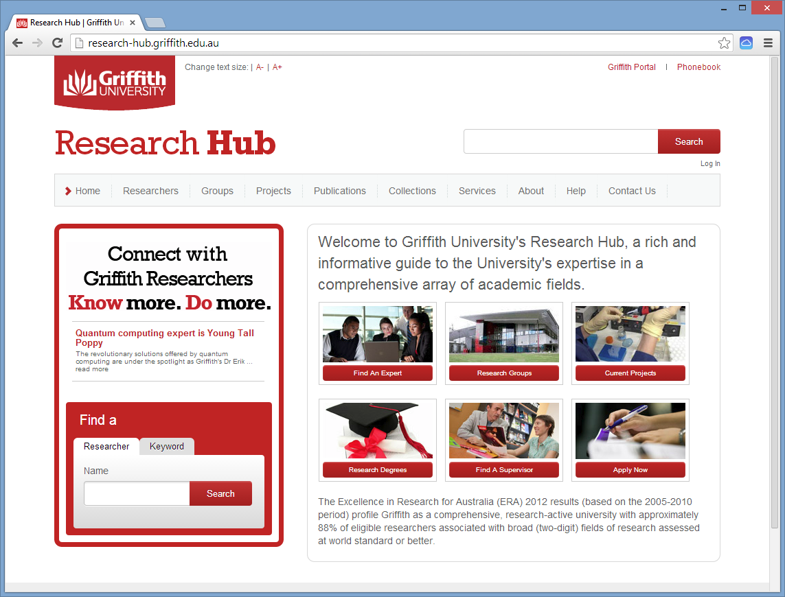

Slide 4
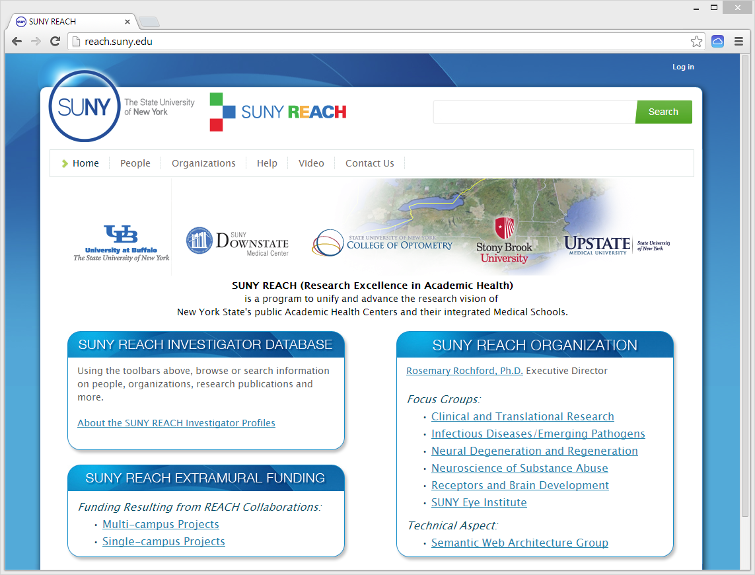

Slide 5
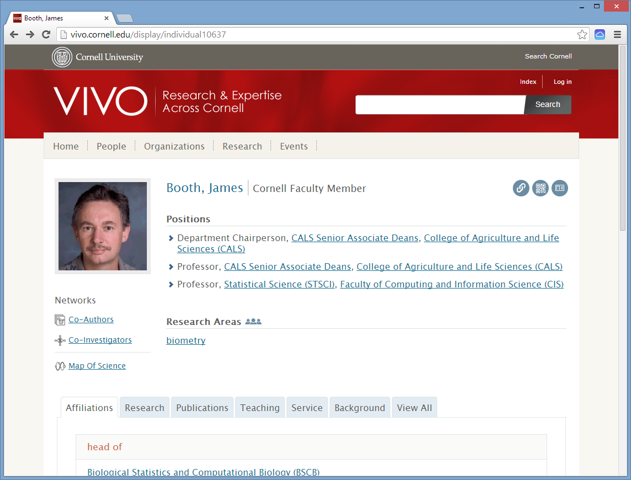

Slide 6
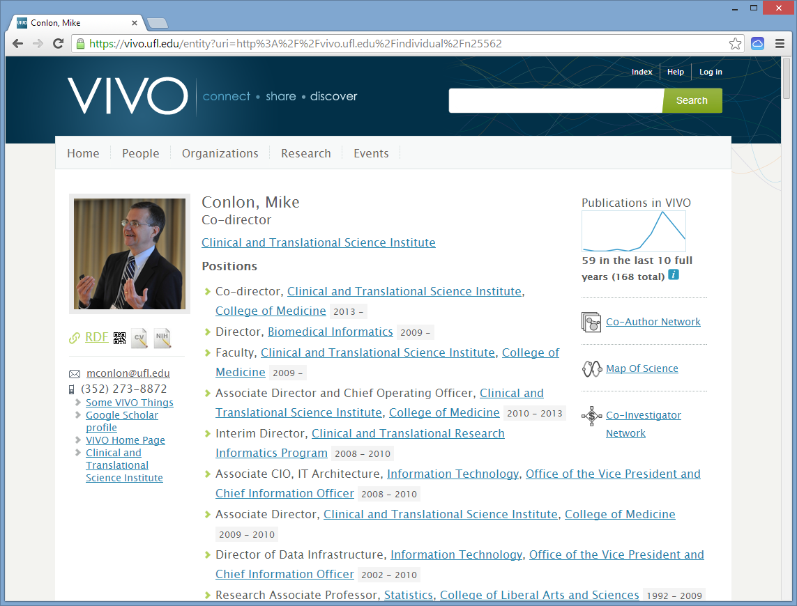

Slide 7
VIVO integrates and reuses institutional data
Reports
Organization
Expert
Finding
Scholars
VIVO
Grants/
Projects
Portfolio/
Vitae
Network
Analysis
Publications/
Scholarly
Works
Teaching/
Engagement
Adhoc
Queries
Visualizations

Slide 8
5-star Linked Open Data
⬆ Available on the web with an open license
⬆⬆ Available as machine-readable structured data
⬆⬆⬆ Available in non-proprietary format
⬆⬆⬆⬆ Open standards for identifying things (URI , RDF [, and Ontology])
⬆⬆⬆⬆⬆ Link your data to other people’s data
Berners-Lee, T. (2006) Linked Data, http://www.w3.org/DesignIssues/LinkedData.html

Slide 9
ORCID in the VIVO-ISF Ontology
<rdf:Description rdf:about="http://vivoweb.org/ontology/core#orcidId">
<rdf:type rdf:resource="http://www.w3.org/2002/07/owl#ObjectProperty"/>
<rdfs:domain rdf:resource="http://xmlns.com/foaf/0.1/Person"/>
<rdfs:label>ORCID iD</rdfs:label>
<obo:IAO_0000112 rdf:datatype="http://www.w3.org/2001/XMLSchema#string">
This is now an object property where the object value is a resource of the form <http://orcid.org/NNNN-NNNN-NNNN-NNNN>. This is to support connecting VIVO and ORCID in the linked data web. Note: a person can have multiple ORCID iDs.
</obo:IAO_0000112>
</rdf:Description>

Slide 10
Systems producing VIVO-ISF Data
VIVO sites
  Including CTSA, USDA, SURA, APA, EPA, NCARS
Harvard Profiles sites
  Including RCMI schools
Elsevier PURE sites
  Including Northwestern, Miami
Symplectic Elements sites
  Including Dartmouth, Penn, Bournemouth
Additional sites producing VIVO data from other systems

Slide 11
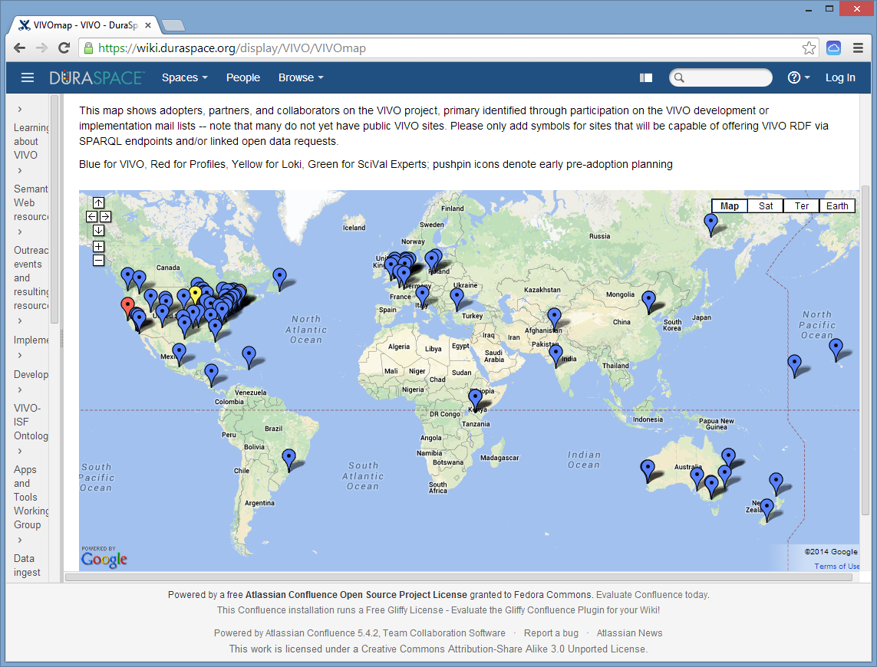

Slide 12
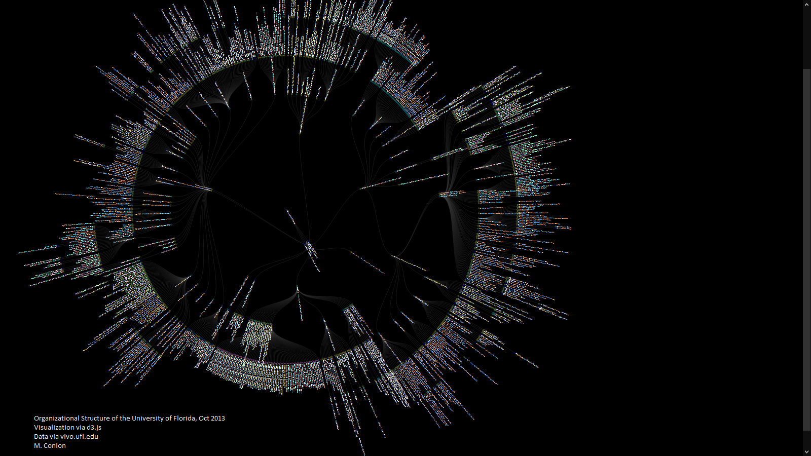
data visualization

Slide 13
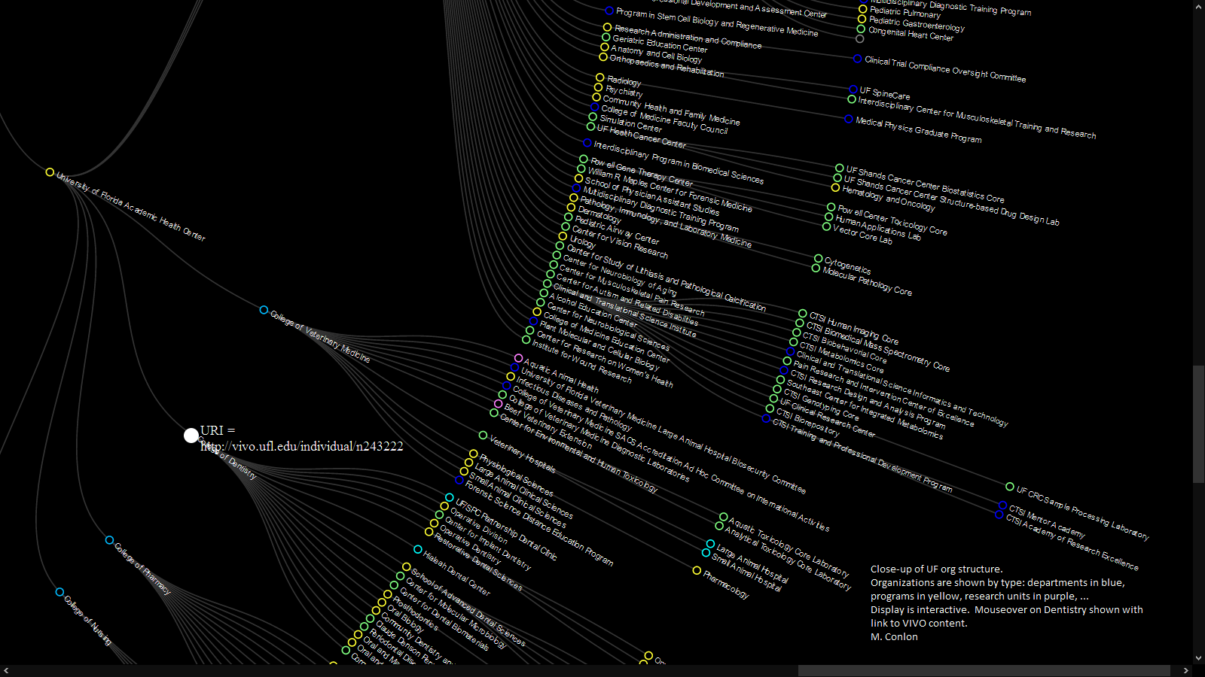
visualization via d3.js data via vivo.ufl.edu

Slide 14
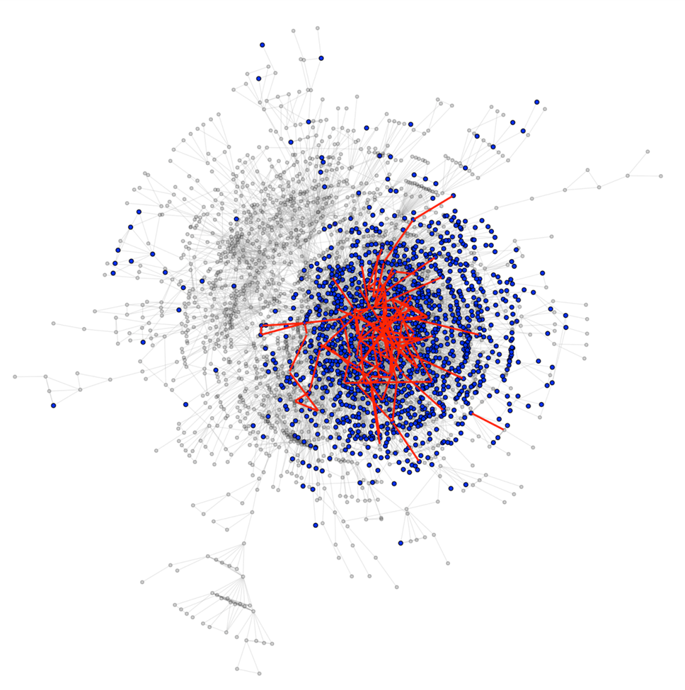
Impact of
Pilot
Funding on University
Social
Network
Chris McCarty,
Raffaele Vacca
Co-author network of the University of Florida, 2013.
Health Center Faculty in blue. Pilot awardees and new
connections in red.

Slide 15
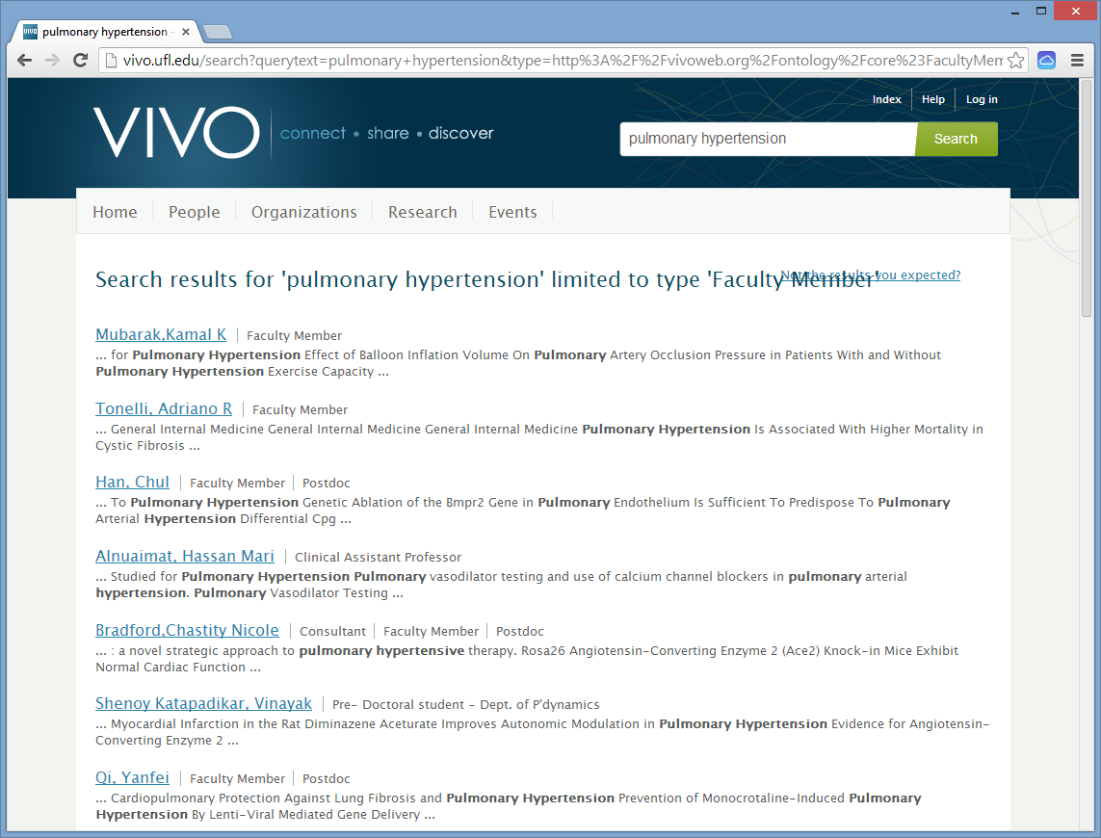

Slide 16
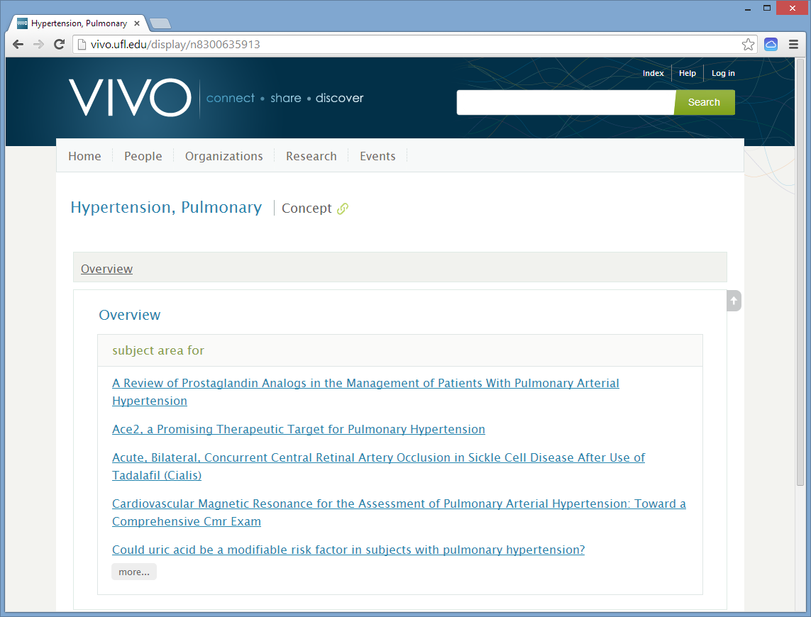

Slide 17
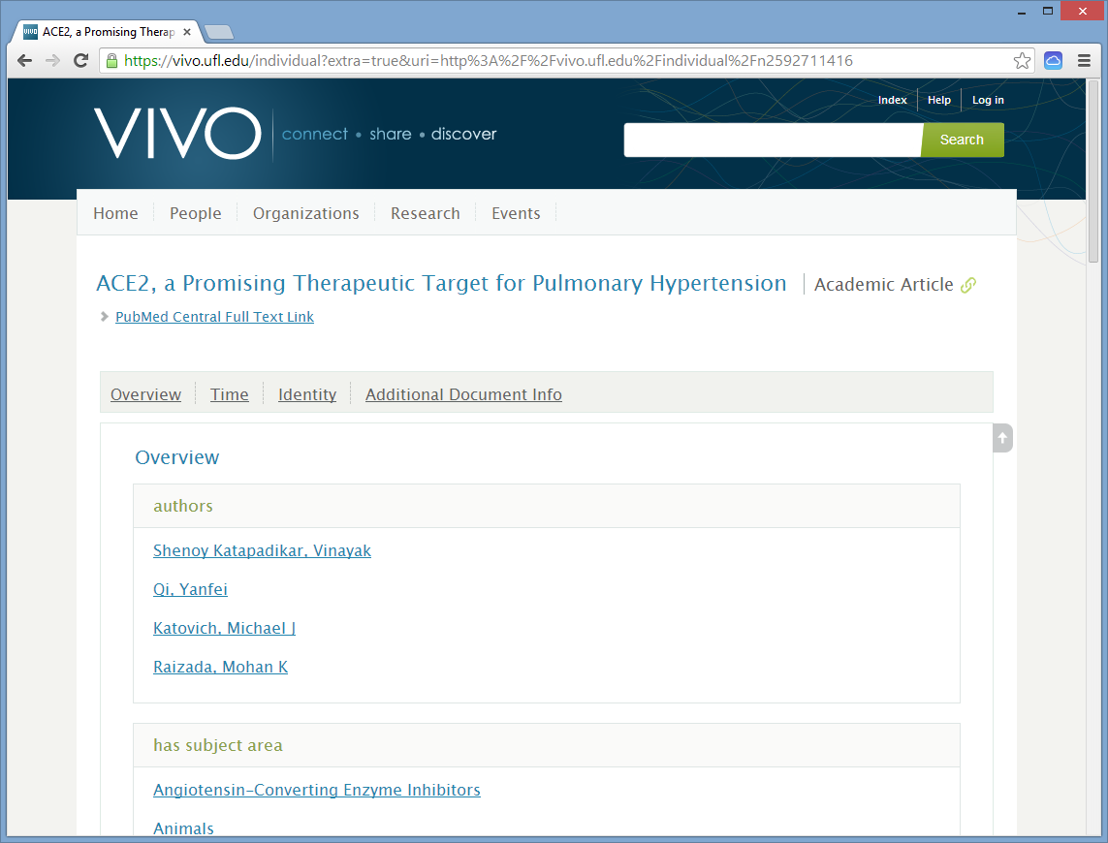

Slide 18
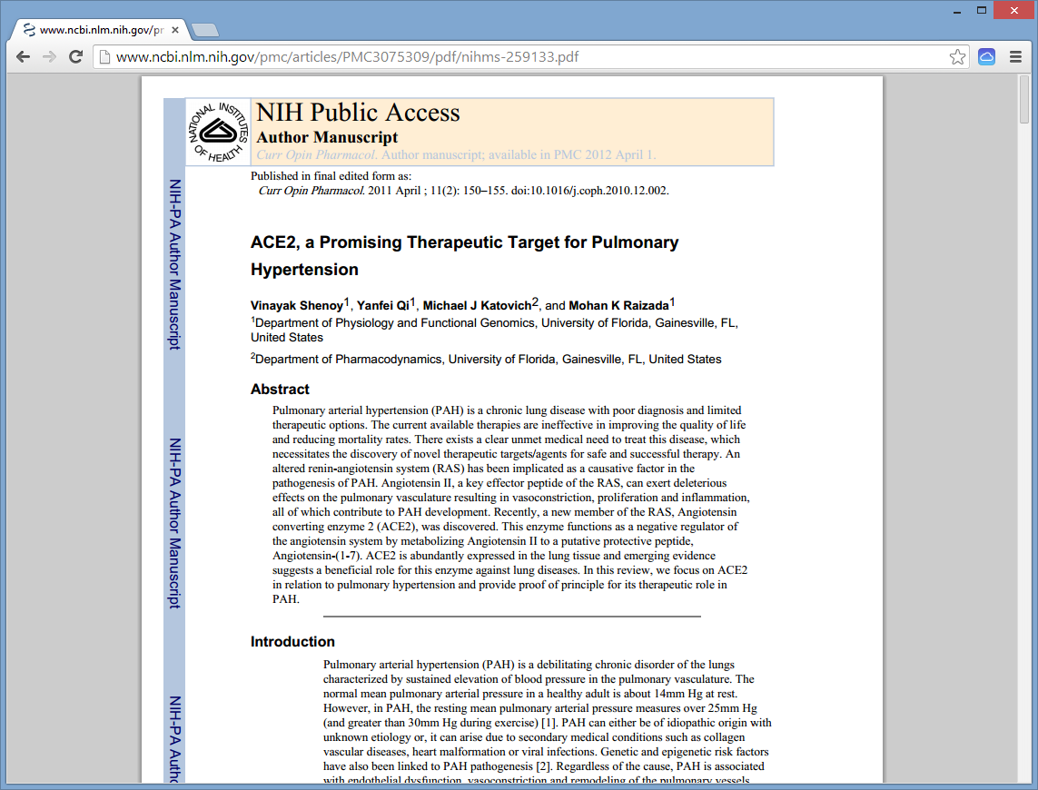

Slide 19
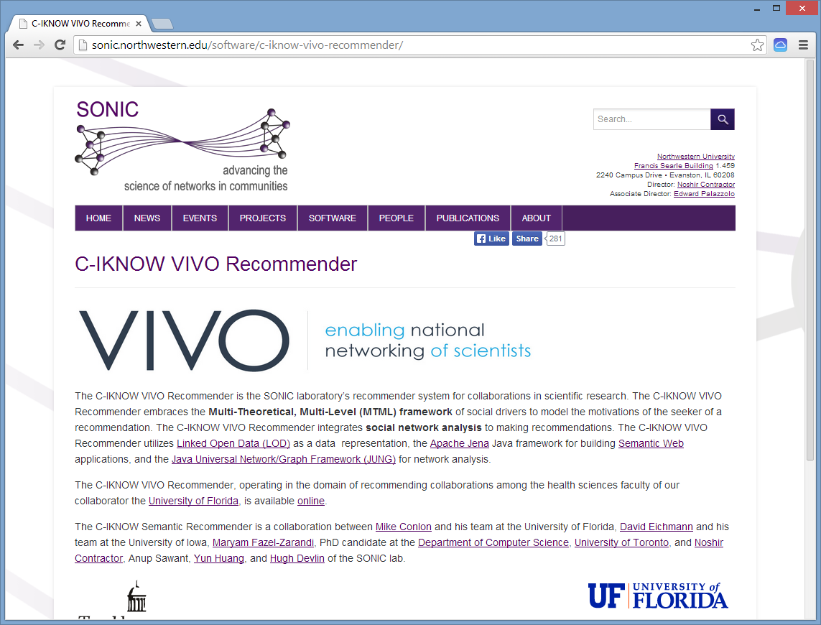

Slide 20
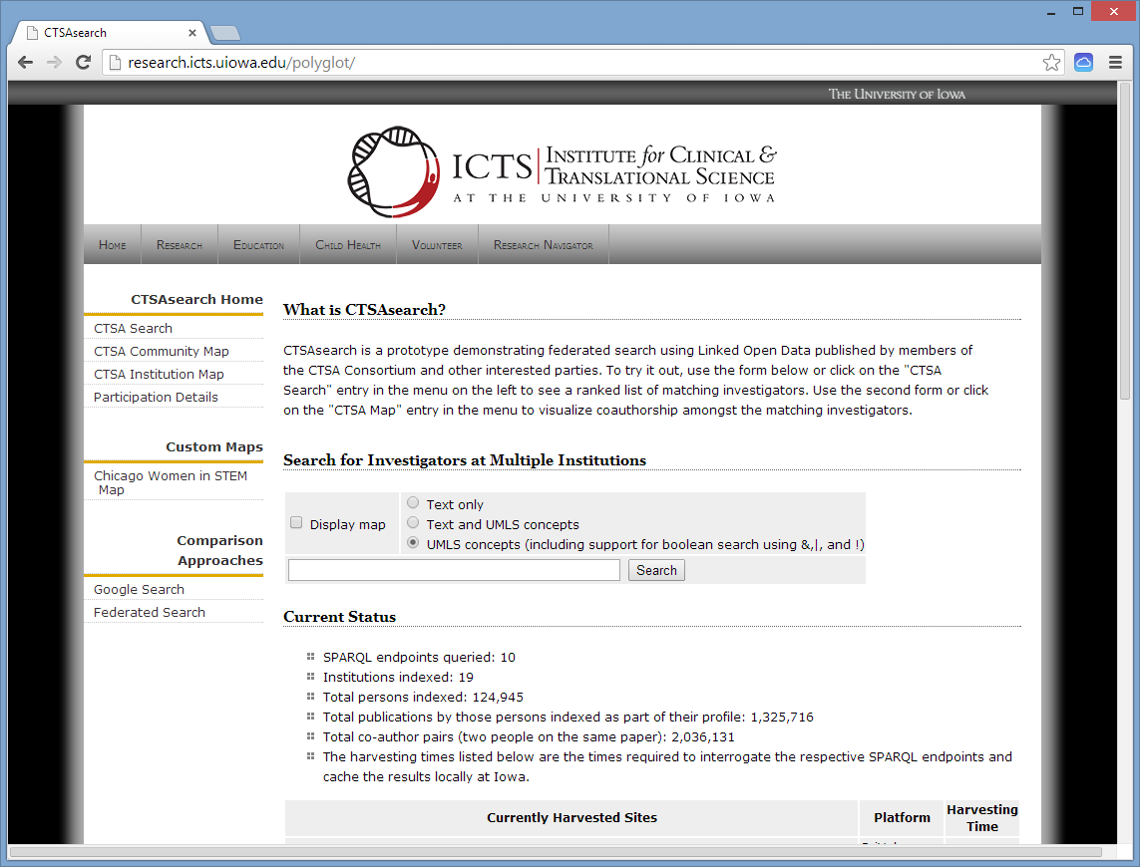

Slide 21
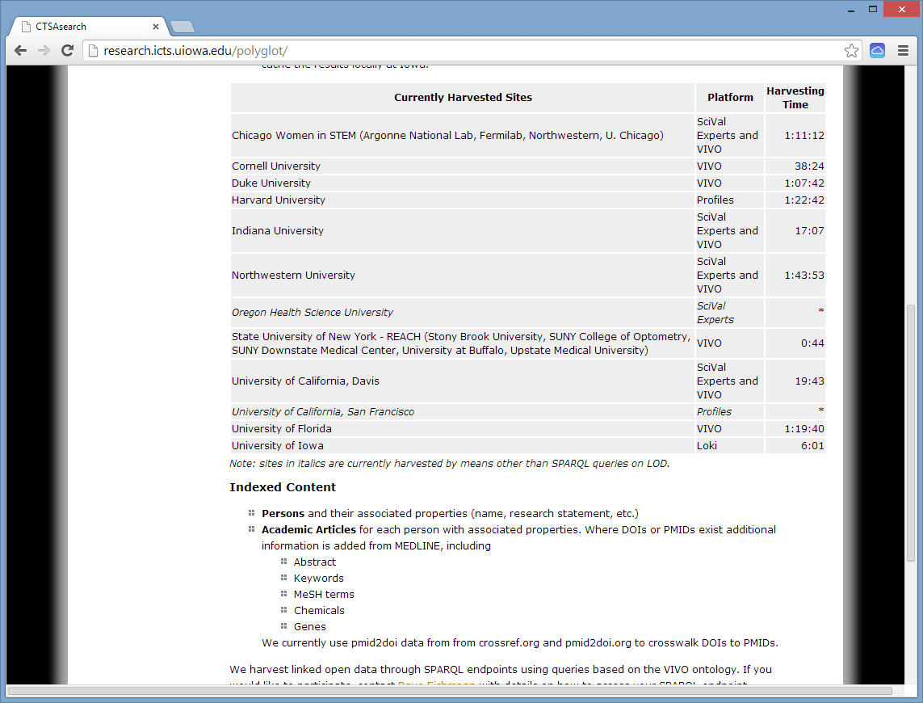

Slide 22
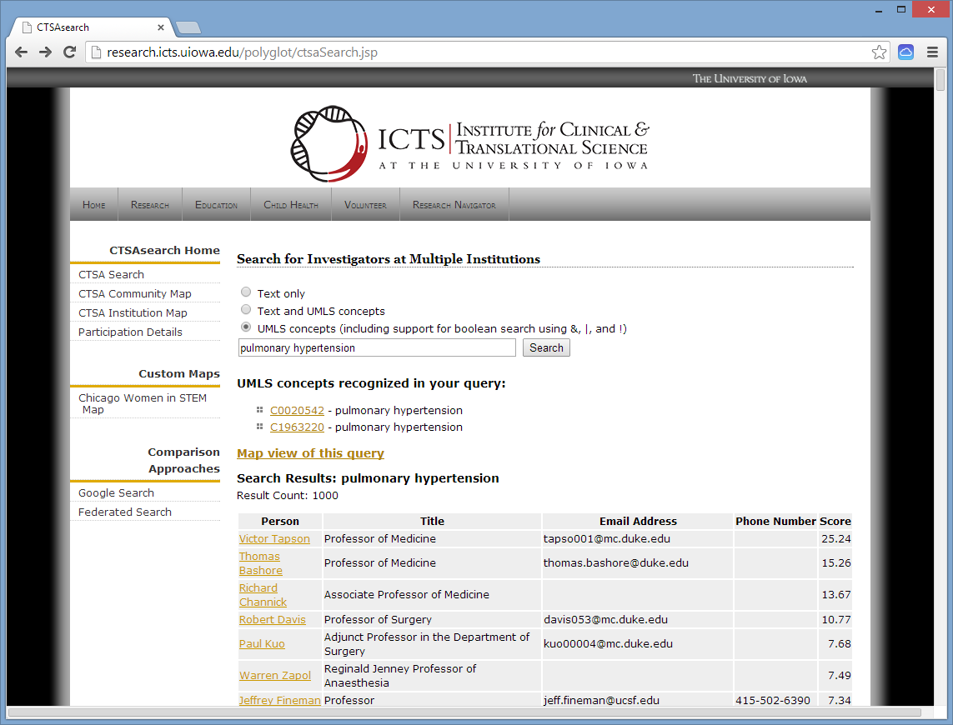

Slide 23
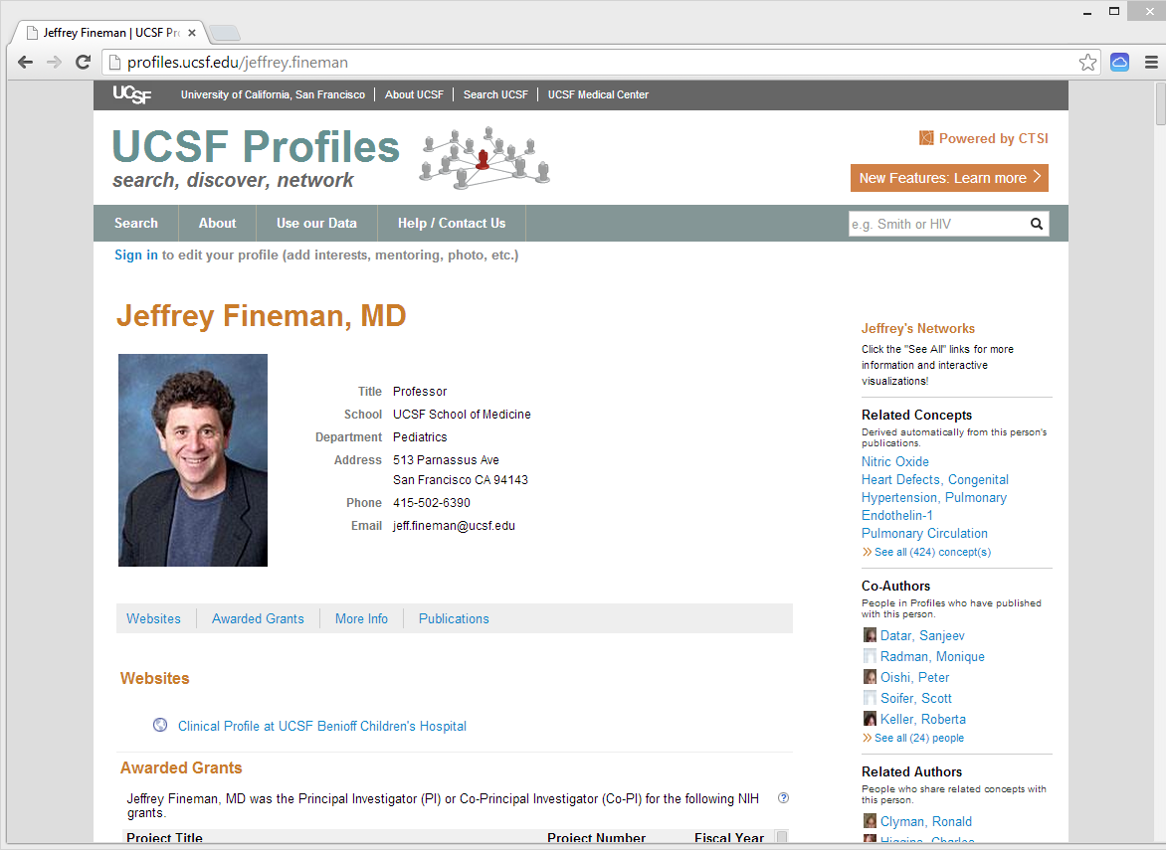

Slide 24
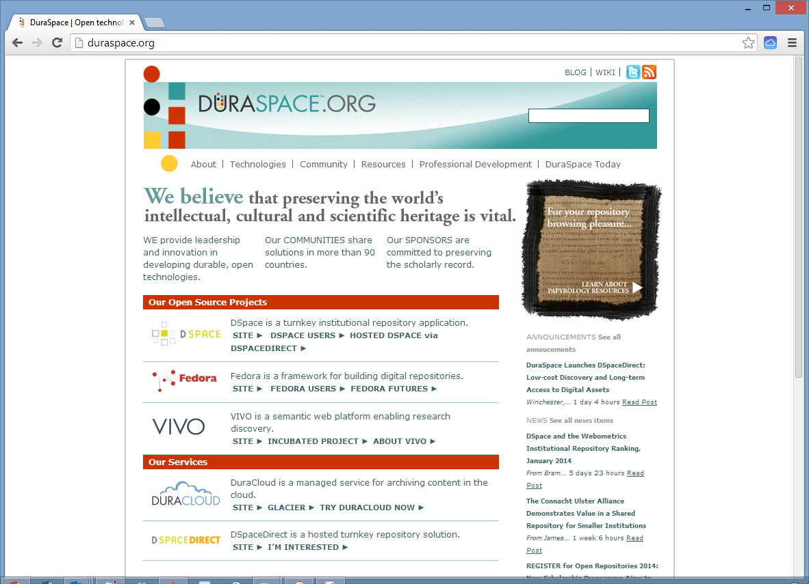

Slide 25
Learn More
The Conference
  Sixth Annual VIVO Conference, Aug 12-14, Cambridge, MA.
  David Weinberger, Harvard University
  James Onken, National Institutes of Health
The Book
  Börner, K, Conlon, M, Corson-Rikert, J, Ding, Y VIVO: A Semantic Approach to Scholarly Networking and Discovery, Morgan-Claypool, ISBN 978-1608459933
The Web
  VIVO Project Site http://vivoweb.org

