Slide 1
Leveraging the deeper graph
(via queries or patterns)
Steven Folsom
Paolo Ciccarese
LD4L Use Case 4
Notes:
First discuss a pilot project to convert non-MARC metadata to RDF and make connections with external linked data graphs to discover relationships to other entities.
Paolo will then go into detail about a general purpose pipeline he has designed to convert metadata to RDF and perform concept identification and elicitation of semantics and linkages along the way.

Slide 2
UC4
The essence of this use case is making use of complex graph relationships via queries or patterns (rather than direct connections) to allow discovery that would not be possible without the semantics of different relationships between items and types of items included in the graph. User stories and demonstrations will be somewhat tied to available data because detailed information and relationships will not be available for all resources.

Slide 3
Pilot: Linking Hip Hop Flyer Metadata to MusicBrainz/LinkedBrainz Data
Goals
Model non-MARC metadata from Cornell Hip Hop Flyer Collection to RDF
  Test BIBFRAME for describing the flyers
  Test the use of other ontologies for describing other entities, e.g. events, venues (more on this in a moment)
Use of LinkedBrainz URIs for performers to discover relationships to other entities to discover relationships to other entities…
(Keep on to da break of dawn)

Slide 4
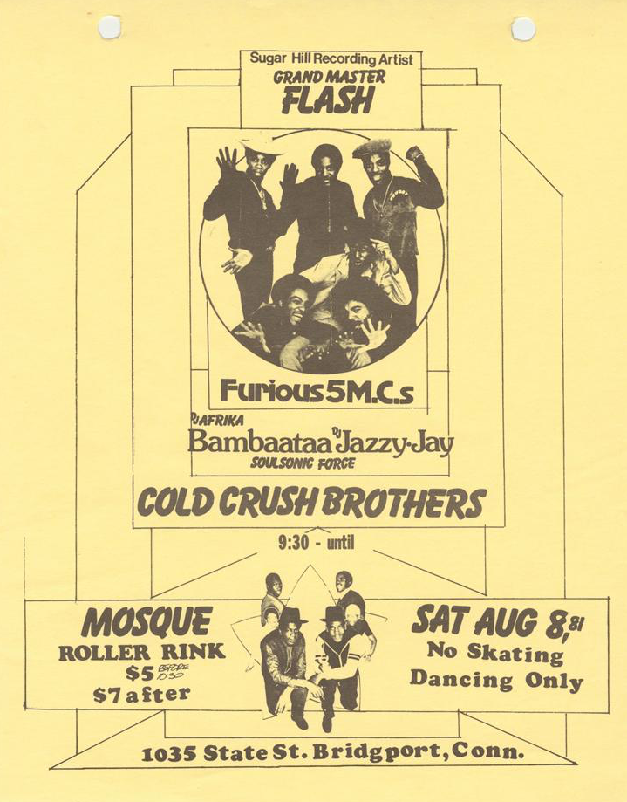
About the Hip Hop Flyers
Notes:
(494 Flyers)
Each of flyer describes an event/s
Events can have a known venue. Multiple flyers can refer to the same venue.
Each event can have anywhere from 1-20 (plus) performers

Slide 5
Flyer Metadata
  Cataloged using ARTstor’s SharedShelf
  Custom template
    Uses some elements for VRA (worktype, category, start and end dates)
    Customized to capture specialized metadata, graphic designer, event and venue information
  Uses Getty AAT for worktypes, RefID’s.
  Mostly local authorities for performers, rarely represented by LCNAF or other name authorities

Slide 6
Ontology Decisions
Describe the flyer in BIBFRAME, extend where needed
  Used Getty AAT to create bf:Work sub-classes
Describe events and related entities using MusicOntology, Event Ontology and Schema.org
Use foaf:Person’s to reflect RWO persons, with bf:Person as an associated authority

Slide 7
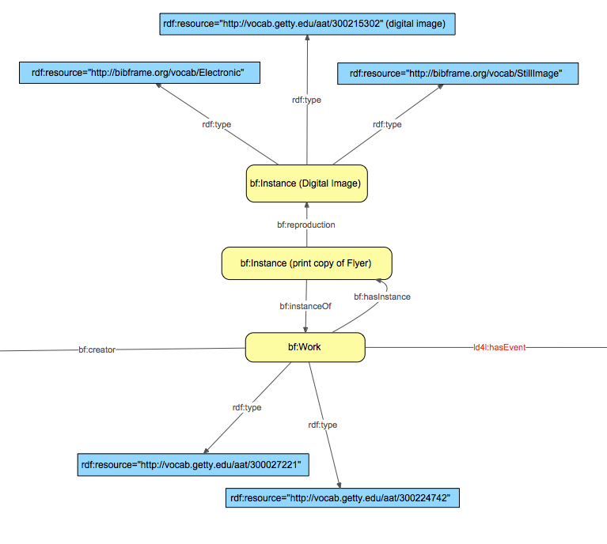
Ontology Decisions: BIBFRAME for Flyers

Slide 8
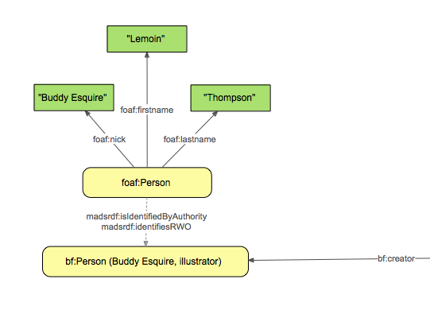
Ontology Decisions: FOAF for Persons
Notes:
Considering Schema persons as well.

Slide 9
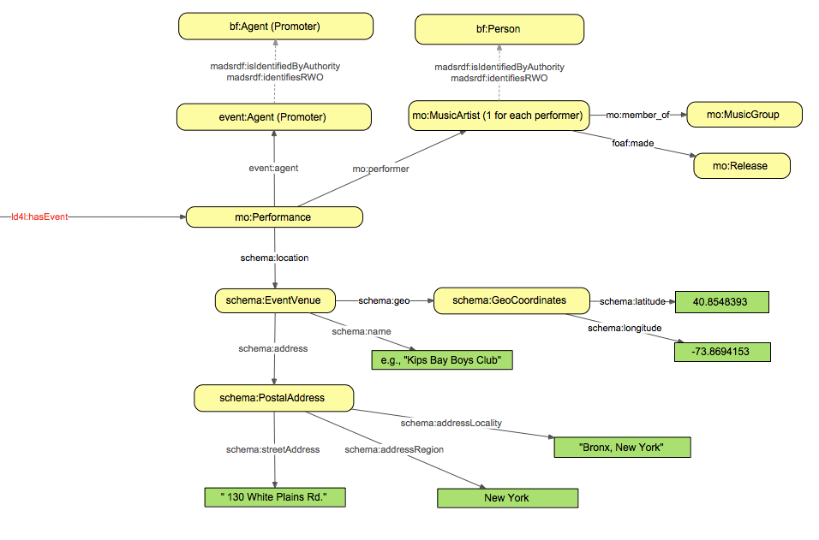
Ontology Decisions: Events and Performers

Slide 10
Tying this to external Graphs
When we have a MusicBrainz URI for instances of mo:MusicArtist we can query for relationships to other entities and properties of these new entities.

Slide 11
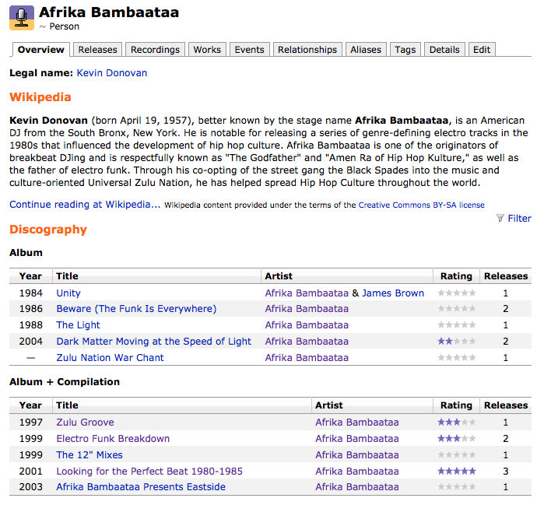
MusicBrainz
Notes:
MusicBrainz is an open music encyclopedia that collects music metadata and makes it available to the public.
Pulls in descriptions from Wikipedia
has relationships to other artists
Works they have produced
Events they were related to
All of this data is available as RDF through LinkedBrainz

Slide 12
BrutE force Reconciliation
Manually searched for entries for 1,100 literals (many of these were derivations for the same performer)
Found roughly 250 URL’s for entries in MusicBrainz of the were found
Ultimately surfacing 115 unique URLs

Slide 13
LinkedBrainz.org
CONSTRUCT { ?s ?p1 ?o1 .
?o1 ?p2 ?o2 . }
WHERE { ?s ?p1 ?o1 .
?o1 ?p2 ?o2 .
FILTER (
?s = <http://musicbrainz.org/artist/c9378ced-9e63-4edc-ab37-35bde1062a32#_>
)
# Eliminate guid property
FILTER ( ?p1 != <http://purl.org/ontology/mo/musicbrainz_guid> )
FILTER ( ?p2 != <http://purl.org/ontology/mo/musicbrainz_guid> )
# Eliminate Tracks
FILTER ( NOT EXISTS {
?o1 a <http://purl.org/ontology/mo/Track> .}
)
FILTER (NOT EXISTS {
?o2 a <http://purl.org/ontology/mo/Track> .}
)
}
Notes:
A query constructed by Rebecca:
Allows us to get back triples about relationships artist have to other artists and groups, and works they have created
And also to get those triples when the objects are used as the subject of other triples.

Slide 14
LinkedBrainz.org continued
{ "@graph": [
{ "@id": "http://musicbrainz.org/artist/c9378ced-9e63-4edc-ab37-35bde1062a32#_",
"http://xmlns.com/foaf/0.1/based_near" : [ "http://musicbrainz.org/area/489ce91b-6658-3307-9877-795b68554c98#_" ] ,
"http://purl.org/ontology/mo/member_of" : [ "http://musicbrainz.org/artist/73046026-6228-41a3-aa12-b3b796b491fa#_" ] ,
"http://xmlns.com/foaf/0.1/made" : [ "http://musicbrainz.org/signal-group/3cfacddf-a4ac-3fb8-9c29-fdaf1c429212#_" ,
"http://musicbrainz.org/release/396c4bd1-50d2-43d7-9149-bfd56daad006#_" ,
"http://musicbrainz.org/release/9a019ed2-3daf-4024-94dc-fd8f24ed6a59#_" ,
"http://musicbrainz.org/signal-group/40e49ce8-c8ee-3c2b-9861-6b521a092ba1#_" ] } ,
{ "@id": "http://musicbrainz.org/area/489ce91b-6658-3307-9877-795b68554c98#_",
"@type" : [ "http://www.w3.org/2003/01/geo/wgs84_pos#SpatialThing" ] ,
"http://www.w3.org/2000/01/rdf-schema#label" : [ { "@value" : "United States" } ] ,
"http://www.w3.org/2002/07/owl#sameAs" : [ "http://ontologi.es/place/US" ,
"http://dbpedia.org/resource/United_States" ] ,
"http://open.vocab.org/terms/sortLabel" : [ { "@value" : "United States" } ] } ,
{ "@id": "http://musicbrainz.org/release/396c4bd1-50d2-43d7-9149-bfd56daad006#_",
"@type" : [ "http://purl.org/ontology/mo/Release" ] ,
"http://purl.org/dc/elements/1.1/title" : [ { "@value" : "Def Jam / Cold Chillin\u2019 in the Spot" , "@type" : "http://www.w3.org/2001/XMLSchema#string" } ] ,
“
Notes:
the artist’s releases, but we also get more URI’s that open up for more querying.

Slide 15
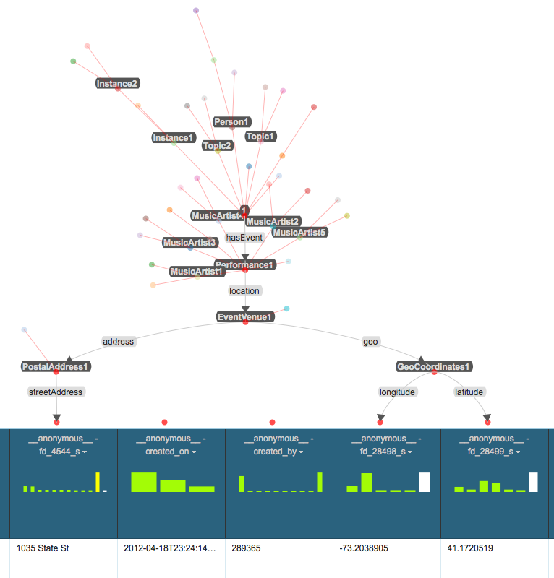
Mapping Metadata to RDF Using Karma
Notes:
wanted to see if I could devise a workflow for generating RDF with as little scripting as possible.
open source software Karma, developed by the Information Science Institute at USC.
Serviceable software with a bit of a learning curve.
Upload ontologies and the metadata that you want to convert to RDF. Then you can set semantic types for the values in the data file.
Pretty unstable, but if you can complete the mapping before any crashes you can publish the RDF.

Slide 16
If the Workshop was in March/April
[This is where you would see a Vitro demo.]

Slide 17
Remaining Work
Continue Metadata to RDF Mapping
  Some is easy, e.g. Event dates, Instance descriptions
  Decide what to “note”, e.g. directions to the venue, admission prices may not fit neatly into classes.
  Anything related to the item has been tabled while bf:HeldItem gets worked out, e.g. Copyright and access information
Post Processing
  Decide on URI’s for new resources created from the data
  Link to more resources, e.g. dbpedia
Reconciliation
  mo:Performers with BIBFRAME, VIAF, and other persons
  mo:Releases with bf:Audio resources (or some newly created subclass for music recordings)

Slide 18
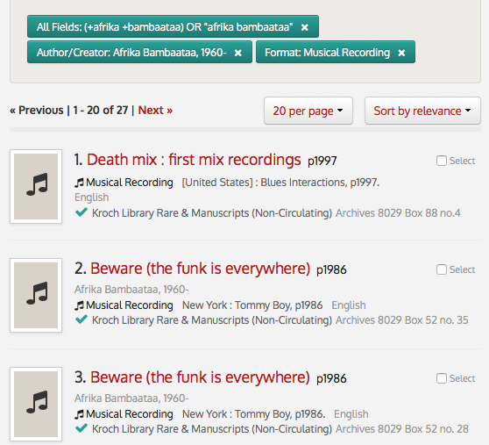
Reconciling mo:Release with bf:Audio
Notes:
The last mile is perhaps the hardest…
Reconciling BIBFRAME and MusicBrainz URIs would mean we could then point researchers from the flyers to album releases in our collections by performers mentioned in the flyers. LinkedBrainz has a property to record ID’s for Releases, but it’s rarely used in the data.

Slide 19
Takeaways
Able to map large parts of our metadata to RDF using multiple ontologies to discover more relationships to more entities (still some mapping and reconciliation work to do)
Largely predicated on manual workflows for preprocessing, URI lookups, and unstable software for RDF creation
Need more URI’s, for both linking to and linking from in order to take advantage of queries and patterns
That’s where Paolo’s pipeline comes in!

