Slide 1
Or… Don’t expect a lot of URIs in records, yet.
(in 7 minutes, 53 seconds)
Steven Folsom, Cornell University
LD4L Workshop, February 23, 2015
URIs you can expect to find in library records
(in 8 minutes or less)

Slide 2
Thesis Advisors and VIVO
Background
Varied historic practice of cataloging theses
500 Note fields for advisors, e.g. http://newcatalog.library.cornell.edu/catalog/5936706
Unauthorized 700’s advisors
Recent policy is to not record advisors at all because of difficulty of ascertaining this information from the printed document itself.
Current Workflow
MARC Records are derived from Graduate School database for managing theses submissions
  Advisor information isn’t harvested because of policies related to print, e.g. http://newcatalog.library.cornell.edu/catalog/8267081
Notes:
Pilot to test connections between BIBFRAME Persons and Cornell faculty profiles in VIVO.

Slide 3
Thesis Advisors and VIVO (Continued)
LD4L/Cornell LTS Pilot Project
Cornell Technical Services is adjusting the current automated practice for creating MARC records from Graduate School database to include Thesis Advisors
  Using NetIDs from the Graduate school database for advisors to look up against VIVO to get URIs for the faculty members
  Creating 700’s with advisor relator terms and VIVO URIs, e.g. http://newcatalog.library.cornell.edu/catalog/8793227
Cornell VIVO is considering persistence of URIs
  Possibly shifting from solely representing *current* research at Cornell, or expanding its definition of gravitas.
With…
700 1 ‡a Ceci, Stephen John ‡e thesis advisor ‡0(uri)http://vivo.cornell.edu/individual/individual23258

Slide 4
Thesis Advisors and VIVO (Continued)
We can create…
<bf:Work rdf:about="http://ld4l.library.cornell.edu/8793227">
<relators:ths rdf:resource="http://ld4l.library.cornell.edu/8793227person8"/>
<bf:Person rdf:about="http://ld4l.library.cornell.edu/8793227person8">
<bf:label>Ceci, Stephen John</bf:label>
<bf:authorizedAccessPoint>Ceci, Stephen John</bf:authorizedAccessPoint>
<madsrdf:identifiesRWO rdf:resource="http://vivo.cornell.edu/individual/individual23258"/>
</bf:Person>
</bf:Work>

Slide 5
URI Ground Swell
Evident by the number of different exceptions to “the usual” (more on this in a moment)
Program for Cooperative Cataloging (PCC) Vision, Mission, and Strategic Directions 2015-2017: “SD3: Provide leadership for the shift in authority control from an approach primarily based on creating text strings to one focused on managing identities and entities”
Motivations: Disambiguation, Collation, and what we’re all in this room for… preprocessing for LOD

Slide 6
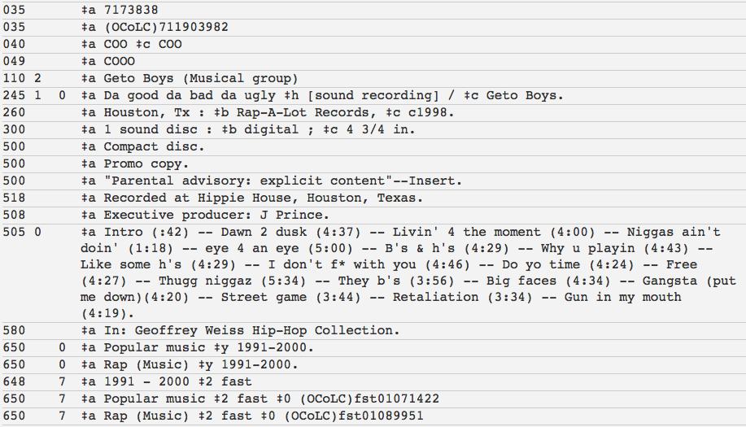
The Usual (Bib Data)
Notes:
Most ILS’s do not generally store URIs in BIB records, and rely on proprietary relational db structures to connect to stored authorities

Slide 7
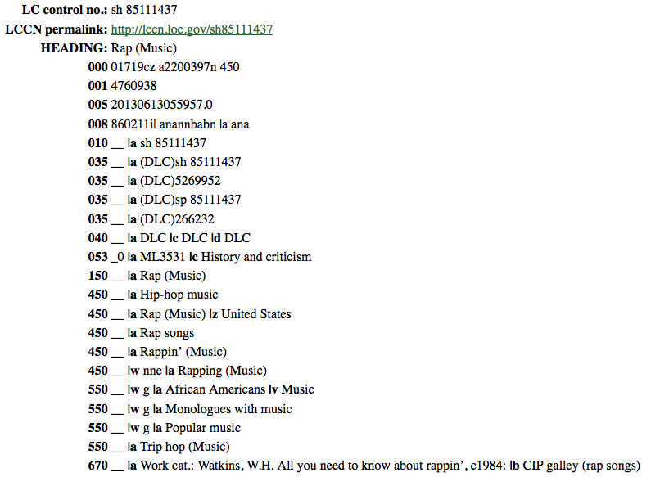
The Usual (Authorities Data)
Notes:
Doesn’t have dereferencable URIs. No mention here of the id.loc.gov linked data

Slide 8
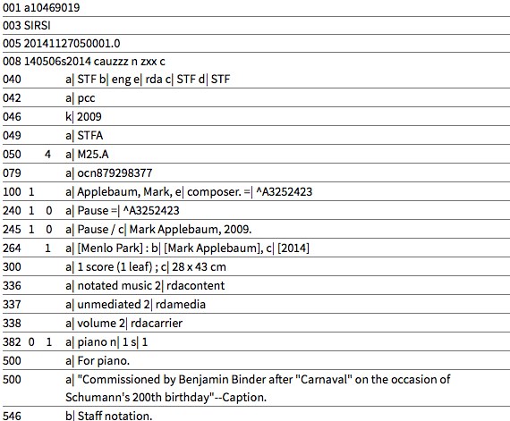
Sometimes (Stanford Catalog)
Notes:
Here’s a record from the Stanford catalog with keys to the authority record.

Slide 9
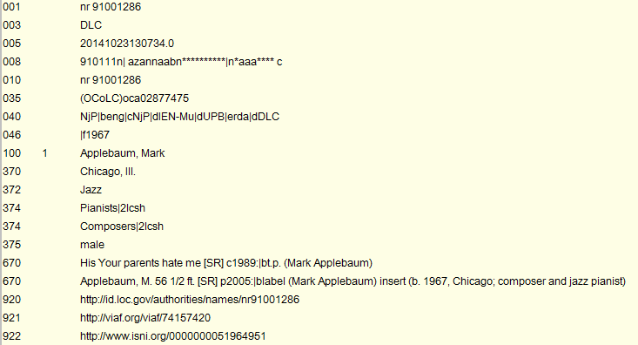
Authorities with URIs (Stanford)
Notes:
Stanford has contracted with a vendor to add URIs to their MARC Authorities.

Slide 10
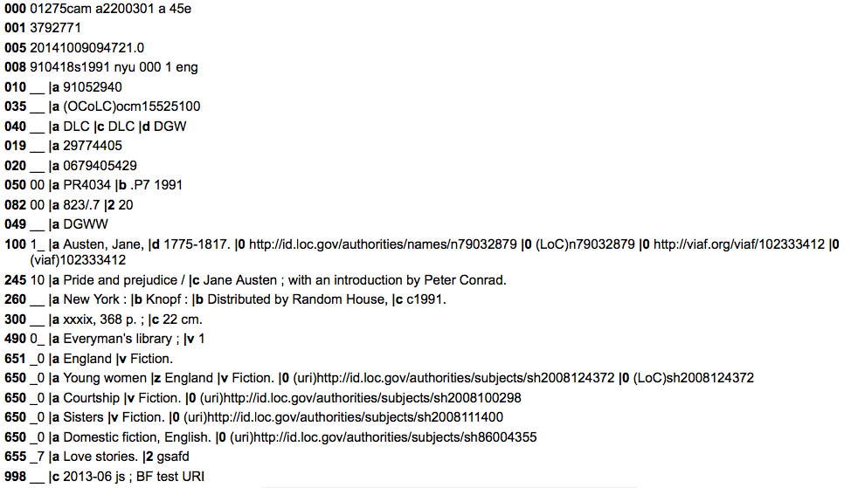
The Unusual: George Washington University

Slide 11
OCLC WorldCat Work IDs
Princeton University library has been piloting adding these URIs to a locally defined field
Cornell University Library Technical Services has approached OCLC about formalizing services around these ID’s for immediately use in our Blacklight catalog to cluster works and long term in linked data
Lots of other supporters, e.g. Dan Scott’s message to the WC-DEVNET-L list, Nancy Fallgren at NLM

Slide 12
My 8 minutes are up.
Notes:
Now for more from Darren on programmatic attempts to harvest URIs…

