Slide 1
Fedora/Islandora: From the Sublime to the "Less-Sublime"
Gail Hodge & Daniel Redmon
DC Fedora Users Group
Oct 06, 2014

Slide 2
Short Outline – Short Talk
Federal Science Repository Service (FSRS) Update
  Iraq Science & Technology Information Repository (ISTIR) (Drupal / Islandora)
Other Repositories
  Homeland Defense Information Analysis Center (HDIAC) Repository (Drupal / Islandora)
Announcement….

Slide 3
Federal Science Repository Service (FSRS)
NTIS-IIa public-private partnership http://fsrs.ntis.gov
Help multiple agencies develop repositories that:
  Are durable against technology changes, yet flexible
  Support preservation and long-term access
  Are based on standards
  Promote interoperability
  Support open government initiatives
  Promote further use of an agency’s content
  Can be tailored to an agency’s needs

Slide 4
Iraq Science & Technology Information Repository (ISTIR)
3 year project to develop document management and foster knowledge sharing within the Iraq Ministry of Science and Technology (MOST)
Islandora 6x / Drupal 6
Different object types including reports, journal articles, GIS files, presentations, etc.
Extended Metadata scheme for digital objects based on MODS
Controlled keywords from European Environment Agency’s GEMET Thesaurus in Arabic and English
Other controlled vocabularies such as organization names in both languages

Slide 5
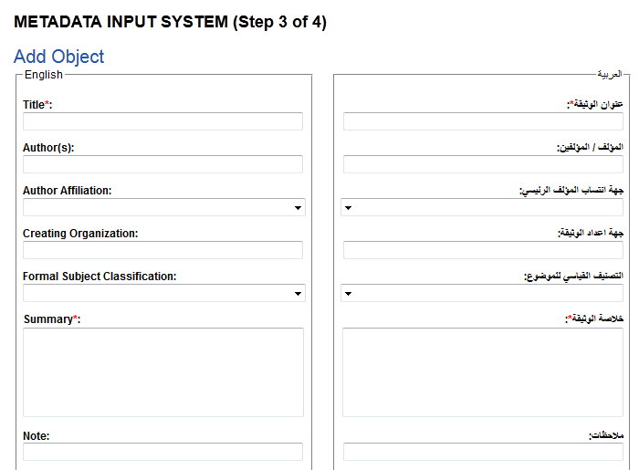
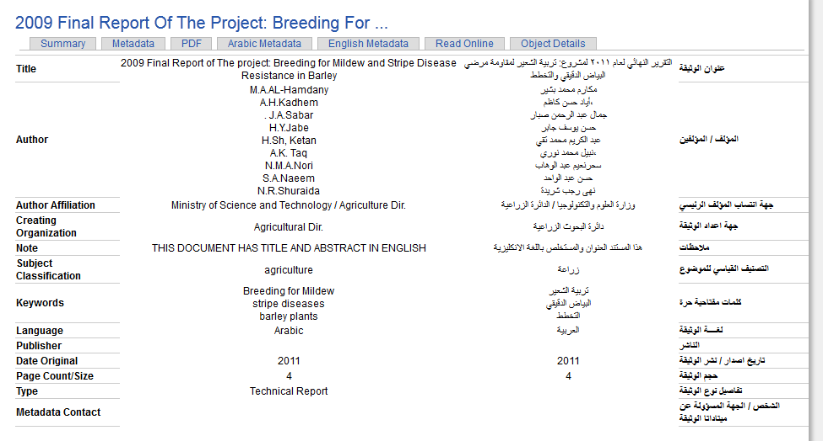
ISTIR Customizations
Custom bilingual front end for metadata
Extended PDF Solution Pack with custom tabset tied to XACML permissions

Slide 6

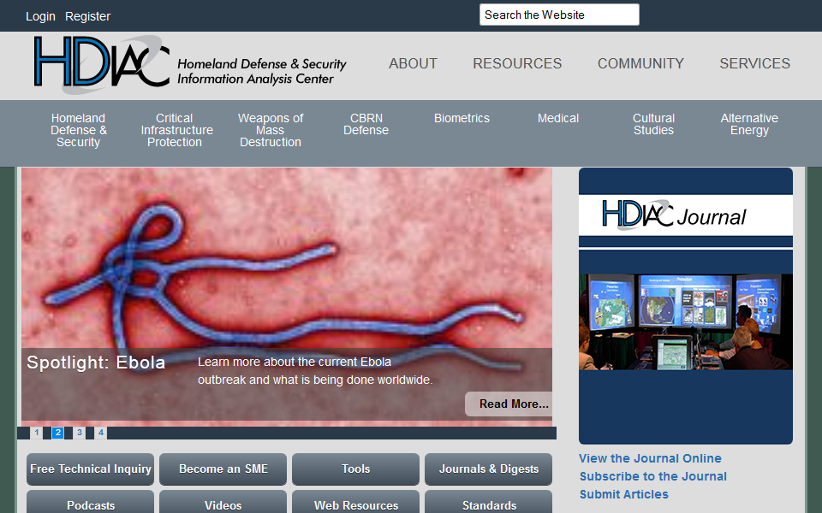
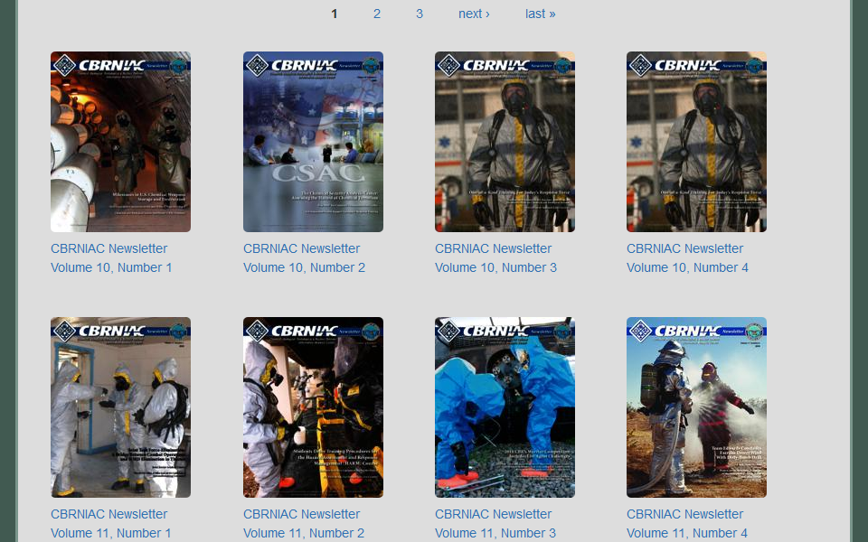
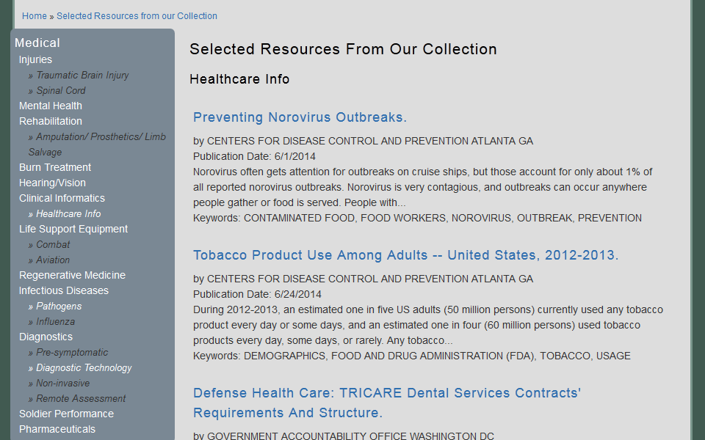
Homeland Defense Information Analysis Center (HDIAC)
Overview
  Drupal 7 / Islandora 7
  2 Distinct Collections as part of public interface
Hosted Journals Collection
  Other relevant journals
  PDF Solution Pack with custom MD schema
Selected Resources from the Collection
  Pulled into Drupal interface using Solr Views
  PDF Solution Pack with custom MD schema

Slide 7
Duraspace Registered Service Provider
Registered Provider status is imminent
While our focus is on the US federal government, we do support other clients
Specific repository development or as part of larger engagements

Slide 8
Services Available Through:
FSRS – requires an interagency agreement with NTIS
Other contracting vehicles such as GSA, Alliant Small Business, etc.
Direct agreements with non-government organizations

Slide 9
Contact Us
Gail Hodge
Information International Associates (IIa)
ghodge@iiaweb.com
865-742-5430
Daniel Redmon
Information International Associates (IIa)
dredmon@iiaweb.com
865-298-1224
Wayne Strickland
National Technical Information Service (NTIS)
wstrickland@ntis.gov
703-605-6543
For more information about FSRS:

