Slide 1
Ingest and Presentation of Serial Publications
Diane Boehr
John Doyle
Doron Shalvi
DC Fedora Users Group Meeting
October 6, 2014
National Library of Medicine
National Institutes of Health
U.S. Department of Health and Human Services

Slide 2


The NLM Digital Repository
Digital Library
  Search, browse and access
  resources held in NLM’s collection
Preservation Repository
  Safeguards for long-term viability
  of digital content
Winky the Watchman. 1945
Anatomy, Descriptive and Surgical.
Gray, 1859

Slide 3
Back-end: redundant storage & services
Primary Data Center
Browser
Browser
Backup Data Center
BIG-IP
80%
3DNS
20%
BIG-IP
Fedora
Primary
#1
Fedora
Primary
#2
Fedora
Backup
#1
Fedora
Backup
#2
External
Storage
Read
Only
External
Storage
Managed
Storage
Managed
Storage
Managed
Storage
Managed
Storage
Solr
Solr
Solr
Solr
Resource
Index
Resource
Index
Resource
Index
Resource
Index
Fedora DB
Fedora DB
Fedora DB
Fedora DB

Slide 4
Front-end: “Digital Collections”
Browse & Search (Blacklight)
    Open source OPAC application, widely used
    Rich faceting, responsive, lightweight design
Book Viewer (NWU)
    Open source software from Northwestern University
    Open source JPEG2000 server (Djatoka)
Video Player with Search (NLM)
    Features video transcript search & play-ahead jump
Web Service for third-party programmatic search

Slide 5
Descriptive Metadata
Voyager
MARC bib records to OAIDC, DMDIndex
Fedora Repository
Voyager bibs updated with resource permalinks,
date of ingest

Slide 6
Content
Audiovisuals
  106 digitized films
    Working off DVD access copies
    Higher quality digitization coming soon
Texts
  12,000 digitized volumes
    Single & multi-vol monographs
    Mostly scanned onsite
    And now, the first serial titles

Slide 7
What is a serial?
A resource issued in successive parts, usually having numbering, that has no predetermined conclusion (e.g., a periodical, a monographic series, a newspaper)
Notes:
Definition adapted from RDA. When it starts, it is expected to continue indefinitely, although we know they often cease publishing. The current definition includes resources that exhibit characteristics of serials, such as successive issues, numbering, and frequency (regular or irregular) but whose duration is limited (e.g., newsletters of events). Each issue should bear numbering or date or something that makes it uniquely identifiable.

Slide 8
Challenges presented by serials
Because they are ongoing, information about them may change
  Title
  Issuing body
  Frequency, etc.
Numbering schemes vary among (and within) titles; the number of possible levels is unpredictable
Notes:
Part 1, vol. 3, no 12 or Band 3, fascicle 1

Slide 9
Challenges presented by serials
They may have supplements, indexes, special issues or reprints
They often have relationships to other serials
  Earlier/later titles
  Companions
  Language editions or translations
Notes:
They may also be supplements, indexes, special issues or reprints

Slide 10
Serials metadata
A catalog record for a serial is created at the title level and the information presented applies to the serial as whole
Indexing records are created at the article or issue level
Notes:
Note the contrast. The cataloging data will often be very general since it must be broad enough to cover all current and future issues of the title. Important information about specific issues may be recorded in notes, but we generally avoid issue specific information..

Slide 11
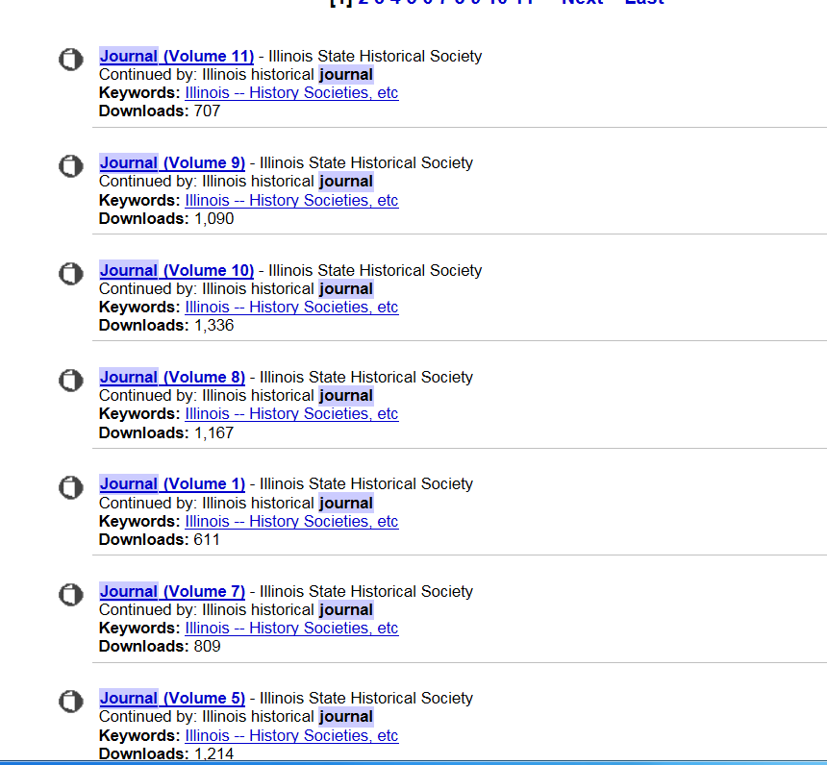
Common serial display
Notes:
Digitizing the serial is the simple part. Displaying it in a way that maintains the integrity of the title and provides for easy navigation is the hard part. Very often, a display of digitized titles looks something like this. If you’re lucky there will be a volume number or date to distinguish the issues, which all of course, have the same title. But they are not presented in any logical order and therefore, there is no way to easily see what issues are available. The display here (from Internet Archive) does let you know there is a later title (on each issue). Wouldn’t it be nice if there were an overall record for the Illinois State Historical Society journal where that information could be recorded once?

Slide 12
NLM’s display goals
Provide the user with a unified title level display that provides complete information about all the issues available, in chronologic order and easily navigable to any issue desired

Slide 13
Display issues
How do we work with a single catalog record, yet provide a user display that uniquely identifies each issue that has been digitized?
How do we best allow the user to see the full structure of the contents of the serial?
To what level of detail should we drill down?
Notes:
We did know that our data model uses the catalog record. We needed to determine how best to use one set of descriptive metadata and have it apply to all issues, since we are not indexing the journals we scan (that is PubMed’s role). We did however, want users to be able to see all the issues available, in order, keeping the integrity of the journal’s internal structure (i.e. vol. 1, no 1, vol. 1, no 2 before vol. 2) We had to decide how far we would drill down if the journal itself had a numbering scheme that went to 4 or 5 levels.
I think we were very successful in meeting our goals and Doran will explain how we did that.

Slide 14
Abstract Serial Hierarchy
Descriptive
Metadata
Root node
(serial)
Intermediate nodes
(series, volume, part)
Leaf nodes
(issue, number)
Page images

Slide 15
Leaf nodes with missing hierarchy
Descriptive
Metadata
Root node
(serial)
Intermediate nodes
(series, volume, part)
Leaf nodes
(issue, number)
Page images

Slide 16
Encoding of serial hierarchy
Scanning Spreadsheet
(Excel)
Tabular listing of each scanned issue (leaf node),
with hierarchy for that issue (e.g., Part II, Volume 3)
STRUCT
(XML)
Normalized hierarchical structure of serial
Display
STRUCT
(HTML)
HTML display representation of serial
computed in advance

Slide 17
Scanning Spreadsheet

Slide 18
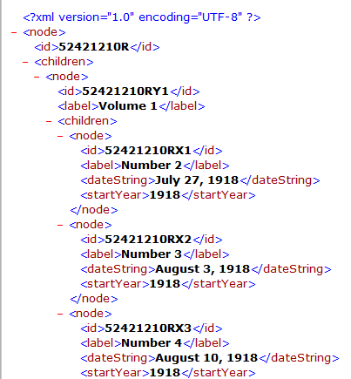
STRUCT XML

Slide 19
Serials data models
Root | Intermediate | Leaf
PID | PID | PID
DC | DC | DC
RELS-EXT | RELS-EXT | RELS-EXT
DMDINDEX | DMDINDEX | DMDINDEX
THUMB | THUMB | THUMB
Preview | Preview | Preview
STRUCT |  | METS
DisplaySTRUCT |  | OCR
 |  | PDF

Slide 20
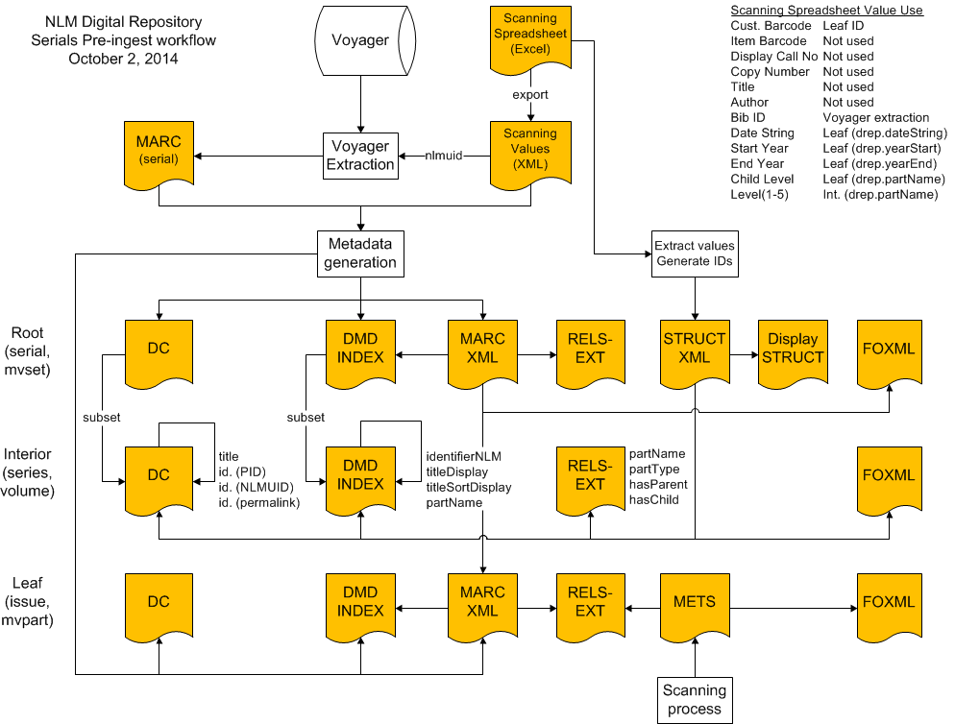

Slide 21
Demonstration
http://collections.nlm.nih.gov

