Slide 1

PCC CONSER WORKSHOP
May 22nd, 2025
Meet the Experts
Q&A
Discussion: Prepare for the implementation of the Official RDA
Notes:
M: ML

Slide 2
MEET THE EXPERTS
Kevin Balster, Continuing Resources Management Team Leader, University of California, Los Angeles
Stephen Early, Cataloger, Center for Research Libraries
Steven C Shadle, Head, Serials Cataloging, University of Washington Libraries
William C. (Hank) Young, Principal Cataloger, University of Florida
Notes:
ML

Slide 3
From Adam Schiff (academic Library)
With the WEM lock, what will be PCC policy for naming serial and series works, particularly in regard to series authority records? Will we use the same authorized access point for what RDA considers now to be separate works? Will qualifiers such as (Online) be making a comeback?
Notes:
KB, 2, SE, M: MS

Slide 4
From Ian So (academic library)
I'm not sure when to use $e issuing body relationship term. Can this relationship term be used with 110 field (i.e. corporate body as creator) also, or it must be used with 710 only?
OCLC #663443180: This title Service list of the Imperial Maritime Customs, which is of administrative nature. Shall we use $e issuing body or $e author at 110 field?
Notes:
SE/HY M: ML

Slide 5
From Cheryl Wegner (humanities research library)
Is "irregular" now considered a valid term to use in the 310 and 321? RDA 2.14.1.3 lists it as a valid term; OCLC BibFormats does not. Also is it still true that "x" should only be used in the Regl field if there is a "z" or a blank in the Freq field? Documentation says yes, but practice is all over the map?
Notes:
SS/HY M: MS

Slide 6
From Echo Rue (government library)
We use OCLC WMS at our library and I am curious about a specific serial that we have that has changed names and/or publishing location over a long span of time.
NGS Magazine history of changes/oclc numbers (and attached scans to show the dates/ISSN/publication info and title as correspond to each change) -
OCLC Record 15555570 NGS Newsletter ISSN 0887-1353 1987-1999 Published in Arlington VA
OCLC Record 43367810 NGS Newsmagazine ISSN 1529-4323 2000- [2008] July/Sept vol 34 #3 Published in Arlington VA
OCLC Record 276783602 NGS Magazine ISSN2472-4661 $y1529-4323 1st Oct-Dec 2008 vol 34 #4 Published in Arlington VA unclear why ISSN 2472-4661in 022 if it is an error, per 588 field I checked the issue cited but not with this ISSN?
OCLC Record 276783602 NGS Magazine ISSN1529-4323 Changed from Arlington VA to Annapolis Junction, MD National Genealogical Society with publication on Vol 51, no. 1 (January-March 2025)
Questions about these:
What would make them be the same record with denotations of the changes in one record with all the names vs separate OCLC records - ie when is it best to denote changes and keep the same record vs create a new record and link the data to previous publications/oclc record?
If there are older 260 field in a record, should record be updated by adding a new 260 for change in publication date or update the old data to 264 and add a new 264 for new publication? Or keep the 260 and add a 264?
Notes:
SE M: ML

Slide 7
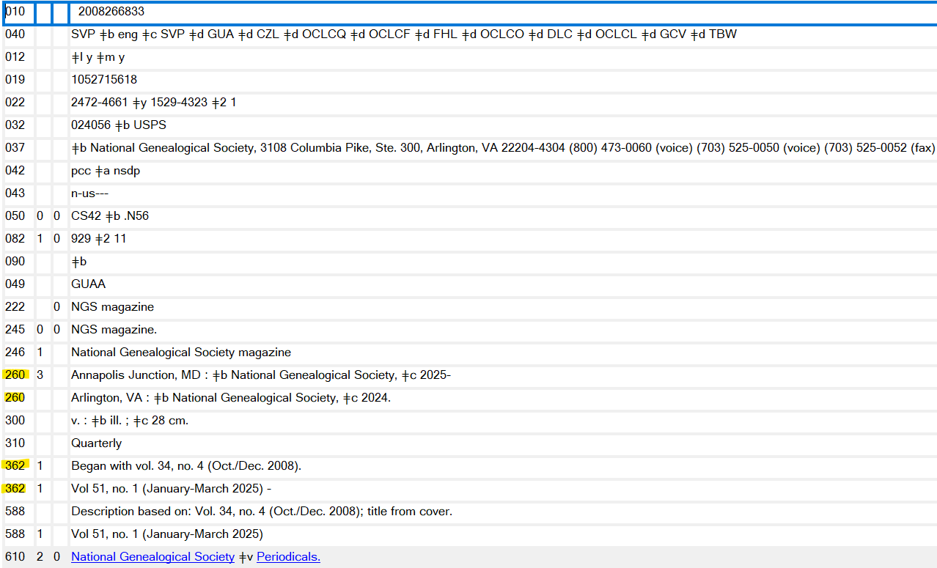
From Echo Rue (government library)
For this record:
260 $3 2008-2024 $a Arlington, VA : $b National Genealogical Society, $c 2008-
260 3 $3 2025- $a Annapolis Junction, MD : $b National Genealogical Society
Ctry mdu (for current place of publication)
Also: remove the incorrect additional 362: 362 1 Vol 51, no. 1 (January-March 2025) -
Notes:
SE M: MS

Slide 8
From Ted Schwitzner (Academic Consortium)
What is the intended use for linking fields, such as 780 and 785, in local and/or consortial catalogs? In CONSER records, linking fields 76X-78X identify known relationships between publications that may be located anywhere. However, a given institution may have only one related title, or electronic content may be limited to less than the full run of a related title. With LSPs expanding functionality to identify related records, how can these data be preserved without also leading patrons to local dead ends?
Notes:
SS/HY M: ML

Slide 9
From Renee (Academic library)
OCLC/PCC PURL Service (CONSER PURLs): How many institutions are still actively using (i.e., creating new CONSER PURLs) and maintaining CONSER PURLs for open access resources?
Notes:
Open to the audience, poll (creating new, maintain, disregard) M: MS

Slide 10
More Questions?
Notes:
M: ML

Slide 11
DISCUSSION
Implementation of the Official RDA
Should we generally try to keep the same style of documentation (e.g., word/pdf documents created and maintained separately), or attempt to integrate some content into a smaller set of documentation or the RDA Toolkit?
What are the highest priorities in terms of updating documentation or training?
What updates need to be done in advance of the Official RDA implementation, and what can come afterwards?
Are there any unresolved issues that need to be settled before we begin updating documentation?
Notes:
KB

