Slide 1

Data Model
DC-IRD Y3 Kickoff
July 19-20, 2011

Slide 2
Goal
Deconflate the data model
  Provide a separation of concerns
  Bring DCS concepts to the front
  Initially:
    Containable Model
    Deliverable Model
    Technical Registry Model (In work – Elliot)
    Preservable Model (In work – Timmo )
    Other Business Objects Model (In work)
    General Query Model and Spatial Query Model
    Disseminable Model (TBD – late Y3 proposed)
Paradigm: The DCS is “bytestream oriented” but can store and deliver structured data for processing
Enables OAIS processing but other parts of the information lifecycle too

Slide 3
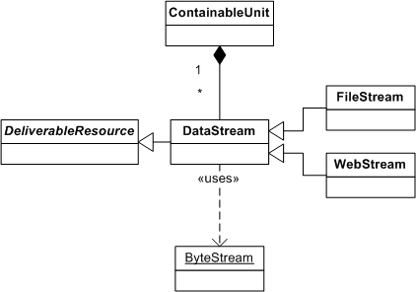
Containable Model
Persistence is provided as ByteStreams
Any entity can be serialized (circularity)
Independent of the information contained (stands alone and support rebuilding)

Slide 4
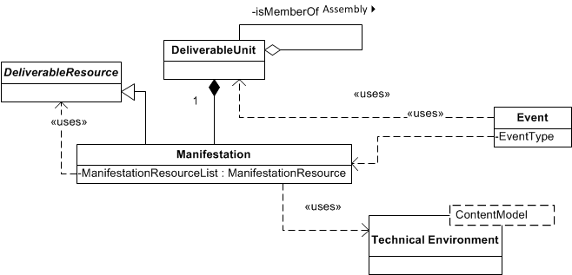
Deliverable Model
Models fixed (bit) content aspect of DCS (see Disseminable)
Information objects in terms of any DeliverableResource but usually DataStreams
Represents the atomic granularity in the DCS
Primarily represents a whole/part relation

Slide 5
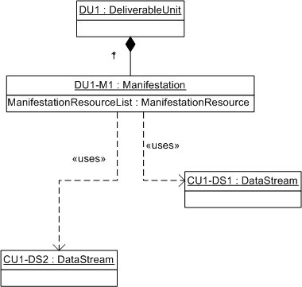
Example Deliverable Unit
Describe method returns a graph
Get methods return parts of the graph
May have one or more DeliverableResources proxied by ManifestationResource (to avoid ownership)

Slide 6
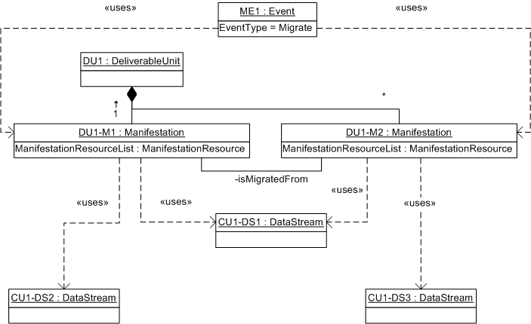
Example Format Migration
Significant properties are preserved
Not all DeliverableResources are necessarily migrated at the same time
Keeps history as a relation and Event

Slide 7
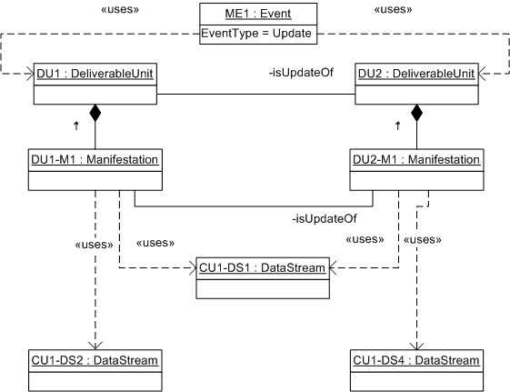
Assemblies (with Versioning)
Assemblies serve multiple-uses (e.g. Archival Information Collection and Versioning)
DU is still atomic
Version creates new DU and significant properties change (relation and Event)
AIC is a DU so it can act like one in all ways (preservation)

Slide 8
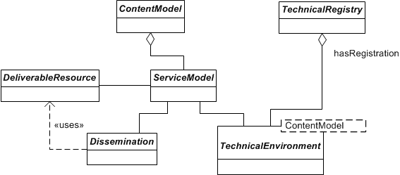
Disseminable Model
Delivers both fixed and dynamic representations
Supports deliveries for more complex preservation-related representations
Can engage FEF to deliver transformed representations
Should be model driven to make practical for the long run
Still a work in progress since it is dependent on many parts of the DCS

