Slide 1

Deploying a Research Dataset Catalog at Texas A&M University
Managing research data from creation to curation to retention
Presented by James Creel at the DSpace North American Users Group Meeting on September 24, 2024 and released under a CC-BY license.
(Portions of this presentation have been previously given at the Texas Conference on Digital Libraries 2024 and the TAMU System Virtual Library Conference 2024)
Notes:
I’m here to tell you about an exciting new initiative that came out of the VPR’s office.

Slide 2
Outline
Origins and Motivations
Requirements Gathering
Initial Prototyping
Custom Features Development
Evolution of Entity Model
Finalizing a Production Pilot

Slide 3
Origins
In 2023, the Vice President for Research articulated a need for tracking and managing the extensive data output from University research.
VPR initiated a collaboration with Faculty Affairs, Technology Services, and University Libraries in order to realize the vision.
Notes:
VPR sees the need for the university and PIs to begin stewarding research datasets throughout the lifecycle and has tapped the libraries to provide the assistance to the PIs with data stewardship and to provide a catalog of the datasets for discovery and compliance. Rightly so, because assisting with information stewardship and providing catalogs are some of the things libraries do best.

Slide 4
Motivations
Discoverability
Research Impact
Experimental Reproducibility
Preservation
Compliance
Notes:
Motivations inherent to library practice as well as motivations communicated to us from VPR and faculty.
Libraries were pleased to be tasked with this project, as it hit so many boxes for our mission – all of which are enticing carrots for PIs. However, the initiative would not have come about without the Compliance gorilla. It is on this basis that the VPR must bring the stick to complement our carrots. That being said, the VPR also strongly endorses the carrots.

Slide 5
Discoverability
Metadata
- Basics…
- Discipline
- Subject
- Format/means of processing
SEO
- HTML Meta tags
- Sitemap
- Indexing by search engines
These considerations feed into the impact of the research.
Notes:
More than just a web presence, discoverability requires metadata and search interfaces as well as the facilitation of search engines’ interfaces by spoon feeding them the metadata they like in the format they can use on a platform they recognize.
Libraries consider this a “carrot” to entice researchers to share their metadata with us.

Slide 6
Research Impact
Wider dissemination of research
Ability to find collaborators in other fields
Promotion and Tenure considerations
Note that wider discovery and dissemination of the research will enable more parties to attempt the reproduction of experimental results.
Notes:
A secondary carrot offered by the libraries.

Slide 7

Experimental Reproducibility
As datasets are made available to other researchers in the field, a new avenue for reproducing experiments is opened.
Will require comprehensive metadata about the structure and ways of processing datasets.
Notes:
Image credit: Bing AI
Integrity of research is reinforced in two ways:
New experiments can have their results compared with the dataset
Datasets can be used as inputs to analyses to confirm conclusions

Slide 8

Compliance
Data retention within specified time frames
Easy identification of Primary Data Access Contact (PDAC)
Secure, authorized access to records
Reporting for audits
This capability offers bonus capabilities for analysis and visualization
Notes:
Image credit: Bing AI
TDR has a working group to address uncertainty surrounding data retention dates. The concern is baked into this initiative and the RIS should help out.

Slide 9
Requirements Gathering
The service must:
satisfy all the motivations for managing research data, especially unmet compliance requirements
engage faculty in the collection of their research data with minimal impact on their existing workflows
integrate with existing systems that are tracking research activity and outputs

Slide 10
Considerations of the Status Quo
Faculty are reluctant to take on additional work that they consider unnecessary for the conduct of research.
Research projects are already being tracked extensively in a TAMU RIS – but it is concerned with grant compliance, not research outputs.
The issue of storing datasets is already being addressed – TAMU has a Dataverse instance, and funding agencies and disciplines offer their own data repositories as well.

Slide 11

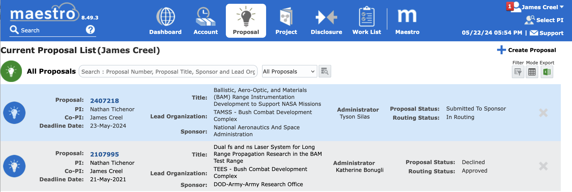
Research Information
Management System (Maestro)
A service provided by VPR that has been in use by the TAMU System for years to track all grant-funded research projects.
We’ve had limited success getting faculty to record their research data outputs here.
Notes:
Not the best news on this front – we are getting push-back on forcing researchers to input dataset deliverables upon project closeout.
However, we are looking at only several hundred projects per year, which, with dedicated staffing, will enable us to consult with Pis and curate records individually.

Slide 12
Dealing with the Status Quo
Faculty are frequently out of compliance in that their research data
  are not publicly available
  are not retained for required periods
  are not known to the legal owner, i.e. TAMU
Our catalog must:
  track, but not reposit, research data
  serve as a CRM for librarians and compliance officers to reach out to faculty and help them meet obligations
  use as its primary information source an RIS that does not tell us about research data

Slide 13
Workflow
  Data Management Plans (DMPs)
  Research Information System (aka Maestro)
  Record Ingestion
  Cataloging
  Reporting and Auditing

Slide 14
Research
Data
Lifecycle

Slide 15

Initial Prototyping
Decided on a custom DSpace instance to meet all the initially apparent requirements
Scheduled work on a 3-week sprint cycle with daily check-ins with product owner
Sprints 1 and 2 yielded a prototype data catalog with sketchy/uncurated records suitable for demos and shopping around.
Notes:
image credit: abovethelaw.com

Slide 16
Custom Features
ETL and Import scripts
Metadata customizations
  project dates
  chain of custody
  others relevant to research
UI niceties
  link to dataset
  link to scholarly profile
Tracking chain of custody – keeping a record when the PDAC changes
Entity model

Slide 17

Record Ingest and Cataloging
Using a custom DSpace repository as the data catalog: Data@TAMU.
Extract,Transform,Load of information from Maestro and other research information sources
Using DSpace SAF (Simple Archive Format) to populate records.
Notes:
Chose DSpace because we know it, it seemed to fulfill many of the use cases right out of the box, and couldn’t find any compelling reasons not to.
Accessing the Data Warehouse to get exports of Maestro project data which we collate with Dimensions dataset listings and output as metadata spreadsheets.
This step in the workflow requires too many assumptions for the records to be ready for publishing. We have leveraged the Dimensions data for the purposes of prototyping. Later, such records would require curation.
Furthermore, we will soon begin ingesting in-progress project records from Maestro in order to pre-populate catalog records. These will go into DSpace workflow for curation.

Slide 18
Entity Model
PDAC
Research Project
Dataset
PDAC
Many to One
Many to One
Research
Project
Dataset
One to Many

Slide 19
Evolution of Entity Model
Started with Dataset and PDAC only
Realized, after some months, that when librarians said “dataset” we were referring to catalogable assets – but when VPR’s office and faculty said “dataset” they referred to research data that might not be packaged for reposit.
We must track all research data, understanding that almost all projects produce research data, but relatively few produce research datasets

Slide 20
Scripted Imports from Data Sources to produce SAF
Maestro → PDACs and Research Projects
Dimensions → Datasets
Dataverse → Datasets?
Other data repositories… → Datasets?

Slide 21
Custom Metadata
Project termination date
Finding aids
  A single-level description of extent, scope, and content of the research data associated with a research project
Link to dataset in data repository
Link to scholar’s profile
Other research related fields
Chain of custody

Slide 22
UI Improvements
Theming
Hiding sensitive metadata
Links to scholarly profiles
Links to dataset in data repository
PIs and Co-PI listing

Slide 23
Concluding Work for Pilot
After reaching fuller understanding with VPR and reforming the entity model, the prototype reached minimal viability in two more sprints.
As of this presentation, production deployment is pending.

Slide 24

Click to add your credits
DEMO
Subtitle

