Slide 1

Presentation Title
SAFCreator Mini Workshop
Presented by James Creel at the DSpace North American Users Group Meeting 2024, University of Minneapolis, Elmer Andersen Library
Subtitle
These training materials by James Creel are licensed under a Creative Commons Attribution 4.0 International License. Some of these materials are adapted from previous DSpace training licensed by the author.

Slide 2
Workshop Outline
Prerequisites
Setting Up SAFCreator
Overview of DSpace Metadata
Using SAFCreator
  Formatting Content and Metadata
  Validation
  Writing SAF
Importing/Exporting Content with DSpace

Slide 3
Prerequisites
Java Runtime Environment: https://jdk.java.net/23/
CSV Spreadsheet editor (e.g. Excel)
Optionally, for more advanced use:
Apache Maven
GitHub client
ssh client (e.g. PuTTY)

Slide 4
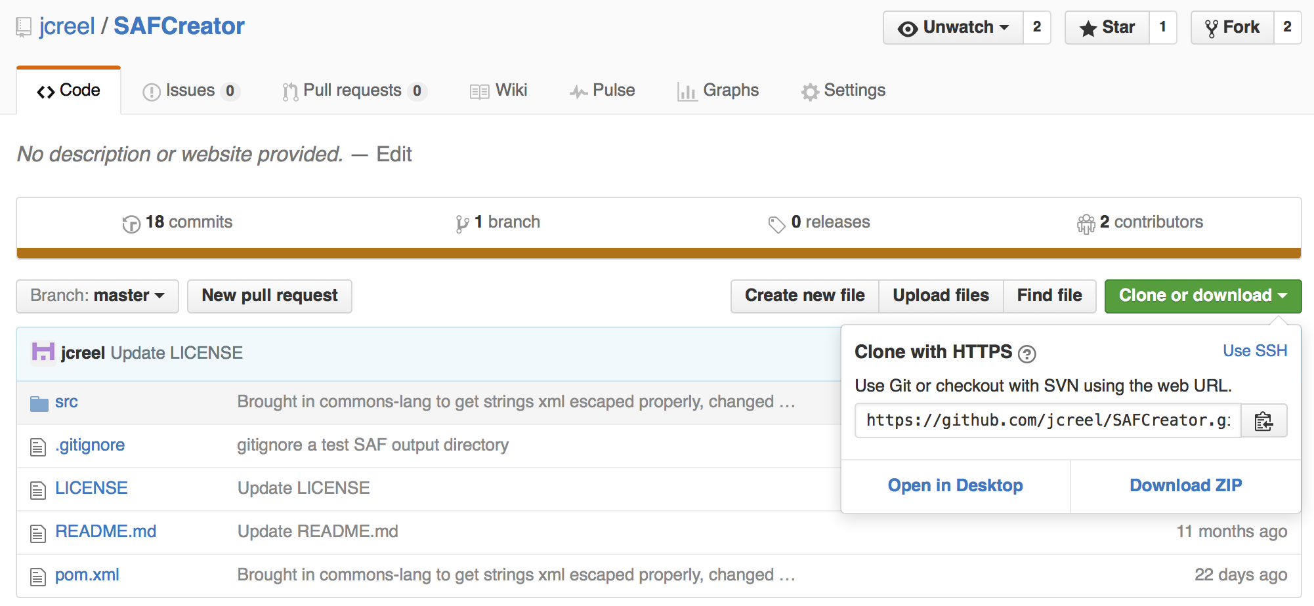
Setting Up SAFCreator -
Get SAFCreator
Use a git client to clone, or download the zip from https://github.com/jcreel/SAFCreator

Slide 5
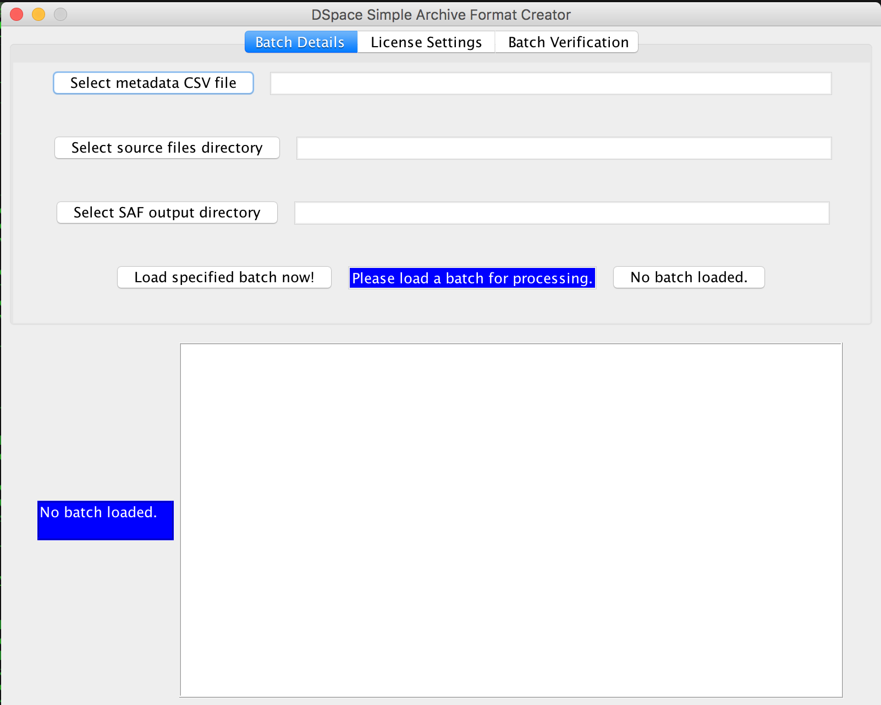
Setting Up SAFCreator –
Run SAFCreator
You are in possession of a runnable .jar file.
Run it from command line with:
java -jar SAFCreator-0.0.2-SNAPSHOT.one-jar.jar
(Or, double-
click it?)

Slide 6
Caveats
If you’re on Windows and care about special characters, you will need to run java with some special parameters to enforce UTF-8 (notes on the GitHub repo)
If your archive contains dc fields that are not in your metadata registry, you will get cryptic error messages on import.
On Mac? When you compress your archive to .zip, your .zip will contain a __MACOS directory. Remove it with
zip -d your-archive.zip "__MACOSX*"

Slide 7
Excel
Import and export as UTF-8
Beware of Leading BOM character which will result in cryptic error message about dc.field not being found

Slide 8
Using SAFCreator
Overview of Interactions
Loading Batch Data
Licensing and Authorization of Batch Content
Verifying Batch Data
Writing SAF
What about those other tabs?

Slide 9
Using SAFCreator (1/5)
Formatting Content and Metadata
Find the example source data in [SAFCreator-install-dir]/src/main/resources/SAF
Open up the CSV
  “filename” or “GROUP:BUNDLENAME” or “BUNDLE:BUNDLENAME” are column headers for file designations
  schema.element.qualifier are column headers for dublin-core-style metadata
  Multiple field values are delimited with the double bar ||

Slide 10
Using SAFCreator (2/5)
Loading Batch Data
Select three filesystem locations:
  Source metadata spreadsheet
  Source file directory
  Output directory
Click “Load specified batch now!”
Check the console for feedback

Slide 11
Using SAFCreator (3/5)
Licensing and Authorization
On the second tab, you can
Attach custom license text
Restrict read access on the item’s content to a specific eperson group

Slide 12
Using SAFCreator (4/5)
Validating Metadata
The third tab provides access to the validators, which must pass prior to writing the batch.
Validators provided in the stock distribution:
  Local files exist
  Labels are schematically correct
  Remote files exist

Slide 13
Using SAFCreator (5/5)
Writing SAF
Return to the first tab after validating.
Click “Write SAF data now!”
Check the console for feedback

Slide 14
Functions of additional tabs
Advanced tab has settings that allow for configuration of network settings for remote downloads, as well as tweaks on the writing of the SAF
Flags tab will display “flagged” events on attempting to resolve remote files during batch verification

Slide 15
DSpace SAF
Overview
The top-level directory contains one directory for each item in the batch.
Each item directory must contain:
  The bitstream files
  A contents manifest contents
  Optionally, a handle that contains handle for new item
  Optionally, a collections (not handled in current SAFCreator)
  A metadata file dublin_core.xml
  Optionally, other metadata files with names like metadata_[schema].xml where [schema] is the schema’s name.
  Scott Phillips provides a fine guide at http://www.scottphillips.com/2009/05/howto-dspace-batch-ingest/

Slide 16
DSpace SAF
Contents Manifest
The contents manifest contents names each bitstream that will be in the item as well as it’s disposition:
  Bundle
  Permissions
  Primacy

Slide 17
DSpace SAF
Metadata
The SAF uses a specific XML format for the encoding of Dublin Core style metadata.
  dublin_core.xml
  metadata_[schema].xml where [schema] is another metadata schema in your repository’s registry
The containing element is dublin_core with a schema attribute.
The field elements are dcvalue with schema, element, and qualifier attributes.

Slide 18
DSpace SAF
Import Script
[dspace-install-dir]/bin/dspace import takes a number of arguments, many required
  -a: to add items (-d deletes and -r replaces)
  -e: eperson email
  -s: source directory
  -c: collection handle
  -m: mapfile
  -t test mode

Slide 19

Click to add your credits
Thanks for your kind attention!
Subtitle

