Slide 1
Cloud Native Preservation
Digital Preservation 2019

Slide 2
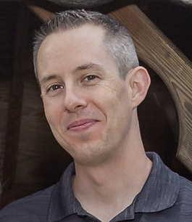
Bill Branan
LYRASIS - Sr Engineering Lead
DuraCloud Technical Lead
  Open Source project - est 2009
  Preservation utilizing cloud storage
  Preservation utilizing academic DDPs
  Hosted by DuraSpace, now LYRASIS

Slide 3
Cloud object storage
A data storage architecture that manages data as objects that are free of hierarchy, allowing all data objects to exist at the same level in a storage pool. Each object includes the data, a unique identifying name, and metadata. Cloud providers offer object storage as a massively scalable and low cost storage solution.
Examples
Amazon S3, Microsoft Azure Blob Storage, Google Cloud Storage, Rackspace Cloud Files, Wasabi Cloud Storage
Notes:
We are going to be talking today about performing preservation within cloud systems, and this always starts with storage
Show of hands, how many of your or your institution is using one of these platforms to store files

Slide 4

Cloud object storage benefits
Virtually unlimited capacity
Low cost
Greater institutional / departmental / individual control
Access to content for processing
Ability to use tools built against cloud APIs
Reduced maintenance
Access / availability
Security controls

Slide 5
Are cloud features sufficient for preservation?
Notes:
Answer: It depends, but in many cases NO.
If you are moving content out of a preservation-aware system (DuraCloud, LOCKSS, Chronopolis, APTrust, etc) and into cloud storage, you need to know that you are losing some of the preservation benefits of that system

Slide 6
Features of a Digital Preservation solution
Create multiple distributed copies of content
Maintain inventory of all content and storage locations
Maintain audit log of all content stored and all changes made
Verify file fixity / integrity
Provide an administrative dashboard
Partial Support
Perform metadata extraction
Perform format identification
Perform virus scans
Perform format migrations
No Support
Notes:
This list is not comprehensive, but instructive
S3 Inventory tells you what is in storage at the moment it is run, but how do you know what *should* be in storage?
Many of these features are supported by existing digital preservation systems (DuraCloud, LOCKSS, Chronopolis, APTrust) or tools (Archivematica), but can we do this work directly in the cloud?

Slide 7

The Future
Support all preservation functions
Work in a cloud environment
  To take advantage of cloud capabilities
  To benefit from new cloud features and functions
  To avoid egress charges
Shared approach, tools, and best practices
Shared development overhead

Slide 8

Cloud Preservation Toolkit
A set of tools to perform preservation functions
  Independent deployment - use only what you need
  Consistent, repeatable deployment using configuration management tools
  Primarily serverless
A community of developers to maintain and improve tools
  Open source function code
  Open source configuration management scripts
  A community of practice
Notes:
Deployed with Terraform and Ansible
Serverless - to limited maintenance, low operational cost, scalable
These tools are already being built, why not work together?

Slide 9
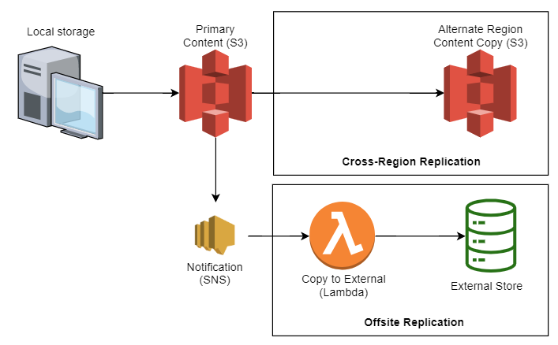
Multiple copies
Notes:
Function Examples: A starting point for the conversation
Could be done in multiple ways
Examples are in AWS: Would look different in other cloud providers

Slide 10
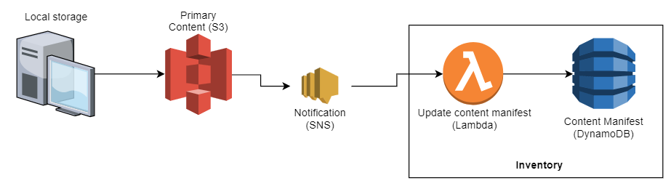
Inventory

Slide 11
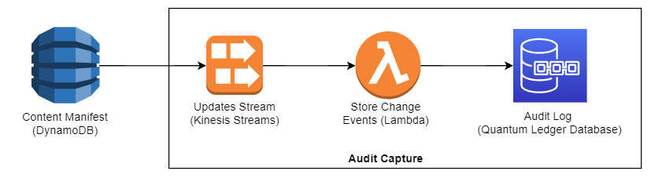
Audit Log
Notes:
This could be done in multiple ways. Goal here is to show variety of options.
Could capture events directly from the S3 SNS notifications
Could write audit log in DynamoDB or in another S3 bucket
Quantum Ledger - Provides immutable and cryptographically verifiable history of all changes

Slide 12
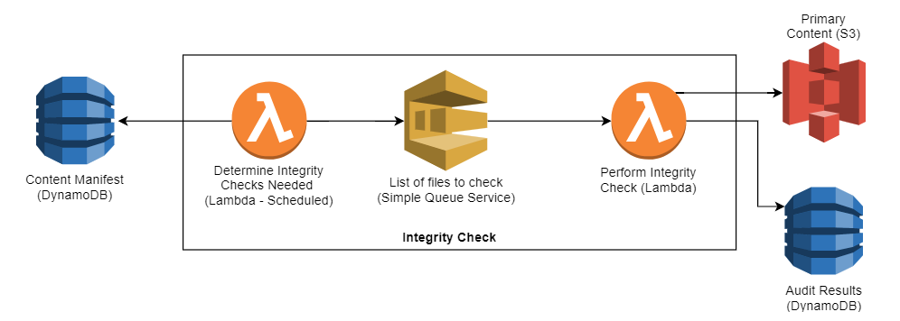
Integrity Checks
Notes:
Format migrations are essentially the same

Slide 13
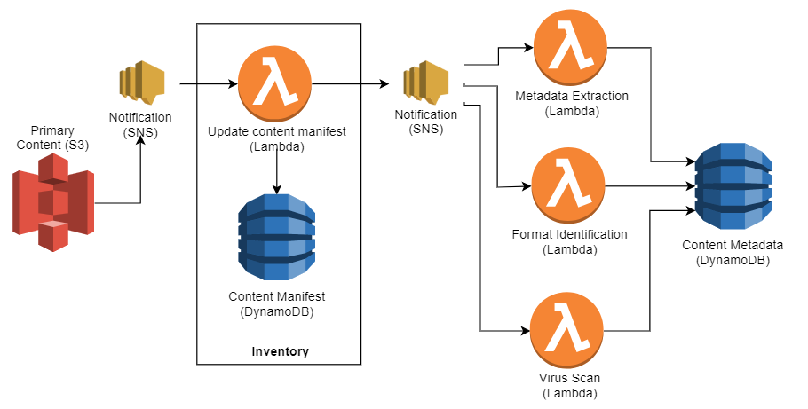
File Processing
Notes:
Each process would be its own function and could be deployed independently

Slide 14
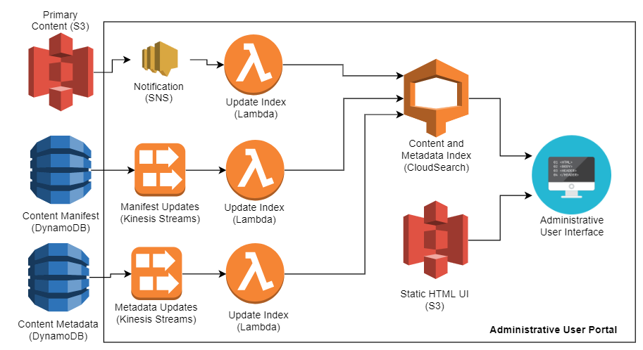
Administrative UI

Slide 15
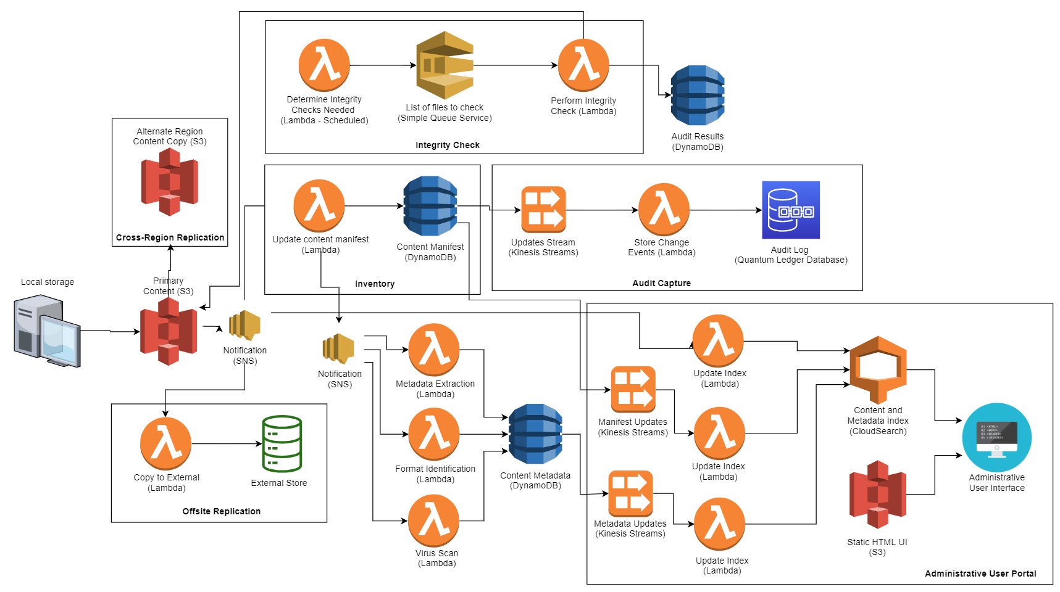
Putting it all together

Slide 16
Benefits
Convenient - Allows the continued use of cloud storage for high-value content
Efficient - Preservation actions occur within the cloud environment
Shared - Consistent set of tools used and maintained across institutions
Configurable - Use only the components that are relevant to you
Manageable - Each function is limited in scope
Scalable - Serverless tools allow for broad scaling
Low cost - Serverless tools ensure charges only apply when work is done
Automated - Deployment and updates managed by CM tools
Confidence that data is preserved!

Slide 17

Is this the future you want to see?
bill.branan@lyrasis.org

