Slide 1
2021 North American VIVO Users Meeting
Rachid Belkouch – research data management advisor, liaison to steering committee
Nicolas Dickner - systems librarian, data ingest
Jonathan Laporte – web developer
Alexander Jerabek – systems librarian, scrum master
Michel Héon - enterprise architect

Slide 2
Presentation goal
Presenting UQAM top priorities for 2021
VIVO's vision at UQAM
Internationalization
Visual of the VIVO-UQAM portal
VIVO-UQAM data sources
Interoperable Data Ingestion pattern (VIVO-DataConnect)
Development Environment tool for VIVO
(UQAM-DEV)

Slide 3
VIVO @ UQAM : a shared vision with the community
UQAM is a publicly funded university
i18n means a greater adoption, more hands on deck
Shared :
  data connection method : streamlining the process with Kafka
  Shared development tool
  Shared method
Rachid Belkouch

Slide 4

Internationalization
VIVO i18n
  Next sprint January 25th to 29th
  wiki.lyrasis.org/display/VIVO/Sprint+-+i18n
  1.12 release candidate in February
  Continue to contribute to stable release 1.12
Nicolas Dickner

Slide 5
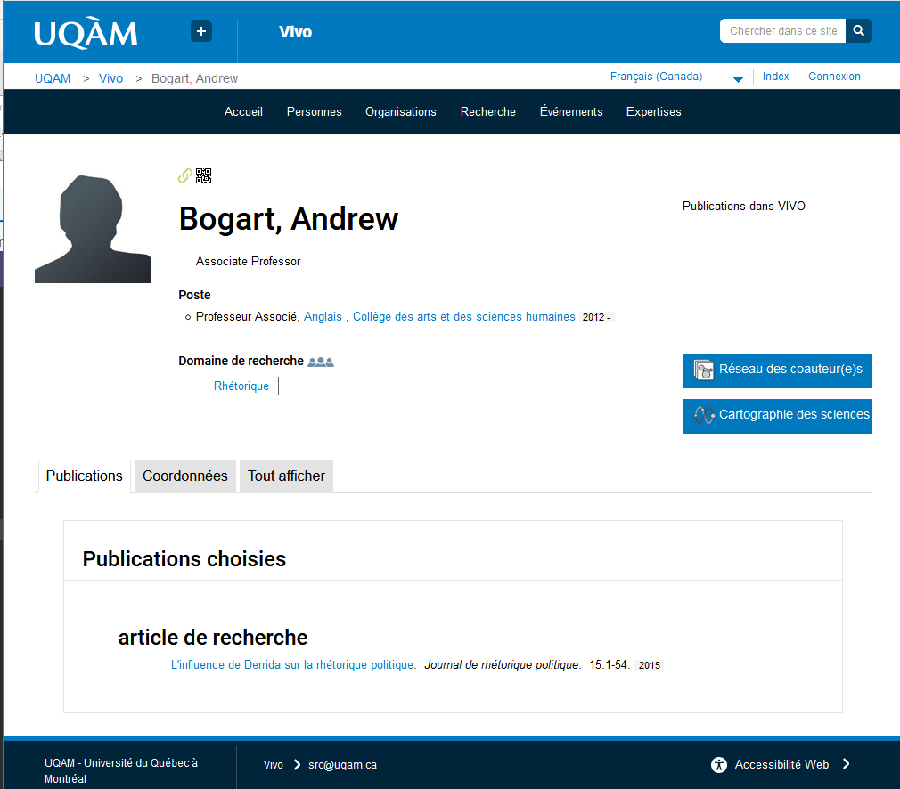
Visual of the VIVO-UQAM portal
Collaborative work with A/V to implement the institutional header and footer;
Easy to add, modify or override CSS, JavaScript, image and even templates theme files;
Responsive design in progress (Bootstrap);
Separation between logic functions and display -> updates preserve the theme.
Jonathan Laporte

Slide 6
VIVO-Data Sources
Refbase – harvest bibliography
Dataverse – connect to research data
EPrints / DSpace - harvest references in institutional repository
Local institutional web services (HR, LDAP), etc – person details
ORCID – promote visibility, unique identifier for VIVO
Alexander Jerabek

Slide 7
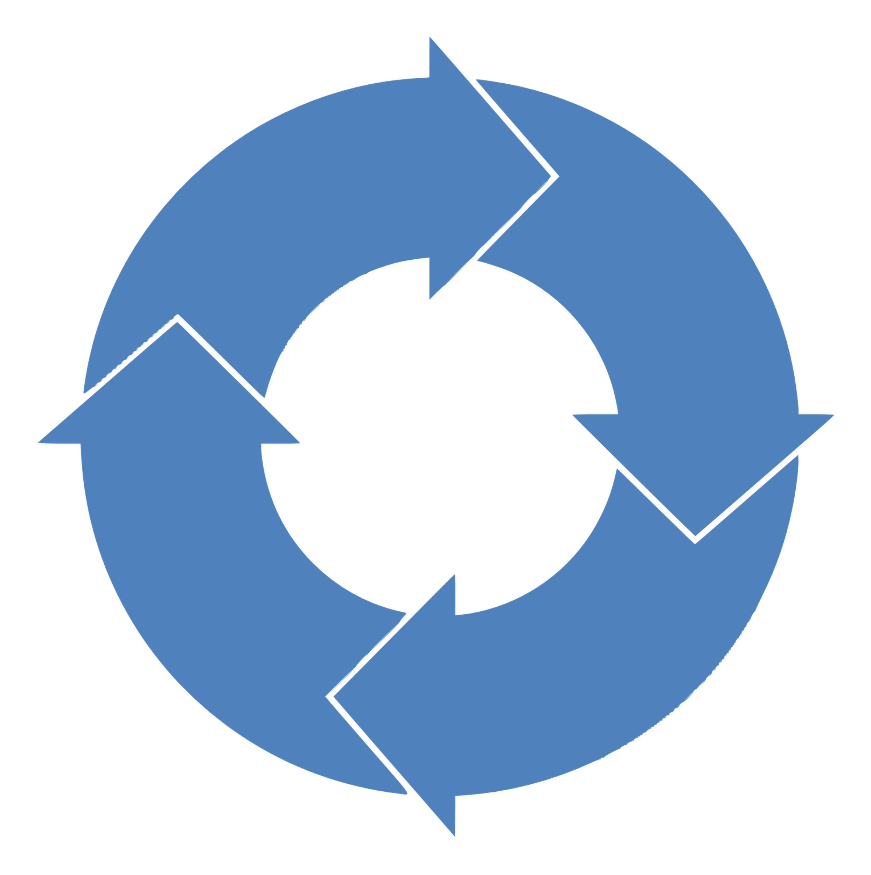


VIVO-DataConnect project (1/2)
An Institutional Interoperable Data Exchange Pattern
VIVO's classic data flow architecture (ETL Pattern)
Institutional data source
Extract
Load
Application
Target data source
Transform
Service web access
Relational DB to RDF graph translation
Periodically run in batch mode
Semantic association
SPARQL Update
Unidirectional data flow from source to target
Michel Héon

Slide 8
VIVO-DataConnect project (2/2)
An Institutional Interoperable Data Exchange
Each data repository is both the source and the target of the data flow
Data exchange is initiated by sending asynchronous events
The message encapsulates the information in a JSON-LD notation and standardized by the VIVO vocabulary.
Proof of concept with ORCID as data source, in collaboration with TIB
Relational DataBase
Other TripleStore
Graph Database
Other kind of DataSources
Files DataSources (CSV, Excel, JSON…)
VIVO
Messaging Framework
Michel Héon

Slide 9
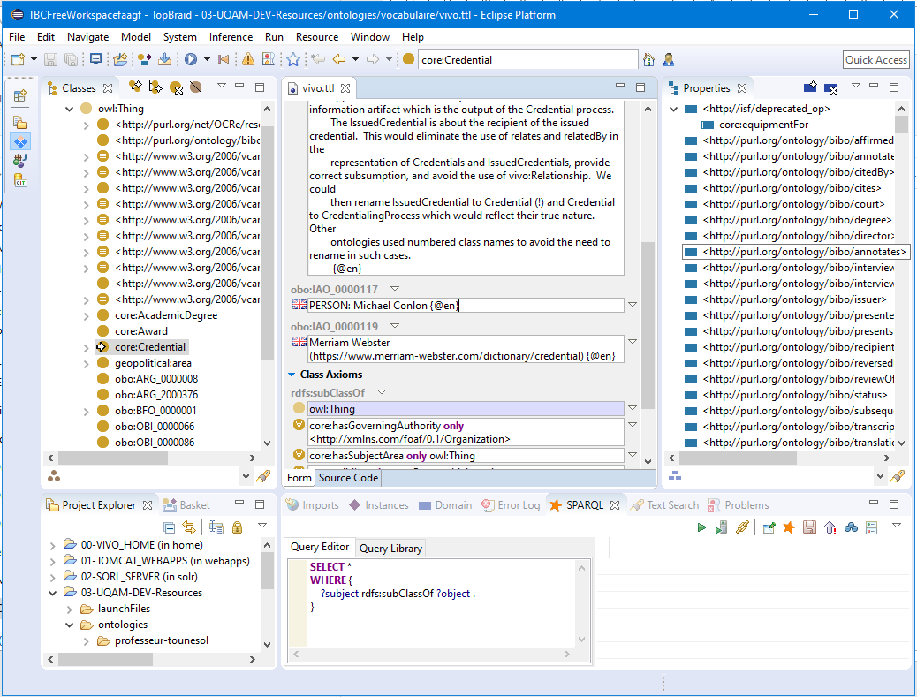
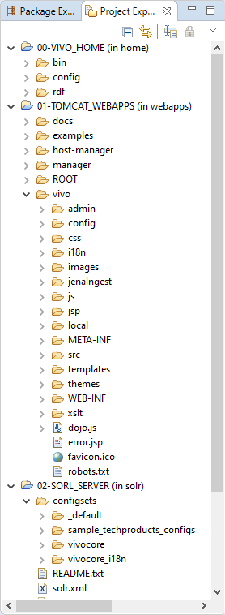

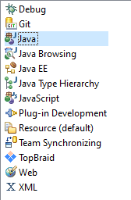
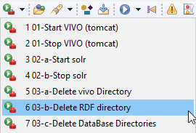
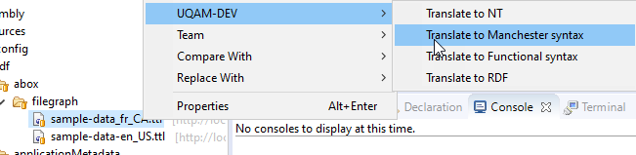
Development Environment tool for VIVO
Make the VIVO development process accessible to as many people as possible
Encapsulated access to VIVO's building process
Based on Eclipse J2EE project for Java Developer (Java, Git, Maven, Tomcat etc.)
Encapsulated access to VIVO's internal structure
Ontology engineering and editing
Michel Héon

Slide 10
UQAM is proud to continue to participate in the VIVO internationalization project
2021-Q1 The VIVO-UQAM version goes into production
Q{1-3} starting up VIVO-DataConnect
Conclusion

