Slide 1
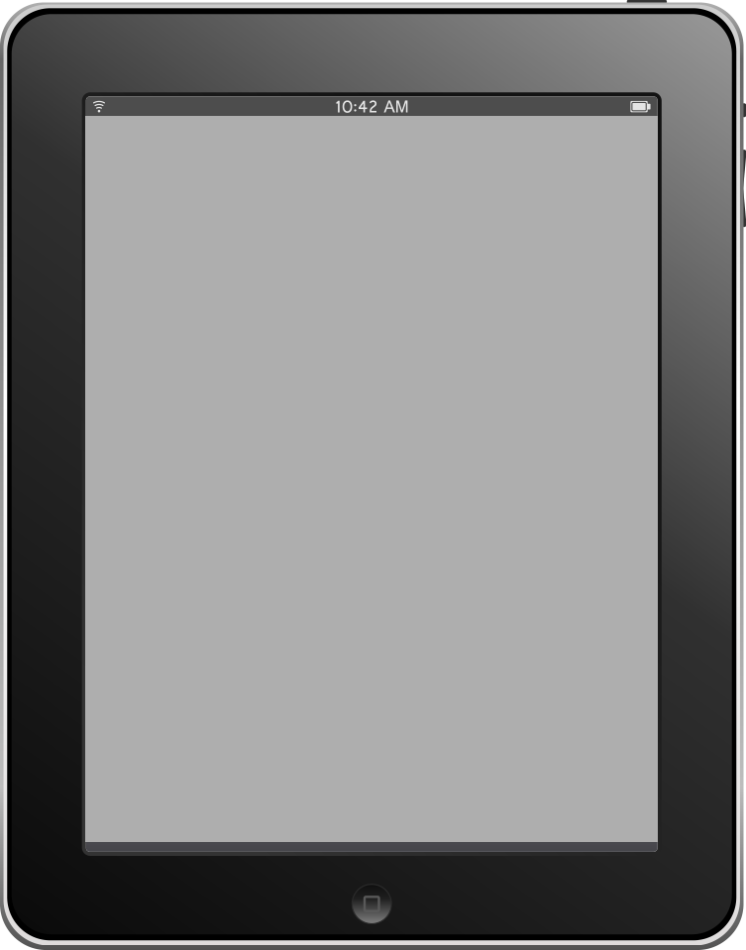
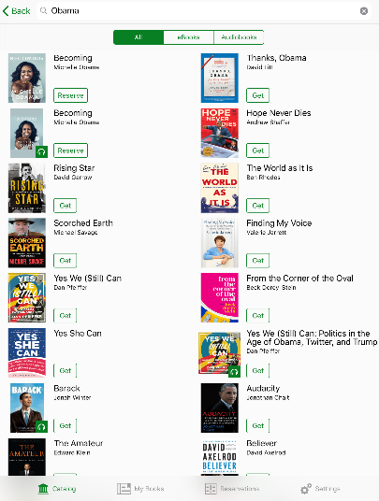
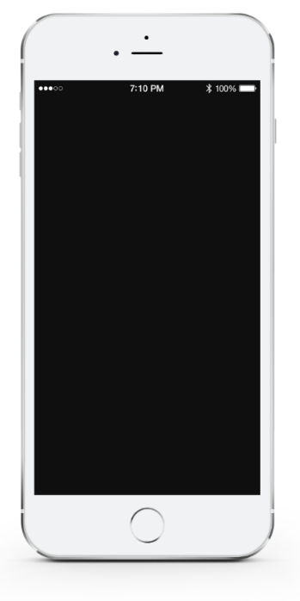
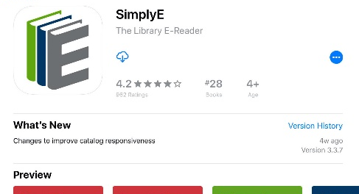

Ebooks From Your Library To You
Borrow thousands of e-books and audiobooks from [library name]
Welcome to SimplyE!
SimplyE is the app that gives you access to a nationwide ebook and digital audiobook library lending program. It’s easy to browse, borrow, and read any ebook or listen to any digital audiobook in our library’s collection on your mobile device.
Easy to learn, navigate & use
In a few steps, download the app and start reading. SimplyE works on Apple and Android phones and tablets. Most books are available
immediately and there are no late fines!
Thousands of books, new & old
Easy to find what you want to read, whether you’re browsing our collection or searching for a specific title. SimplyE will recommend titles you might like based on your choices. No need to download multiple apps – with SimplyE all your ebooks are in one place.
Accessible for everyone
SimplyE is created with assistive tech-nology, making it accessible for those with visual impairments or reading difficulties. Adjust the text font, size and color. Need help getting or using SimplyE? Your library is here to guide you.
Protects your privacy
SimplyE was designed by libraries for libraries, so your privacy is very important. Unlike commercial reading apps, your usage is not tracked. When you choose SimplyE, you support public libraries and ensure equitable access to digital reading.
Set up SimplyE in three easy steps:
START READING!
  Download and open the SimplyE app.
  Find [library name].
  Enter your library card ID and PIN to search, borrow, read and listen!
  Don’t have a library card? Contact us at: library contact info
Download SimplyE at the Apple App Store or Google Play Store or visit [Library web site] for more information.
Insert library logo

