Slide 1
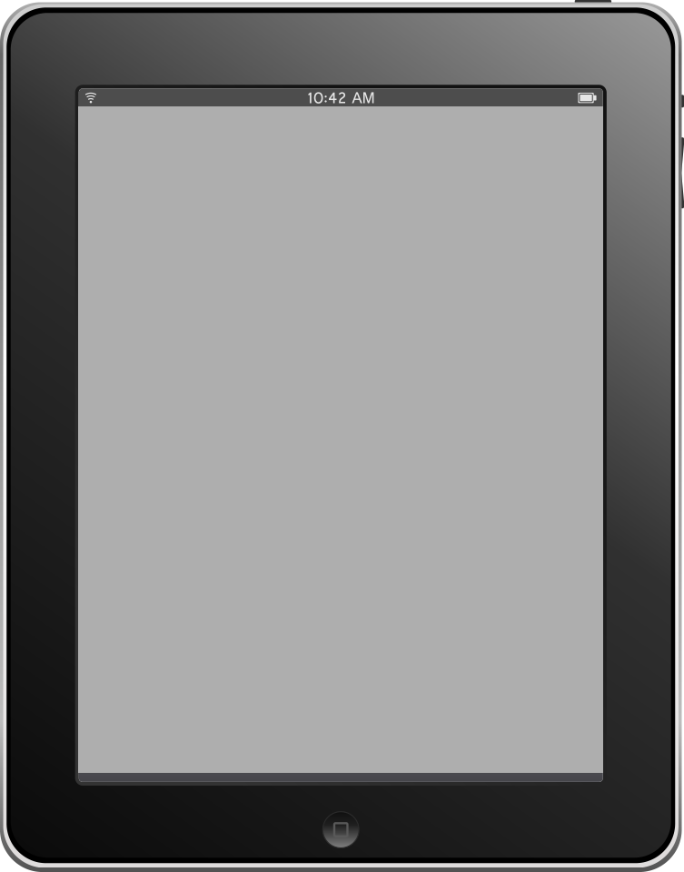
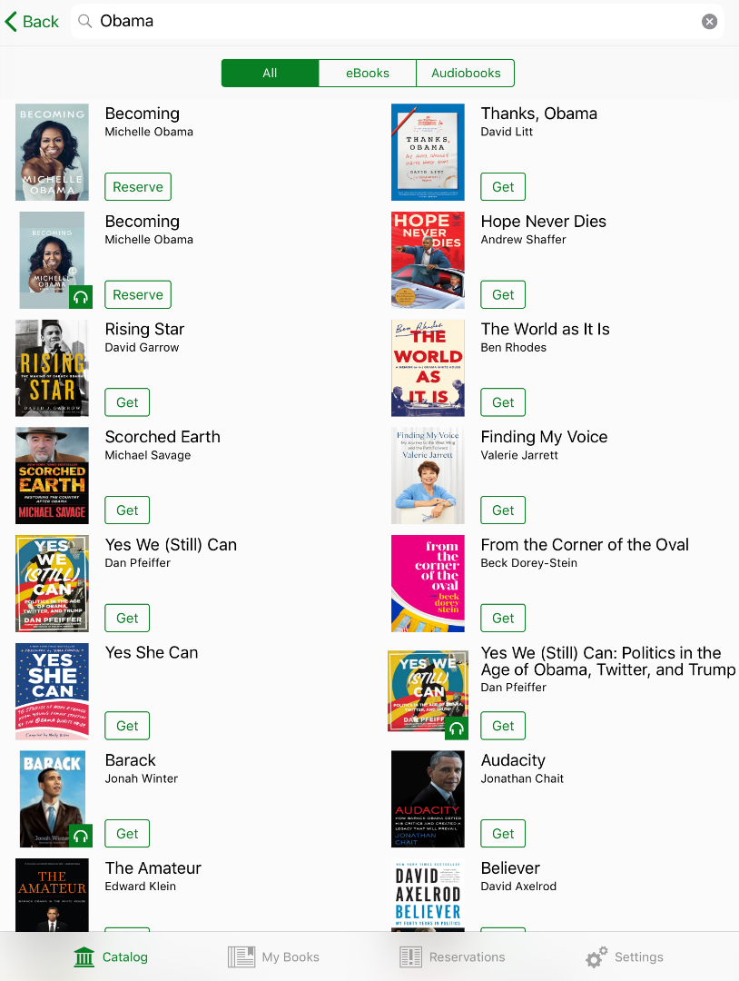
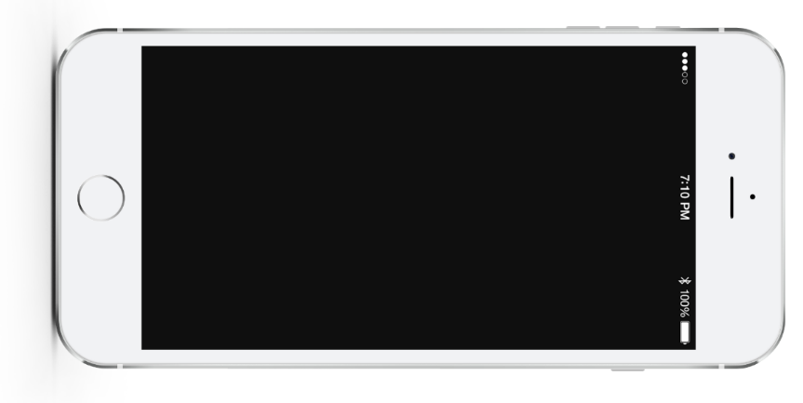
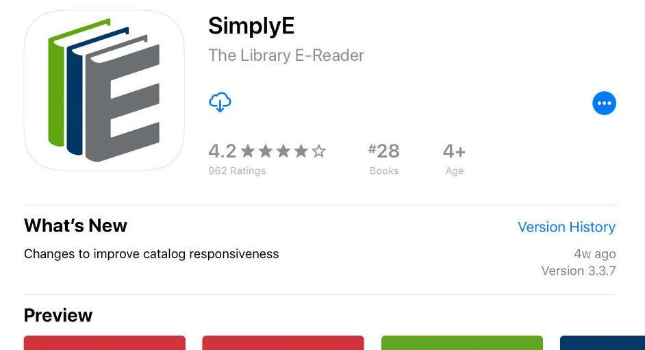
Welcome to SimplyE!
Getting Started Webinar
Insert Library Logo here

Slide 2
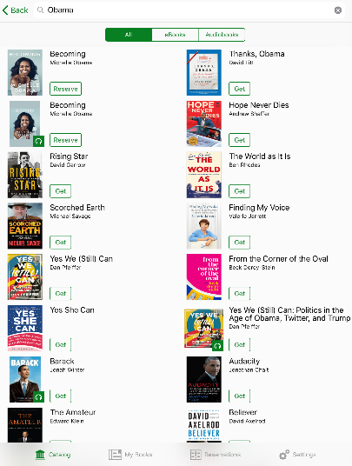
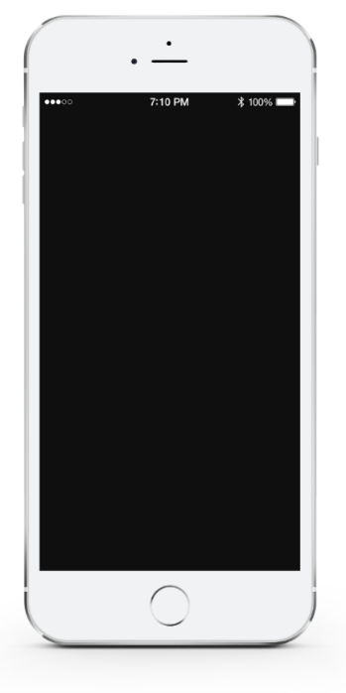

What is SimplyE?
Created by a partnership of libraries for their communities.
Nationwide e-book and digital audiobook library lending program.
App that makes it easy to browse, borrow, and read and listen to books in our library’s collection on your mobile device.
Use your library card to borrow thousands of e-books and audiobooks to read or listen to on your phone or tablet.
Notes:
What is SimplyE?
Created by a partnership of libraries across the country, led by The New York Public Library.
Gives you access to a nationwideebook and digital audiobook library lending program.
SimplyE is the reading app that makes it easy to browse, borrow, and read e-books or digital audiobooks in our library’s collection on your mobile device.
With SimplyE you can use your library card to borrow thousands of ebooks and audiobooks to read or listen to on your phone or tablet.

Slide 3
Easy to learn, navigate and use
Thousands of new e-books, audiobooks, classics
Accessible for those with visual impairments or reading difficulties
Protects your privacy
Notes:
SimplyE is:
Easy to learn, navigate and use.
In a few steps, you can download the app and start reading. SimplyE works on Apple and Android phones and tablets. Most books are available immediately without having to wait, and there are no late fines!
Offers thousands of new ebooks, audiobooks, and classics.
It’s easy to find what you want to read, whether you’re browsing our collection or searching for a specific title. And SimplyE will recommend titles you might like based on your choices. There’s no need to download multiple apps–with SimplyE all your ebooks are in one place.
Accessible for those with visual impairments or reading difficulties.
SimplyE is created with assistive technology, accessible for those with visual impairments of reading difficulties. You can adjust the text font, size and color.
Protects your privacy.
SimplyE was designed by libraries, so your privacy is very important. Unlike with commercial reading apps, your usage is not tracked. And, when you choose SimplyE, you support public libraries and ensure equitable access to digital reading.

Slide 4
Set Up Account
Download and open SimplyE app
Find [library name]
Enter library card ID and PIN to search, borrow, read and listen!
Notes:
Set Up your SimplyE Account in Three Easy Steps:
Download and open the SimplyE app from the Apple App Store or Google Play Store (for Android devices)
Find [library name]
Enter your library card ID and PIN to search, borrow, read and listen!
Let’s Get Started!

Slide 5
Device Compatibility
Apple iOS
Android
Recommended: iOS 13+
Minimum: iOS 10
Recommended: Android 10 API 29 and above
Minimum: Android 5.0 Lollipop
Not Compatible
Any iOS devices using iOS 9.3.6 or older
Any Android devices using Android 4.4.4 or older
Nook e-readers
Kindle e-readers and tablets
Kobo e-readers
Notes:
Apple iOS:
Recommended: iOS 13+
Minimum: iOS 10
Sampling of devices tested: iPhone 6s, iPhone 8, iPhone XR, iPad Mini, iPad 9.7 inch
Android:
Recommended: Android 10 API 29 and above
Minimum: Android 5.0 Lollipop (some users will still have issues if they cannot update their devices)
Sample of devices tested: Google Pixel & Pixel 2, Nexus 7, Galaxy Note, Galaxy Tab A, Moto e5
Not Compatible:
Any iOS devices using iOS 9.3.6 or older
Any Android devices using Android 4.4.4 or older
Nook e-raeaders
Kindle e-readers and tablets
Kobo e-readers

Slide 6
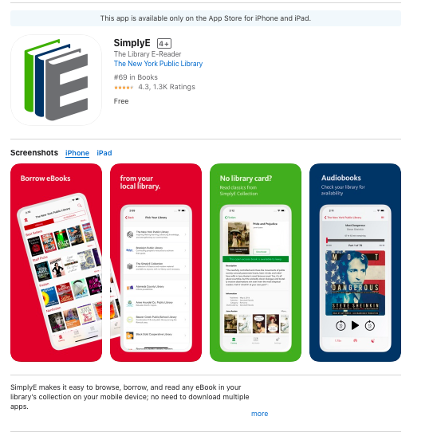
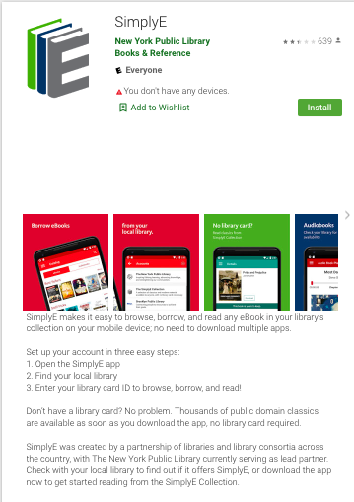
Download to Device
Apple iOS: App Store
Android: Google Play Store

Slide 7
How to Log In
Apple iOS Devices
Android Devices
Settings tab
Accounts
Library Name
Enter your barcode number or library card number number
Enter your PIN or phone number
Log In
Catalog
Building icon to choose Library Name
Menu
Down arrow
Manage Accounts
Accounts
Plus sign (+)
Library Name
Enter your barcode number or library card number
Enter your PIN number or phone number
Log In
Back arrow twice
Menu
Down arrow
Library Name
Menu
Catalog
Notes:
How to Log In with your Library Card
Apple iOS Devices
Tap the Settings tab at the bottom right of the screen
Tap Accounts
Select Library Name
Tap and enter your barcode number or library card number number
Tap the PIN field and enter your PIN or phone number
Tap Log In
Tap Catalog tab at the bottom left of the screen
Tap the building icon in the top left to choose Library Name
Start browsing and searching for e-books
Android Devices
Tap Menu on the upper left of the screen
Tap down arrow
Tap Manage Accounts
Tap Accounts
Tap the plus sign (+) in the top right corner
Tap Library Name
Tap the library’s name
Enter your barcode number or library card number
Enter your PIN number or phone number
Tap Log In
Tap the Back arrow twice
Tap Menu on the upper left of the screen
Tap down arrow
Choose Library Name
Tap Menu on the upper left of the screen
Tap Catalog
If you encounter problems logging in with your barcode or library card number, please tap Report An Issue under our library's account screen.

Slide 8
Search & Browse
Landscape orientation of initial screen
Notes:
To browse titles:
Tap Catalog (located at the bottom of the screen on iOS or on the top left of the screen on Android), which will display titles in various categories. Swipe from right to left to view the popular and available books in each category (tap the category titles or More... to view all books in a category).
To search for a specific author or title:
Tap the search icon in the upper right corner and enter the author or book name. Tap the cover of any book to read its description or download or reserve it.

Slide 9
Sort & Filter Results
Landscape orientation of screen of ebook titles
Notes:
Sorting & Filtering Results
When viewing all books in a category, you can filter by Availability and Collection, and sort by Author, Title, and Recently Added.
You can also filter and sort books in the My Books and Reservations tabs.

Slide 10
Reading E-Books
Landscape orientation of reading interface
Notes:
Once a book is downloaded, tap the Read button. Turn pages by tapping on the right or left edges of the screen.
Apple iOS:
Tap the center of the screen to open the navigation bar. The table of contents can be found in the upper right corner. Tap Tt to access controls for adjusting text style and size, brightness, and contrast. To exit the title, tap the back arrow (<) in the upper left corner.
Android:
You can find the navigation bar in the top right of the screen. This includes the table of contents and access controls (Aa) for adjusting text style and size, brightness, and contrast. To exit the title, use the “back” functionality of the device.

Slide 11
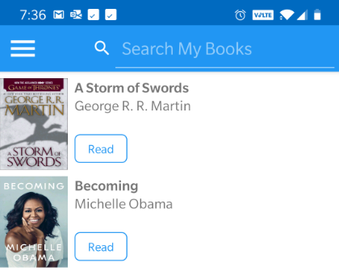
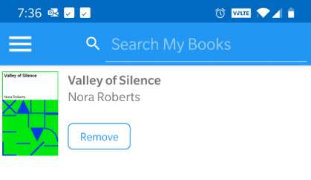
My Books
Notes:
Accessing New Reservations (Holds) and Borrowed E-Books
In the Reservations and My Books screens, drag the list downwards to check for available reservations or holds and books you may have checked out from another source. E-books downloaded with another app might not be available to view in SimplyE.

Slide 12
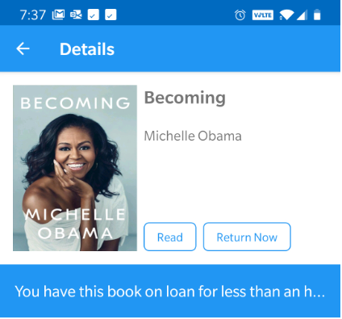
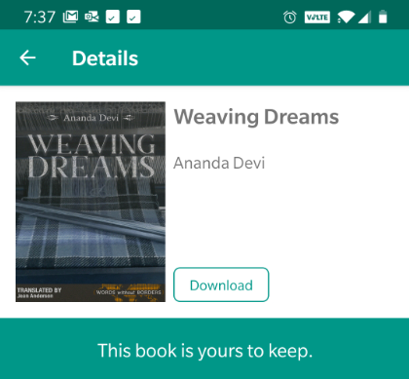
Return & Download
Notes:
Returning E-Books
All digital titles are automatically returned to your library at the end of the lending period, so you never have to worry about late fees. If you'd like to return a title early, click on the title or cover of the book to open up the description and select Return. If an item is not on hold for another patron, when it expires, you can borrow and download it again.
Free to Keep E-Books
Public Domain and Creative Commons-licensed books can be found in the SimplyE Collection. Tap the icon in the upper left corner to toggle between your collections. These books are yours to keep. Free to Keep books will display only a Download button. There is no hold queue and no expiration date on these items. Tap the Download button to get the book. The button will change to Delete or Read once downloaded. The book will also show up in the list under the My Books tab with a Read and a Delete button.

Slide 13
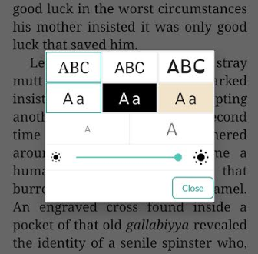
Fonts
Contrast
Text Size
Brightness
Accessibility
Notes:
Adjust the font type by tapping one of three available settings:
Serif
Sans Serif
Open Dyslexic
Tap the screen outside the control to close the control
To adjust text size:
Tap the large A to make the text bigger or the smaller A to make the font smaller.
Tap the screen outside the control to close the control.
Adjust the contrast by tapping on one of the three available combinations:
White text on Black background
Black text on Sepia background
Black text on White background
Tap the screen outside the control to close the control
To adjust brightness:
Drag the slide control to adjust brightness to your preferred setting.
Tap the screen outside the control to close the control.

Slide 14

  Questions? Your [Library Name] is here to help!
  Find information sheets, how-to videos and more – all free!
  [enter your website URL]
  Contact us: [enter your contact information]
Enjoy reading and listening!
Notes:
Have more questions? The [Library Name] is here to help!
Find information on our website at: [enter your website URL]
Find information sheets, how-to videos and more – all free!
Or contact us: [enter your contact information]

