Slide 1
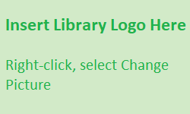
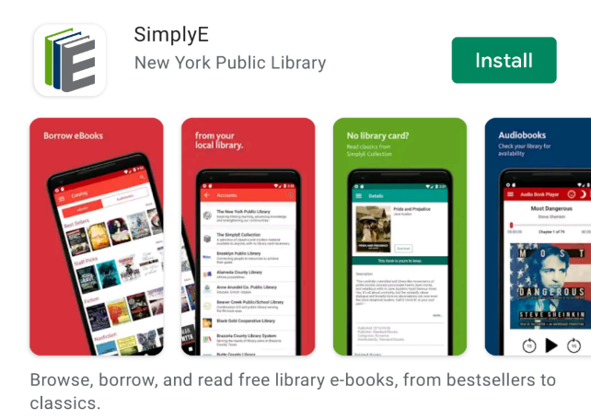
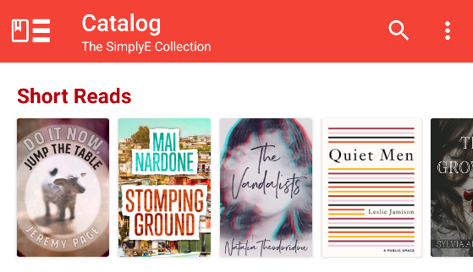
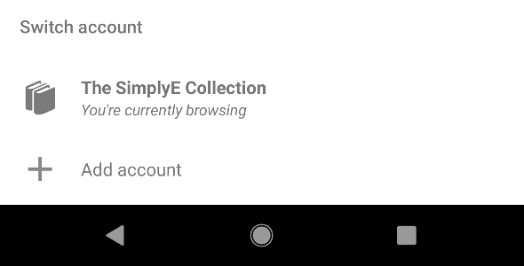
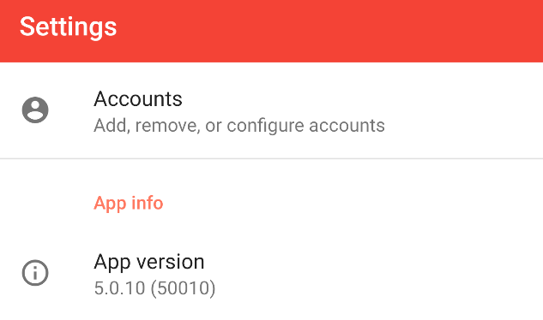
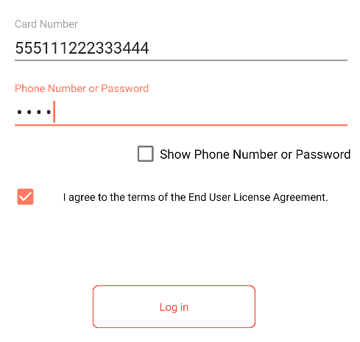
SimplyE for Android Devices
What is SimplyE?
SimplyE is a free app that allows you to search Library Name’s eBook and audiobook collection across multiple sources, all at the same time, and download them to your Android Tablet or Smartphone.
You will need an Android device (v 5.0 or higher), and a valid library card number and password.
SimplyE is not compatible with Kindle or Nook devices.
Getting Started
Install the App
Open the Google Play Store app and search for SimplyE
Tap Install, then open the SimplyE App
Tap Agree to accept the Terms of Service
Log In to your Library
If it’s your first time opening SimplyE, tap Find Your Library
Otherwise tap the ≡ icon on the upper-left corner, then Add Account
Locate and tap Library Name in the list
Tap Settings in the lower-right corner, then Accounts, then select your library
Enter your library card number and password
Tap Log in
Select Your Library’s Catalog
Tap the ≡ icon in the upper-left corner
Select Library Name from the list
The library’s catalog will appear

