Slide 1

UT Libraries DAMS Architecture

Slide 2
Overview
Backend
Frontend
Integration

Slide 3
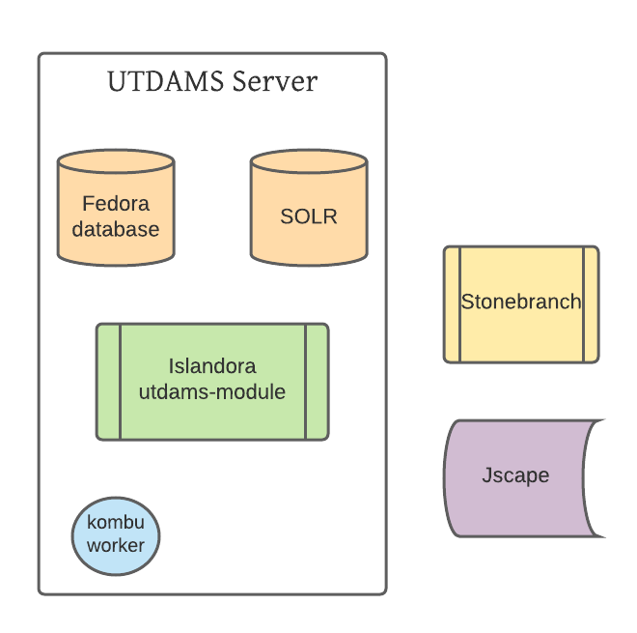
Backend

Slide 4
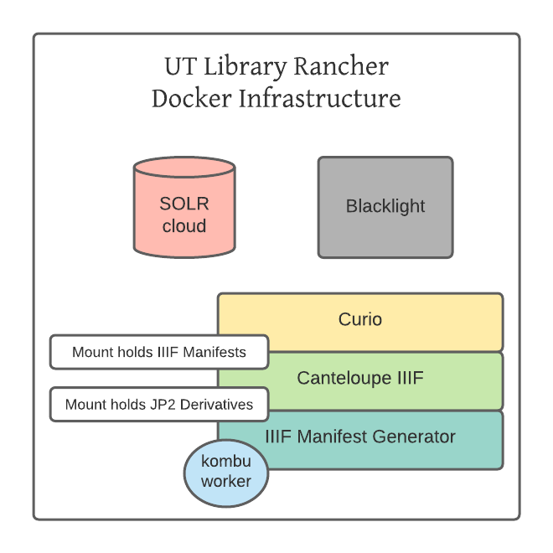
Frontend

Slide 5
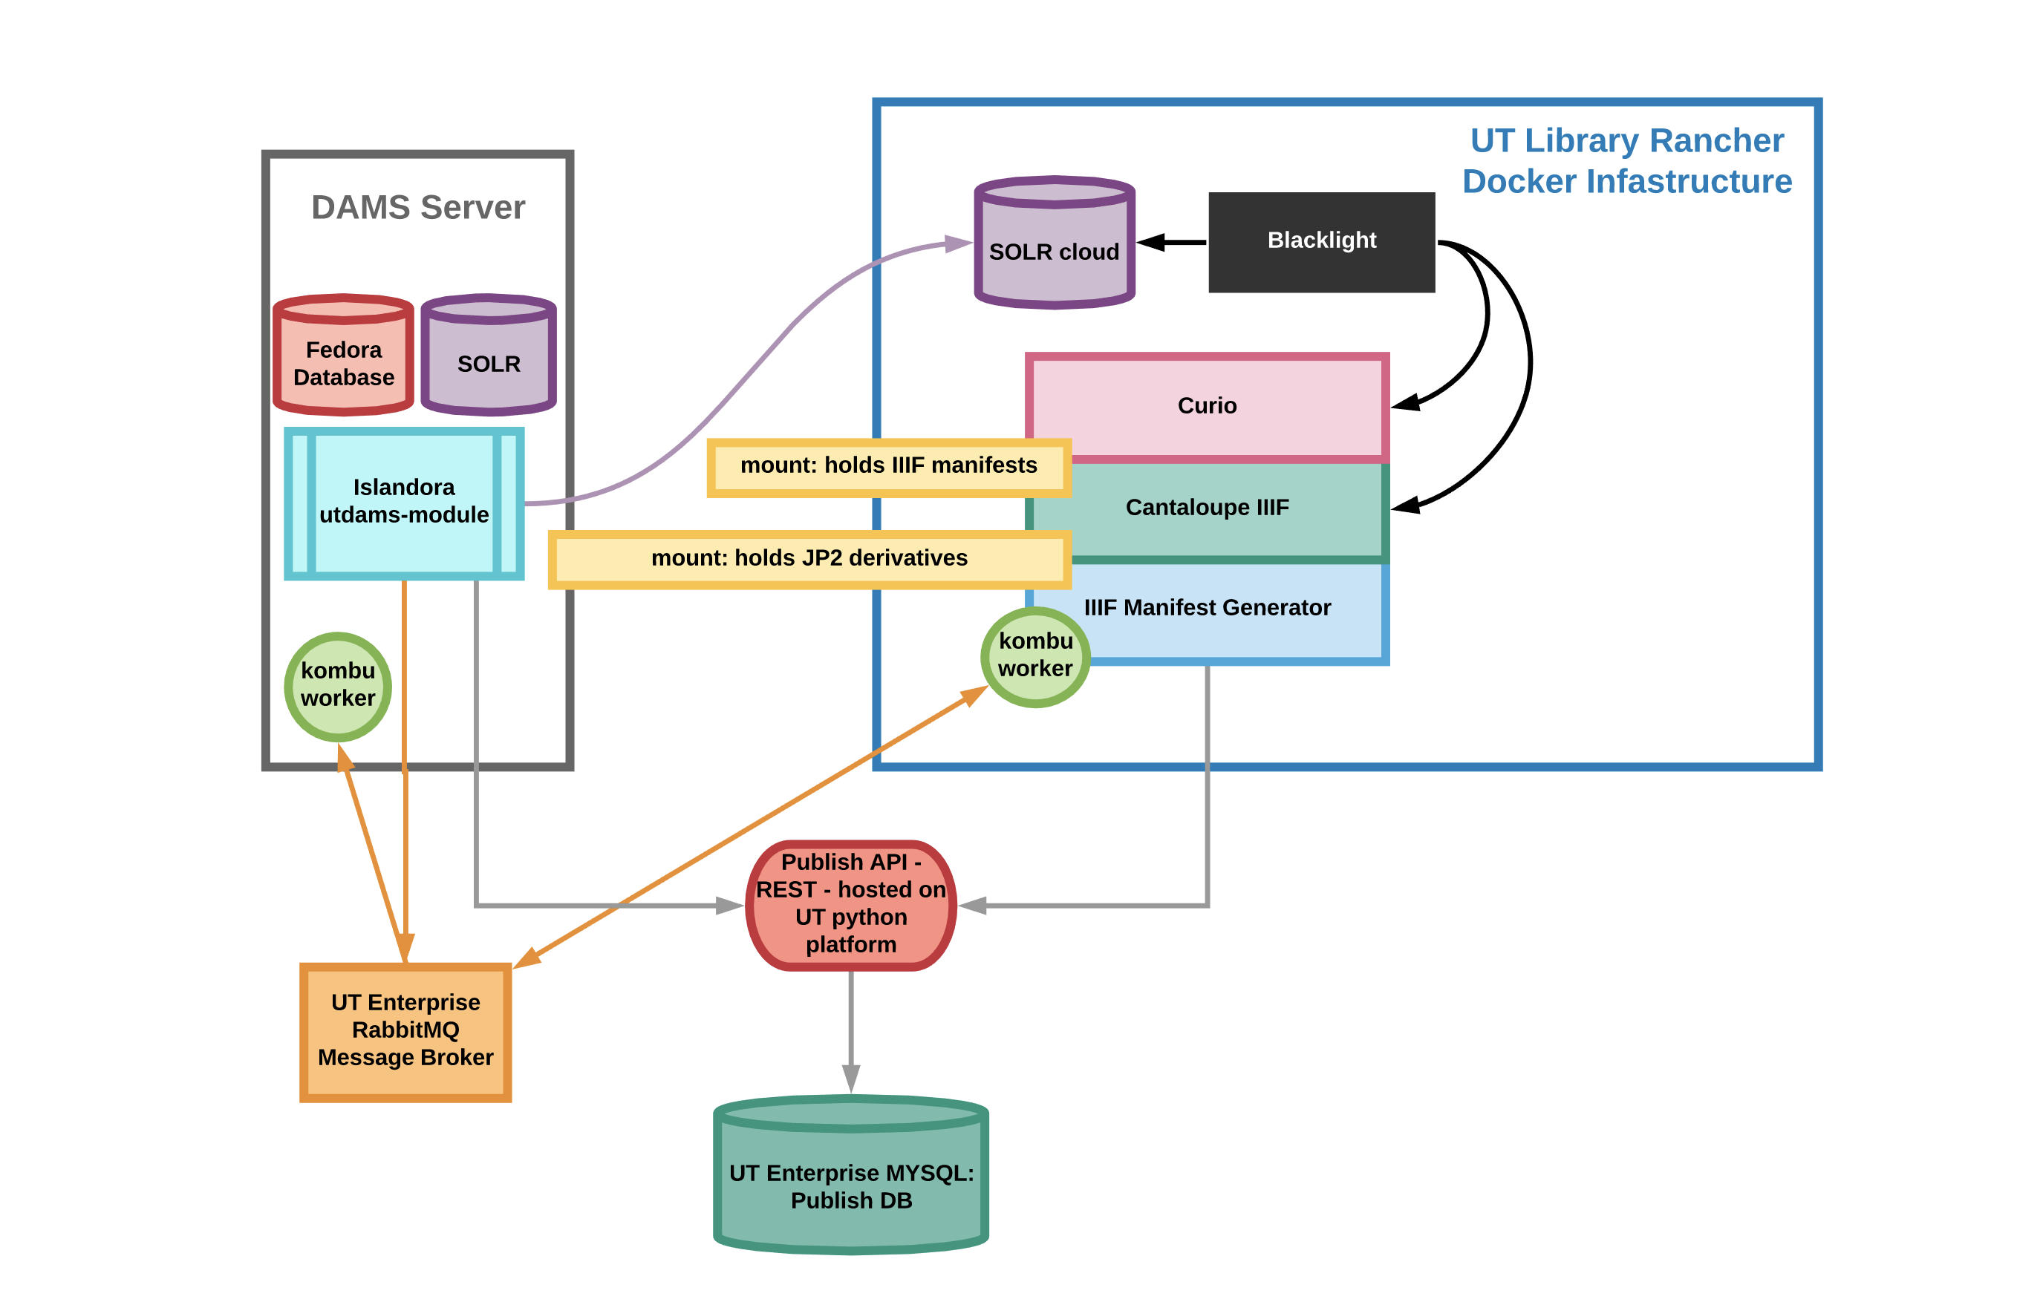
Integration

Slide 6

Questions?

