Slide 1
Alternative Vocabularies in MARC Cataloguing:
An overview
Chew Chiat Naun
PCC URIs in MARC Pilot, January 29, 2021
naun_chew@harvard.edu
Notes:
Please freely use chat
Disclaimer: not expert on any of the topics I’m about to talk about

Slide 2
Expand use of linked data value vocabularies to augment, and where feasible to replace, existing metadata practices
-- From PCC Strategic Directions 2018-2021
Notes:
Scope of what I mean by “alternative vocabularies”
Loosely related topics
Includes linked data counterparts of existing MARC data but also alternatives to commonly used vocabularies
Use of alternative vocabularies is not necessarily dependent on linked data, but the philosophy and technologies generally go together

Slide 3
Linked data in MARC
Authority 024
$0 and $1 throughout MARC format
$4 for relator URIs
$2 to indicate name vocabularies
758 for work IDs
More recent developments, e.g. $0 and $1 for 022 (ISSN)
Notes:
Many of these changes were introduced in 2017-19 through the work of the original PCC URIs in MARC Task Group
Point is not to make MARC an ideal linked data carrier, but to facilitate a transition

Slide 4
Quiz question no. 1
How long do you expect to use MARC?
Notes:
Is all this even worth doing?

Slide 5
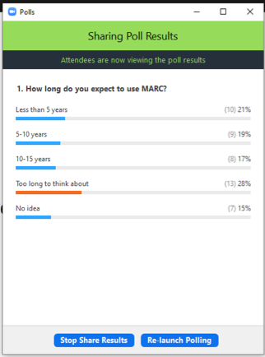

Slide 6
Two strategies
024 in MARC authorities
010 ## $a n 79056533
024 ## $1 https://isni.org/isni/0000000121491740
100 1# $a Rendell, Ruth, $d 1930-2015
Direct use of external sources
100 1# $a Rendell, Ruth $2 isni $1 https://isni.org/isni/0000000121491740
Notes:
The two strategies we’ve been pursuing in this pilot.
Other examples of direct use later in the presentation.

Slide 7
What’s driving these changes?
Emergence and adoption of linked data vocabularies
Experimentation with alternative platforms and mixed workflows
BIBFRAME transition
Overcoming limitations of traditional standards
Notes:
To reiterate: we are going through a transition period
Emergence and adoption of linked data vocabularies - within the library world, examples include vocabularies such as FAST and the LC faceted vocabularies (LCDGT, LCGFT, LCMPT)
Experimentation with alternative platforms - Wikidata being a prominent example
Use of alternative platforms often means mixed MARC/non-MARC workflows - other examples include European efforts to integrate ISNI with library authorities, or LC “NACO lite” plans
BIBFRAME transition - includes a major effort by LC to publish vocabularies for descriptive library data on id.loc.gov; raises MARC conversion issues
Behind all of this: Overcoming limitations of traditional standards: coverage, granularity, but also governance, technology/infrastructure, and diversity and inclusion

Slide 8
Recent and current work
PCC Wikidata pilot
Faceted vocabularies (e.g. SSFV report on LC vocabularies; FAST)
Language codes (PCC BABEL)
Id.loc.gov - see example
RDA vocabularies
SHARE-VDE
Notes:
Current work in the library sphere
Show example from id.loc.gov

Slide 9
Where are alternative vocabularies coming into use?
Names (persons, organizations)
Descriptive elements
Language
Subjects
Genre/Form
Demographic terms
Other named entities (e.g. events, buildings, creative works, etc.)
Notes:
1st category of names is, broadly speaking, the agent and agent-like entities that library authority files focus on, although of course there are also other things in there
So pretty much all of the things we try and cover in library cataloguing
Will talk further about descriptive data, genre/form, language, demographic terms

Slide 10
Quiz question no. 2
Where have you considered using alternative sources?

Slide 11
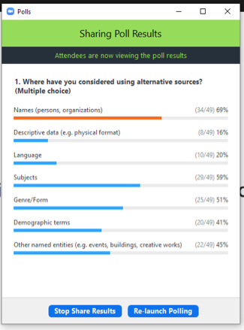

Slide 12
Descriptive and administrative metadata
Illustrative content:
340 ## $p Portraits $0 http://id.loc.gov/vocabulary/millus/por [or 353]
Broadcast standard:
346 ## $b NTSC $0 http://id.loc.gov/vocabulary/mbroadstd/ntsc
Encoding level:
LDR 03518nkc a22002535i 4500
Type of continuing resource:
008 010123c19909999ko mr p 0 | 0kor d
http://id.loc.gov/vocabulary/menclvl/5
http://id.loc.gov/vocabulary/mserialpubtype/periodical
Notes:
Pause on this slide for a while.
Many descriptive elements not previously regarded as “controlled” are now available as linked data vocabularies in RDA and id.loc.gov
The linked data vocabularies are what we will use in native RDF (BIBFRAME) cataloguing
Linked data equivalencies often specified through mapping, e.g. to/from MARC fixed fields, but can also be asserted directly in MARC in many cases.
1st two examples show newer use of variable fields with URIs
2nd two cases show continued use of fixed field MARC data
Note that MARC Proposal 2021-03, approved this week, expanded the number of continuing resource types defined in MARC
Type of continuing resource could be coded in 655
Some areas where MARC continues to be developed to accommodate external vocabularies
Question: what are reasons for preferring one strategy (direct provision of URIs vs mapping) over the other?
Not so necessary for closed vocabularies in BIBFRAME/MARC ecosystem
Stronger case for including URIs when:
Taking advantage of data outside the BIBFRAME/MARC vocabularies
Providing data for external consumption, e.g. Google Books

Slide 13
Simplifying MARC practice
LDR 01104ntm a22002897a 4500
100 1# $a Suttles, Virgil
245 10 $a Developing cross-cultural fellowship within a multiethnic group of Christians in Cayenne, French Guiana / $c by Virgil Suttles.
502 ## $a Thesis (D. Min.)--Southwestern Baptist Theological Seminary, 1994.
655 #7 $a Academic theses $2 lcgft $0 http://id.loc.gov/authorities/genreForms/gf2014026039

Slide 14
Or even ...
007 ## sd fsngnnmmned
300 $a 1 audio disc : $b digital, CD audio ; $c 4 ¾ in.
338 ## $a audio disc $b s $2 rdacarrier
340 ## $b 4 ¾ in.
344 ## $a digital $2 rdatr
344 ## $b optical $2 rdarm
347 ## $a audio file $2 rdaft
347 ## $b CD audio
655 #7 $a Audio compact discs $0 ??? $2 ???
Notes:
What’s the catch? AAT does not have a subclass for *audio* compact discs, only photo CDs. Similar situation with other vocabularies I looked at. Scope for useful work to be done here.
For form (format) data, this approach can be extended well beyond what MARC fixed fields and even RDA vocabularies can cover.

Slide 15
Names: alternative workflows
Wikidata
100 1# $a Quintana, Jaime $1 http://www.wikidata.org/entity/Q5925286
024 in MARC authority
010 ## $a n ????????
024 ## $1 http://www.wikidata.org/entity/Q5925286
100 1# $a Quintana, Jaime $d 1967-
Notes:
But highest value use of alternative vocabularies is arguably outside these technical kinds of cataloguing data.
Alternative workflows where you use external source instead of NAR, or as an interim workflow step
Analogous example to follow in Adam’s presentation

Slide 16
Genre/Form
Examples:
  LCGFT
  Art & Architecture Thesaurus
  OLAC Video Game genres
  Rare Books and Manuscript vocabulary
  Zine Subject Thesaurus
Domain specialization
Community governance
Notes:
Thanks to my colleague Honor Moody for these examples
Historically there has always been more variety of data in the 6XX block -- initially with subjects, but increasingly with genre/form. If I had to guess, 6XX would probably have been one of the earliest places where $2 (source) appeared in the MARC format.
Some are dedicated genre/form vocabularies, others include genre/form terms
Important advantages of specialized form/genre vocabularies
Domain specialization
Community control of vocabularies

Slide 17
Other areas
Language: PCC BABEL report
  7,868 codes in ISO 639-3 vs 485 in MARC vocabulary
  Example: North American Indian (Other)
  Addresses BIBFRAME as well as MARC implementation
  Scripts
  ISO 639-3 not currently available as linked data; role for id.loc.gov?
Demographic data
  Example: Wikidata project for Indigenous peoples of North America
Goals include: The implementation and maintenance of ontologies, vocabularies, and multilingual thesauri relating to Indigenous peoples
Notes:
Languages
Instead of “nai” for “North American Indian (Other)”, ISO 639-3 will have specific codes for the individual languages. In the MARC list there are about 45 UF references to “nai”. (Isabel Quintana’s example from PCC Wikidata list)
Demographic terms address similar diversity issues
Won’t try to talk about them here since I am not well qualified to speak in this area
Good illustration of point about community expertise, mobilization, and governance
Talk at recent OCLC session about coverage indigenous peoples

Slide 18
Questions? Comments?

