Slide 1

VIVO Components
..as units of deployment

Slide 2
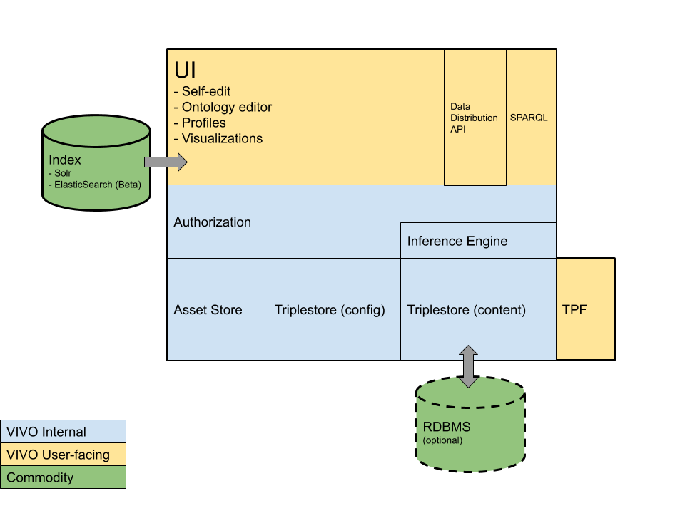
VIVO 1.11.0
Note: Arrows connect separately deployed components

Slide 3
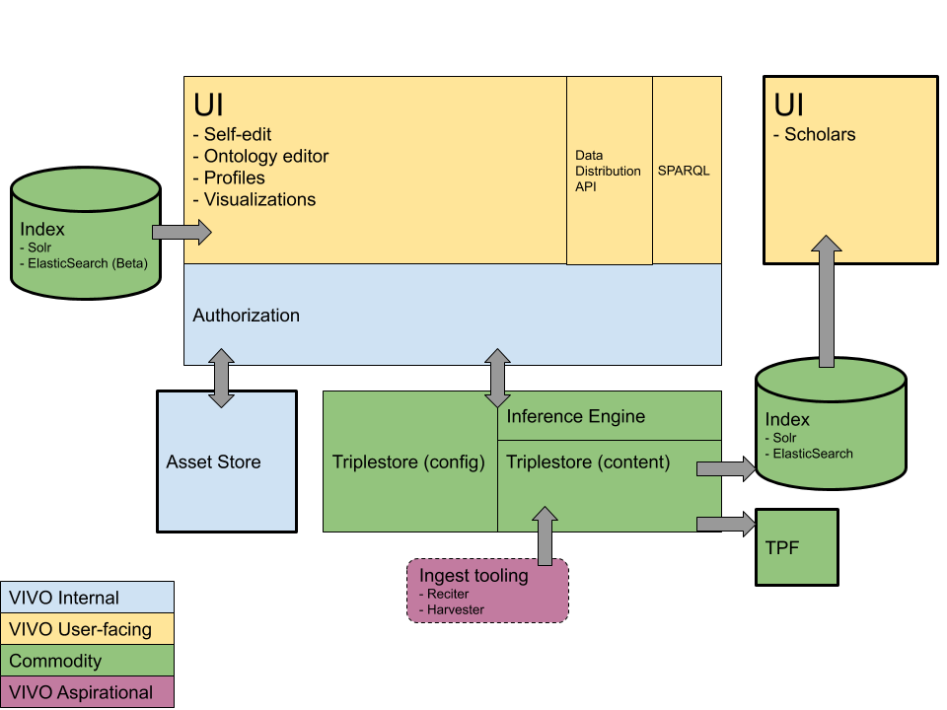
VIVO Decoupled (future)

