Slide 1
Discovery Brainstorming
Findings things is awesome

Slide 2
From the grant: Discovery
Potential discovery enhancements to Blacklight include (1) knowledge panel in search; (2) browsing based on authority files and links to related entities in external data; (3) semantic search; and (4) microdata on item pages to enable machine crawling.
Items 1 (knowledge panel in search results to present contextual information powered by linked data) and 4 (microdata) have proven implementations in other discovery environments, and will be the first targets for development.
Item 2 (browse) offers the richest potential benefits to users. This effort will require balancing the capabilities of the data, user needs, design of an intuitive and useful interface, and technical constraints of current technologies.

Slide 3
From the grant: Discovery
Q: Does this mean visualization/navigation?
Browse challenges/questions:
  Is it viable to integrate a network graph powered by semantically enriched library metadata? Would such a tool prove useful and intuitive to library users in a general purpose discovery environment?
  How can concatenated, LCSH subject headings best be represented in a browse interface? Is it possible to break them into discrete elements (such as with FAST) and enable toggling on and off discrete elements? If so, will it be intuitive?
  For geographic browse, what kinds of visualizations will allow for users to navigate for works about or by creators in certain areas? Will points-on-maps provide enough / useful visualization, or will regions be needed (and more useful)? How will we cluster or show density of terms—via a cluster of pins or perhaps a heatmap?
  Can we implement a NetFlix or Amazon-style browse that will meet patron needs and expectations for scholarly browse, and also be based on the catalog data we have?
  Does the growth in use of mobile device users of the catalog change anything we might do for browse user interfaces?
Q: What ARE patron needs and expectations?

Slide 4
From the grant: Discovery
Q: User tasks and expectations?
How does that work?
Item 3 (semantic search) also has promise, though the best examples of semantic search happen in more tightly scoped information domains (such as medical search using MeSH). Analysis and experimentation will be required to see if subject searches and headings will lend themselves to a semantic approach in a general catalog environment. We intend to explore geographic search as a first and promising entry point to this approach. Analysis will include how patrons interact with the library catalog, especially for subject searches and searches resulting in zero results, to create a better, user-centered design; log analysis of current searches, as well as data analysis to determine what search arguments could be transformed to alternative searches with richer results using linked data. It will also include exploring technical approaches to semantic search, including adding semantically-related terms at index time, leveraging dynamic look-ups of linked terms via external services, and performant approaches to including semantic type-ahead / autosuggest of search terms.
We’ll need to gather examples of these different areas.
These are technical approaches that may result in specific possibilities
for what users can do with the catalog.

Slide 5
Should probably ask this first
What are the main problems we are trying to explore/solve?
Helping library patrons do what?
  Find materials in data linked to but not present within the catalog that still helps them with their research or work ?
  Browse enriched/enhanced catalog content
    Linked data enables discovering new and interesting relationships?
      Within the catalog?
      To external resources?
  A compelling use case? (The infomercial model)
    OMG this was so hard (opens cupboard door, falls down)
    But NOW I can do this! (opens TWO cupboard doors, smiles at camera)

Slide 6
A compelling use case?
Diedre’s research has focused on the effects of colonization on a particular indigenous community in India. She is particularly interested in retrieving any anecdotes or artifacts from the community in that time period.
  She fires up your friendly neighborhood catalog (more likely she goes to Google but let’s hope she gets redirected to the library)
  She types in the name of the community (or the time period or she uses the map and a date range) to see what artifacts might exist in the catalog
  Because we’ve linked to wikidata, and wikidata has a collection specifically about this community, related catalog entries + wikidata information are available to support search, browse, and display.
  She writes a nice letter of support .. Oh wait, I’m still dreaming

Slide 7
A compelling use case? (The sequel)
Diedre is interested in seeing articles specific to heart attacks and their effects on a specific segment of the population.
  She begins typing in “heart attack”
  Because the catalog is “smart” enough to know that “heart attack” and “myocardial infarction” are related, she gets results tagged with one or both of these terms
  She can then begin to narrow these results down to those that are related to her query
Diedre is looking for architectures influenced by or that influenced Mughal design
  She begins to type in “Mughal architecture”
  Next to her results, she also sees “related architectures” panel that includes search results for architectures related to this particular style
  Additionally, there is a “contemporary to” and “geographically related” section that gives options to search for architectures at the same time and/or nearby

Slide 8
What does that mean
Discovery: Search?
  Weaving in information into search index itself
  Enabling relationships between entities to influence results
Discovery: Browse
  Using linked vocabularies/authorities/other data to enable browsing of catalog info
  (?And vice versa?)
Discovery: Display
  Weaving in information from external sources into search results or individual result info
Semantic Search
  Finding semantically related results
    How? Ontological reasoning? Natural Language Processing (using Machine Learning)? Combination
      Store-bought or bespoke?
  What does this mean for the user?
  How do we evaluate the effectiveness/usefulness of this search feature?

Slide 9
We have the things and you have the things. Let’s find the things together
Your things
Our things
This could probably look better

Slide 10
Data and Process | User Experience
Connections to Wikidata/Dbpedia?, VIAF, and ISNI for display in individual search result | External data where connected to item is displayed on the details page for the item (knowledge panels and/or dispersed through show view)
Externally linked information is used to augment the search index | Labels and terms from external sources can provide search results from related items in the catalog. Facets using values from external vocabularies can be used to retrieve catalog results (e.g. LCSH? FAST? Or something else not in the catalog?)
Relationships between entities and vocabularies/external data used to define hierarchies/taxonomies | Graph or taxonomic navigation (or some form of navigation that is well-suited to exploring graphs and trees in both browse and search tasks)
Semantically related terms (from ontologies? ML magic? a combination?) are used to augment the index | Did you mean “something more specific” when you typed in “specific”? OR Here are all the results including both “specific” and “something more specific”
Geographic data has been connected for location info (people, works, etc.) | Use this map to find all works ABOUT this location or published IN this location OR by authors somehow related to this location
Schema.org json now available on item view page | Are you searching Google? Here are some library results
LCSH and FAST probably in catalog but breaking them apart more?
Also, possibly something something IIIF

Slide 11
Meetings/Discussions
Stanford’s discussion with internal developers/search folks
  Potential areas for overlap between local and grant work
  Blacklight Summit: Identified schema-compliant output as part of item level show
Cornell’s discussion with internal developers/search folks
  Authorities linking/browse capabilities
  Possibility (not final) for bringing in images
Blacklight Summit:
  https://search-ld.library.wisc.edu/ (screenshots at end) (and other examples/discussions that are relevant)
Notes:
Need to review meeting notes again

Slide 12
Now vs. Blue Sky
Low-hanging fruit: practical/possible/integratable
  I can do this in my catalog
    Cornell and Stanford priorities for their own library catalogs
  Now you can do this in your catalog
    Because we contributed back to Blacklight core
  Examples: Knowledge panel (Cornell has example), authority browse, Schema.org, images (?), info on display page (?) [what would be ‘acceptable’?]
  Others?
The greater possibilities
  Search and discovery enhancements/modifications

Slide 13
References
Related work around Wikidata in this project
LD4 workshop: Discovery day and Wikidata
  Stacy Allison-Cassin and Anna St. Onge (Indigenous communities)
Project Passage
  Specifically Explorer UI
    Information from Dbpedia in entity-level info
    search across multiple sources
    possibility for integrating search by title, author, subject based on title in entity view
Found this summary:NLP, Machine Learning, AI etc.
Related: Blacklight, Spotlight, ArcLight, GeoBlacklight (anything else?)
Notes:
https://www.oclc.org/research/themes/data-science/linkeddata/linked-data-prototype.html

Slide 14
Images of interest
Chalet slides by Astrid:
https://docs.google.com/presentation/d/1clrHX5HP7WLkGdrSW2im8qNq8YJhsqms9XVdtCz4Ir4/edit?usp=sharing
Following slides are from : https://search-ld.library.wisc.edu , https://newcatalog.library.cornell.edu, and copied out from the OCLC Linked Data Prototype slides and a screenshot from the final meeting webinar

Slide 15
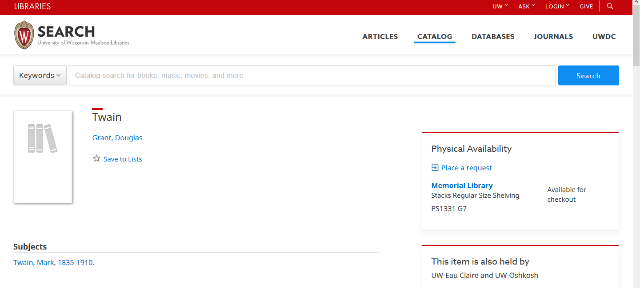
Images of interest

Slide 16
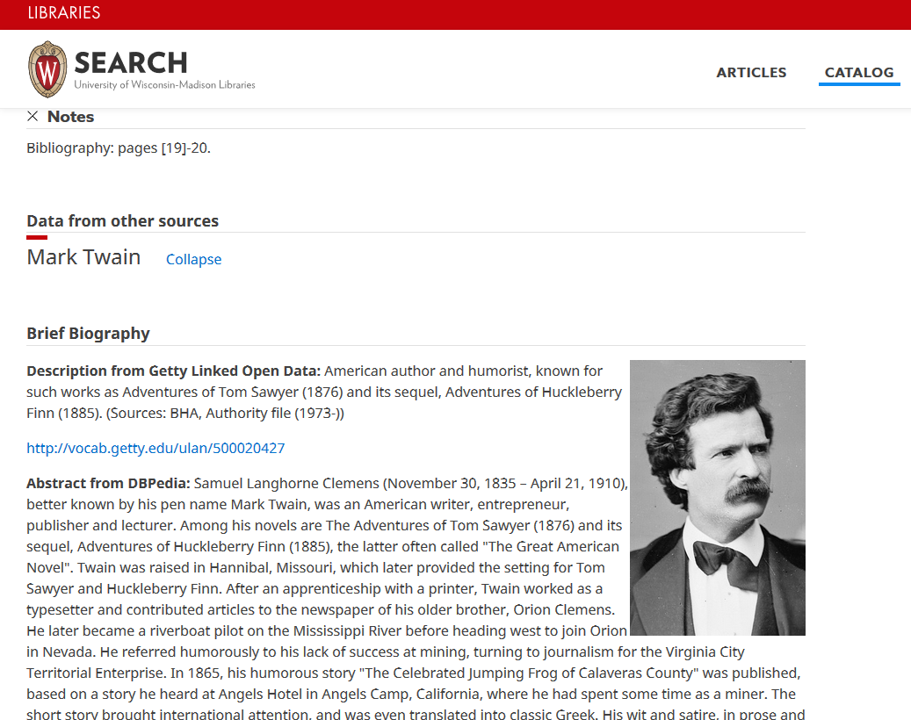

Slide 17
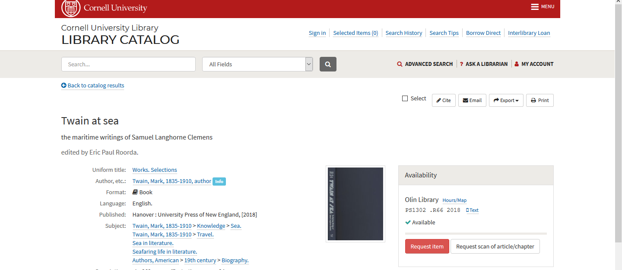
Notes:
Cornell

Slide 18
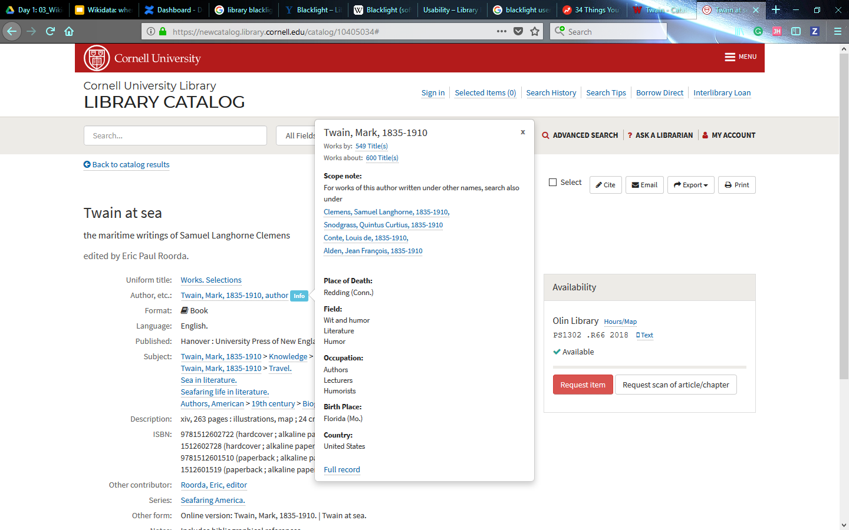

Slide 19
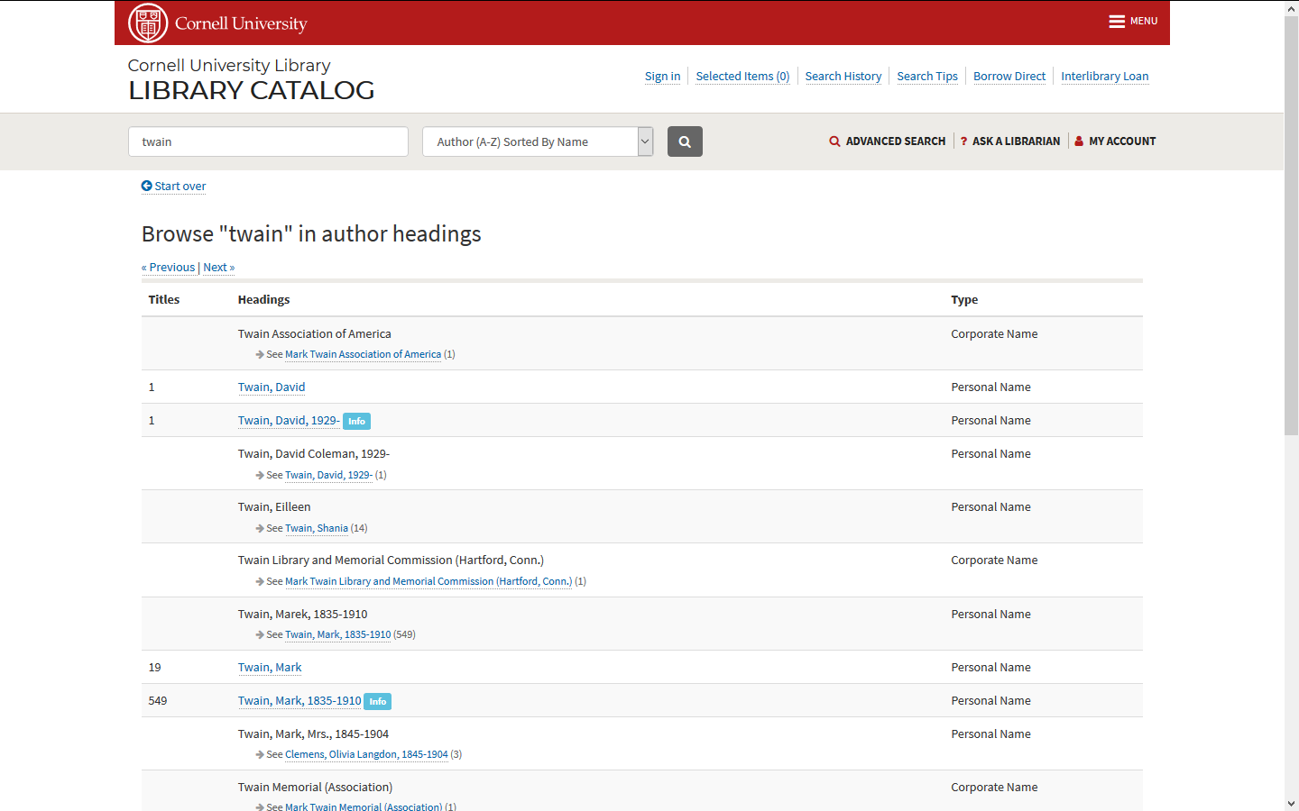

Slide 20
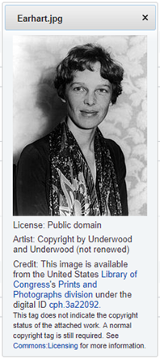
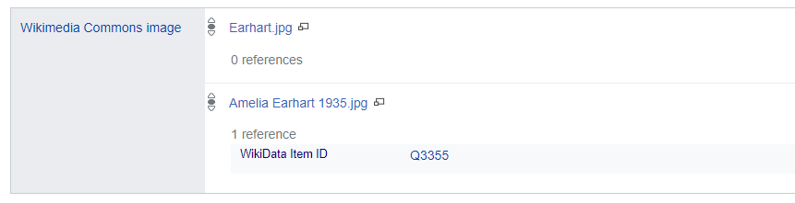
Extending the Entity Ecosystem: Gadgets
Notes:
The Wikibase UI can be extended by writing little “Gadgets” … basically small Javascript applications that can be invoked from Wikibase pages.
For example, we created a gadget that would make gather thumbnail images and metadata for statements associated a MediaWiki Commons image with an entity.

Slide 21
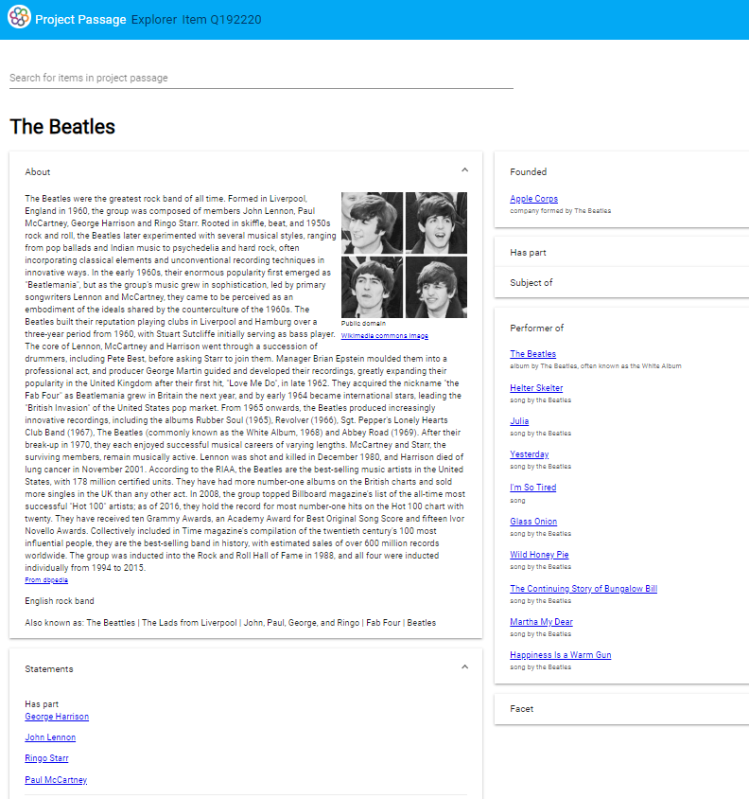
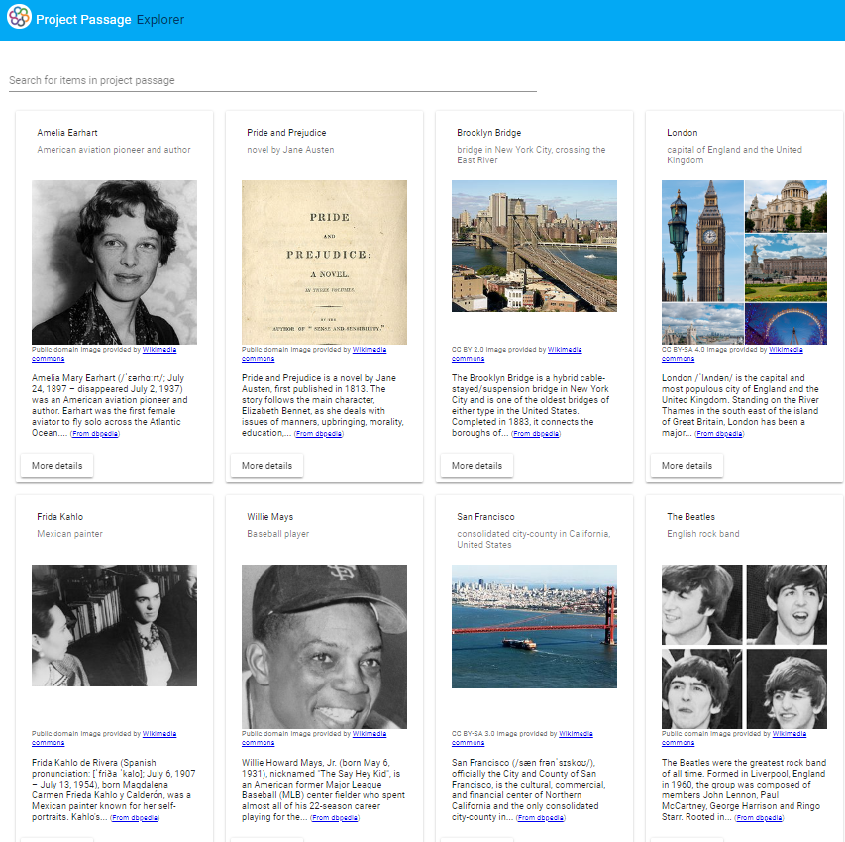
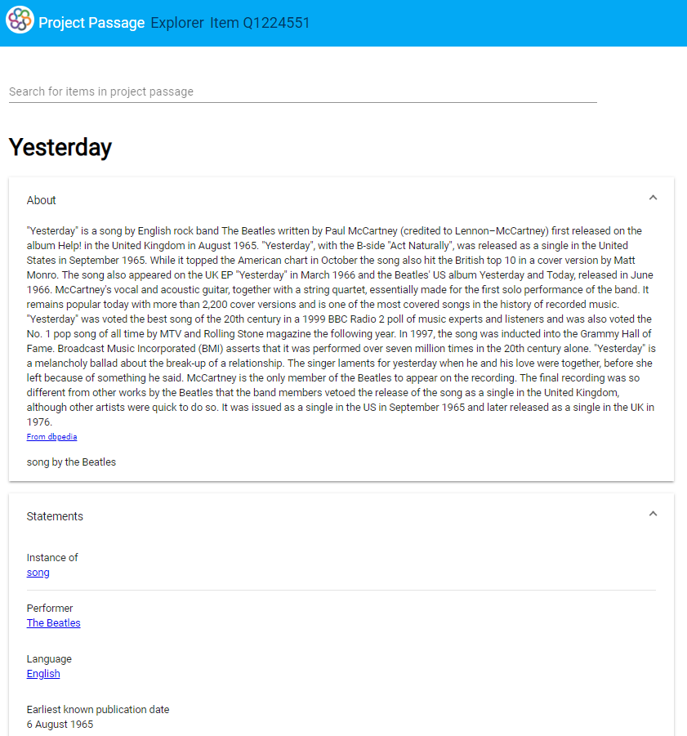
Extending the Entity Ecosystem: Explorer
Notes:
We created our own fit-for-purpose extensions, including an “Explorer” for browsing through our entities which utilized the MediaWiki Search API as well as the SPARQL Query API to gather data, with other sources like DBpedia providing additional context.

Slide 22
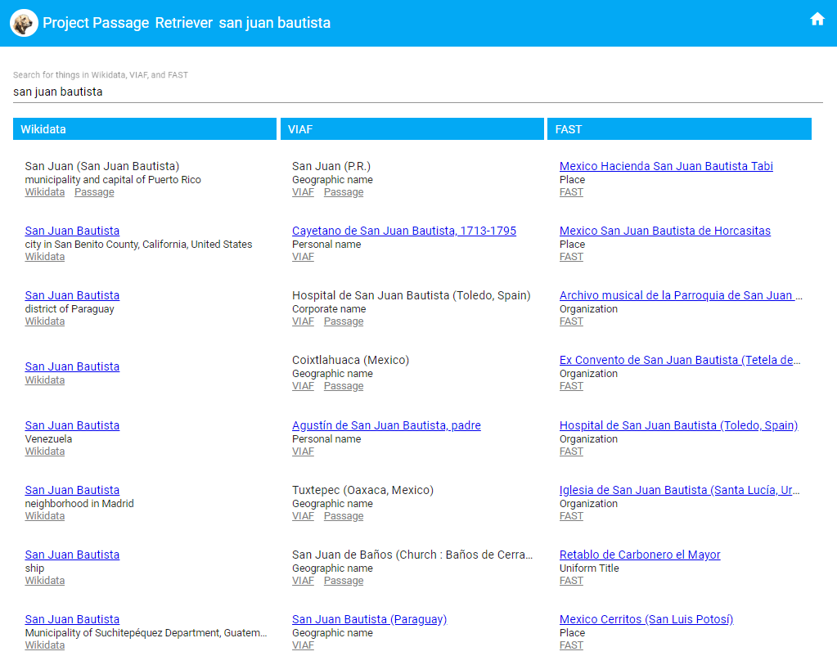
Extending the Entity Ecosystem: Retriever
Notes:
Our “Retriever” extension was built in response to, and guided by, pilot participant feedback, as a way to fill in some of the “entity gaps” in the system.
A simple keyword search interfaces uses the Wikidata, VIAF, and FAST APIs to return possible matches. Selecting one of the matches fills in data in a simple form for double-checking data quality and supplementing descriptions, with a one-click button to create a new entity description in the pilot system Wikibase.

Slide 23
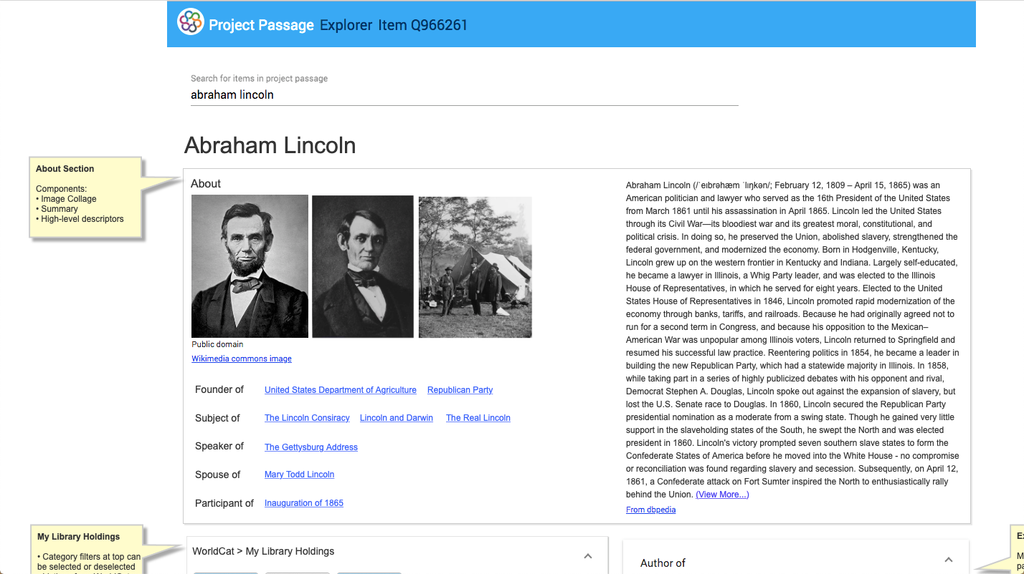
Incorporating WorldCat into the Explorer

Slide 24
