Slide 1

Recent Developments in Digital Asset Management at TAMU Libraries
A report on our use of open-source services and standardized protocols to enable rich curation, discovery and exhibition
James Creel, Ryan Laddusaw and David Lowe

Slide 2
Talk Outline
Architectural Overview
Structured content in Fedora and DSpace
Generating IIIF Manifests
  Implementing IIIF Collection API 2.0
  Minting identifiers for image resources
IIIF Clients and exhibition
Discovering content using Solr

Slide 3



The Big Picture
DSpace
RDF Webapp
SAFCreator
MAGPIE
Fedora
IR-IIIF Manifest Service

Slide 4
Repository hosted content
DSpace
  Our legacy platform with tons of image and PDF content
  We ingest content with single item submission, over SWORD, or as SAF
  We expose content with the RDF webapp: https://oaktrust.library.tamu.edu/rdf/handle/1969.1/169475
Fedora
  Our new platform that we’re first using for digital exhibitions
  Accommodates any RDF graphs around your content
  We get the content in using MAGPIE
  We’re using PCDM to structure our exhibition content: https://api.library.tamu.edu/fcrepo/rest/3b/6f/c3/25/3b6fc325-f6ca-41d8-b91e-8c5db3be8c13

Slide 5
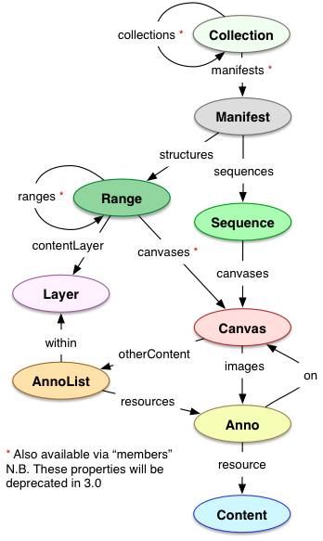
IIIF- the International Image
Interoperability Framework
The de-facto standard way to structure image (and maybe even A/V) content
Inclusive of the Web Annotation standard (circling right back to W3C and RDF)
Notes:
Image Credit - IIIF Consortium
http://iiif.io/api/presentation/2.1/#22-additional-types
CC-BY License

Slide 6
IR-IIIF Manifest Generation Service
Generates IIIF Collection or IIIF Presentation manifests on demand for DSpace RDF or PCDM-structured Fedora content
https://api.library.tamu.edu/iiif-service/dspace/collection/1969.1/169475
https://api.library.tamu.edu/iiif-service/fedra/collection/3b/6f/c3/25/3b6fc325-f6ca-41d8-b91e-8c5db3be8c13/alice_in_wonderland
Latest version will mint UUIDs for new resources. Our Cantaloupe has been augmented with a resource delegate that resolves these UUIDs against the IIIF service. This makes for cleaner manifests.

Slide 7
API for ID minting/resolution
These are example calls to the service to generate UUIDs for given image URLs:
Get a new UUID:
curl -X POST -u admin:abc123 https://api-pre.library.tamu.edu/iiif-service/resources?uri=https://api-pre.library.tamu.edu/fcrepo/rest/mwbObjects/CofeEarHis/Pages/CofeEH0001/files/CofeEH_0001.jp2
Get a URL for a UUID:
curl https://api-pre.library.tamu.edu/iiif-service/resources/667a8e3f-459f-44e1-b959-ccb77dedafa5
Redirect from a UUID to its URL:
https://api-pre.library.tamu.edu/iiif-service/resources/667a8e3f-459f-44e1-b959-ccb77dedafa5/redirect
Delete a UUID:
curl -X DELETE -u admin:abc123 https://api-pre.library.tamu.edu/iiif-service/resources/667a8e3f-459f-44e1-b959-ccb77dedafa5

Slide 8

IIIF Image Server - Cantaloupe
Complies with the IIIF Image API
Able to resolve source images remotely over HTTP - no need to store or duplicate source images on the Cantaloupe server’s filesystem

Slide 9
Exhibition and Discovery
Spotlight
https://spotlight.library.tamu.edu/spotlight/austin-map
Mirador (actually embedded as an iframe on that last exhibit)
SAGE - Solr aggregation engine
  https://demos.library.tamu.edu/sage
Blacklight
  http://blacklight-pre.library.tamu.edu/

Slide 10
Next Steps…
Getting more curators to provide and curate their content
Further structuring with RDF, PCDM, IIIF
  More complex structures ingested into Fedora
  Better graph traversal in UIs
  More robust translations from RDF to PCDM
Better affordances for metadata assignment and annotation
  Suggestions, controlled vocabularies during curation
  Web Annotation for IIIF Manifests
More complex content types – A/V, 3D
Dedicated, separate ID minting and resolution services
Production-quality discovery across collections

Slide 11
Places to learn more and get involved
MAGPIE - https://github.com/TAMULib/MetadataAssignmentToolService
- https://github.com/TAMULib/MetadataAssignmentToolUI
SAFCreator - https://github.com/TAMULib/SAFCreator
DSpace - https://wiki.duraspace.org/display/DSPACE/Home
Fedora - https://github.com/fcrepo4/fcrepo4
Amherst PCDM Extension - https://gitlab.amherst.edu/acdc/repository-extension-services/tree/master/acrepo-exts-pcdm
IIIF - https://iiif.io
PCDM - https://github.com/duraspace/pcdm
Cantaloupe - https://medusa-project.github.io/cantaloupe
IR IIIF Generation Service - https://github.com/TAMULib/IRIIIFService
SAGE - https://github.com/tamulib/sage
Spotlight/Blacklight - https://github.com/projectblacklight/spotlight

