Slide 1

Community Update
30 January 2020
Rosalyn Metz (Emory University)
on behalf of Samvera Steering Group

Slide 2
What is the Samvera?

Slide 3



The Software
And so much more...

Slide 4
The Community
Samvera: a vibrant and welcoming community of information and technology professionals who share challenges, build expertise, and create sustainable, best-in-class solutions, making the world’s digital collections accessible now and into the future.

Slide 5
Vital Statistics
36 partners
  Notch8
  Ubiquity Press
  University of Utah
924 Slack members
  Up from 756 last year!
21 active Working Groups &
Interest Groups
Connect 2019 by the numbers:
140 attendees
40 organizations
4 countries
2 continents

Slide 6




Service Providers
CoSector
DCE
Notch8
Ubiquity Press

Slide 7
Working Groups and Interest Groups
Some working groups...
Component Maintenance Working Group
Samvera Repository Managers Interest Group
Samvera Fundraising Working Group
Samvera Geo Predicates Working Group
Samvera Marketing Working Group
Samvera Metadata Interest Group
Samvera Newspapers Interest Group
Samvera Vision Statement Working Group
Samvera Roadmap Council
Samvera User Experience Interest Group

Slide 8
Working Groups and Interest Groups
Other Active Groups
Hyrax-Valkyrie Development Working Group
Hyrax Working Group
Machine-readable Metadata Modeling Specification (M3) Working Group
Samvera BrowseEverything Interest Group
Samvera Code Stability Working Group
Samvera CONTENTdm Migration Interest Group
Samvera Contribution Model Working Group
Samvera Documentation Working Group
Samvera Governance Working Group
Samvera Hyku Interest Group
Samvera Interest Group for Advising the Hyrax Roadmap (SIGAHR)

Slide 9
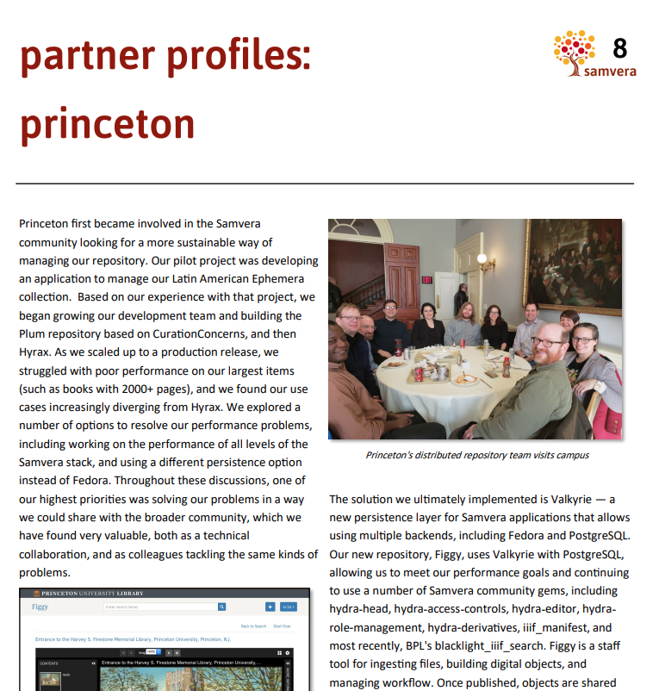
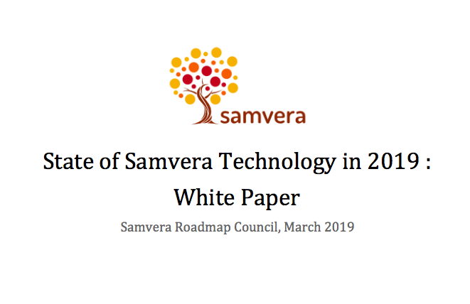
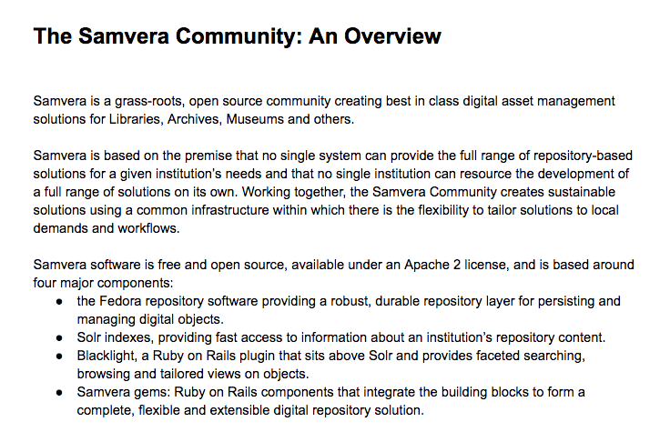
Communications
2018 Annual Report
Technology White Paper (March 2019)
Samvera Community
Overview (October 2019)

Slide 10
Governance Update

Slide 11
Governance Recommendations
Steering Will Become an Elected Body from Partners ✅
Steering Will Hire Centralized Staff
Partners Will Develop a Contribution Model ✅
Partners Will Establish a Roadmap Council ✅
Newly Established Steering Will Update Bylaws ✅
Partners Will Assess Governance at the End of 2019

Slide 12
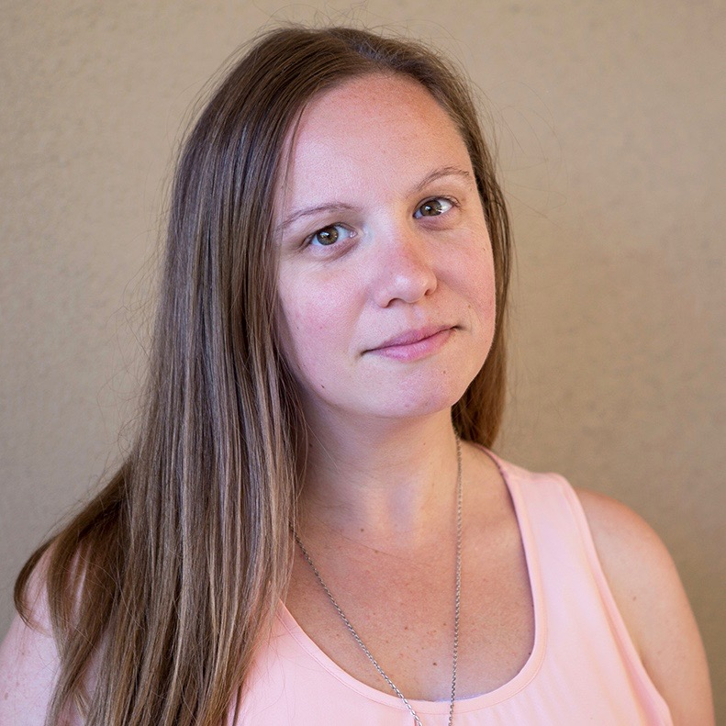
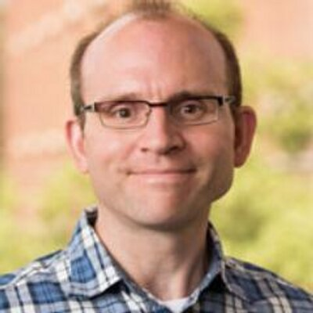
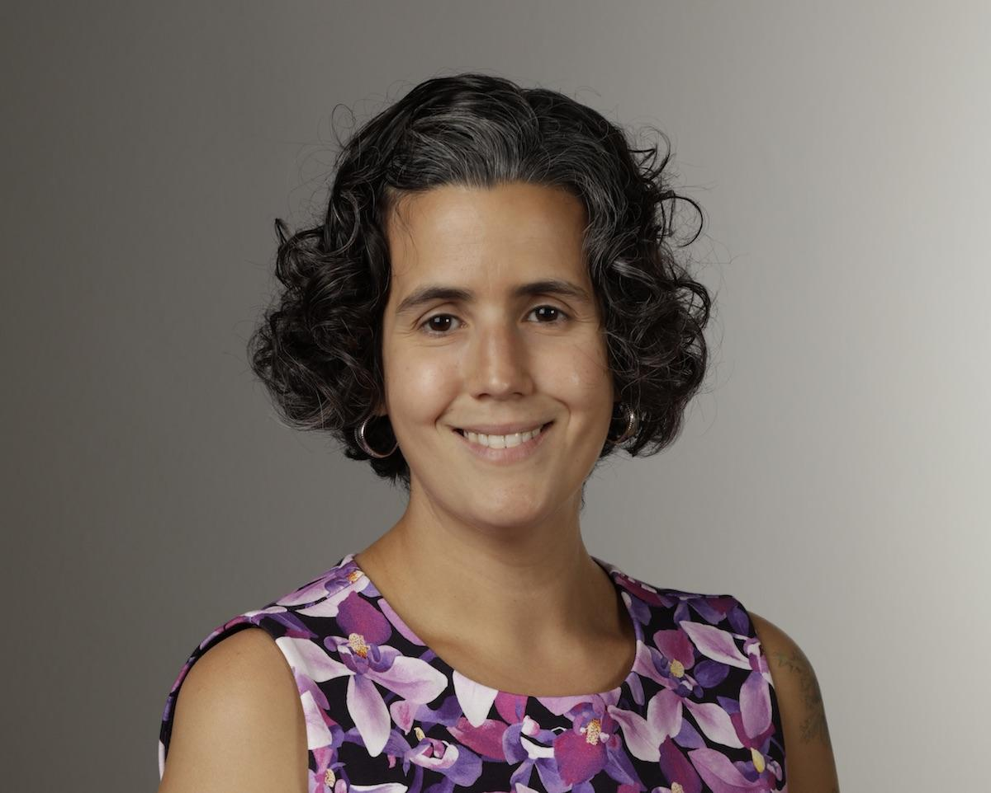
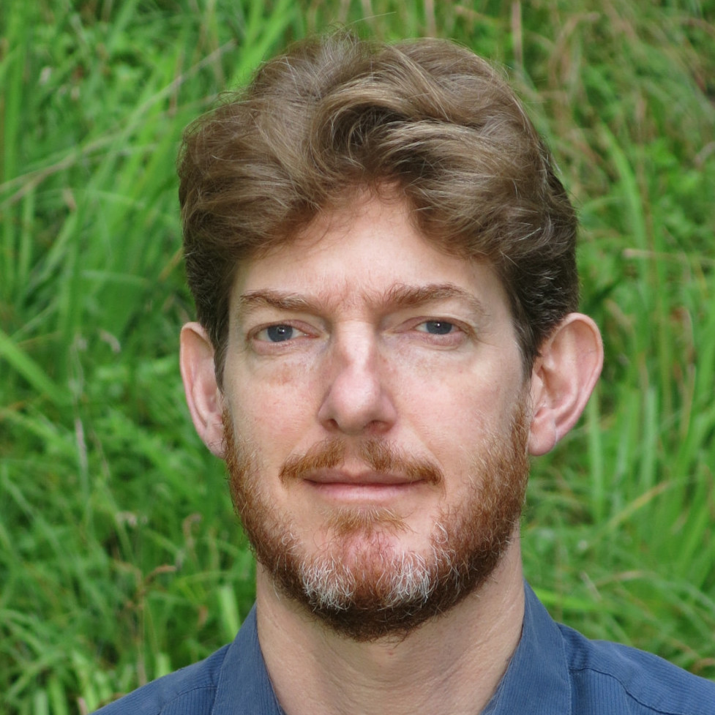
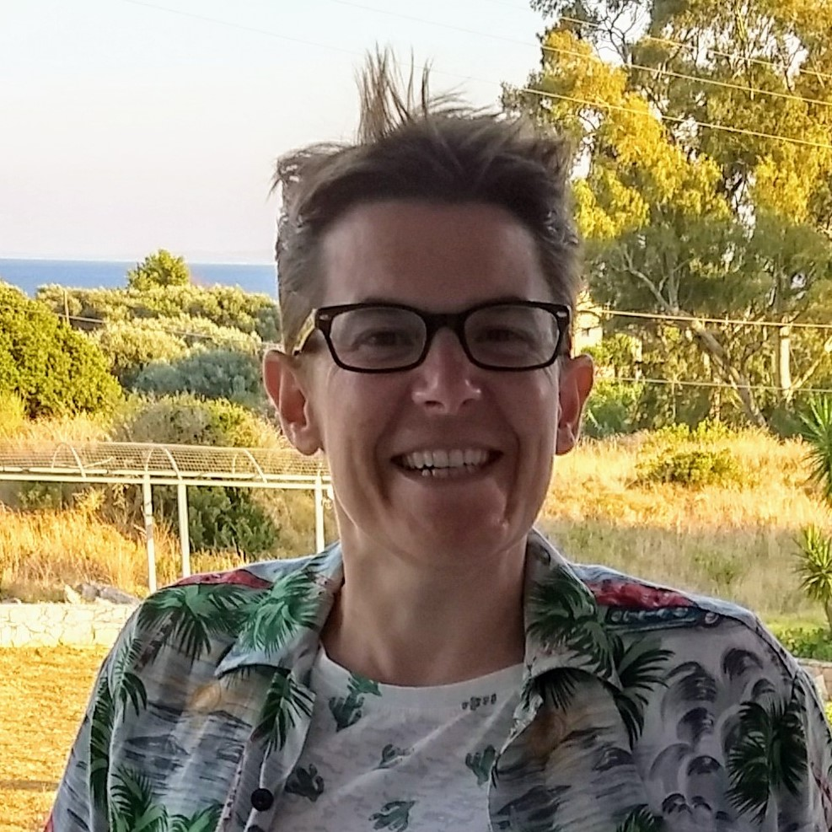
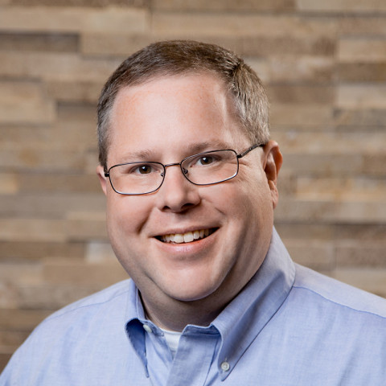
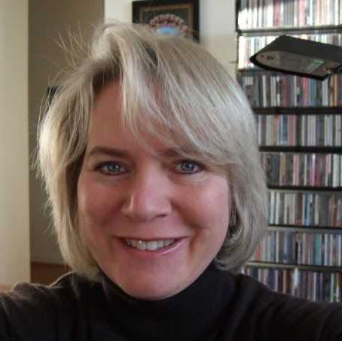
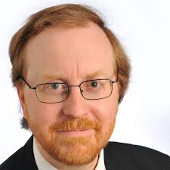
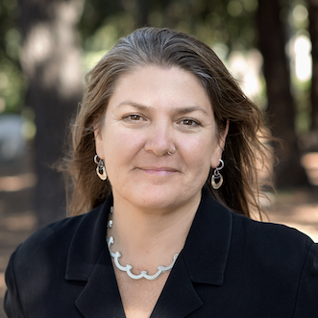
Steering Group
Three seats elected annually; members serve 3-year rotation
For 2019-2022
Carolyn Caizzi (Northwestern) -
special election in late 2018
Hannah Frost (Stanford)
Simeon Warner (Cornell)
Continuing with governance recommendations

Slide 13
Contribution Model
Tiered costs based on size of the institution
Provides a stable income to assist with hiring staff

Slide 14
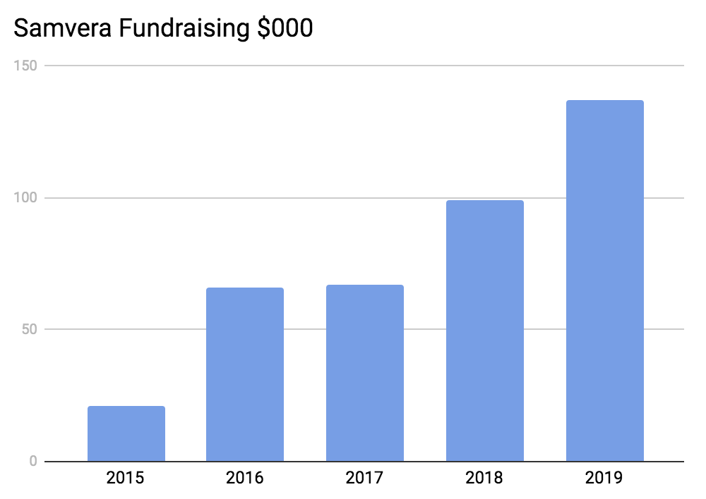
Fundraising (2015-2019)

Slide 15
Hiring Centralized Staff
Steering is working on moving forward with hiring.
Initial focus will be on a community manager.

