Slide 1

IRIS
THE CINECA’S CRIS SOLUTION
Vivo new features
Ferrario Federico, Galasso Alessandro, Bonora Paolo
Notes:
Good morning to everybody, my name is Federico Ferrario and I am the IRIS product manager: the CINECA’s "Current Research Information System" solution.
I want to thanks all of you, Mike and Andrew for this chance for CINECA to share our experience with VIVO.
I’m here to understand if community is interested that CINECA share our new features.

Slide 2
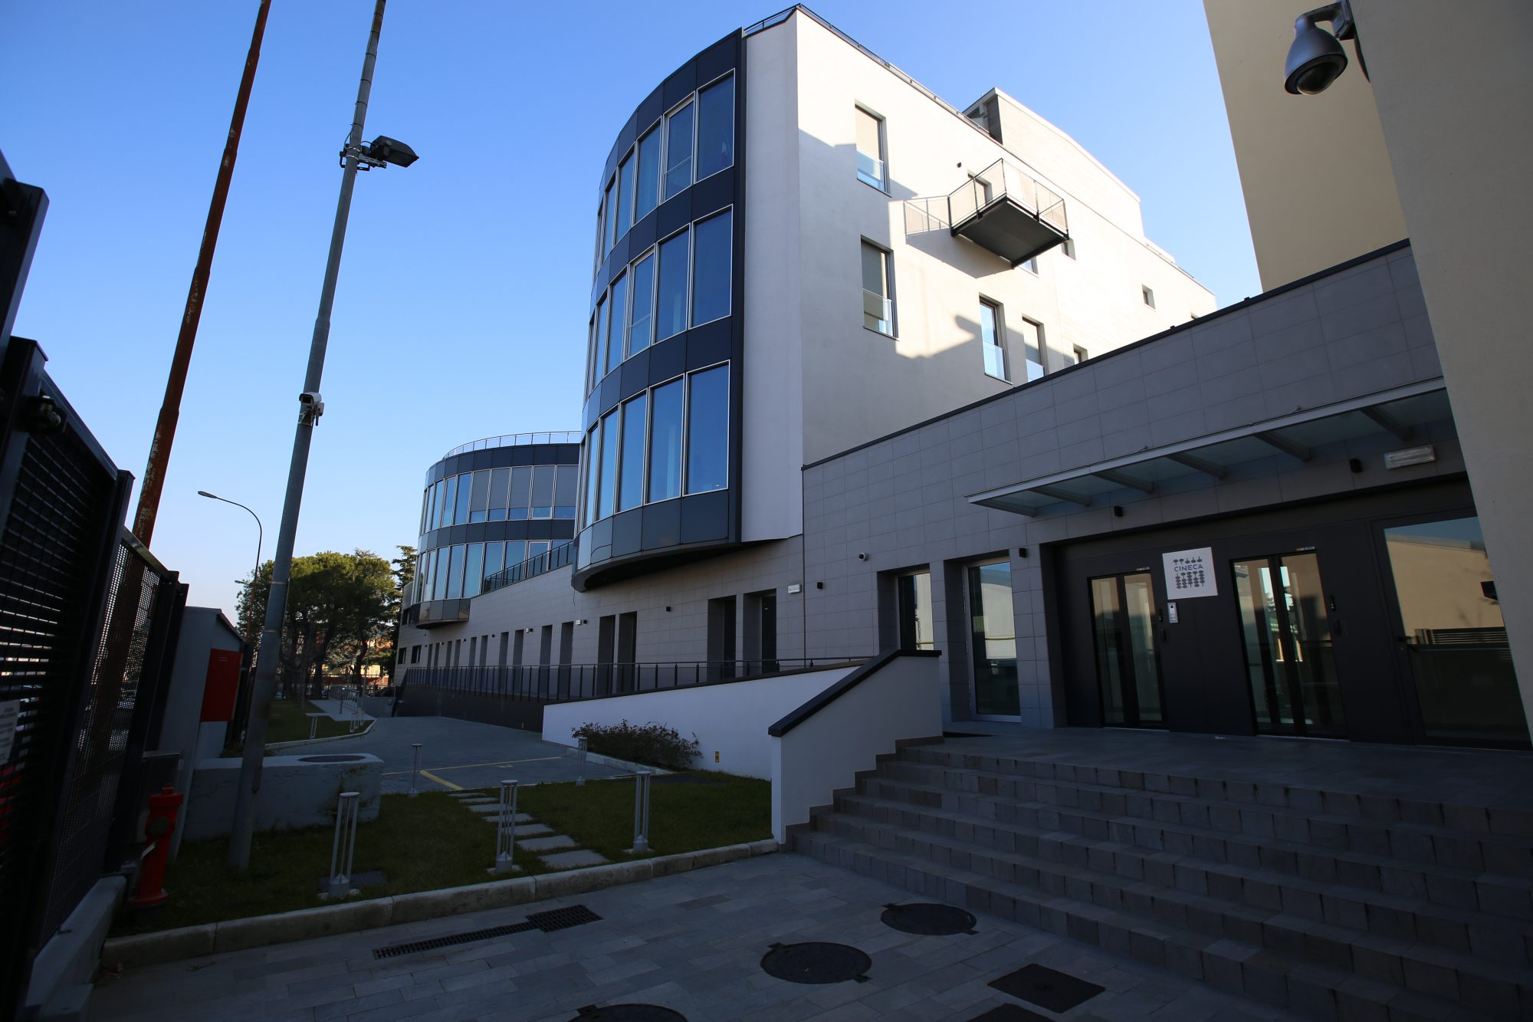
What about CINECA?
CONSORTIUM
67 italian universities
9 Research Institutions
Italian Ministry of Education (MIUR)
NON PROFIT
Founded in 1969, with more 700 employees,
Notes:
Before go indeed in my presentation I want to spend two minutes talking about CINECA.
CINECA is a non profit consortium founded in nineteen sixty nine with more than seven hundred employees.
It is a consortium of:
- Sixty seven universities
- Nine research institutions
- And (really important in this presentation) the Italian Ministry of education
So the most important stakeholders in Italian research's ecosystem are all part of the consortium

Slide 3
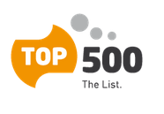
What about CINECA?
Today it is the largest Italian computing centre, one of the most important worldwide.
shows the 500 most powerful commercially available computer systems known to us
CINECA is often been in the TOP 10
Notes:
CINECA is the largest Italian computing center, one of the most important worldwide. In the last twenty years the consortium is often been in the top 10 positions of the TOP 500: the ranking of the five hundred most powerful commercially available computer systems

Slide 4

What about CINECA?
Scientific Research
High Performance Computing – FERMI: 5° in EU / 15° WW)
Scientific Visualization & Interactive Virtual Environments
We support activities of the scientific communities through:
supercomputing and its applications
qualified employees that assists researchers in the use of the technological infrastructure
Notes:
We support activities of the scientific communities not only through supercomputing and its applications, as mentioned before but also with qualified employees that assists researchers in the use of the technological infrastructure

Slide 5

What about CINECA?
Technological Innovation
Data Center
Information and Knowledge Management Services Health Care Systems
It is also concretely engaged in technological transfer activities for businesses and public administration.
it creates advanced systems for data management and analysis in the biomedical and health, manufacturing and large-scale retail trade sectors
Notes:
It is also concretely engaged in technological transfer activities for businesses and public administration. In particular, it creates advanced systems for data management and analysis in the biomedical and health, manufacturing and large-scale retail trade sectors

Slide 6

What about CINECA?
Higher Education
Solutions & Services for the University Administration
Services for the Ministry of Education, University and Research (MIUR)
CINECA develops complex information systems to support all the Higher Education
Notes:
Cineca develops complex information systems to support all the Higher Education processes: from students systems to HR systems, from accounting to research system, and so on.

Slide 7
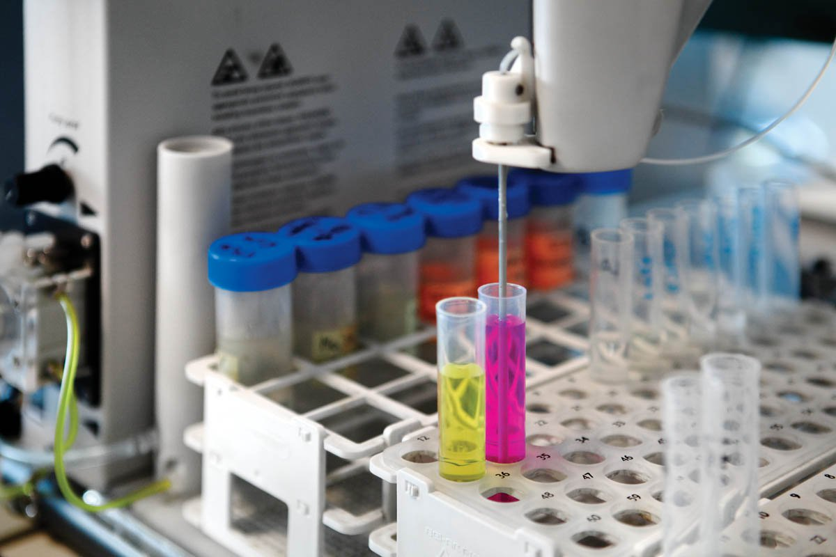








Italian research ecosystem: Institutional stakeholder
CRIS
National
databases
Evaluation Agency for
University & Research
(ANVUR )
Universities
&
Research Institutes
Ministry of Education,
University & Research
(MIUR)
Notes:
Let’s look at a really simplified view of the Italian research ecosystem.
By one side there are Universities that need to manage research activities and they use for this purpose a CRIS system.
By the other side there is the Ministry of Education that need to archive, manage and analyze information about research from all Universities. For these task Ministry needs a complex information system platform.
The ministry to evaluate quality of research in universities has an Agency called ANVUR. ANVUR define criteria and deadline for each evaluation exercise (such as: VQR that is the National Evaluation Exercise for Research every 4 year, SUA-RD that is evaluation of departments every year and so on) and use, for evaluation, data archived in the Ministry database .
The Ministry define distribution of funds based on the ANVUR analysis results.
In this ecosystem CINECA is the technical partner of all this actors. I think that, this is one of the reason because today the title of my presentation is «a success case»

Slide 8

Italian research ecosystem: Universities
CRIS
National
databases
Evaluation Agency for
University & Research
(ANVUR )
University
&
Research Institutes
Ministry of Education,
University & Research
(MIUR)
Notes:
But… let’s start from the peripheral point of view talking about CRIS systems in Universities.
And in Italy if you talking about CRIS systems you are talking about IRIS.
I say "airis" in English way but the real name, because is an Italian product is "iris".

Slide 9

What’s about you, IRIS?
Universities to do research need resources. They have:
to build laboratories;
to buy equipment;
to recruit researchers…
Resources
Which are skills of my researchers, which equipment do we have and who use this equipment?
Notes:
I’m going to analyze research in universities with a really simple workflow.
First of all Universities to do research need resources: they have to build laboratories, they have to buy equipment, the have to recruit researchers, and so on.
Which are skills of my researcher, which equipment do we have and who use this equipment? These questions seems to be simple but in my experience is not so easy, for universities, reply to this questions or they can reply with long delay and great effort.
So, the first step is: university has to manage resources.

Slide 10
What’s about you, IRIS?
With these resources, Universities can:
carry out projects
sign contracts
register patents…
Resources
Do you know success rate of your projects? Do you know which workgroup is involved in which projects?
Projects
Notes:
With these resources, Universities can carry out projects, they can sign contracts with industries, they need to register patents, they can, in general, carry out activities.
Do you know success rate of your projects? Do you know which workgroup is involved in which projects?
So, the second step is: university has to manage projects.

Slide 11
What’s about you, IRIS?
During the lifecycle of projects researchers write publications
Resources
Products
Do you know the average of publications for departments last two years?
Projects
Notes:
During the lifecycle of projects researchers write publications.
Do you know the average of publications for departments last two years?
So, the third step is: university has to manage publications.

Slide 12
What’s about you, IRIS?
Evaluation
Now I have a huge database with resoucers, projects, patents, contracts, publications….
what I need more over?
I need to evaluate what I have done to define investments for the next cycle.
Resources
Products
Projects
Notes:
Now I have a huge database with resources, projects, patents, contracts, publications…. what I need more over? I need to evaluate what I have done to define investments for the next cycle.

Slide 13
What’s about you, IRIS?
Evaluation
Anything else?
I surely want to increase visibility of my university to attract different stakeholders: students, industries, partners for grants… so I need a shop windows for my skills
Resources
Dissemination
Products
Projects
Notes:
This is the only thing I want to do with this database? No… I surely want to increase visibility of my university to attract different stakeholders: students, industries, partners for grants… so I need a shop windows for my skills.

Slide 14





What’s about you, IRIS?
Evaluation
Resources
Dissemination
Products
Projects
Notes:
All these steps of research lifecycle are covered by IRIS’ s modules.
the resource management module: RM
the activities and project module: AP
the institutional repository module: IR
the evaluation and review module: ER
The expertise and skills module: ES

Slide 15



What is the coverage of IRIS in Italy?
78 production environments
Amoung Universities and Research institutes
Growth rate of
40 % in the last 3 years
Notes:
Before going deeper in what is IRIS… I want to show you some statistics to demonstrate that IRIS is not a virtual use case but a concrete product.
IRIS is installed in seventy-eight Universities and Resource Institutes. In the last three years we have a growth rate of forty percent.

Slide 16

“78 universities” is just an absolute number
What is the coverage of IRIS in Italy?
Based on University size(ANVUR ‘s classification )
100%
Big Universities
90%
Medium Universities
30%
Small universities
Notes:
Ok, I said: «seventy eight universities» but this is an absolute number… what is the coverage of IRIS in Italy? I try to explain it with two comparisons.
The first is what is the coverage of IRIS in Italy based on universities dimension. ANVUR, the Italian agency of evaluation, classifies university in 3 classes: big, medium and small.
IRIS is used by hundred percent of big universities, in the ninety percent of Medium and in the thirty percent of small.
The low number of thirty percent of small universities include also online universities, that don’t need a CRIS or are too small to justify internal effort and costs to use IRIS.

Slide 17
“78 universities” is just an absolute number
What is the coverage of IRIS in Italy?
Compared to professors and researchers registered in Ministry's databases of publications
96%
IRIS coverage
Notes:
Another interesting comparison is: how many researchers in Italy use IRIS? We can compare the sum of researchers in all IRIS's installations with the total number of researcher registered in the ministry's database and we can say that the ninety-six percent of researchers in Italy use IRIS

Slide 18






Technicalities
Notes:
Just one slide for Technicalities.
IRIS is based on three open source platforms: DSpace for Institutional repository module, VIVO for Expertise and Skills module and some Pentaho’s components for analysis and reporting. On top of these platforms, we have developed custom modules.

Slide 19

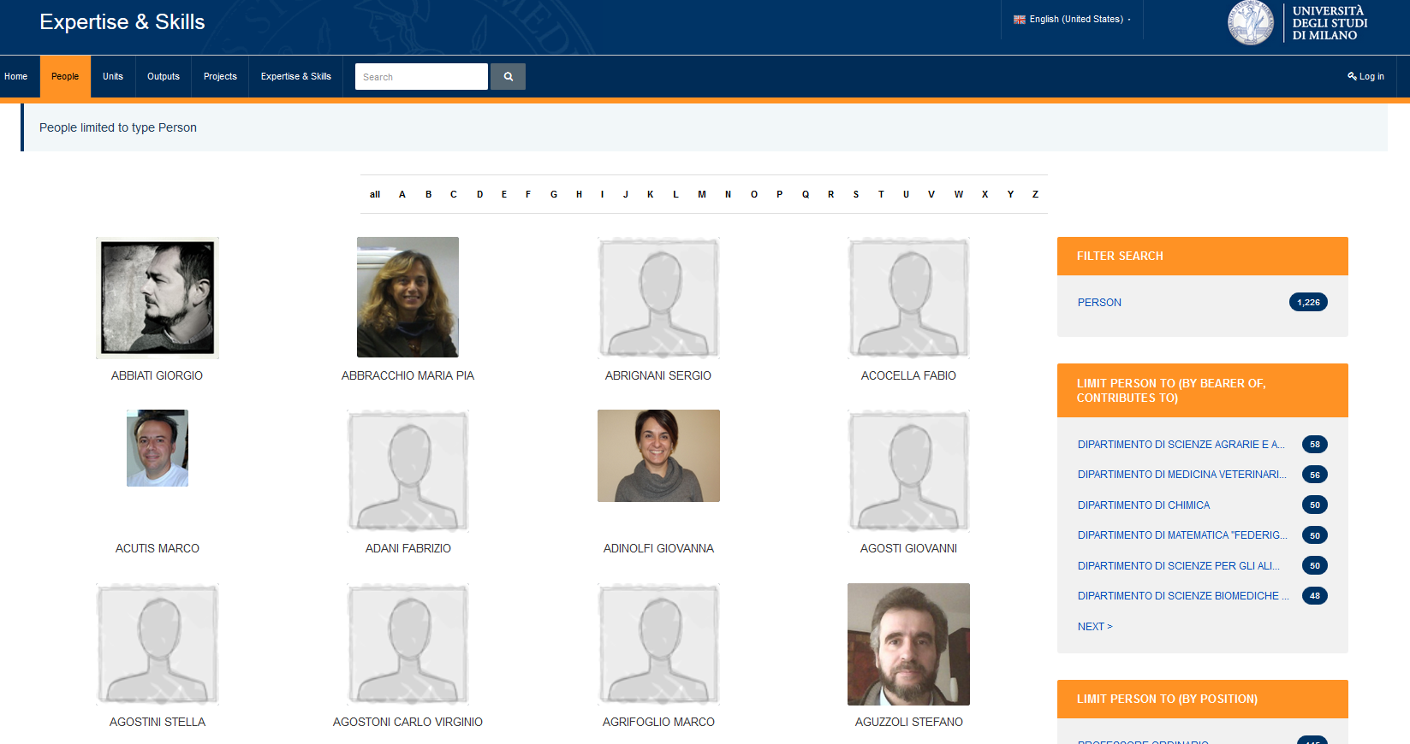
Features #1: Faceted browsing in browse and search page
From configuration, based on JSON file, you can define fields used for faceted browsing.
Notes:
The first feature we have implemented is faceted browsing on browse and search pages.
We have implemented on SOLR.
From configuration, based on JSON file, you can define fields used for faceted browsing.
After configuration, VIVO add these fields to SOLR, and presents them in search and browse pages.

Slide 20
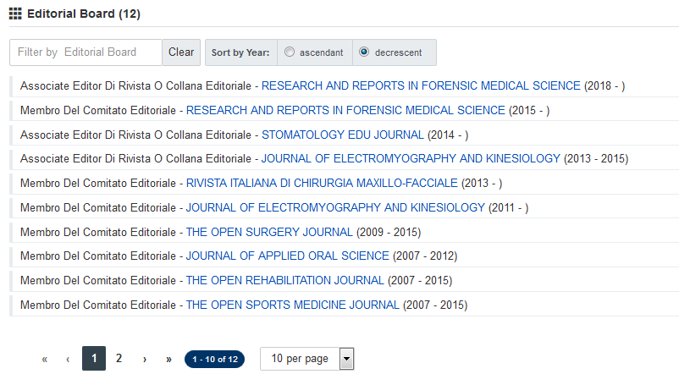
Features #2: paginated properties
Each property can be configured to have:
Search feature
Sorting
Pagination
Notes:
Second feature is paginated property.
Using a simple open source js named Jplist you can configure in a JSON file which properties need this rendering.
You have:
Searching, filtering, pagination and sorting of list.
You can define:
Default items number per page;
Field for sorting
Filters based on field;

Slide 21
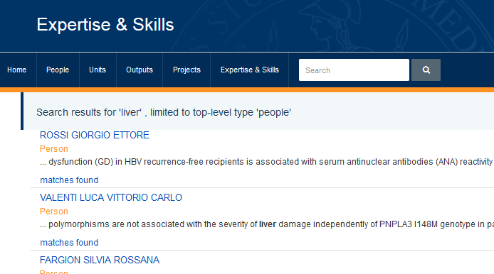
Features #3: «matches found» in search
Why this researcher is in the top of the list?
Is he real an expert of domain I’m looking for?
Notes:
On search results there is a new link.
This new feature response to this question: Why this researcher is in the top of the list?
Is he real an expert of domain I’m looking for?
Clicking on this link VIVO shows a modal with all entities, releated to people in the search results, that matches my search.

Slide 22
Features #3: «matches found» in search
VIVO shows a modal with all entities, releated to people in the search results, that matches my search.
BEFORE
VIVO searchs in ALL-TEXT fields.
AFTER
VIVO searchs in ALL-TEXT fields.
Clicking on «matches found» VIVO search again in all related items to find single entities matches.

