Slide 1
Linked Data for Rare Materials
LD4P project at the Harry Ransom Center
Paloma Graciani Picardo
Brittney Washington
@LD4P Conference
July 17th, 2020

Slide 2
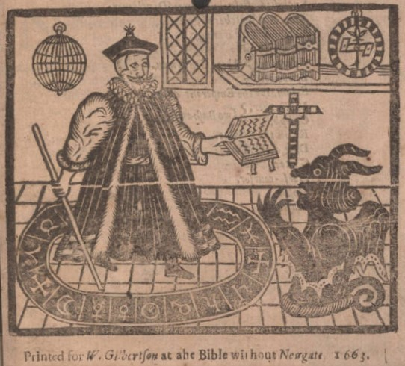
LD4P2 project at the HRC
Focus on our pre-1700s Rare Book holdings
  ~20.000 Marc records submitted to SHARE-VDE
Areas of activity
  Programmatic data transformation analysis
  Local experimentation
  Community engagement
Detail of Christopher Marlowe’s The tragicall history of the life and death of Doctor Faustus (London: William Gilbertson, 1663). Carl H. Pforzheimer Library, Harry Ransom Center

Slide 3
Programmatic data transformation analysis
Local triplestore implementation → Key
No mappings for 590 and 79x fields
SPARQL to understand data model
retrieving all printers
PREFIX bf: <http://id.loc.gov/ontologies/bibframe/>
PREFIX rdfs: <http://www.w3.org/2000/01/rdf-schema#>
select ?instance ?printer
where{ ?instance bf:instanceOf ?work .
{ ?work bf:contribution ?contributionid.
{ ?contributionid bf:agent ?isni.
{ ?isni rdfs:label ?printer. }
?contributionid bf:role ?roleid.
{ ?roleid rdfs:label ?rolelabel.
FILTER (STRSTARTS(?rolelabel, "printer"))
}
}
}
}
Contribution access points mapped to bf:Work domain (including printers and binders)
Genre/Form terms mapped to bf:Work domain
bf:selfmark values mapped straight from Library of Congress Call Number field

Slide 4

Local experimentation
LD4P BF2 Rare Materials
HRC ARM test
Department working sessions and cataloger’s feedback
Yale ARM
HRC Rare Materials Profiles
5 main templates (un-nested)
7 nested templates
BF2, ARM, RDF and RDFS
id.lov.gov, Getty, Ligatus
PeriodO, RBMS vocabularies (!)

Slide 5
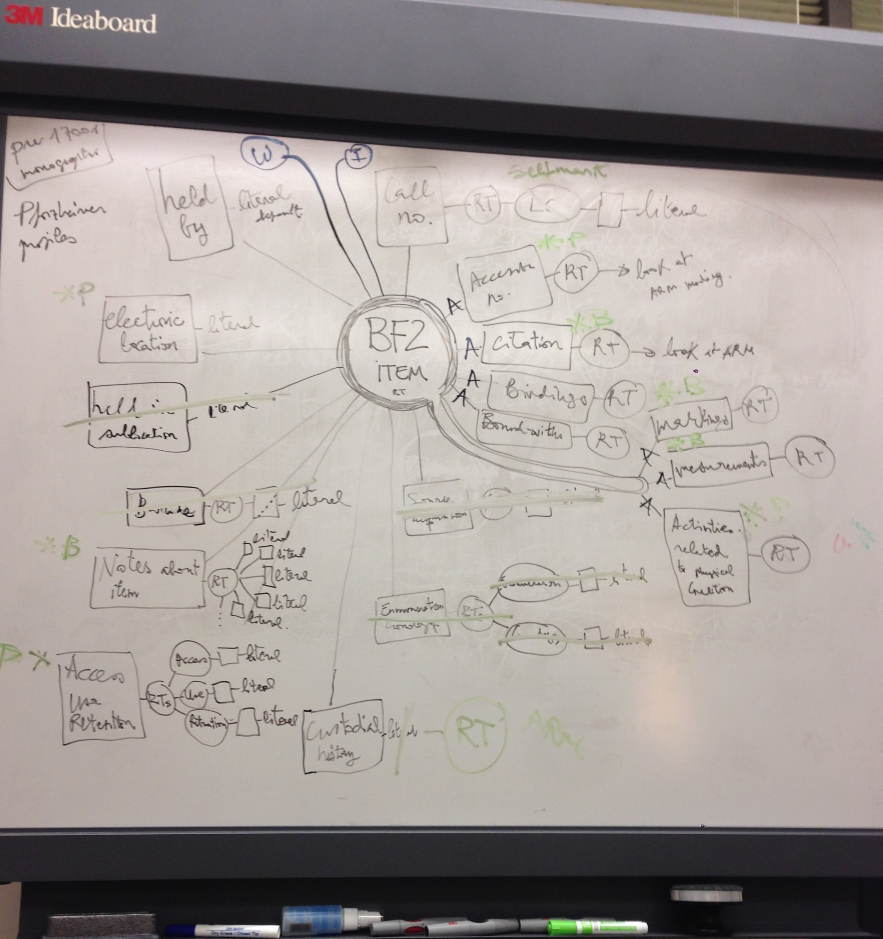
Just another Friday morning at the Ransom Center Book Cataloging department...

Slide 6
Importance of Community
Advocacy
Borrowing bits and pieces of application profiles from others
Supportive network - inspiration and/or commiseration!
Talking through questions and challenges
  Collective expertise
  Unique perspectives
  No “reinventing the wheel”

Slide 7
Rare Materials Affinity Group
Makes use of the collective expertise to discuss needs and challenges particular to rare materials
Builds upon the existing relationships among rare materials communities, and will liaise with associated communities as needed
  Association of College and Research Library's Rare Books and Manuscript Section's Bibliographic Committee (ACRL RBMS BSC)
  the Art and Rare Materials Ontology Extension group which includes members from:
    Art Libraries Society of North America's (ARLIS/NA) Cataloging Advisory Committee
    ACRL RBMS BSC
    Society of American Archivists (SAA)

Slide 8
Questions
What type of linked data projects are you working on?
What kind of materials are being described?
What ontologies/vocabularies are being used?
How are you ensuring interoperability?
What communities do you rely on for support in learning linked data for special collections?
ld4.slack.com
#ld4_2020_specialcollections_track
#rareaffinitygrp
@p_graciani
@Brttney Washington

Slide 9


We’d love to hear from you!
Paloma Graciani - paloma.graciani@austin.utexas.edu
Brittney Washington - brittney.washington@austin.utexas.edu
ld4.slack.com
#ld4_2020_specialcollections_track
#rareaffinitygrp
@p_graciani
@Brttney Washington

Slide 10
