Slide 1
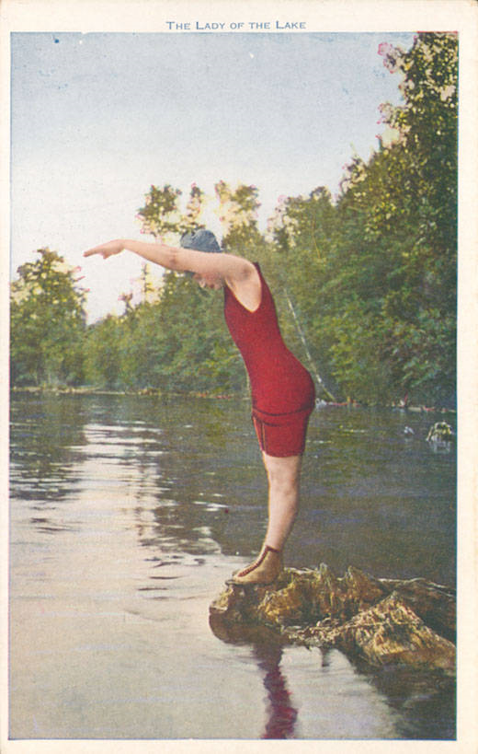

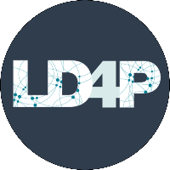
Jumping into the Linked Data Pool
Two Texas Institutions within the LD4P Cohort
Image of a woman jumping into a lake. From Curt Teich Postcard Archives Digital Collection (Newberry Library). http://collections.carli.illinois.edu/cdm/ref/collection/nby_teich/id/428930

Slide 2
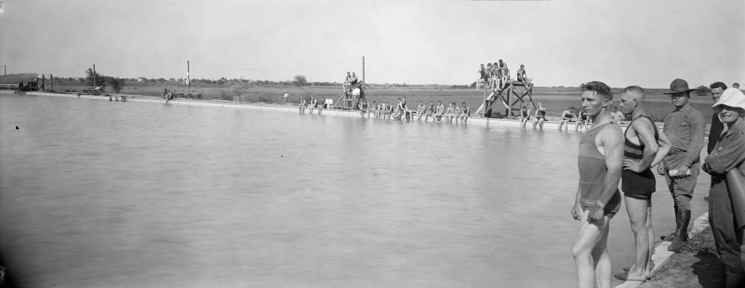
Presentation overview
Source
LD4P project background
HRC and TAMU in the LD4P Cohort
Collaboration opportunities
Challenges
Next Steps

Slide 3
LD4P Project Background
A two-year project that builds on the success of LD4P Phase 1 project (2016-2018) and Linked Data for Libraries Labs (LD4L Labs)
  LD4P1 consisted of six partners: Stanford, Columbia, Cornell, Harvard, Princeton, and the Library of Congress
  Piloted linked data for production for library resources, including: standards/guidelines and infrastructure, workflows, BIBFRAME ontology extensions
Aims to “scale up” this effort to a broader cohort of libraries to demonstrate what is needed to successfully transition workflows from MARC to linked data
Collaboration with the Program for Cooperative Cataloging (PCC)
  Invitation for PCC libraries to submit proposals in July (Deadline: August 13, 2018)
  17 libraries selected to receive subgrants of $50,000

Slide 4
LD4P Project Goals:
The creation of linked data expressed in BIBFRAME from a cohort of academic libraries
Development of a cloud-based sandbox editing tool to support the creation and reuse of linked data
Development of policies, techniques and workflows for the automated enhancement of MARC data with identifiers
Better integration of library metadata and identifiers with the Web through collaboration with Wikidata
The enhancement of a widely-adopted library discovery environment with linked-data based discovery techniques
Continued community collaboration to ensure exchange of ideas and techniques

Slide 5
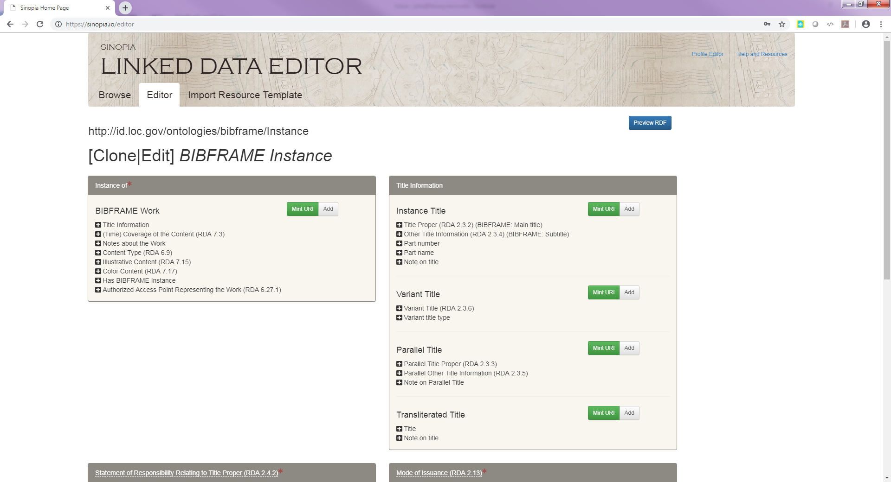
Sinopia: A Cloud-Based Linked Data Editor

Slide 6
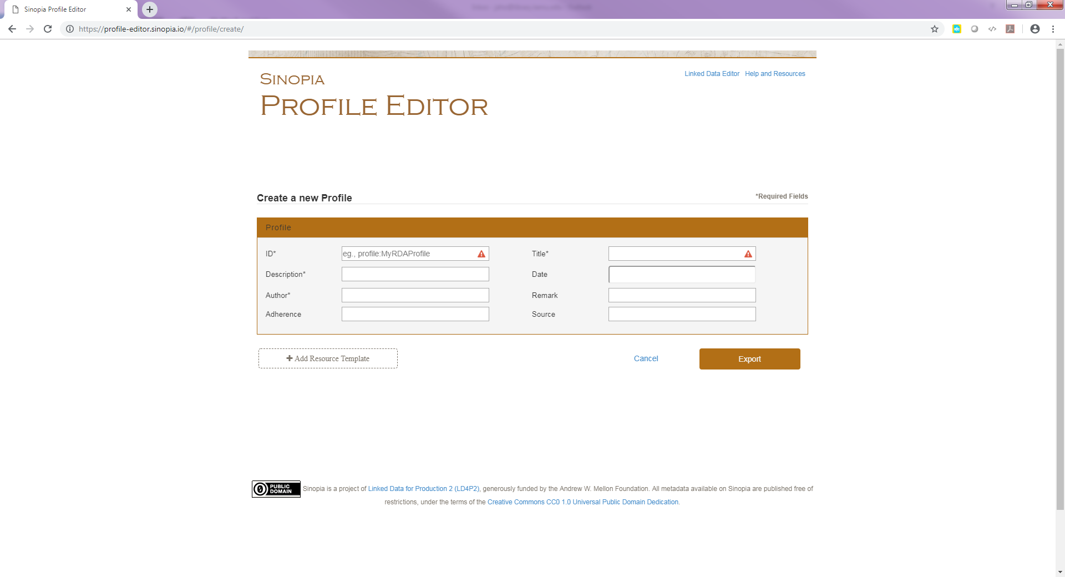
Sinopia: Profile Editor

Slide 7
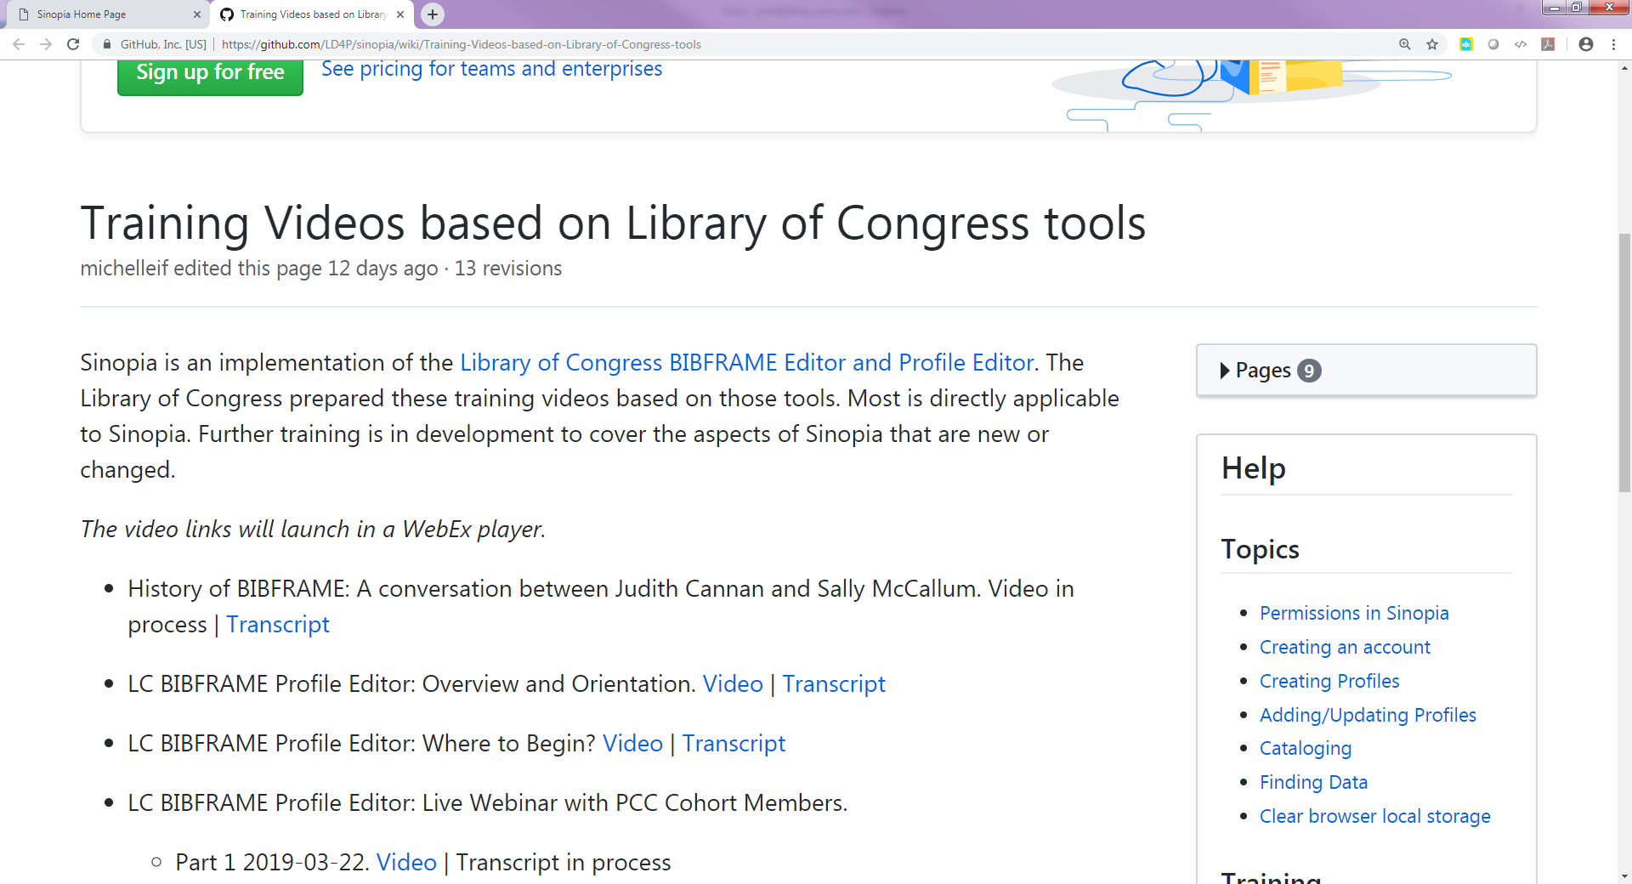
Training for Sinopia

Slide 8
The Ransom Center proposal
What?
  Evaluate
    Models and vocabularies for special collections using RDF
    Programmatic conversion services
    Focus on COPY-SPECIFIC DATA and ITEM-LEVEL description (!)
  Identify
    Strategy to transition some MARC-based workflows to linked data
  Engage
    With the library community
    Development of shareable policies to manage Linked Data bibliographic
    descriptions
Who?
  Book Cataloging and Metadata
  Library Division
  Curators
  Web
Metadata Research Assistant
(grant funded position opens August 2019)

Slide 9
The Ransom Center proposal
How?
  ~21,000 bibliographic records (pre-1700s holdings)
  YEAR 1
    Develop strategy for assessment of converted data
    Create BIBFRAME + ARM profiles
    Collaborate with other members of the LD4P cohort and Library Community
  YEAR 2
    Perform usability test for BIBFRAME item-level information
    Original cataloging in Sinopia
    Facilitate training of HRC staff at large on Linked Data, RDF, ontologies, and BIBFRAME topic
    Collaborate with other members of the LD4P cohort and Library Community
  TENTATIVE
    Local implementation of a triplestore
    Test Blacklight enhanced Linked Data functionalities

Slide 10
Texas A&M proposal
Main components
  MARC production metadata to be converted to RDF (Resource Description Framework for semantic web)
  Training
    Both paraprofessional cataloging staff and professional catalogers
    Lean method for streamlining workflows
  Cost effectiveness of BIBFRAME for metadata production
    Can paraprofessionals do the work or are professional catalogers needed?
      At what point in the process?
    Cost-effectiveness of using BIBFRAME for metadata production
    Core-level records vs. fuller level records
Secondary consideration
  BIBFRAME and FOLIO

Slide 11
Texas A&M proposal
What?
  Don Kelly Research Collection of Gay Literature and Culture
    Special collections materials containing multiple formats
      Focus: LGBTQ regional and national history documenting the community’s struggle for both legal and social recognition
      Formats:
        Books
        Serials
        Visual material
        Ephemera
Why?
  Cushing Memorial Library and Archives has a backlog of more than 60,000 items. Cataloging staffing levels are insufficient and will likely remain so in the near future

Slide 12
Collaboration opportunities
Developing BIBFRAME profiles*
  Profiles working group -- Profiles best practices
  Profiles wranglers
  Cloning, reusing or starting from scratch
  Cross-institutional profile development (more about this later)
Sharing workflows
  Managing profiles in GitHub
  Question Authorities Support requests
  Converted data analysis
Training strategies
  LC training
  Train the trainers

Slide 13
Collaboration opportunities (cont.)
Communication channels
  Slack
  Wiki
  Google Groups
  Public Drive
  GitHub
  In-person and remote meetings
Affinity Groups
  Rare Materials (more about this later)
  Discovery
  Wikidata
  Non-roman scripts
Working Groups
  Sinopia User Group
  Sinopia Profiles Working Group

Slide 14
Rare Materials Affinity Group
Charge: seeks to make use of the collective expertise across the member and cohort institutions to discuss needs and challenges particular to rare materials, and to coordinate the development of resources to support our work.
The Rare Materials Affinity Group will build upon the existing strong relationships among rare materials communities, and will liaise with associated communities as needed.
Meets monthly
Discuss project details
Collaborate on profiles
Acts as a support group!

Slide 15
Managing expectations & Anticipating challenges
Building the ship while sailing it
  Initial assumption of project risks --- management of expectations
  Project team needs to ramp up on new technologies
  Cohort institutions need to get up to speed
  We don’t know what we don’t know
Learning new skills
  RDF, ontologies, classes and properties
  Github and JSON
  Workflows adaptability
Reconciling community specific standards and vocabularies with the BIBFRAME model and the linked data environment
Data transferability (BIBFRAME to MARC and vice versa; ILS interoperability)
Shared data (cooperative cataloging; will we be duplicating work)

Slide 16
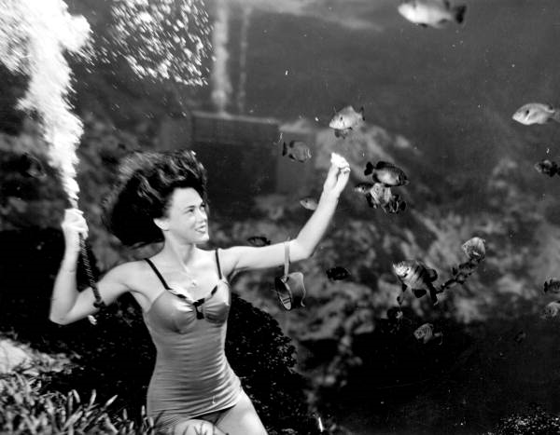
Our next steps
Training
  Building skills for ourselves
  For our colleagues in the library
Profile development/adaptation
Analyzing data
Collaborating with the community
  Sharing data
  Sharing best practices
  Facilitating training
Frances Dwight feeding the fish as a part of the underwater show at Weekiwachee Springs. 1948. Black & white photoprint, 4 x 5 in. State Archives of Florida, Florida Memory. https://www.floridamemory.com/items/show/67364, accessed 25 April 2019.

Slide 17
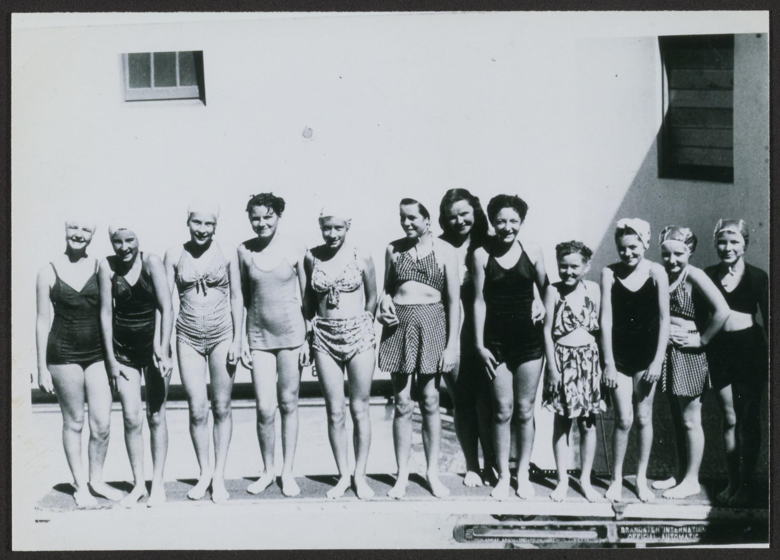
Ways to get your feet wet
Affinity Groups are open to others outside of the LD4P 2 Cohort
LC Training videos & Transcripts
BIBFRAME
LD4P2 Website
Conferences
  LD4 conference is free!
  Look out for further presentations at ALA, RBMS, LD4, etc.
Source

Slide 18
Questions now,
questions later?
Jeannette Ho - jaho@library.tamu.edu
Paloma Graciani - paloma.graciani@austin.utexas.edu
Amanda Ros - aros@library.tamu.edu
Brittney Washington -brittney.washington@austin.utexas.edu

