Slide 1
NLM Access and Preservation
Lindsay Franz Jennifer Gilbert
History of Medicine Division Technical Services Division
National Library of Medicine
National Institutes of Health
U.S. Department of Health & Human Services

Slide 2
Access
Refine by feature: List of Counts by Format
FDA Notices of Judgment
Profiles in Science
HAV transfer station

Slide 3
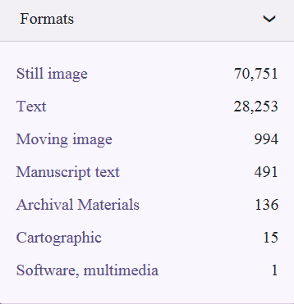
Access to Content
List of Counts by Format

Slide 4
Splash Page
New search box: Search by Format and Browse all Items
Recently Digitized
Collections
Related Projects

Slide 5
FDA Notices of Judgment
Digital archive of the published federal notices of judgment for manufacturers and products prosecuted under the 1906 Pure Food and Drug Act.
View documents via PDF Viewer from within the site or download PDF, OCR, and Metadata.
Hair dye did not contain warning: “Caution this product contains ingredients which may cause skin irritation on certain individuals and a preliminary test according to accompanying directions should first be made. This product must not be used for dying the eyelashes or eyebrows. To do so may cause blindness.” 1939- product was ordered to be destroyed. https://fdanj.nlm.nih.gov/catalog/csnj00013

Slide 6
Profiles in Science (41 profiles)
Archival collections of prominent scientists, physicians, and others who have advanced the scientific enterprise.
Broad range of documents and visuals (view within site or download: PDF/OCR)
https://profiles.nlm.nih.gov/JJ/

Slide 7
HAV transfer station
Higher quality access copies for the Digital Collections
Replaces an outdated ineffective old process (ripping an mpg via USB connected DVD player)
Transfer station uses higher-end software (Premier Pro and BlackMagic) to generate a mov and mp4 directly from BetaSP tape (1 generation removed from film)
In the future, plan to convert U-matic and VHS

Slide 8
Preservation
U-matics
Modern Manuscripts

Slide 9
U-matics
Pilot project for AV preservation
  Preservation master, encoding FFV1 wrapper Matroska (MKV)
  Derivative, encoding H.264 wrapper MP4
  DVD containing Derivative
Viewable only on site
  Copyright issues
  508 compliance requirements

Slide 10
Dark Archive
Original repository requirement
U-matics preservation catalyst for development
Dark or dim?
Lessons learned from pilot will be applied to next phase

Slide 11
Modern Manuscripts
Processing collections now (17 total)
Word documents and handwritten materials
Currently in QA
Thumbnail view
Able to download PDF and OCR Text
Item searched within a collection will be highlighted.

