Slide 1

Orientation to the Profile Editor

Slide 2
What this covers
Profiles & Resource Templates
  Orientation & Terminology
Property Templates
  Orientation & Terminology
    Property Templates with Literals (Data properties)
    Property Templates with Resources (Object properties)
    Property Templates with Lookups (Object properties)
    Value constraints (Defaults)
    Mandatory, Repeatable

Slide 3
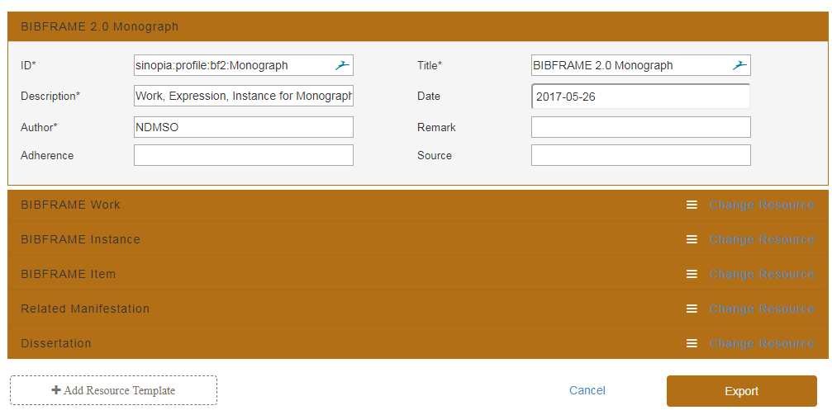
Profiles
A profile is a container for one or more resource templates
A profile includes metadata for the profile + associated resource templates
Profiles are used only within the Profile Editor & in GitHub. The profile metadata does not load into the Metadata Editor.

Slide 4
Profiles (2)
Metadata about the Profile
Resource templates
This example shows a profile containing 5 resource templates.

Slide 5
Resource Templates
A resource template is a container for a single resource (i.e., class) + its associated property templates
Includes metadata for the resource template + associated property templates
All resource templates are contained within a profile in the Profile Editor and when stored in GitHub.
Click on a Resource Template in a profile to expand and see its metadata & associated properties

Slide 6
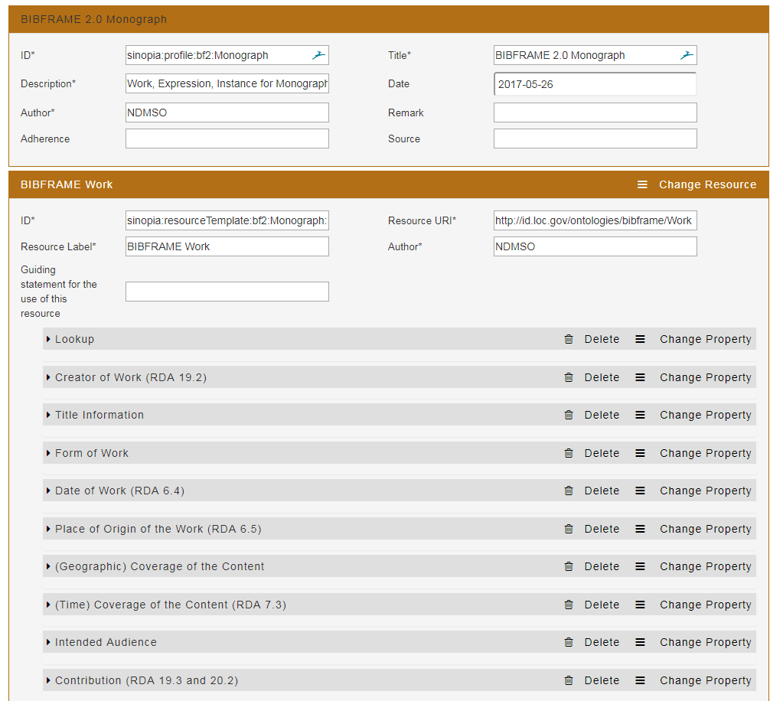
Resource Templates (2)
Each resource template in a profile loads as an individual unit in the linked data editor. It does not appear as part of the profile.
Metadata about the Resource Template
Property Templates
This example shows a resource template for a Work, with 10 property templates.

Slide 7
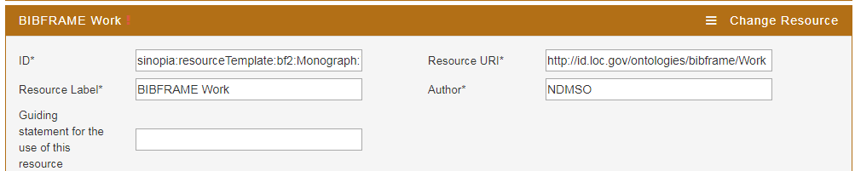
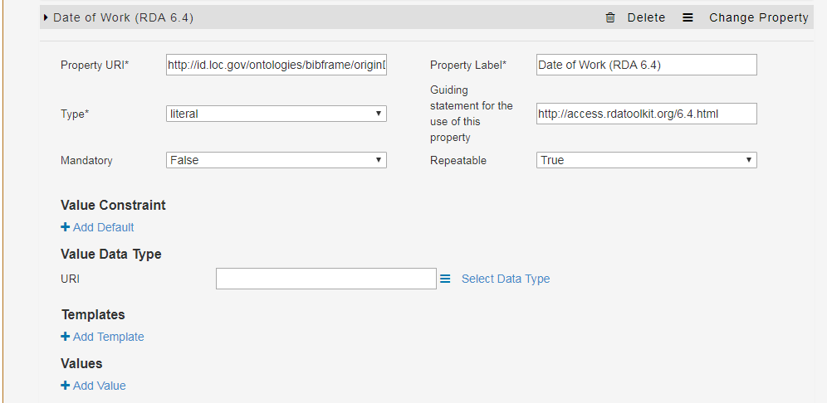
Property Templates
A property template is a container for a single property + its attributes + associated values/resource templates
  .
The combined resource & property templates broadly model the relationship between a BF class and either
  a literal
  a set of values (from a pull-down list)
  or
  another resource template
  .
        Once the profile is loaded into the editor, you will then enter individual values/literals, either by hand or through a dropdown menu.

Slide 8
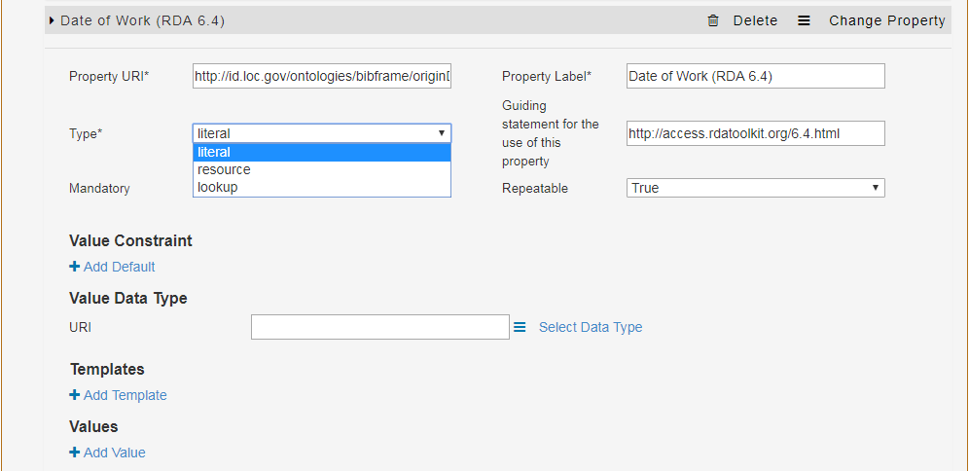
Property Templates—Literals (Data properties)
Type—Literal
        The values you will input when inputting metadata in the linked data editor will be strings (literals)
        :w1 a bf:Work ;
        bf:originDate “2019” .
        :w1 = some work
        “2019” = a value entered by the metadata practitioner. These will be indicated by quotation marks going forward.

Slide 9
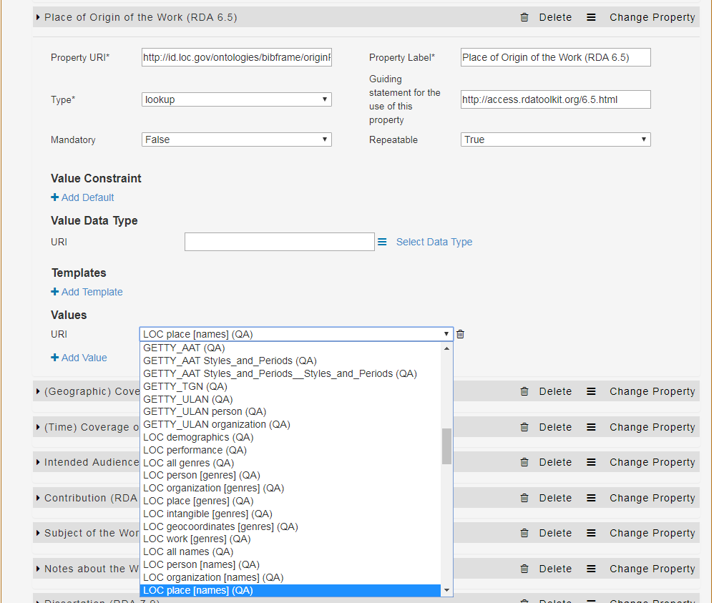
Property Templates—Lookups (Object Properties)
Types of properties—Lookup
Your value is a lookup in a controlled vocabulary
  vocabulary choices are accessed by a pulldown list
:w1 a bf:Work ;
bf:originPlace http://id.loc.gov/authorities/names/n79018544
  .

Slide 10
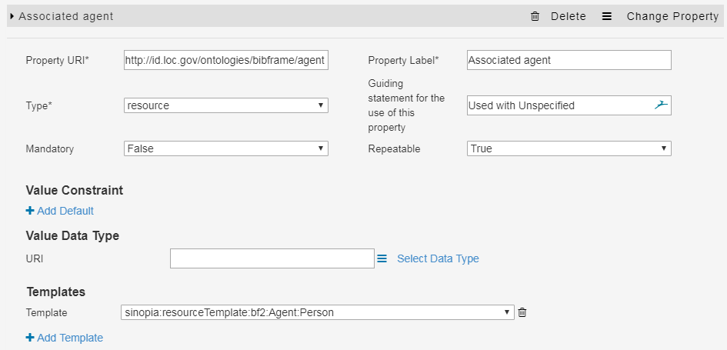
Property Templates—Resources (Object Properties)
Types of properties—Resource
You are relating your resource template to another resource template (a referred resource template) by a property (here bf:agent)
the resource template is referred to by its ID; it may or may not be part of the same profile

Slide 11
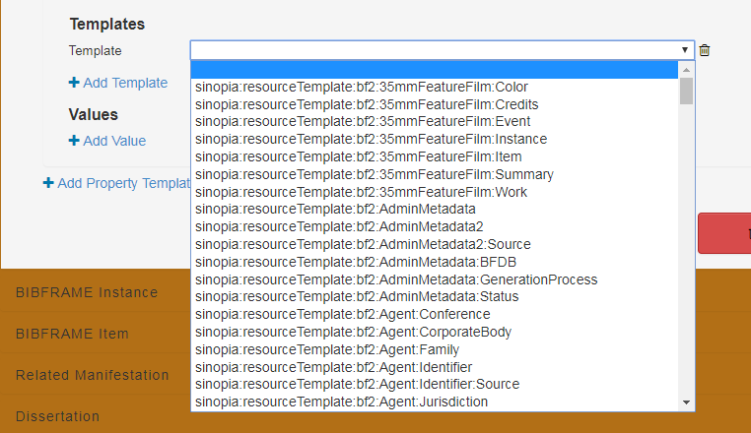
Property Templates—Resources (Object Properties)
Referred templates are accessed by a pulldown menu of template IDs.
If a template is not available on the list:
add the resource template ID manually to the list in the profile editor (not yet available)
pick any template as a stop-gap, and edit the template name in the JSON after you export (currently available)

Slide 12
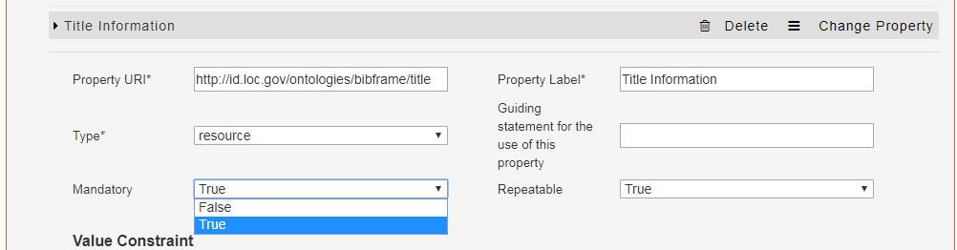
Property Templates: Mandatory, Repeatable
Defines whether a property value is mandatory or optional
when mandatory, it will appear with a star beside the field label in the editor
Defines whether a property value is repeatable or not

Slide 13
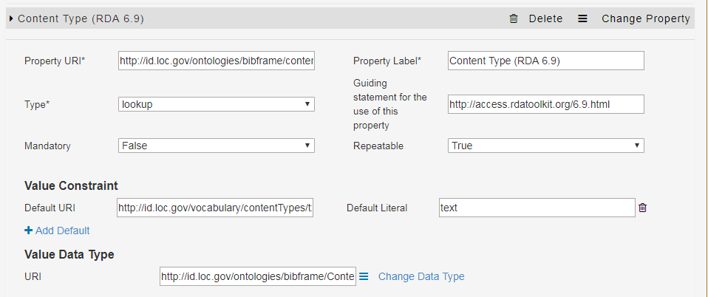
Property Templates (7)—Value constraints
Provides a default URI and/or* a literal for a value
For use when the value is usually the same for any resource
  need to provide both the URI & the literal
  need also to provide a value data type
  can be overridden on data input
Currently, the editor requires both a default URI and a default label. This is a bug, which has been reported https://github.com/LD4P/sinopia_editor/issues/389

Slide 14
The End

