Slide 1

Create a Sinopia Profile from Scratch

Slide 2
What this covers
Creating a new profile from scratch
  naming your profile
  other metadata for your profile
Adding a Resource Template
Adding a Property Template
Adding Default Values
Exporting your Profile

Slide 3
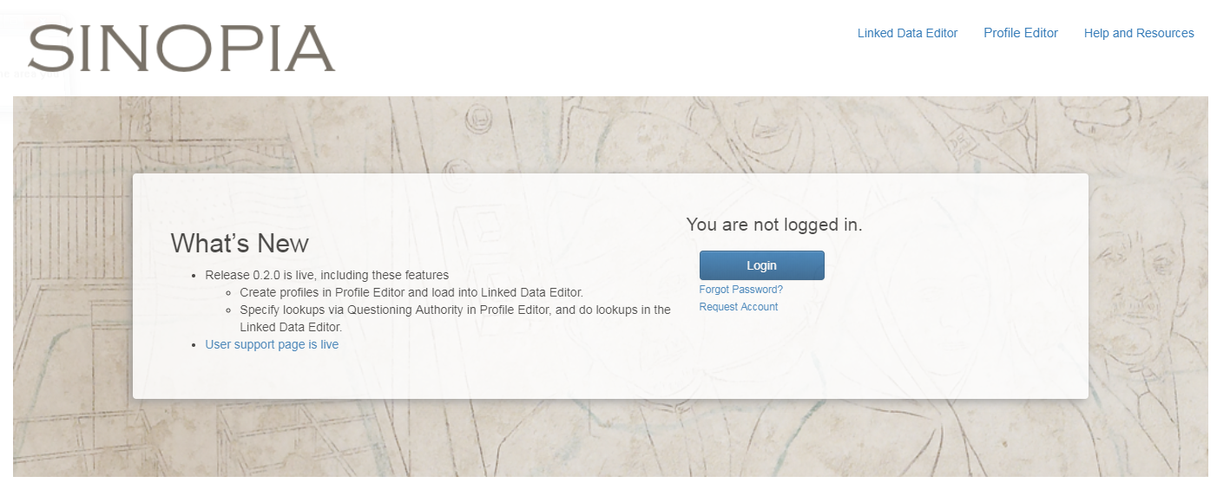
Creating a New Profile
On the Sinopia home page, click on Profile Editor. You do not need to log in.

Slide 4
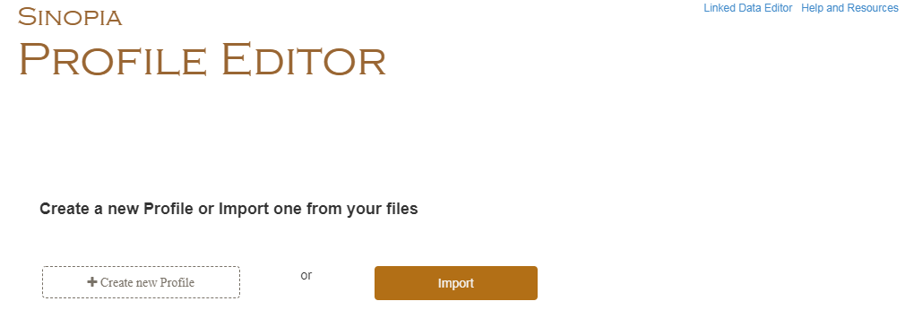
From the Profile Editor page, click on Create New Profile

Slide 5
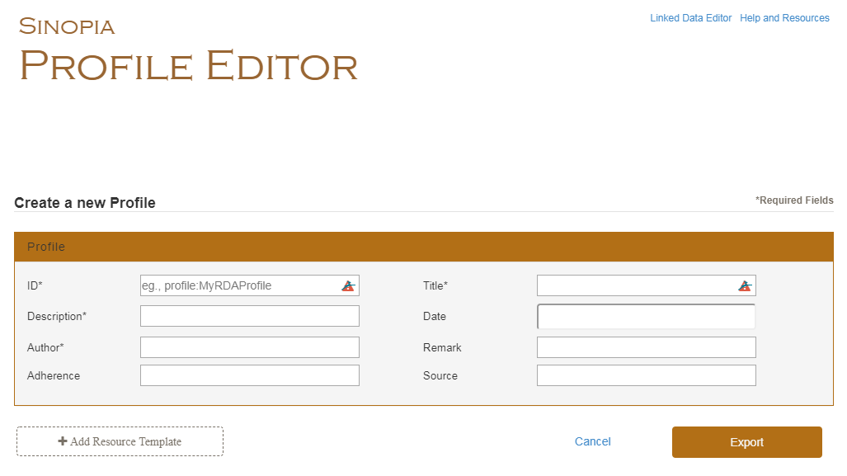
An blank profile will appear on the page.

Slide 6
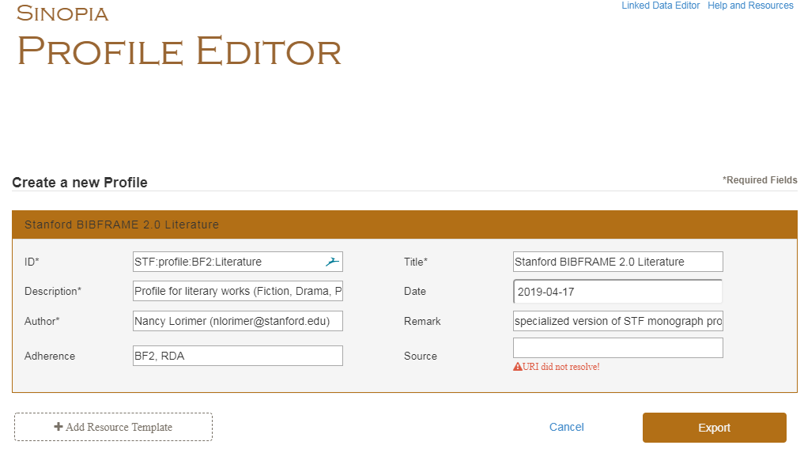
ID*—Include:
  institution name/code
  primary ontology used
  type of profile
  separate parts by colons
Title*
  Readable version of ID
  use institution code or name to start (will cluster your profiles)
Description
  what it covers
Date
  date you created profile
Author*
  name
  email
Remark:
  anything you want to say about the specifics of the profile
Adherence
  Ontology, Cataloging Standards; specialized vocabularies used
Source
  a link to more information about your profile
Add Profile Metadata
Any field with a * is required.
For more help, see the Profile Editor Best Practices Document.

Slide 7
Add a Resource Template
All profiles must have at least one resource template.
Remember:
A resource template is a container for a single resource (i.e., class) + its associated property templates
Click on + Add Resource Template

Slide 8
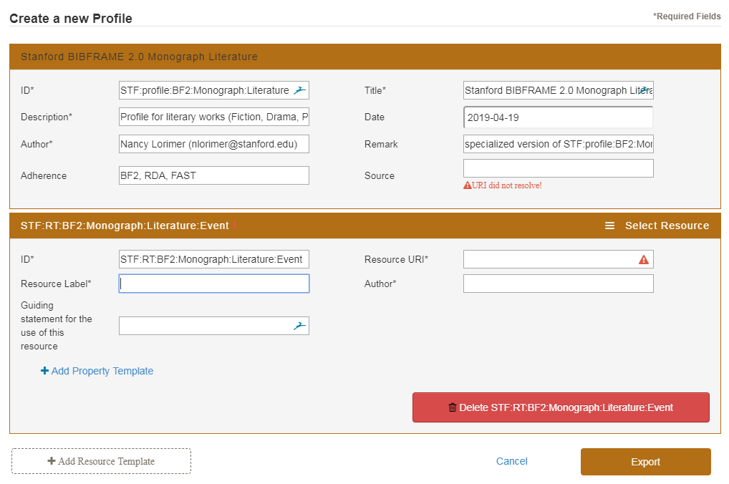
Create an ID for the resource template. it should be based on your profile ID
Click on
Select Resource to get the URI for your resource (class)
You may also type the URI in manually into the Resource URI field

Slide 9
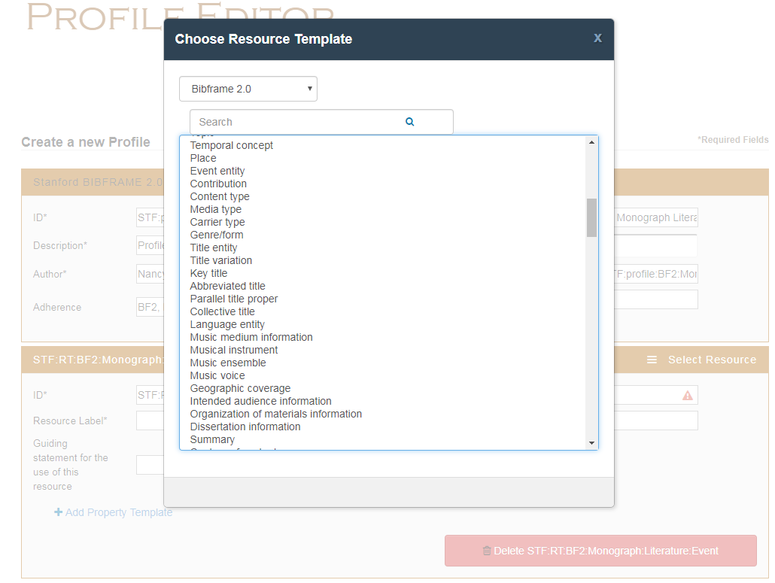
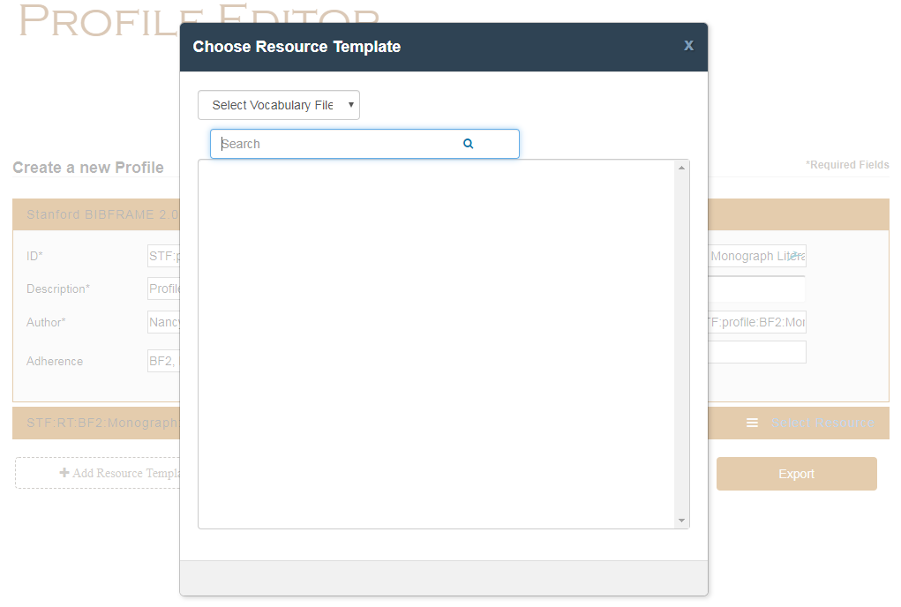
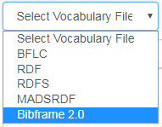
If you clicked on Select resource, a menu appears
Select Vocabulary file from pull-down menu
Select ontology
Select resource (class) type
You can also search via the search box (capitalize the first letter)

Slide 10
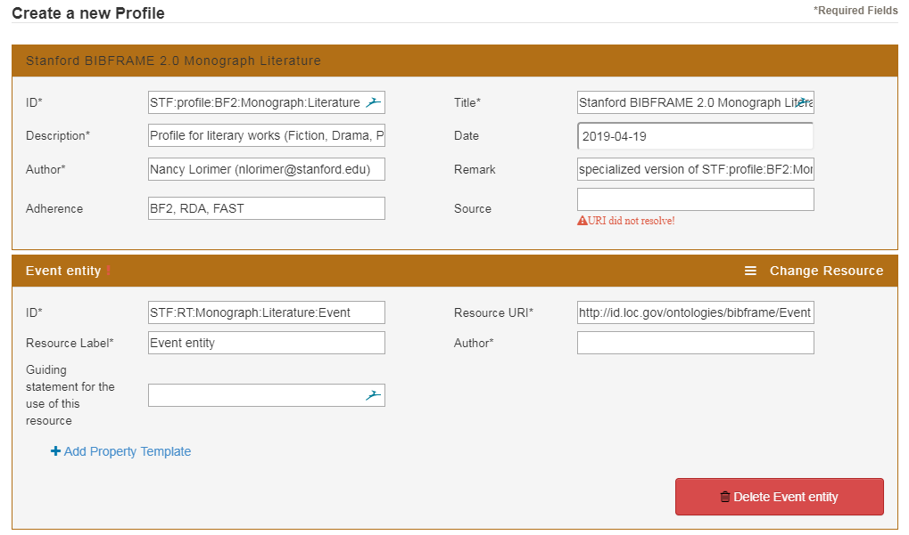
Your URI and label are auto-filled.
If you want a different label (e.g., an RDA label) you can write over the auto-filled label

Slide 11
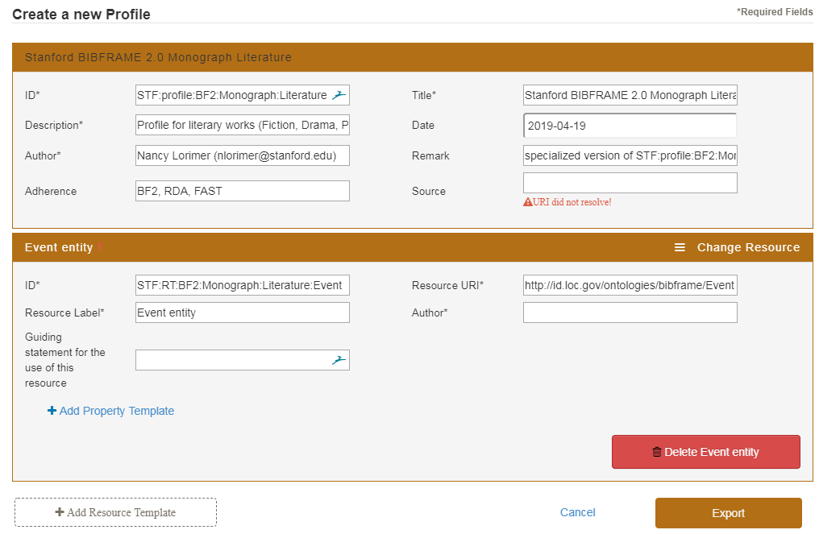
Add a Property Template
Every Resource Template must have at least one Property Template.
Click on Add Property Template

Slide 12
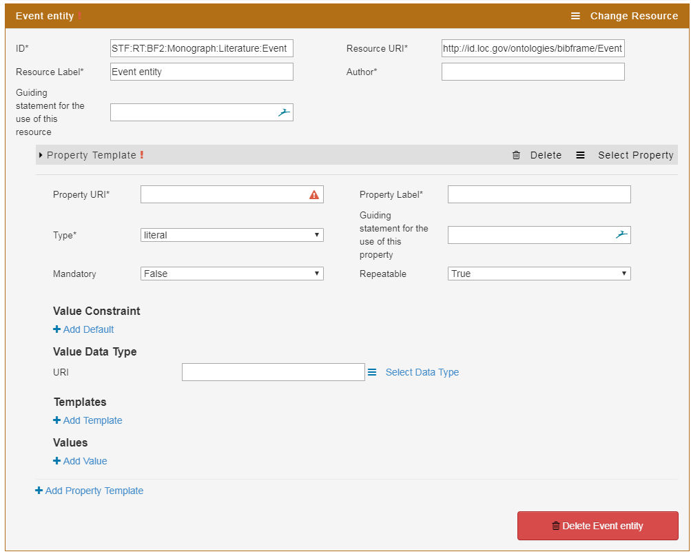
Property Template appears…
Click on “Select Property” to choose your URI from a menu
You may also add the URI & Label manually.

Slide 13
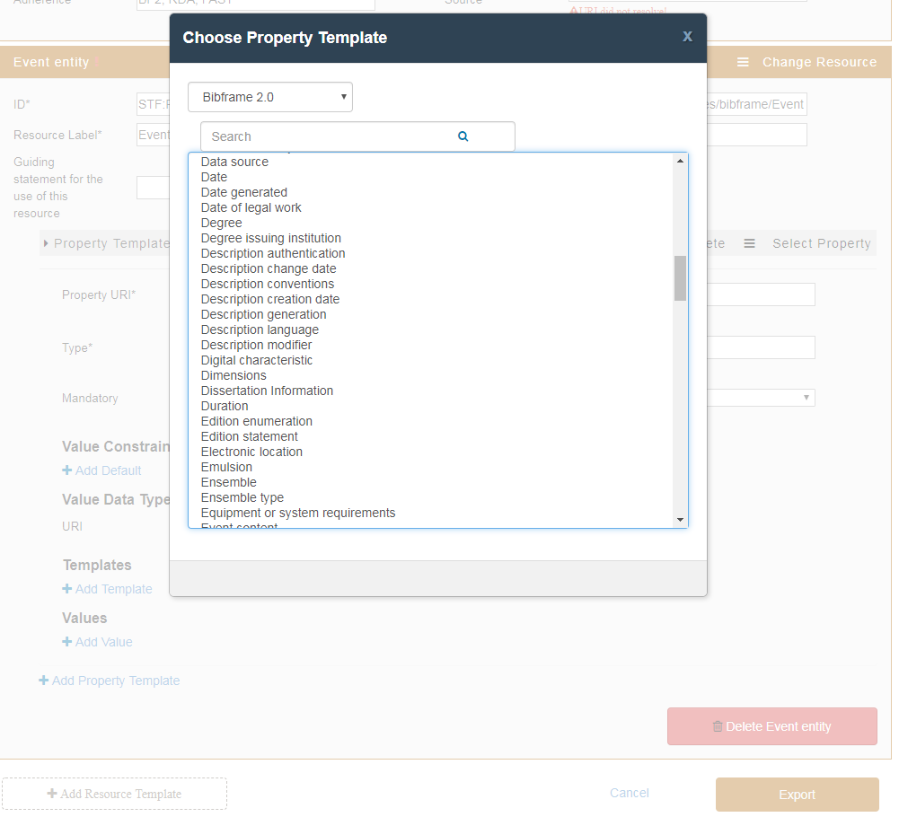
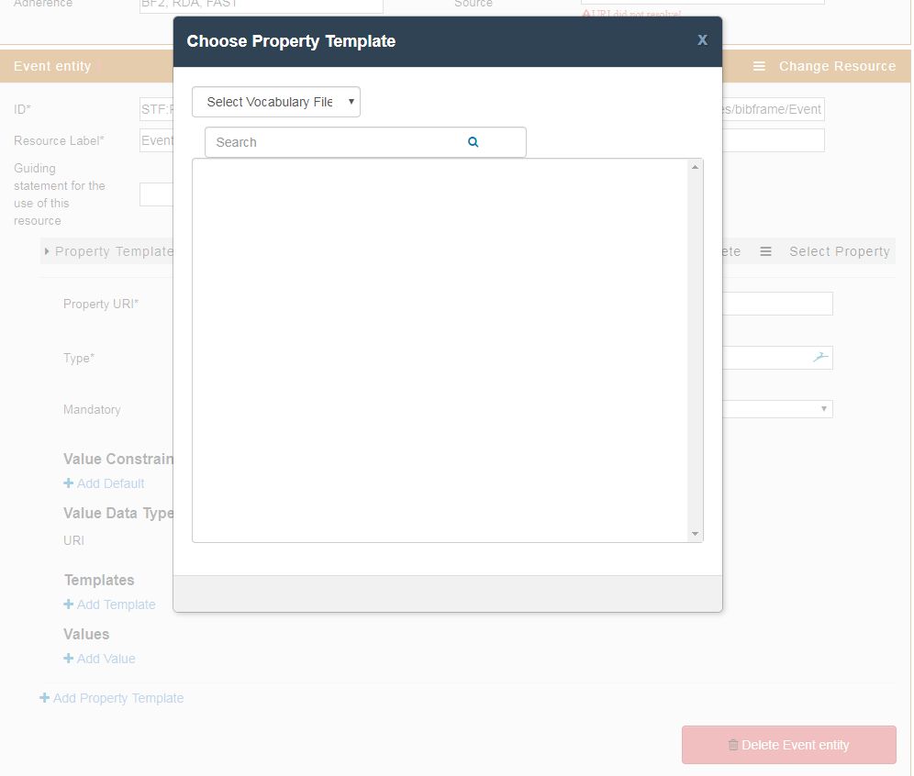
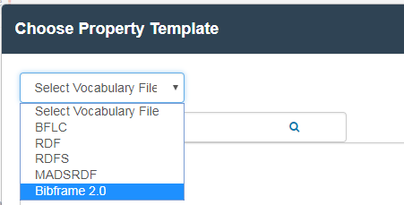
If you clicked on Select Property, a menu appears
Click on Select Vocabulary File & pick an ontology.
Select Property from list

Slide 14
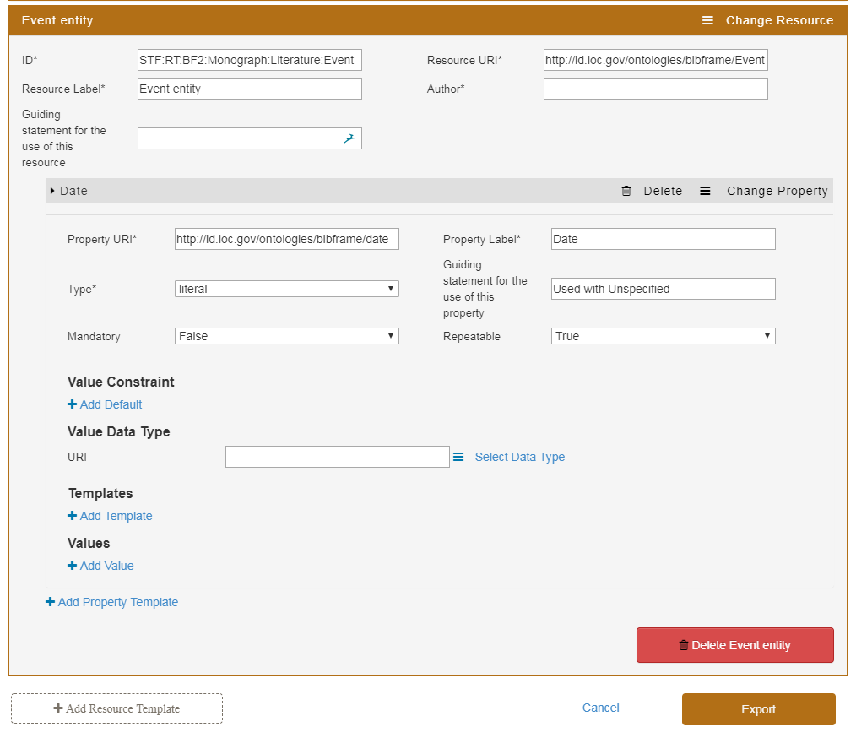
Your URI and label are auto-filled.
If you want a different label (e.g., an RDA label) you can write over the auto-filled label

Slide 15
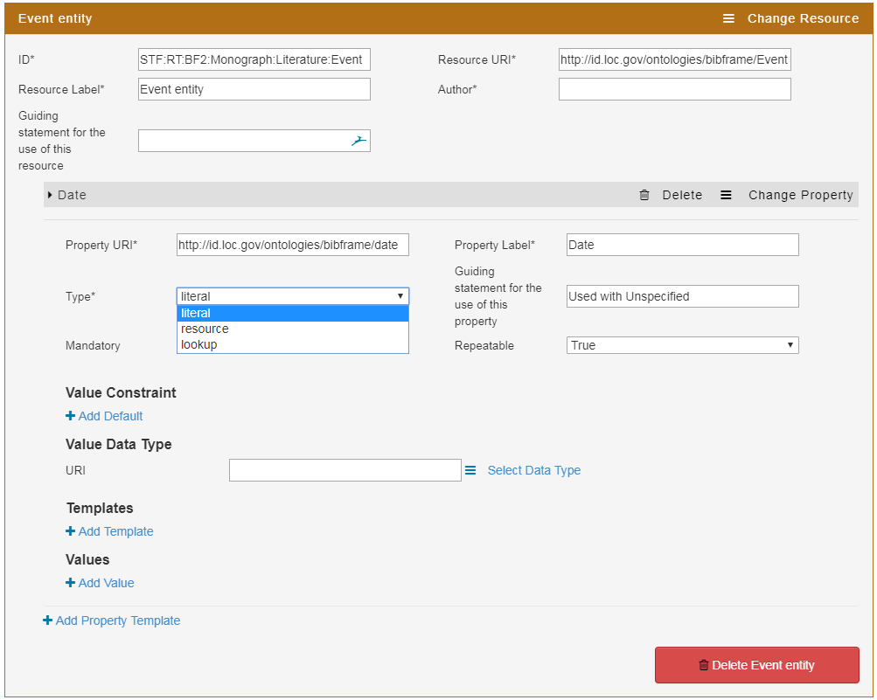
Choose property type (default is literal)
Literal = expected input in the editor is a text string
Resource = expected input in the editor requires another resource template
Lookup = expected input in the editor is from a lookup/list

Slide 16
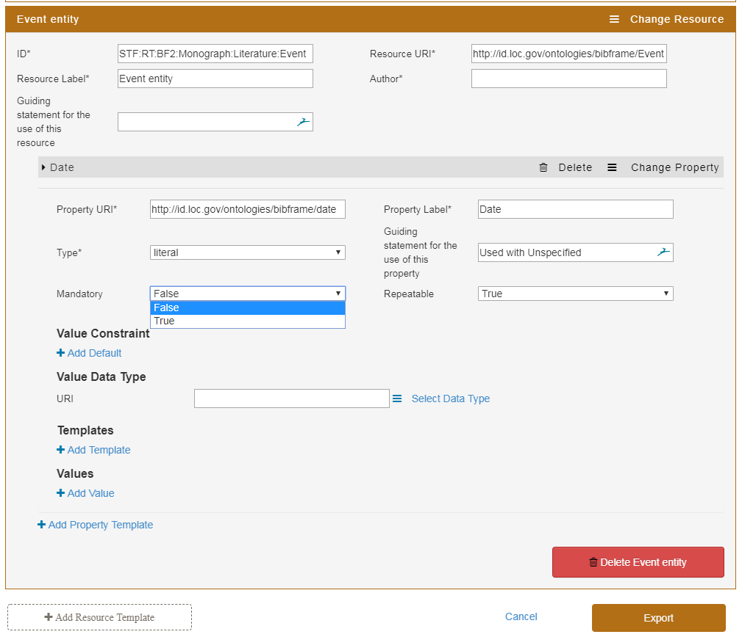
Choose True if the field should be mandatory, False if it is not mandatory; default is False

Slide 17
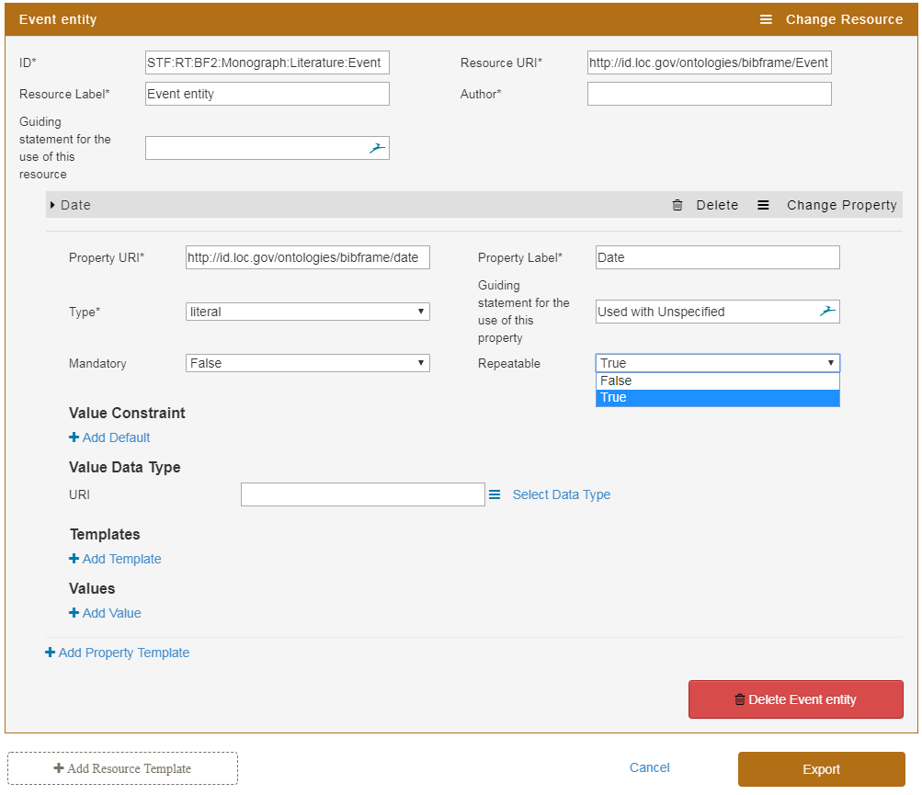
Choose True if the field is repeatable, False if the field is not repeatable; default is True

Slide 18
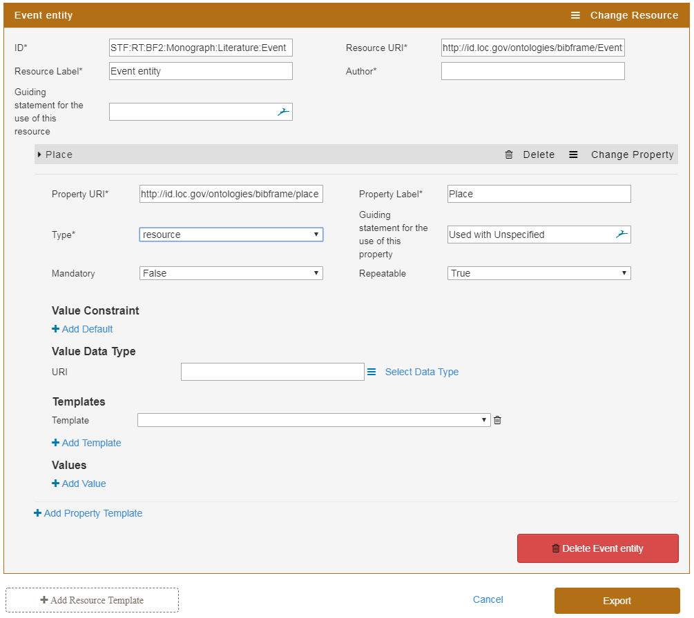
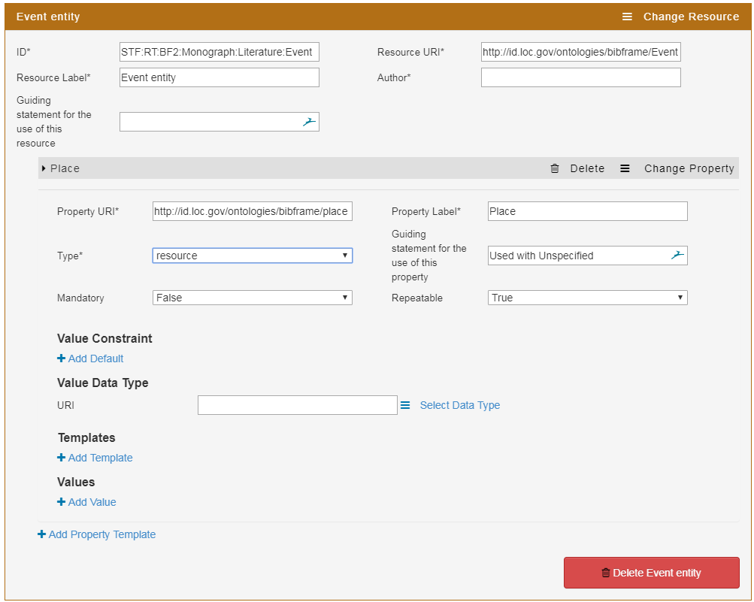
If you chose resource as a type, click on Add template
A box opens up

Slide 19
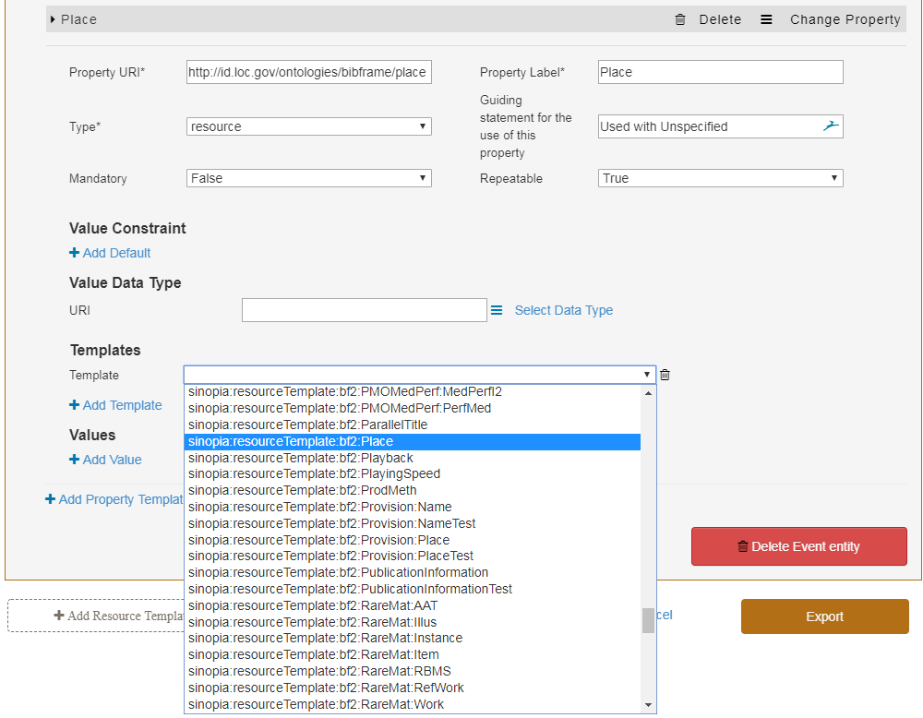
Click on the down arrow. A pull down menu of available resource templates opens up.
If your template is not on the list:
Add the ID manually to the list (not yet available)
Use any resource template ID as a stop-gap and edit the name directly in your JSON file after export

Slide 20
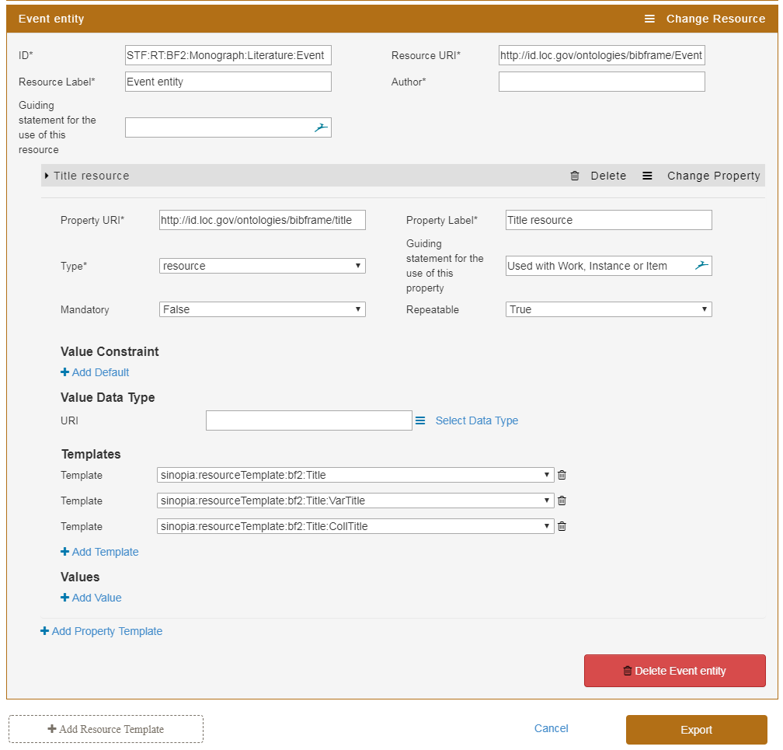
Your property can refer to more than one Resource Template. Simply click on the + Add Template button as many times as needed.

Slide 21
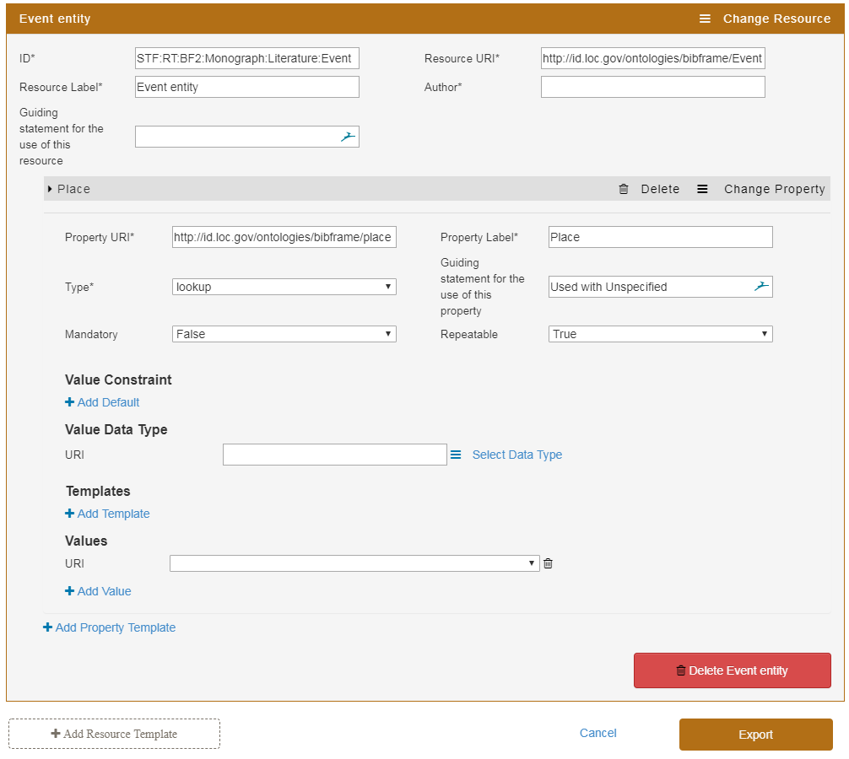
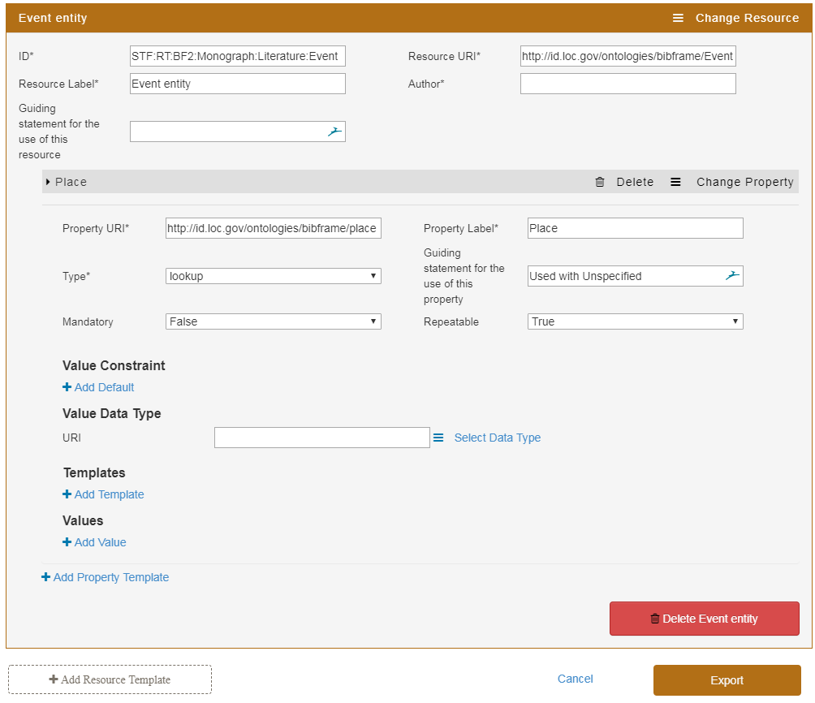
If you chose lookup as a type, click on Add Value
A box opens up

Slide 22
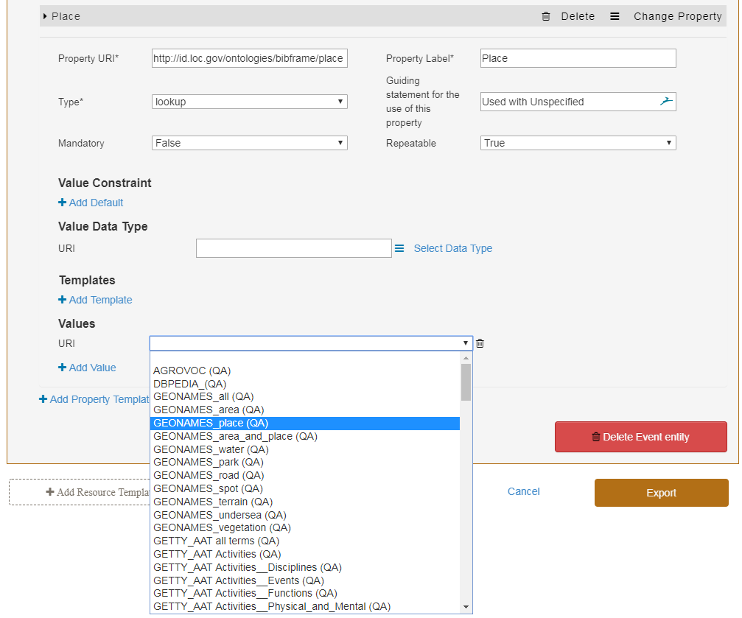
Click on the down arrow. A pull down menu of available vocabularies opens up.
To request the addition of new vocabularies to the list go to:
https://wiki.duraspace.org/display/LD4P2/Request+a+New+Dataset+For+QA

Slide 23
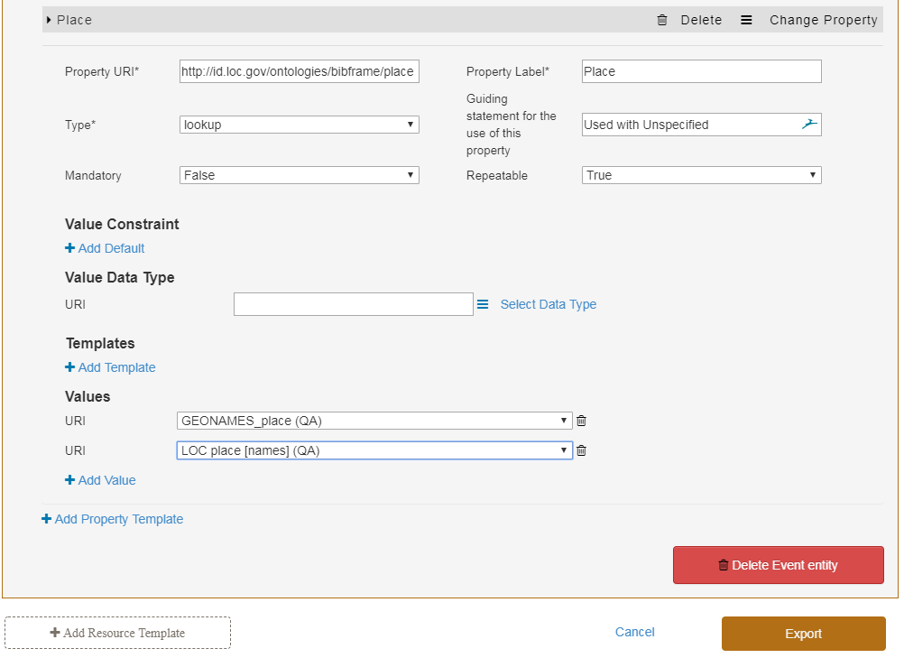
You may add more than one vocabulary. Simply click on +Add Value as many times as needed.

Slide 24
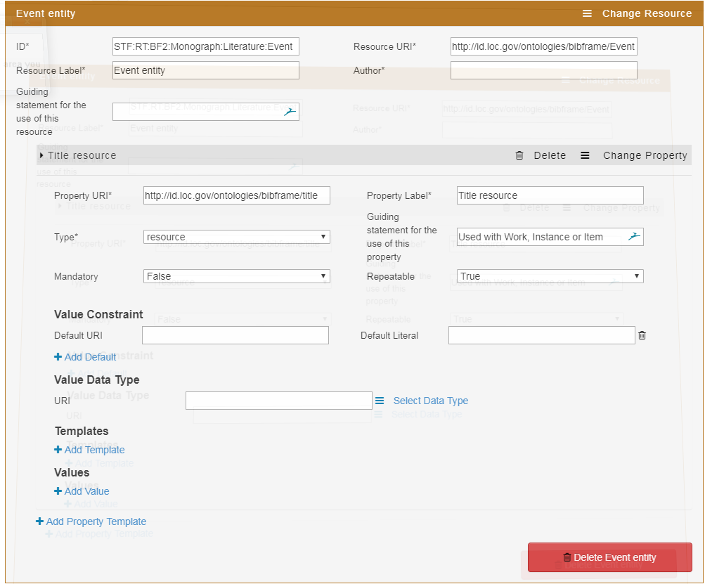
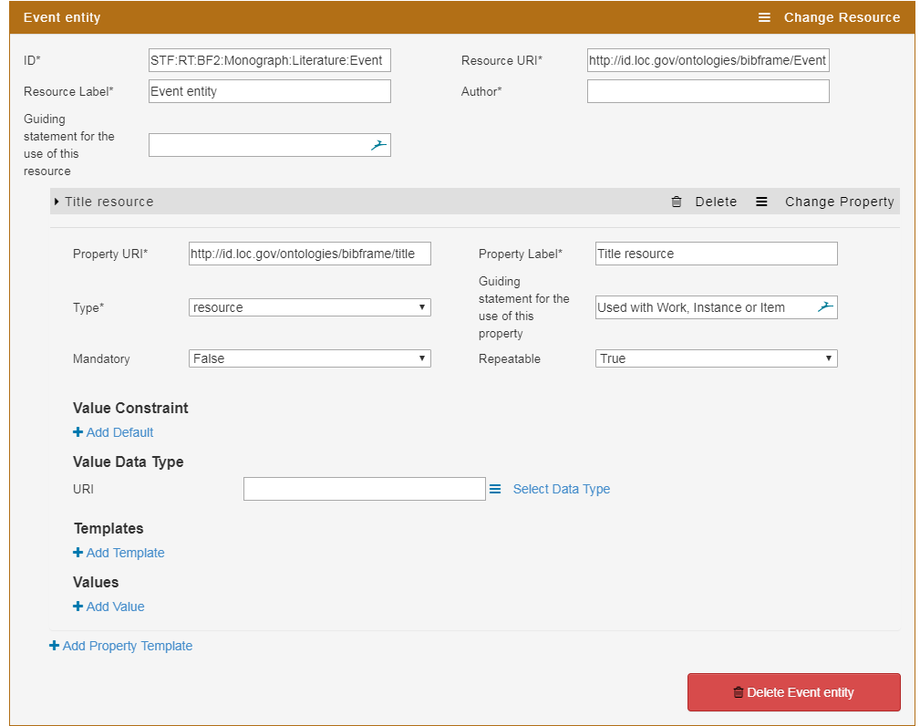
Default Values
To add default values, click on + Add Default under Value Constraint.
A pair of boxes open up.

Slide 25
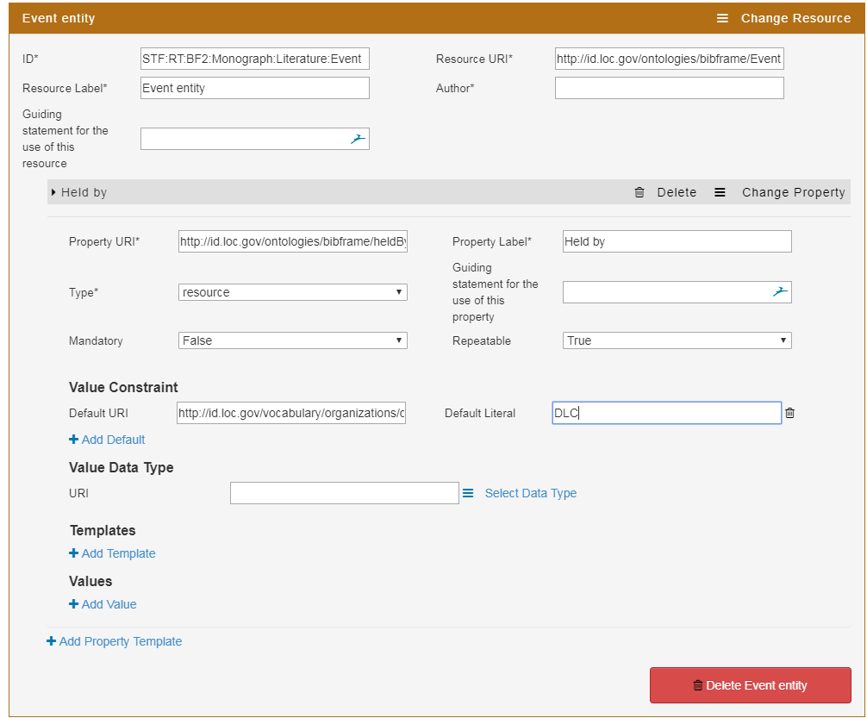
Add your Default URI here.
Add your Default Literal here.
Currently, you need to enter both the URI & the literal for your default. This is a bug that will be fixed.

Slide 26
Exporting & Saving Your Profile
You cannot save your profile in the Sinopia Profile Editor
Instead you export it to your individual computer where it is saved as a download
From there, you can import the file into the Profile Editor to continue editing, into the Linked Data Editor to allow metadata entry, and/or upload it to your GitHub directory
Note: If you do not export, and you close your browser tab, the profile will disappear

Slide 27
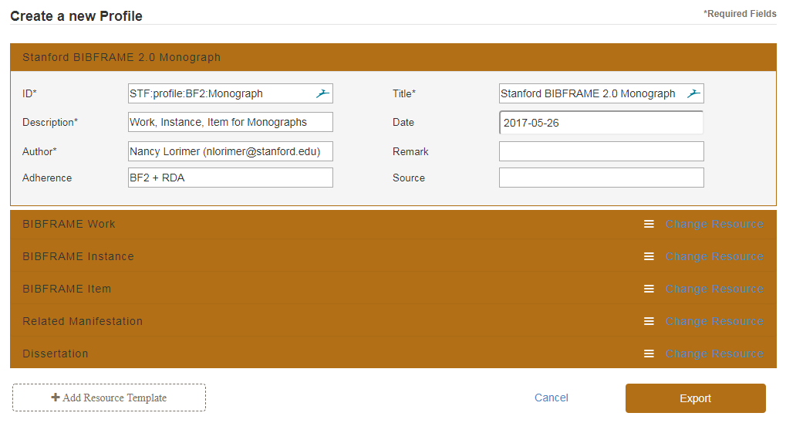
Exporting a profile to your computer
Click on Export

Slide 28
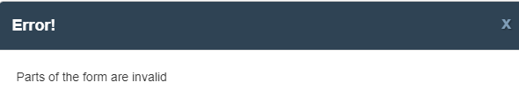
Error Message on Export—Troubleshooting
This means one or more elements are missing from your profile or are invalid.
Check:
All required fields are filled in (required fields are indicated with an asterisk *. These may be at the profile, resource template, or property template level
You have at least one resource template and that resource template has at least one property template.
In the property template the Type (literal, lookup, resource) must agree with the expected value (a literal will expect a literal, a lookup will expect a value list of some sort, and a resource will expect a resource template).

Slide 29
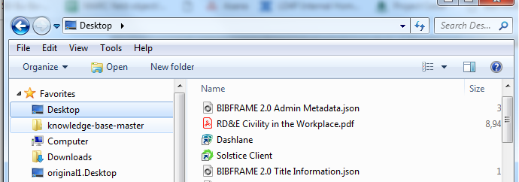
Exporting a Profile to your Computer
The json file will automatically download to your computer.
Use this file to upload your profile to the Linked Data Editor and/or to GitHub.
If you want to look at your file directly, you will need Oxygen or Atom or similar XML editor. A text editor is also possible, but not as pretty.

Slide 30
The End

